Slide 1
The LIHEAP Block Grant Opportunities and Responsibilities
Holly Ravesloot
HHS, Office of Community Services

Slide 2
Presentation Objectives
Goal:
Provide a better understanding of how LIHEAP works so you will be better prepared to develop low-income policies and programs that make the best use of LIHEAP funding in the context of your overall low-income affordability strategy.
This includes:
Who can the LIHEAP program serve?
With what types of services?
With what limitations?
And, with what responsibilities?
Notes:
Many of you are working to develop a comprehensive set of low-income energy policies and programs for your customers and clients. Using examples from different state programs, I will show you that there are many different ways that you can coordinate your LIHEAP program resources with those resources made available by utility ratepayers, state governments, and charitable organizations.
As a result of the information that you receive in this session, we hope that you will be encouraged take a more active role in shaping your state’s LIHEAP program plan and working to ensure that your state’s program delivers high quality services to the clients who need them most.
This is NOT “Dialogue with the Feds”. That session is tomorrow morning’s plenary. At that session you will be able to discuss LIHEAP policy issues with OCS program managers.
This is NOT “LIHEAP 101”. That session is at the end of the day tomorrow. That session will furnish you with all of the basics about the LIHEAP program.

Slide 3
LIHEAP Opportunities Clients and Information
No matter how you ultimately decide to interact with LIHEAP, it is important for you to understand that every LIHEAP program is required to do the following…
Outreach – Conduct outreach to low-income households
Intake/Eligibility – Verify income eligibility for applicant households
The LIHEAP program certifies about 6 million households as income-eligible for program services each year
Special Note: Intake agencies identify and refer households that are not eligible for LIHEAP but ARE eligible for “moderate-income” programs.
Notes:
The LIHEAP program delivers services to about 6 million low-income households in all 50 states, the District of Columbia, the major US territories, and to tribal organizations. In doing so, they verify income for the households that they serve, collected detailed demographic and housing information, and even collect heating fuel expenditures and electric expenditures for more than 1/3 of all households served by the program.
If you are working to improve a low-income program in your jurisdiction and you want to know more about low-income households, your LIHEAP program office is likely to have the information that you need. If you are starting a new low-income program in your jurisdiction and you want to know how to reach low-income households, you might be able to collaborate with your LIHEAP program office in some way.

Slide 4
LIHEAP Opportunities Clients and Information
No matter how you ultimately decide to interact with LIHEAP, it is important for you to understand that every LIHEAP program is required to do the following…
Data – Collect detailed demographic and housing unit data [for all 6 million households]
Energy Expenditures – Collect energy expenditure data [for more than 2 million households]
Notes:
If you want to target low-income energy services to certain types of households, your LIHEAP program office might be able to facilitate that by looking at their program database. And, even if you are trying to serve households who are not income-eligible for LIHEAP, you may be able to identify those households through by working with the LIHEAP program intake agencies and getting them to refer households that are “over-income” to your program.

Slide 5
LIHEAP Opportunities Program Services
The LIHEAP statute allows grantees to use funds for …
Energy Assistance – Help with heating and/or cooling costs
Energy Crisis Assistance – Immediate assistance when threatened with the loss of service
Including emergency equipment repair and replacement
Weatherization – “… low-cost weatherization or other energy-related home repairs …”
Limited to 15% of available funds or 25% with a waiver after March 31st
Notes:
Many of you may think of LIHEAP mainly as energy assistance to help clients to pay their heating bills. And, as we will see in a moment, that is the primary way in which LIHEAP funds are used by our grantees. However, along with funding energy assistances, grantees can – at their option – allocate funds for other important services that they perceive are needed to address low-income energy affordability issues.
Examples include Crisis Assistance, Weatherization … [Next Slide].

Slide 6
LIHEAP Opportunities Program Services
The LIHEAP statute allows grantees to use funds for …
Client Services – “… services that encourage and enable household to reduce their home energy needs …” [Assurance 16 funds]
Limited to 5% of available funds
Development of Leveraging Resources – “… funds … to identify, develop, and demonstrate leveraging programs.”
Limited to greater of 0.08% of funds and $35,000
Program Administration – Program outreach, intake, and operations
Limited to 10% of funds
Carryover – Funds for program start-up while waiting for allocation and disbursement of funds
Each grantee gets to decide how they want to allocate their funds among these services (within limits)
Notes:
… Assurance 16 Services, and Funds for the Development of Leveraging Resources.

Slide 7
Allocation of LIHEAP Funds National (FFY 2017)
Notes:
This pie chart shows you how our state grantees use their funds. It shows that a little more than one-half of the funds are used for heating assistance, 7% for cooling assistance, and 17% for crisis assistance. In total, about 75% of program funds are used for helping low-income households with their energy bills. But over 10 percent is used for weatherization, just under 10% is used for program administration, and about 5% is carried over to the next fiscal year so that states can start up their programs in a timely way.

Slide 8
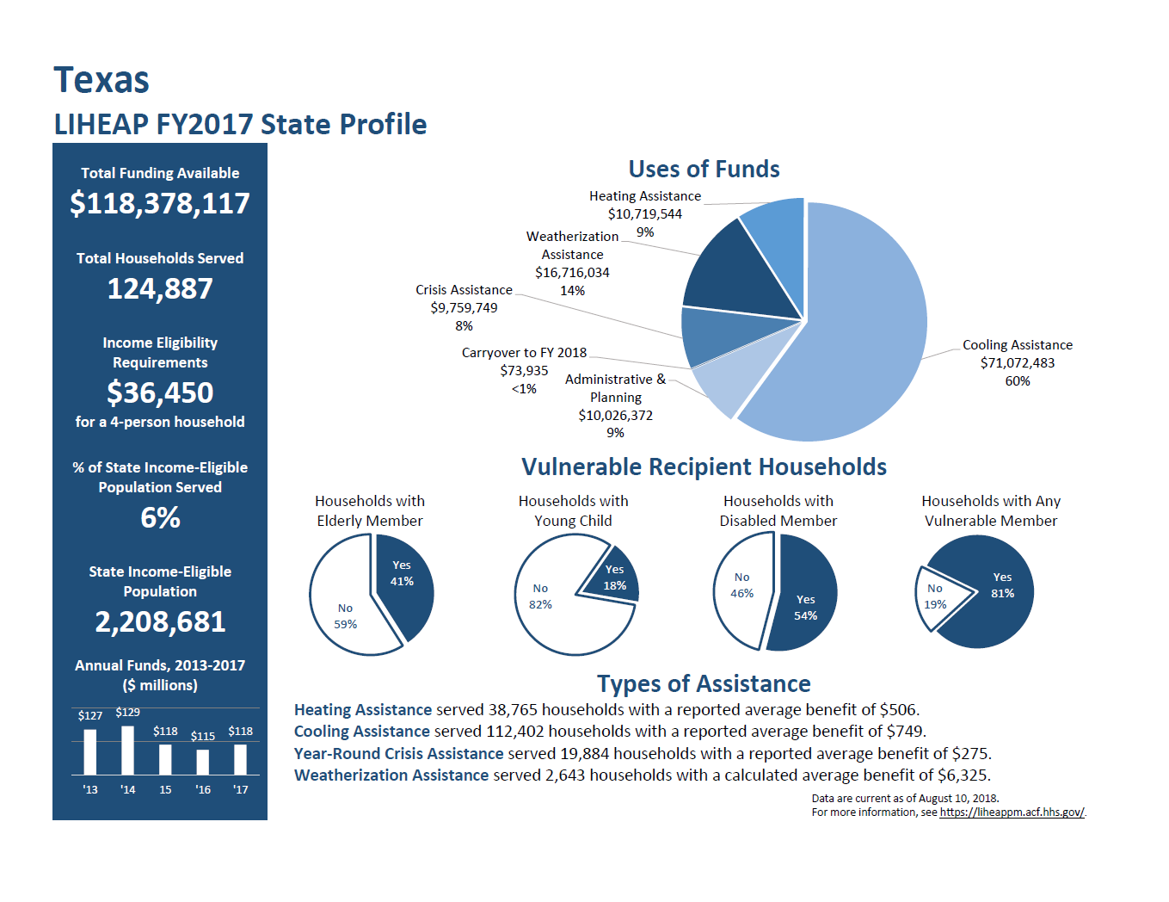
Allocation of LIHEAP Funds Texas
Notes:
What you see on the screen right now is a “Grantee Profile.” These profiles have been developed for every state grantee and for the District of Columbia. They are located on the LIHEAP Performance Management Website and furnish you with a comprehensive set of information for each grantee.
This chart shows you that Texas has chosen to use their LIHEAP funds in a way that is quite different from the national average. Given their climate, they perceive that it is most critical to furnish services for cooling assistance and allocate 60% of the funds for that purpose. In addition, they are allocating close to the maximum amount for weatherization. And, before you question whether that is a good use of funds in a cooling climate state, I will alert you that the National WAP Evaluation showed that weatherization is effective in reducing both heating and cooling costs in about equal measure.

Slide 9
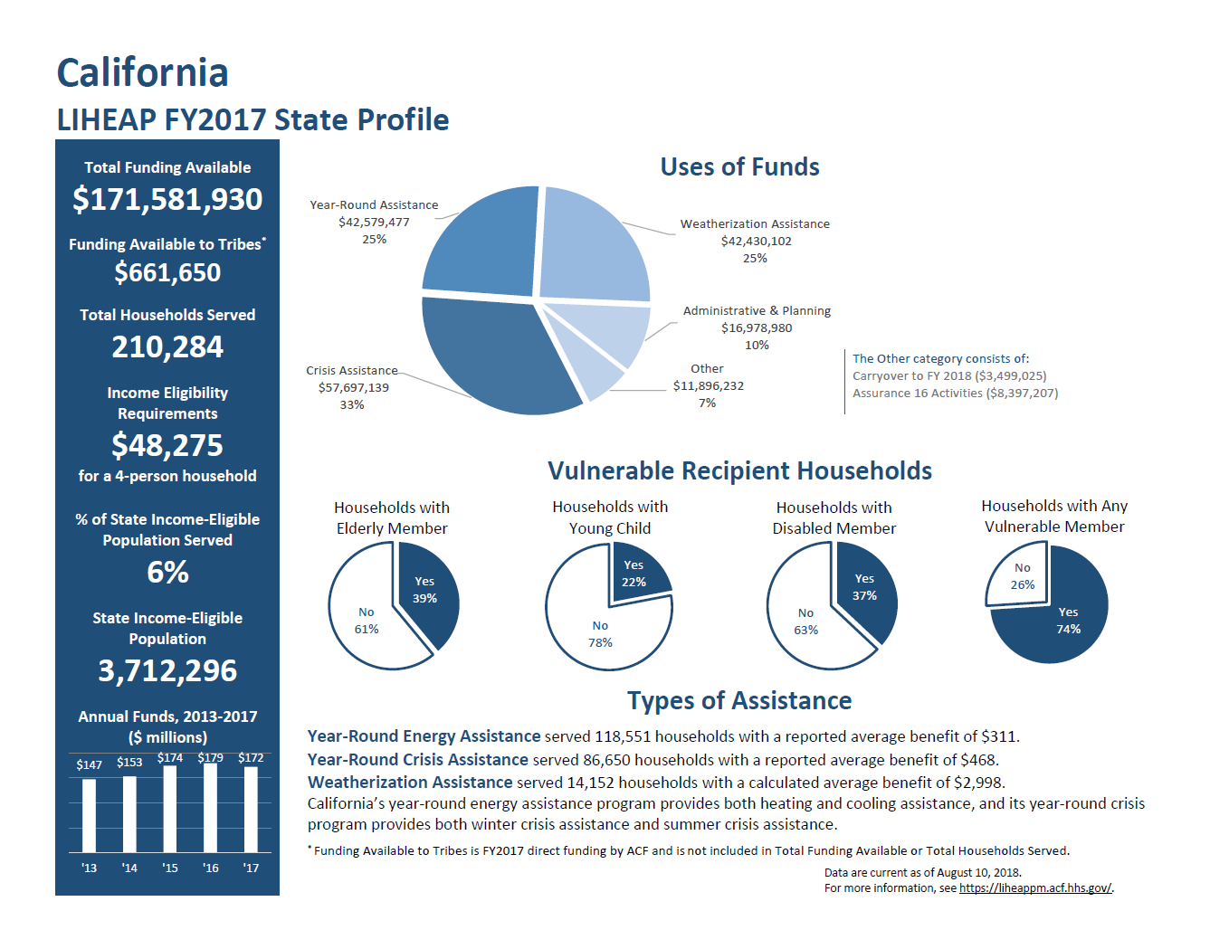
Allocation of LIHEAP Funds California
Notes:
This chart shows you that California is using their LIHEAP funds in still a different way. Rather than designating their funds as being limited to either heating or cooling, they run a year-round program that delivers benefits to clients in the season that they need it the most. They also have focused a significant share of their funds on other ways of addressing energy affordability issues, including allocation of 25% of their funds to weatherization and 5% of their funds to Assurance 16 services.

Slide 10
Allocation of LIHEAP Funds State Comparison
Use of Funds (FFY 2017) | Texas | California | Virginia | Wisconsin
Heating Assistance | 9% | - | 47% | 64%
Cooling Assistance | 60% | - | 16% | -
Year-Round Assistance | - | 25% | - | -
Crisis Assistance | 8% | 33% | 7% | 15%
Weatherization | 14% | 25% | 12% | 9%
Administration | 9% | 10% | 9% | 6%
Carryover | <1% | 2% | 9% | 6%
Assurance 16 | - | 5% | - | -
Notes:
This table shows how LIHEAP funds are used by four different states: Texas, California, Virginia, and Wisconsin.
As you can see in the top three rows, Texas, Virginia, and Wisconsin each use more than 60% of their funds for regular LIHEAP bill assistance in the form of heating or cooling assistance, while California uses only about 25% for regular LIHEAP bill assistance. Looking at crisis assistance, California uses a third of their funds for crisis assistance, while Virginia and Texas use 7 and 8 percent. Finally, as you can see in the last row, California is the only state out of these four that uses funds for Assurance 16 services.
The point here that each state makes decisions within the statutory requirements on how to obligate and use their LIHEAP dollars to best meet their program objectives and goals.

Slide 11
LIHEAP Opportunities Program Management
It is also important to know that grantees have options to administer their program, particularly with respect to program intake. Examples include:
Human Services Department – Some states conduct LIHEAP program intake through their county social services agencies (e.g. New York).
Mixed Program Administration – In other states, they conduct intake for heating assistance through their local human service agencies, but contract with community-based organizations to deliver crisis benefits (e.g. Missouri).
Community-Based Organizations – In still other states, the state office contracts with community-based organizations to conduct all LIHEAP outreach and intake services (e.g. Wisconsin).
It is important to understand how your LIHEAP program administration is structured as you consider what types of collaboration are feasible with low-income programs funded by other sources.
Notes:
[Probably best to read from the slide]

Slide 12
LIHEAP / Ratepayer Relationships Wisconsin
Energy Assistance Programs – Managed by the State Program Office
LIHEAP Heating Assistance – Uses Federal funds to pay heating bills
Ratepayer Electric Assistance – Uses Ratepayer funds to pay electric bills
Weatherization Programs – Managed by the State Program Office
Integrates LIHEAP WX funds, WAP funds, and Ratepayer Funds
Notes:
The Wisconsin program shows one example of how the use of program funds can be coordinated. In Wisconsin, all funding sources are managed by the state program office. The state office contracts with local community-based organizations to do program intake, and then once the agency verifies program eligibility, the state office makes payment to the heating fuel vendor using LIHEAP funds and to the electric company using ratepayer funds. Similarly, if a household applies for weatherization, the local service delivery organizations is using LIHEAP, WAP, and ratepayer funds to deliver services to the client.

Slide 13
LIHEAP / Ratepayer Relationships Minnesota
Energy Assistance Programs – State & Individual Utility Programs
LIHEAP Heating and Electric Assistance – Uses Federal funds to pay for assistance; clients can assign the entire benefit to their heating fuel supplier or assign a portion to their electric supplier.
Ratepayer Electric and Gas Assistance – Individual utilities offer ratepayer-funded assistance to their customers.
Weatherization Programs – State & Individual Utility Programs
LIHEAP and WAP Funds – Intra-department transfer from LIHEAP program office to WAP program office / services delivered by local agencies
Ratepayer Electric and Gas Energy Efficiency – Each utility company contracts with organizations to deliver energy efficiency / some companies contract with local LIHEAP/WAP agencies, while others do not.
Notes:
The Minnesota program shows another example of how the use of program funds are used at the state level. In Wisconsin, only the Federal funding sources are managed by the state program offices. The state office contracts with local community-based organizations for both LIHEAP energy assistance and for weatherization services. However, there only is coordination of Federal and ratepayer funding sources if the electric and gas utilities choose to contract with their local community-based organization(s).

Slide 14
LIHEAP / Ratepayer Relationships New Jersey
Energy Assistance Programs – State & Coordinated Utilities
LIHEAP Heating Assistance – Households apply for heating assistance and receive benefits according to the program benefit matrix.
Ratepayer Electric and Gas Assistance – The state IT Department collects information from LIHEAP on client income and benefits, and from utilities on energy bills. They furnish the utilities with an assigned ratepayer benefit amount based on a formula specified by the Board of Public Utilities. The individual utilities credit the customer accounts for the specified benefit amount.
Weatherization Programs – State & Coordinated Utilities
LIHEAP and WAP Funds – Intra-department transfer from LIHEAP program office to WAP program office / services delivered by local agencies
Ratepayer Electric and Gas Energy Efficiency – The combined set of utilities contractors with for-profit companies to deliver energy efficiency services.
WAP Office and Utilities communicate with respect to identification of the best program for delivering services to clients.
Notes:
In New Jersey, there is a lot of information sharing between the Federal program office and the ratepayer-funded programs. But they are for all practical purposes operated as separate funding sources and programs. With respect to energy assistance, the client is first assigned a LIHEAP benefit and then receives a separate ratepayer funded assistance benefit. And, a household can either receive services through the federally-funded WAP program or from the ratepayer-funded Comfort Partners program.
So, you can see just from these three examples that there are lots of different ways to design your LIHEAP programs and to coordinate with other program funding sources. However, while the LIHEAP program offers lots of flexibility, it does come with certain responsibilities.

Slide 15
LIHEAP Requirements The LIHEAP Statute and the 16 Assurances
While LIHEAP is a Block Grant and offers a considerable amount of flexibility to grantees, the LIHEAP statute also presents grantees with some important responsibilities. Most of these are codified in the 16 Assurances that grantees are required to make to the Federal Government if they receive LIHEAP program funding.
Link to LIHEAP Statute: https://www.acf.hhs.gov/ocs/resource/liheap-statute-and-regulations
Link to LIHEAP Assurances Document: https://bit.ly/2Mm5WVC
When a grantee submits their LIHEAP State Plan, OCS staff review that plan to endure that the state’s plan is compliant with those assurances.
Notes:
I do not have time in this session to review these grantee responsibilities in detail. We recently conducted a National Training for LIHEAP and we had a 90-minute session to train grantees on all of specifics related to these assurances. My main goal today is just to alert you that … when the LIHEAP program manager in your state says that they are required to do “X” … it is likely that these statutory requirements are the foundation for that statement. In the next couple of slides, I will furnish you with just a few examples of those restrictions and responsibilities.

Slide 16
LIHEAP Requirements Program Requirements
The following are examples of important guidance with respect to eligibility for LIHEAP program services included in the LIHEAP statute:
Maximum Income Threshold – “households with incomes which do not exceed the greater of … 150% of poverty … or 60 percent of state median income ...” [Assurance 2]
Minimum Income Threshold – “shall not exclude a household … if their income is less than 110 percent of the poverty level.” [Assurance 2]
Services to Renters - “… will treat owners and renters equitably under the program” [Assurance 8]
Notes:
You might ask your LIHEAP program manager why the program cannot serve moderate income households the way that some housing programs do … and the answer is that the statute does not allow that. But it also does not allow states to serve only very low income households. By statute, the program must make households with incomes up to 110 percent of poverty income-eligible for the program. And, the statute also say that owners and renters need to be treated equitably. Note that it does not say … the implication is that there must be an explicit policy with respect to the treatment of owners and renters.

Slide 17
LIHEAP Requirements Crisis Services
The following are examples of important guidance with respect to crisis services included in the LIHEAP statute:
Funds for Crisis Programs – “Of the funds available to each State under subsection (a), a reasonable amount based on data from prior years shall be reserved until March 15 of each program year by each State for energy crisis intervention.” [State Allotment Section]
Crisis Service Requirements – “not later than 48 hours after a household applies for energy crisis benefits, provide some form of assistance that will resolve the energy crisis if such households is eligible to receive such benefits.”
Crisis Service Requirements (Life Threatening Situation) - “… not later than 18 hours after a household applies for crisis benefits, provide some form of assistance that will resolve the energy crisis if such household is eligible to receive such benefits and is in a life-threatening situation” [State Allotment Section]
Notes:
The statute also has something to say about crisis programs benefits. It requires grantees to set aside some funds to intervene with households in crises after March 15th. And, one reason that some state opt to administer their Crisis program through community-based organizations, even when they administer their regular grant through their social service system, is that the statute stipulates that households in crisis much receive assistance in a very short time period … 48 hours whenever a household applies for crisis assistance and 18 hours when the household is in a life-threatening situation.

Slide 18
LIHEAP Requirements Vendors
The following are examples of important guidance with respect to vendors in the LIHEAP statute:
Informing Client of Benefits – state must “… develop procedures … to notify each participating household of the amount of energy assistance paid on its behalf …” [Assurance 7, part A]
Nondiscrimination – state must ensure “… that no household receiving assistance … will be treated adversely because of such assistance ...” [Assurance 7, part C]
Notes:
In addition, the statute makes the state responsible for ensuring that vendors treat clients according to certain standards. They need to develop procedures that inform the client exactly how much was paid on their account and they need to ensure that vendors do not treat customers who receive LIHEAP benefits in an adverse manner.

Slide 19
LIHEAP Requirements Public Participation
Here is the most important Assurance from the perspective of this meeting:
“The State agrees to provide for timely and meaningful public participation in the development of the plan specified in subsection (c)” [Assurance 12]
Notes:
The statute requires your state LIHEAP program offices to engage all of you in the state planning process. You can take what you learned in this session, in this track, and this conference back to your state and begin to ask questions about why the LIHEAP program in your state does what it does … and why it does not do some of the things that you have learned that others states do. I do have confidence in our state LIHEAP Directors; and, I am confident that you will get good answers from them. But, hopefully, in some cases you will hear back … “Well, we could do that if members of the low-income energy community think that is a high priority way to use funds.”

Slide 20
Additional Information in Track C
Session #2 – Coalition building by local LIHEAP agencies
Session #4 – Reaching out to applicant households
Session #5 – Educating LIHEAP clients
Session #6 – Grantees using Performance Measures data
Notes:
In Session #2, you will hear from LIHEAP intake agencies about their work to build an effective coalition in Massachusetts. It might be useful for you to know that the time some of these agencies spend on that work is paid for by LIHEAP “leveraging” funds. [Note: Each state can use up to 0.08% of funds for this purpose.]
In Session #4, you will hear from the Massachusetts LIHEAP director about how they are working with their intake agencies to ensure that the agencies are reaching out to clients to help them complete their application so that they can receive the program services.
In Session #5, you will hear about how one local agency is working with clients to help them understand the benefits of energy assistance and is encouraging them to see the value of “responsible participation.” If you think that is needed in your state, it is possible that Assurance 16 funds could be used for that purpose.
In Session #6, you will see how state LIHEAP agencies are using Performance Measures data to look at the linkages between LIHEAP funds and ratepayer energy assistance funds to ensure that they are working toward delivering effectively targeted benefits to all households.
Thanks for listening. Go Team!

Slide 21
Contact Information
Holly Ravesloot
Branch Chief
Energy Policy and Evaluation Branch
Division of Energy Assistance
Office of Community Services
Office: (202) 205-4651
Email: holly.ravesloot@acf.hhs.gov
Notes:
Branch Chief for the Energy Policy and Evaluation Branch of the Office of Community Services’ Division of Energy Assistance

