Slide 1
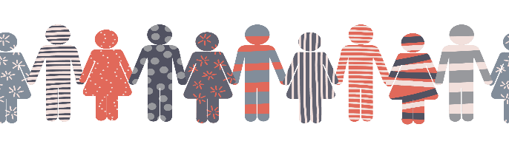
2020 Annual Conference
UNITED WE STAND
Your Minds, Your Body:
S-T-R-E-T-C-H With Us!

Slide 2
Your Minds, Your Body:
S-T-R-E-T-C-H With Us!
Five-Minute Yoga Meditation:
Calm Your Anxiety
By Beyoutifulliving on

Slide 3
