Slide 1
2020 Annual Conference
UNITED WE STAND
NEUAC History Vignette:
The Legacy of Victorine Q. Adams
(April 28, 1912 – January 8, 2006)
Notes:
Speaker: Katrina Metzler

Slide 2
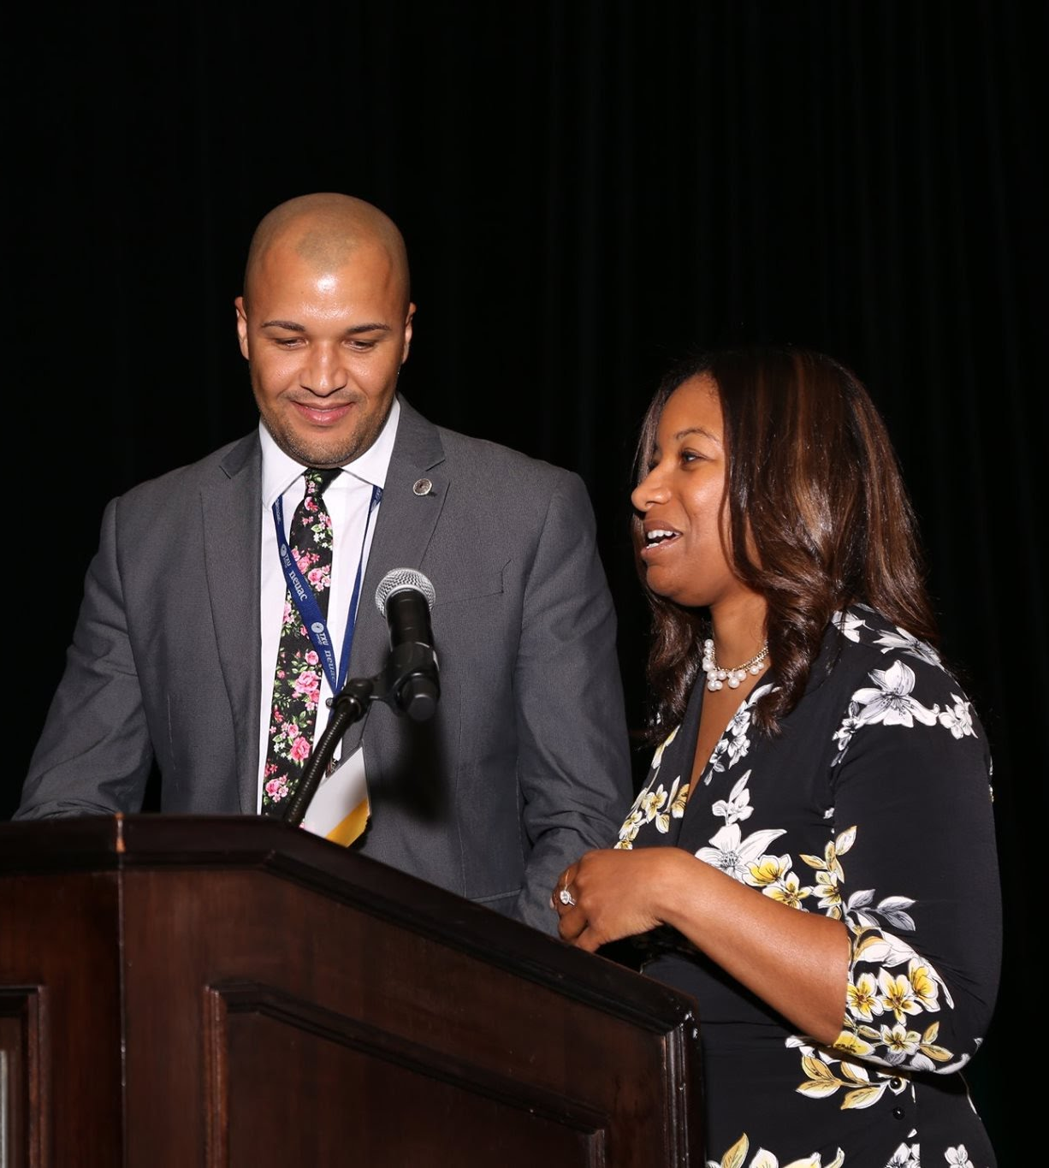
Victorine Quille Adams was a woman of distinction; a public leader and advocate who founded one of the nation’s first fuel fund programs. With grace and compassion, she dedicated her life to bringing about change for the betterment of her community.
NEUAC honors the legacy of Ms. Adams annually with an award in her honor to a non-profit organization that displays an innovative spirit towards raising public awareness and generating financial aid for people in need of energy assistance.
2019 Victorine Q. Adams Awardee
Patrick Strickland, Lumbee Tribe of North Carolina
Notes:
Speaker: Kelly Caplan

Slide 3
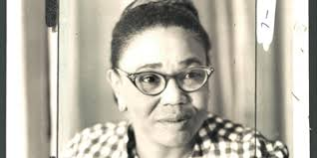
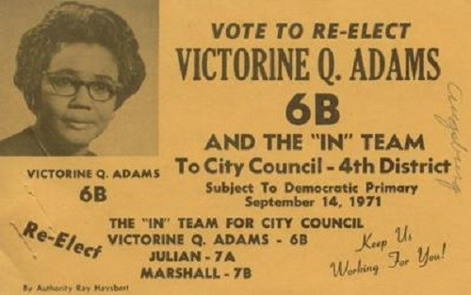
Ms. Adams was the first African-American woman to serve on the Baltimore City Council.
Born in Baltimore, Maryland to Joseph C. and Estelle Tate Quille, she graduated from Frederick Douglass High School and attended Coppin Teachers College, as well as Morgan State College.
After graduating, Ms. Adams worked as a teacher in Baltimore City for fourteen years.
Notes:
Speaker: Rhonda Harper

Slide 4
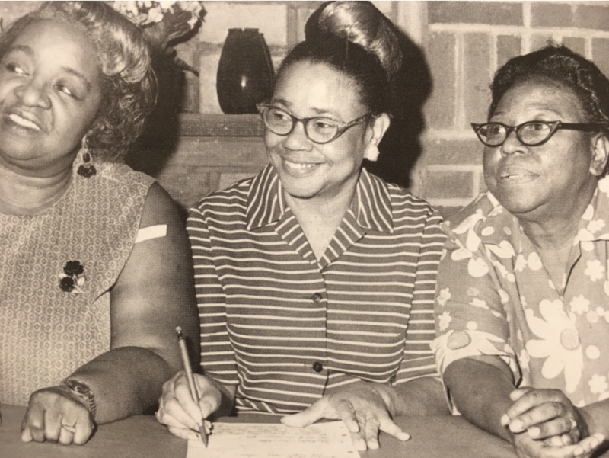
Ms. Adams (center) turned her eye towards politics when she founded a women's political club, the Colored Democratic Women's Campaign Committee, in 1946.
The group focused their efforts on the election of African-American politicians citywide and statewide.
Ms. Adams was successfully elected to the Maryland House of Delegates in 1966. The following year, she left the state legislature to run for a seat on the Baltimore City Council, representing the 4th District.
Notes:
Speaker: Deb Brown

Slide 5
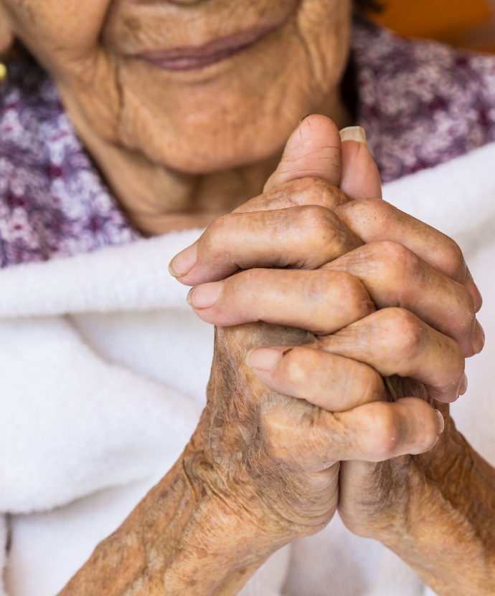
While serving on city council, a couple in her district froze to death in their own home.
In 1979, Ms. Adams partnered with the Baltimore Gas and Electric Company to establish the Baltimore Fuel Fund, which was designed to help local families with their heating bills.
The fund was renamed the Victorine Q. Adams Fuel Fund, and later became the Fuel Fund of Maryland, a recent member of the Governance Board of Directors of NEUAC.
Notes:
Speaker: Gary Swan

Slide 6
VISION & MISSION
The Fuel Fund of Maryland aims to be a lifeline for our vulnerable Maryland neighbors struggling with a home utility hardship. We assist by providing navigation through an array of financial and community resources that empower, engage, and safely connect a household in times of crisis.
Notes:
Speaker: Deb Brown

Slide 7
Past Victorine Q. Adams Award Winners
2010
2011
2012
2013
2014
2016
2017
2018
2019
West Virginia Utility Assistance Program
Community and Economic Development Association of Cook County
Keep Wisconsin Warm/Cool Fund
Catholic Charities of Northeast Kansas
Energy Outreach Colorado
HeartShare Human Services of New York
The Salvation Army (TSA) Care to Share Program
Dollar Energy Fund
Lumbee Tribe of North Carolina
Notes:
Speaker: Gary Swan: (Script to Read): NEUAC honors the Victorine Q. Adams Award Winners past and present for their contributions to the ideals she held dear: equity, justice, and access to utility services that keep homes and families safe.

Slide 8
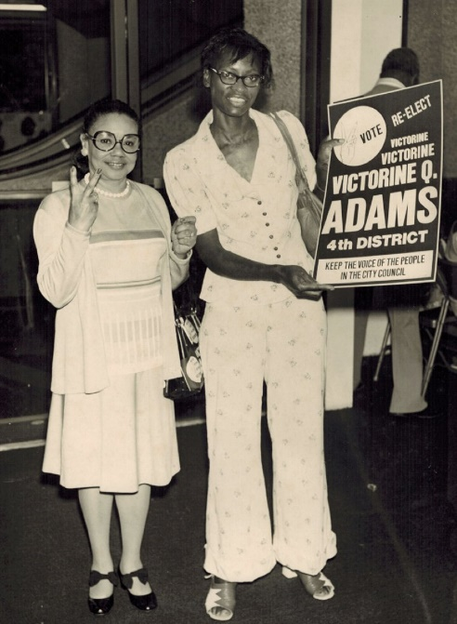
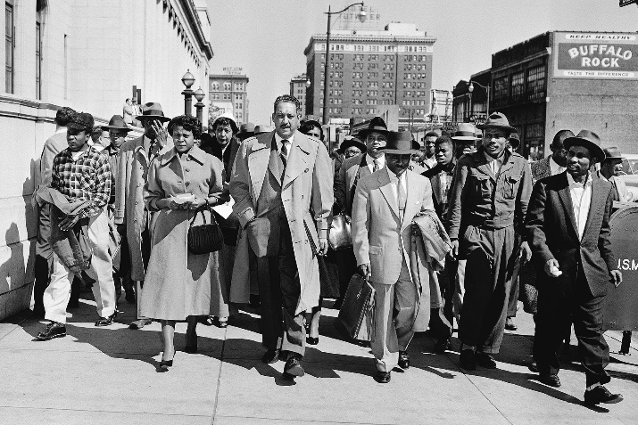
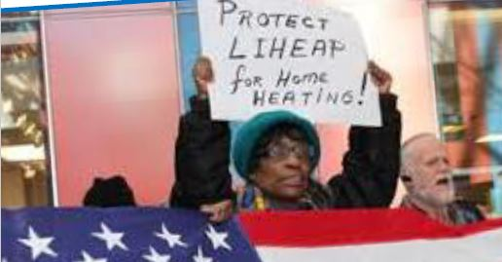
Victorine Q. Adams
Celebrating our History
Notes:
No sound

Slide 9
Continue the Learning: Sources
Victorine Q. Adams on Wikipedia: https://en.wikipedia.org/wiki/Victorine_Q._Adams
Black Then: Discovering Our History:
https://blackthen.com/victorine-q-adams-first-african-american-woman-serve-baltimore-city-council/
Evensi Conscious Community: Baltimore Black History Celebration:
https://www.evensi.us/conscious-community-baltimore-black-history-celebration-fayette-st-outreach-association/293515202
Fuel Fund of Maryland - About Us: https://fuelfundmaryland.org/about-us

Slide 10
Narrators
Katrina Metzler, NEUAC
Kelly Caplan, Washington Gas
Rhonda Harper, Citizens Energy
Deb Brown, Fuel Fund of Maryland
Gary Swan, National Energy Foundation

