Slide 1
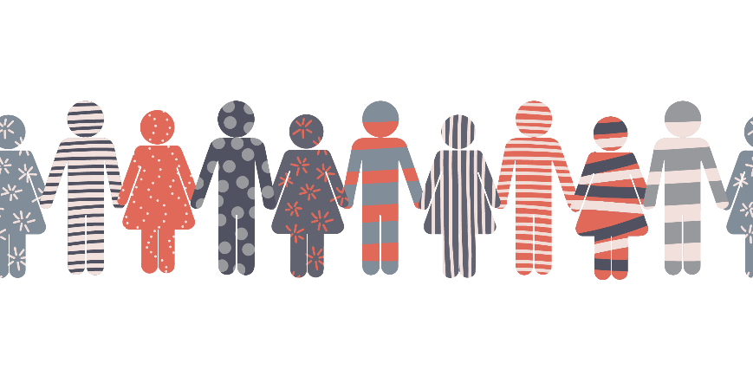
Welcome to the NEUAC 2020 Virtual Conference
Our diversity makes us STRONG.
We can win the fight to end energy poverty TOGETHER.
United We Stand.

