Slide 1
2020 Annual Conference
UNITED WE STAND
Speaker Organization Spotlight: Overview of “Food Shift”
Notes:
NEUAC is pleased to welcome speaker Yuka Nagashima in our next segment to speak about diversity, inclusion and justice in American nonprofits. Yuka is the executive director of an anti-hunger organization called Food Shift based in Oakland, California.
Food Shift works to reduce the harmful impacts of wasted food and improve community health through the recovery, redistribution, and processing of surplus food. Food Shift Catering, a social enterprise kitchen, provides training and jobs to individuals with barriers to employment.

Slide 2
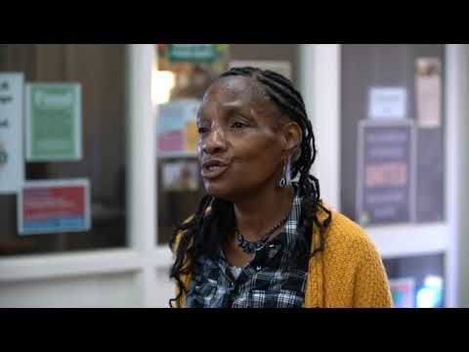
Notes:
Please join me in viewing this short video presentation titled “Food Shift: ready to leap forward” that highlights some of their work. We look forward to hearing from Yuka during the next segment!

