Slide 1
On-Bill Financing for
Rural Communities
NEUAC Conference
June 26, 2018
John-Michael Cross
Program Associate
Notes:
1

Slide 2
On-Bill Programs
Utilities finance energy/water improvements to customers’ homes (or facilitate 3rd party financing)
Loans (or tariff charges) are repaid on the customer’s monthly utility bill
Payments are at least partially offset by savings from the financed improvements
At least 92 utilities in 37 states offer “on-bill” in some form, with many variations
2
Notes:
On-Bill Financing goes by several names: On-Bill Financing, On-Bill Repayment, On-Bill Tariff
ACEEE: “In some contexts, on-bill financing has become an umbrella term for any financing program that includes charges on a utility bill, including on-bill repayment and tariffed on-bill. However, for our purposes here, on-bill is used as the umbrella term, while on-bill financing (or OBF) is restricted to programs in which the utility is the lender.”
On-bill programs basically means a loan or financing, made by a utility or third-party provider to a utility customer that is repaid on the monthly utility bill. Probably the most popular on-bill financing application, and the one that I’ve been most involved with, is electric utilities using it to finance energy efficiency improvements to their customers’ homes, but you can also use on-bill to finance water improvements, community solar, rooftop solar, energy storage.
Attaching the loan or financing to the meter allows for renters, multifamily buildings, and small commercial to participate in on-bill programs. It also adds convenience, as you can see everything on one bill, and allows for transferability to the next occupant or renter.
On-bill programs can be design to be a list bill neutral meaning that the monthly average energy savings are equal to or greater than the monthly loan payment, that can provide positive cash flow for participants.
One of the great aspects of OBF is it provides a viable alternative for homeowners that can’t afford the upfront costs of energy efficiency upgrades and therefore can’t make use of rebates or tax incentives. This then allows for alternative loan underwriting methods, such as using good bill payment history instead of a credit check.
2

Slide 3
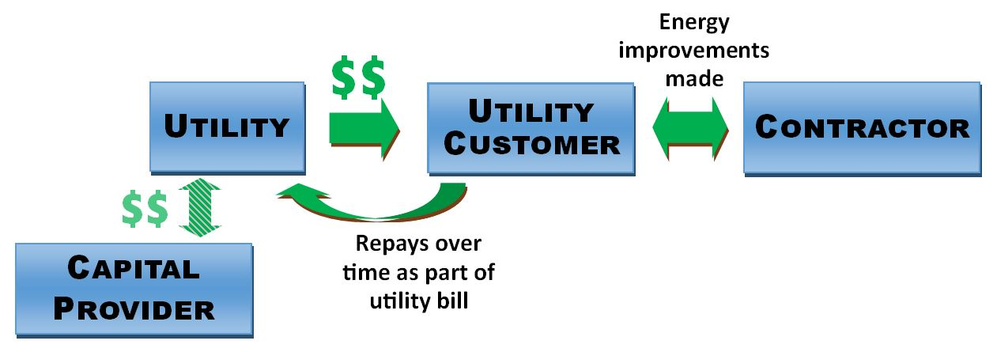
On-Bill Financing
3
Notes:
3

Slide 4
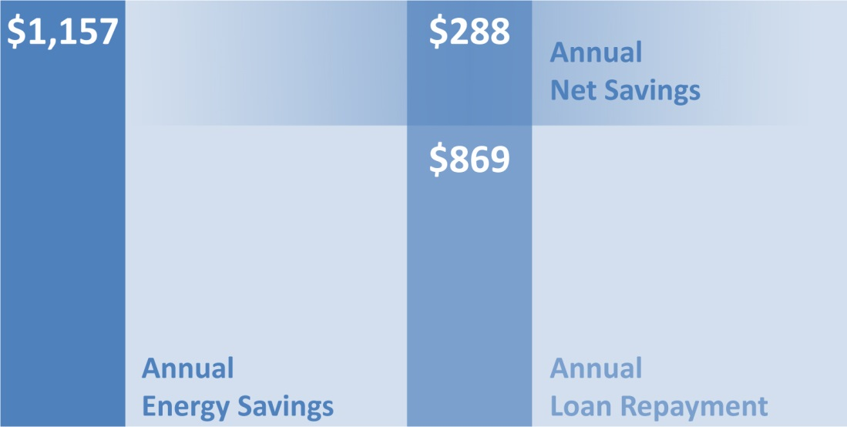
Saving and Repaying “On The Bill”
Average first-year results for the 125 participants in South Carolina cooperatives’ “Help My House” on-bill financing pilot program
4
Notes:
Participants in the pilot saw average savings of 34% with an average energy improvement investment of $7,700 and saved $1,100 annually.
This slide breaks down how program participants saved energy and money through the Help My House program
Reduces energy use by more than 30%
Has a combined electric bill and loan payment lower than the electric bill alone before EE improvements
Saves participants more than $200/yr. after loan payments
Is more comfortable
And homeowners are happy!
4

Slide 5
States with On-Bill Programs
5
Notes:
How can State Energy Office get involved with on-bill financing programs?
There are many options. One of the options, but not the definitive and end all, is to pass a legislation that supports the main elements of on-bill financing, like allowing utilities to attach the financing to the meter, providing support for alternative underwriting criteria, transferability of the financing, support for renters, low-income….
5

Slide 6
On-Bill Loan & On-Bill Tariff
On-Bill Loan – traditional financing to an individual, repaid through the utility bill
On-Bill Tariff – cost recovery charge attached to the utility meter
Meter-Based Loan – loan is attached to the utility meter (and not the individual)
6
Notes:
On-bill financing has generally been grouped into either tariff-based systems or on-bill loans. However, the programs can differ widely due to varying utility and regulatory structure and state legal requirements.
Often in a tariff-based financing program, the cost of the energy efficiency measures are tied to the meter, not the homeowner. The participant pays back the utility over time through a surcharge on their electric bill, but it is not a traditional personal loan. This allows the repayment period to extend beyond the current homeowner to the new buyer should they sell the house and move. The next customer at that meter continues to pay the financing. This is one of the few financing options that can also successfully address the split incentive issue of landlords and tenants in rental properties, with the tenant paying the utility bill and the energy efficiency investment loan repayment. The Help My House program in South Carolina uses this approach.
On-bill loans, however, usually operate like personal or business loans where the loan is non-transferable and must be paid off at the time ownership changes hand. However, some more recent on-bill loan programs have been tied to the building meter and operate as an energy services agreement.
6

Slide 7
On-Bill Opportunities
Reduce barriers to clean energy programs
Deeper energy savings
Low risk of defaults
Improved utility-customer relationships
On-Bill Challenges
Where does the capital come from?
Utility capacity
Contractors
“We don’t want to be a bank”
7
Notes:
7

Slide 8
Expanding Access with On-Bill
Many on-bill programs feature:
No upfront costs to participants
Alternative underwriting
(i.e. good bill payment history in lieu of credit check)
Default rates are typically low, even with alternative underwriting
Opportunity for cash-strapped and credit-poor households
Transferability can allow renters to participate
8
Notes:
Many OBF program feature:
One of the great aspects of OBF is it provides a viable alternative for homeowners that can’t afford the upfront costs of energy efficiency upgrades and therefore can’t make use of rebates or tax incentives. This then allows for alternative loan underwriting methods, such as using good bill payment history instead of a credit check.
Loan default rates are typically low, even with alternative underwriting. An 2016 LBNL report states that historically on-bill programs had a default rate of just 0.88%, or the same as those with traditional underwriting.
Using utility bill payment history allows for low-to-medium income families and renters to access financing for energy upgrades and distributed energy, such as solar.
Provides a wide range of benefits
For the Homeowner/Renter, it lower monthly energy bills, and increased comfort in the house; jobs are created in the community; and the utility sees increased satisfaction and lower demand charges
8

Slide 9
Where Does the Capital Come From?
USDA loan programs for rural utilities
Energy Efficiency & Conservation Loan Program (EECLP)
Rural Energy Savings Program (RESP)
Rural Economic Development Loan & Grant (REDLG) Program
Cooperative Banks
Credit Unions
Community Development Finance Institute (CDFIs)
Utility Internal Funds
Large Private Lenders?
9
Notes:
9

Slide 10
Rural Energy Savings Program
Total Funding | ~ $50 M per year
Eligibility | Entities that provide electric service to rural areas
Purpose | To help rural families & rural small businesses reduce energy costs or consumption
Interest Rate | 0%
Maximum Loan size | Not specified; largest to-date to single utility is $5.8M
Mark-up to end user | Capped at 3%
Loan term | Up to 20 years
Acceptable financial structures/ investments | Re-lending such as on-bill financing, tariff charge, PACE programs, traditional consumer loans
Next application window will open this summer!
Source: USDA Rural Utilities Service
10
Notes:
10

Slide 11
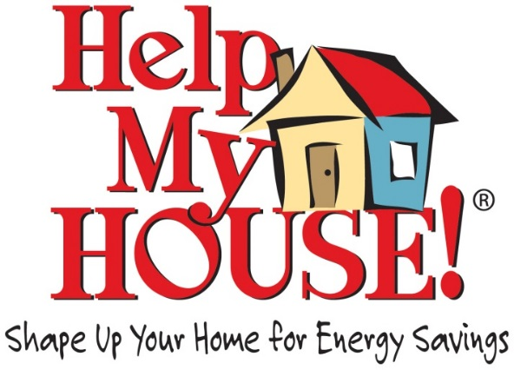
Ex: South Carolina Co-ops
OBF Pilot
2011-2012
8 co-ops, 125 homes
Loan pool from USDA REDLG loans
34% energy savings
On-going OBF Program
2012 - Present
5 co-ops, ~ 600 homes
Loan pool from additional USDA REDLG & RESP loans
Loan is tied to the meter, not the occupant (transferable)
Participants need good bill payment history (no credit checks)
11
Notes:
EESI’s experience and know-how in designing on-bill financing programs for rural utilities comes from our work with the South Carolina cooperatives. We were involved in developing from the beginning and through implementation and on-bill financing pilot for 125 homes across eight co-ops. We did this with our in-state partners, the South Carolina statewide association and the G&T, Central Electric Power.
There is a state on-bill legislation passed in 2010
The program was a hybrid, as it used loans to participants but with the repayment tied to the meter which allowed for transferability of the loan to the next occupant, and it also allowed for bill payment history to be used, as the underwritten practice for program eligibility, instead of the traditional credit checks. This in turn permitted the program to reach a larger part of the cooperative members that it would have been possible with just credit checks.
Participants in the pilot saw average savings of 34% with an average energy improvement investment of $7,700 and saved $1,100 annually. Has a combined electric bill and loan payment lower than the electric bill alone before EE improvements
Cost effective measures: Insulation (attic, wall, floor), HVAC tune-up, duct sealing and heat pump replacement. Also targeted were Mobile homes or manufactured homes that produced large energy savings (replacing electric resistance
Saves participants more than $200/yr. after loan payments
5 cooperatives have developed similar programs to Help My House with their own characteristics, since the pilot ended. For example, one the cooperatives, Aiken Electric added grid-connected water heaters to help them better shape their load curve and save money.
Then: RUS and REDLG loans
Now: RESP loans - $13 million
11

Slide 12
Ex: Midwest Energy in Kansas
OBF Program
2007 – present
1,670 projects
$9.7M invested (multiple capital sources)
Total saved:
3.9 M kWh/yr (equiv. to 355 homes)
448,000 therms/yr (equiv. to 589 homes)
Monthly repayment is less than 90% of predicted savings
Tariff program – “repayment obligation tied to meter”
Participants need to be current on utility bills (no credit checks)
12
Notes:
12

Slide 13
On-Bill Project Assistance
EESI offers free assistance:
Assistance to utilities to design on-bill programs and access funding
Details, case studies, and lessons learned from other working on-bill programs
Resource identification, help overcoming barriers to launching projects
Advice on program implementation
OBF Primer and OBF How-to-Guide
John-Michael Cross
jmcross@eesi.org
202-662-1883
www.eesi.org/OBF
13
Notes:
13

