Slide 1
Building an Effective Coalition in Your State
Andrew Hawkins, Xcel Energy
NEUAC 2019 Conference

Slide 2
Agenda
My background and company
Effective coalitions are not a myth
Building a coalition strategy
Summary
Questions and answers

Slide 3
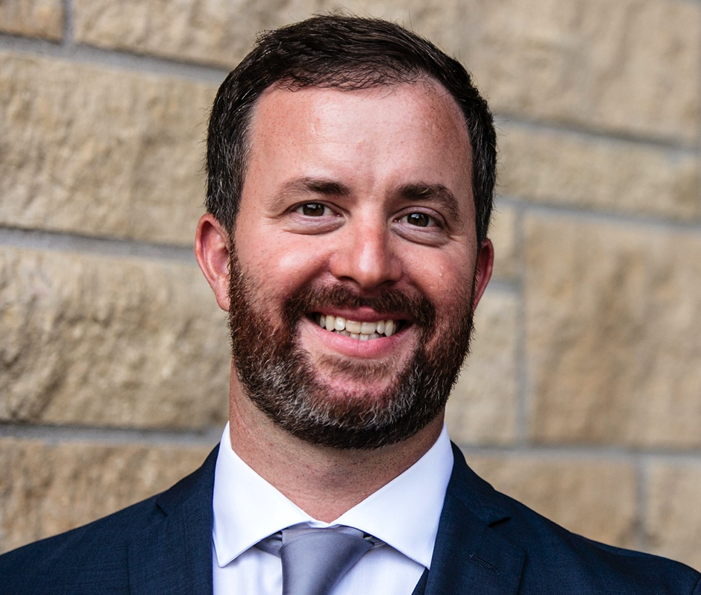
About Me
Started at Xcel Energy in 2001
10 + years experience with energy assistance and low income household programs
Outside of work, you’ll likely see me watching or playing hockey, golf and tennis.

Slide 4
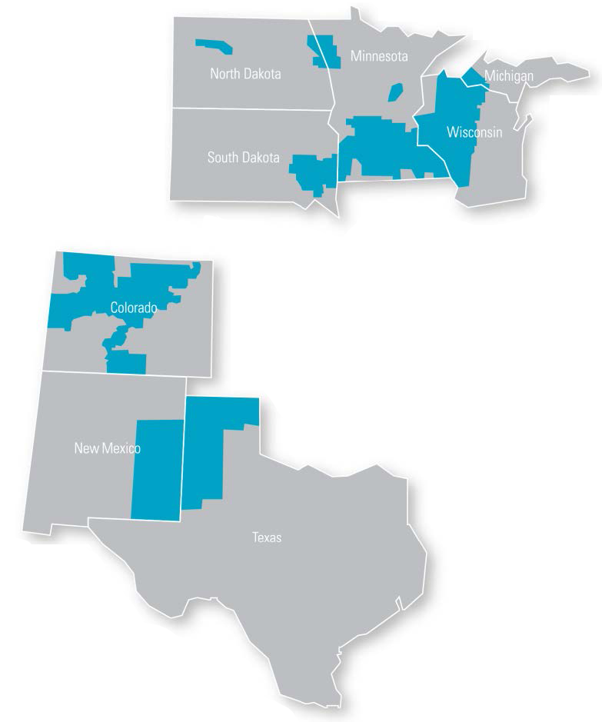
Xcel Energy
Serving eight states
3.6 million electricity customers
2 million natural gas customers
Nationally recognized leader:
Wind energy
Energy efficiency
Carbon emissions reductions
Innovative technology
Storm restoration

Slide 5
Effective Coalitions Are Not a Myth
Coalitions can work and help build trust
Utility companies have resources and staff willing to be a partner
Coalitions benefit:
Households in need
Community partners
Utilities, Government and Regulators
Notes:
Coalitions can work --- Based on my experiences, I know this is not a myth. Some benefits I’ve seen: Increase customer advocacy; Cost savings to company through a request and obtaining additional funds for program staff

Slide 6
Building an Effective Coalition
A three-part strategy:
Get everyone at the same table | Get all parties involved
Conduct regular meetings
Strengthen existing and form new partnerships

Slide 7
Get All Parties Involved
Who to invite?
How do you determine?
Example: Colorado Coalition utility stakeholder group
Results:
Enacted rule changes
Streamlined reporting
Efficiencies for enrollment and weatherization programs

Slide 8
Coalition Example
Colorado Coalition
Xcel Energy
Commission Staff
Energy Outreach Colorado
Energy Assistance/Weatherization
Atmos
Black Hills

Slide 9
Conduct Regular Meetings
How often should meetings be held?
Example: Minnesota Policy Action Committee for Energy Assistance
Fall/Winter/Spring meetings
What works and doesn’t work
Feedback from Stakeholders
Results:
Polar vortex/Increased Funding for Households

Slide 10
Strengthen Existing and Form New Partnerships
Examples:
Colorado medical exemption
Rate case positive feedback
Results:
Created program for medical/seniors
Chronic Care Collaborative
Paid internship

Slide 11
Example of Xcel Energy’s Partnerships
Xcel Energy
Community Action groups
Chronic Care Collaborative
Energy Cents Coalition

Slide 12
Results
$28 Million in available Bill Payment Assistance to Seniors, Medical need and low income households.
In 2018 into Xcel enrolled all eligible LEAP households in Colorado and Minnesota onto the companies programs due to these relationships

Slide 13
Summary
Coalitions do work, utilities are not the bad guy
I’d be looking to execute a strategy that included having all parties at the table, meeting regularly and working to strengthen and build new connections.
In your state, are all parties involved? If so, how regularly do you meet? How are your partnerships going?

Slide 14
Questions and Answers
What are your questions?

