Slide 1
CREATING IMPACT DRIVEN–COMMUNITY PARTNERSHIPS
Presenters:
Karen Clunas, Customer Relations Program Specialist, Peoples Natural Gas
Dave Defide, Manager, Customer Programs, Duquesne Light Company

Slide 2
Safety Message

Slide 3
Summer Safety
Did you know that protection from the sun’s ultraviolet (UV) rays is important all year round, not just during the summer or at the beach?
UV rays can reach you by shining directly down on you in sunny or cloudy weather and can reach you indirectly, by reflecting off of surfaces like water, cement, sand and snow.
The sun's UV rays can cause sunburn in as little as 15 minutes. Sunburn damages skin and poses significant risk for skin cancer.

Slide 4
Summer Safety
An Ounce of Prevention
Unprotected exposure to UV light is a preventable risk factor for skin cancer.
Early detection of melanoma can be a life saver - skin exams may be best way to detect skin cancer early.
Adults can take simple steps to reduce risks:
Do not let skin burn
Avoid sun tanning and tanning beds
Use sunscreen (SPF of 15 or higher) for everyone
Cover up with protective clothing, hat and sunglasses
Seek shade when sun's UV rays are most intense (10 am to 4 pm)
Check out UV index on local weather report when planning outdoor activities

Slide 5
Peoples Universal Services Advisory Group

Slide 6
Development Strategies and Outcomes
Creating Community Partnerships-Why?
Identify partners who will provide insight into program design and development
Increase awareness of Utility Programs and Social Service Programs
Advisory Boards provide input and make recommendations that are utilized for program changes and improvements
Peoples Universal Service Advisory Group
Duquesne Light Income Eligible Program Advisory Group

Slide 7
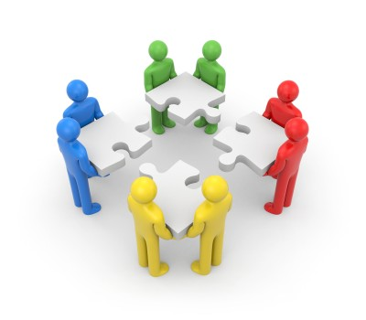
Creating Community Partnerships-Why?
Community and social service agency partnerships provide valuable insights into the needs of the community and limited income customers.
Agencies benefit by learning about utility assistance programs available to their clients.
Working together utilizing existing programs and developing new programs can reduce utility terminations and help to increase participation in Universal Service Programs.
Provides learning opportunities that promote collaboration.

Slide 8
Identifying Community and Agency Partners
Partners can be:
Community Based Organizations-Community Action Agencies
Low-Income Advocate Agencies
Utility Regulators
Other Interested Stakeholders

Slide 9
Community and Agency Partners in Pennsylvania
Partners in Pennsylvania were identified through already existing relationships and by seeking out agencies known to work with customers to provide assistance.
Utilities in Pennsylvania have relationships with the Office of Consumer Advocate, the Pennsylvania Utility Law Project, and the Pennsylvania Public Utility Commission.
Utilities also have relationships with Community Action Agencies and social service agencies. For example, the Salvation Army and Catholic Charities.
Reaching out to these groups to request participation was the first step in forming our advisory groups.

Slide 10
Increase Awareness of Utility Assistance Programs and Social Service Programs
Agencies are provided with in depth program information so that they can educate and refer customers who are seeking assistance.
Utilities learn about the dynamics of poverty in the community and about resources available to limited income populations.
All can work toward a common goal.

Slide 11
Universal Service Advisory Groups in Action-Peoples Universal Service Advisory Group
Peoples Universal Service Advisory Group was implemented in 2013 and continues today. The Customer Relations Department manages the group.
Meetings are held quarterly at Peoples.
The group is comprised of Community Based Organizations, Low Income Advocate Agencies, the Office of Consumer Advocate and other interested stakeholders.
Members from 24 agencies attend.
Meetings are scheduled to coincide with other Utility Advisory Council meetings so that those who have to travel from throughout the state can coordinate.
There is also conference call availability for those who can’t attend in person.

Slide 12
Peoples Universal Service Advisory Group
Structure of the meetings:
Agendas include:
Topics related to administration of the Universal Service Programs-Customer Assistance Program (CAP), Low Income Usage Reduction Program (LIURP), Customer Assistance Referral and Evaluation Program (CARES) and Emergency Furnace Program.
Requests for review and input from the group regarding program development, management and outreach to the community.
This may include proposing outreach methods, identifying barriers to participation and implementing recommendations.
Agency Updates-presentations about programs.

Slide 13
Peoples Universal Service Advisory Group
Outcomes and Results
Examples of changes made based on recommendations from the Advisory Group:
Reviewed the Community Partnership Fund that provided conservation outreach to local communities and determined due to declining participation over several years, the funds should be redirected to the Weatherization program.
Lobbied for and received PUC approval for increasing the Emergency Furnace Program funding.
Proposed and received PUC approval for reducing the CAP plus amount.

Slide 14
Duquesne Light’s Income Eligible Advisory Group

Slide 16
Purpose of the Advisory Group
Gain valuable input from interested stakeholders in a transparent manner
Create a diverse group of knowledgeable partners with the sole purpose of assisting the utility in serving community needs and supporting our income eligible populations
Opportunities exist across multiple channels of delivery including social service and governmental agencies, utility companies, non-profits and other community based organizations.
Streamline regulatory process by obtaining consensus prior to filing
Explore opportunities to integrate income eligible programs to provide customers with a single point of service.

Slide 17
Duquesne Light’s Income Eligible Advisory Group
Duquesne Light’s Income Eligible Advisory Group began in 2016. It is managed by the Customer Programs group.
Meetings are held 2-4 times per year.
The group is comprised of regulators, advocates, Community Based Organizations and various agencies within our service territory.
Open to anyone interested in partnering.
Meetings are scheduled to coincide with Peoples Natural Gas and Columbia Gas companies to maximize in person participation.

Slide 18
Advisory Group Participants
Representation includes:
Public Utility Commission
United Way of PA
Peoples, Columbia, Alcosan. Pgh Water (Utility)
Allegheny County (Government)
Office of Consumer Advocate (Consumer Advocate)
PA Utility Law Project (Low Income Advocate)
Salvation Army
Various Community Based Organizations
Pgh Food Bank
Rebuilding Together Pittsburgh
Housing Authorities
Veteran Organizations

Slide 19
Community Food Bank Opportunity

Slide 20
Community Foodbank Statistics
8 foodbanks in Allegheny County
2 food banks in Beaver County
Visited each twice
5,750 potential low income customer opportunities
5,970 nightlights distributed
6,143 single bulbs distributed
Whole House Audit Program staff partnered to promote free audits

Slide 22
Marketing and Community Engagement

Slide 23
Community Engagement
2018 Update
86 community events
17 specific to low income
CBO trainings; Senior Fairs; Flu-shot clinics; Veteran Fairs; Salvation Army; Tenant Paid High-rises; Hospitals
Trained CBO’s and UPMC social workers on DLC programs
2019- Medical Clinics

Slide 24
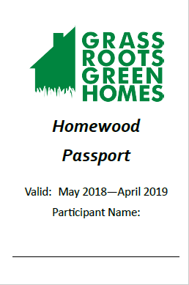
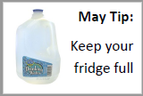
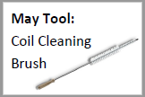
Community Engagement
Grassroots Green Homes
Duquesne Light & Peoples Natural Gas Committee Members
Monthly Tool Kit Distribution Days up to 300 customers in Homewood, PA – low income section of city
Duquesne Light trains at the monthly event on Watt Choices Programs and behavioral tips.
Notes:
Coli brush, faucet aerators, thermometer, outlet insulation, pipe wrap, door sweeps, window plastic, shower timer, weather stripping, light bulbs, night lights, caulking - each month --
Passbooks get stamps for picking up monthly tool kit. We incorporate our WHRP/Act 129 audits into eligible homes within this program.

Slide 25
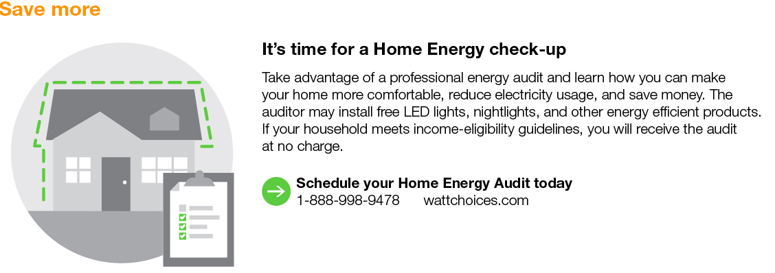
Home Energy Reporting- Behavioral Reports
Low Income Specific Targeted Marketing
Over 15,000 Low Income Customers Targeted
Whole House Energy Audit Promotion

Slide 26
Home Energy Report Marketing Ads
Notes:
Print 6x per year, email monthly. 11-1-17-5-3-18 – over 2,300 income eligible kits sent.

Slide 27
New Conservation Kit
LED Kit
Launched March 10, 2017 to coincide with the Home Show
8 LED Bulbs
2 LED Nightlights
Since March 10, 2017 over 46,000 kits processed for customers

Slide 28
Proposed additions – Smart Comfort
Duquesne Light will use its best efforts to ensure at least 10% of its completed LIURP jobs are for electric heat customers
The Company will provide updates to the Income Eligible Advisory Group on the progress of completed electric heat jobs (will be provided at the next meeting)
Each year, the Company will review lists of customers with high CAP credits (over $1,000) from the prior year and prioritize those customers for LIURP treatment.
Budget increase to approximately $3.0M per year
New Initiatives included (next slide)

Slide 29
Proposed new initiatives – Smart Comfort
Electric Emergency Repair Fund
Available for income eligible customers whose homes are unsafe and are in need of immediate repair
Prioritize CAP customers but will not turn away any eligible customers
Repairs may include, but not limited to central A/C for medically necessary households, frayed/unsafe service drops or when services has been off for a year or more
Limited up to $50,000 per year not rolled over year to year if not spent
De-Facto heating
Provide heating remediation services and education to eligible customers found to be using de-facto or supplemental heating
Identify customers using winter usage pattern
Prioritize CAP customers
Limited up to $100,000 per year not rolled over year to year if not spent
Knob and Tube (K&T) remediation with local gas companies
DLC will pay a portion to remediate K&T to allow gas company to continue with weatherization
Only for homes with older SEER rated A/C units, DLC will offer to repair or replace with new higher SEER unit to capture savings from cooling tied to weatherization
Limited up to $100,000 per year not rolled over year to year if not spent

