Slide 1
New To Customer Assistance & All That Goes With It
Utility Terms
David Nelson

Slide 2
Utility Terms
Disconnect Notice
A warning letter sent by the utility
informing the customer if payment
is not received by the date indicated
in the notice, the service may be
interrupted.

Slide 3
Utility Terms
Payment Extensions
You can request extra time
to pay your bills up to a certain
number of days.

Slide 4
Utility Terms
Energy Assistance Program /Low Income Programs
Programs where the utility provides
credits on your bill.

Slide 5
Utility Terms
Payment Agreement
You can request payment options to
pay your bills over a longer period of time.

Slide 6
Utility Terms
Social Services
Government or non-profit agencies that can provide cash
assistance to help customers with utility bill payments.

Slide 7
Utility Terms
Level Payment Plan or Budget Billing
Program to easily avoid seasonal spikes in
energy costs by spreading your payments
evenly across the year.

Slide 8
Utility Terms
Basic Service Charge
Charge for basic system
infrastructure and customer-related
services including customer account,
meter reading and maintenance.

Slide 9
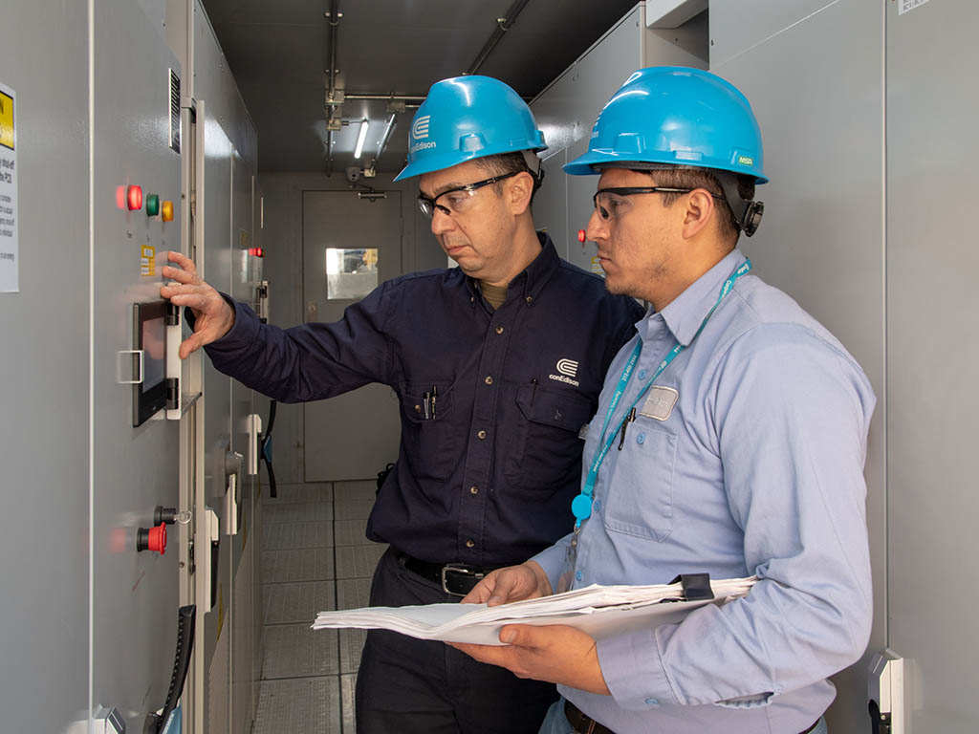
Utility Terms
Delivery Charges
Charges for maintaining the system
through which a utility delivers
electric and gas service to you.

Slide 10
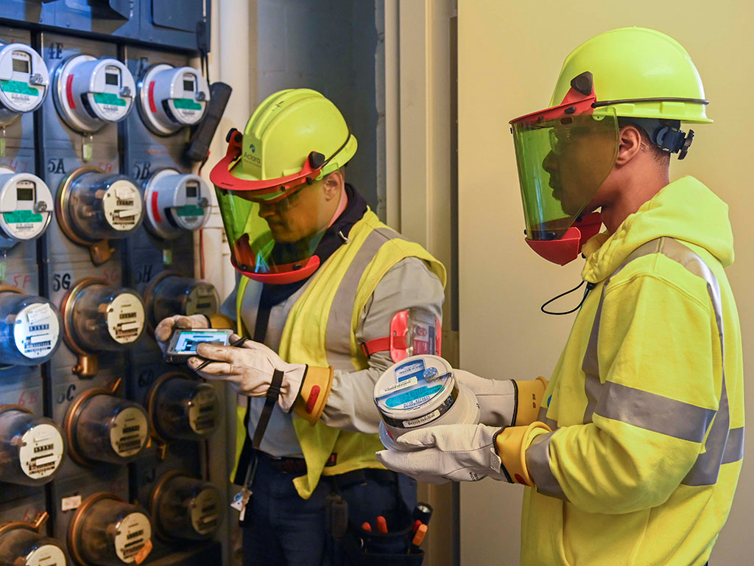
Utility Terms
Supply Charges
Charges for electric or gas service
supplied to you by the utility or
Energy Service Company.

Slide 11
Utility Terms
Energy Service Company (ESCO)
A company which can offer competitive supply prices to customers.

Slide 12
Utility Terms
Life-Support Equipment
If you or a loved one use life-support equipment, utilities need to know in case of an emergency or power outage. Don’t forget to include people in your service area who do not receive a bill from utilities because electric service is included in their rent.

Slide 13
Utility Terms
Medical Emergency/ Hardship
If you’re dealing with a medical emergency, the last thing you need to worry about is paying your bill. If you are hospitalized let your utility know. Utilities can arrange to give you extra days to pay your bill.

Slide 14
Utility Terms
Special Services
Utilities can provide Special Services like:
If you’d prefer to get your bill in large type or Braille
TDD services
Special programs for Seniors

Slide 15
Utility Terms
Third Party Notification
You can choose a relative, friend, or organization
to receive a notice from your utility if your bill is
overdue and your electric or gas service might be
turned off.
The third party is not responsible for paying your
bill, but may be able to help resolve the problem.
Having a third party involved can be especially
helpful if you are ill, elderly, live alone, or travel
frequently.

Slide 16
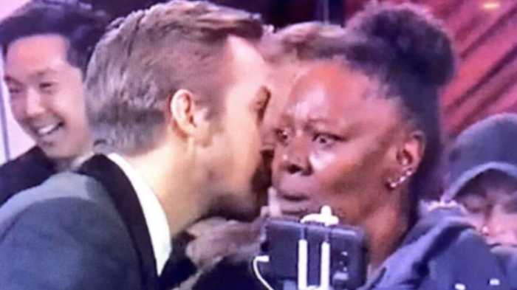
THE SECRET
What you talking about David?!!!!

