Slide 1
YOU QUALIFY FOR LIHEAP
What Else?

Slide 2
Heating Equipment Repair or Replacement Benefit
If you are a homeowner and eligible, the Heating Equipment Repair and Replacement benefit can help you repair or replace your furnace, boiler and other direct heating equipment necessary to keep your home’s primary heating source working.
Benefit amounts are based on the actual cost incurred to repair or replace your furnace, boiler, and/or other essential heating equipment, $3,000 for a repair and $6,500 for a replacement.

Slide 3
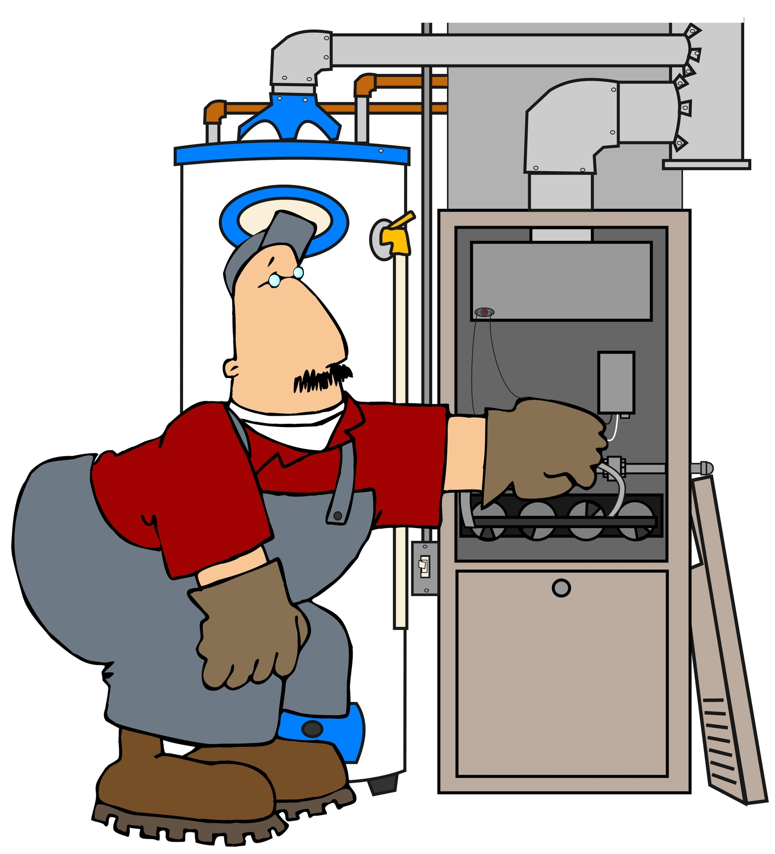
Clean and Tune Benefit
Eligible households can receive energy efficiency services, which includes the cleaning of primary heating equipment, but may also include chimney cleaning, minor repairs, installation of carbon monoxide detectors or programmable thermostats, if needed, to allow for the safe, proper and efficient operation of the heating equipment.
Benefit amounts are based on the actual cost incurred to provide clean and tune services, up to a maximum of $400. No additional HEAP cash benefits are available.

Slide 4
Clean and Tune Benefit
You may be eligible for a benefit if:
You are the homeowner
Your household’s gross monthly income is at or below the
current income guidelines for your household size as posted on
the following table
Your primary heating equipment is more than 12 months old
Your primary heating equipment or chimney has not been
cleaned within the last 12 months
You do not have a service contract with your vendor that
includes clean and tune services

Slide 5
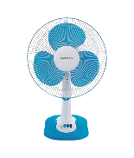
Cooling Assistance Benefit
If you are eligible, you may receive one Cooling Assistance benefit per applicant household for the purchase and installation of an air conditioner or a fan to help your home stay cool.
In circumstances where an air conditioner cannot be safely installed, a fan will be provided.
Only one air conditioner or fan, not to exceed $800 with installation, will be provided per applicant household. No additional HEAP cash benefits are available.

Slide 6
Cooling Assistance Benefit
You may be eligible for a Cooling Assistance HEAP benefit if:
Your household's gross monthly income is at or below the
current income guidelines for your household size
You receive Supplemental Nutrition Assistance Program
(SNAP) benefits, or
You receive Temporary Assistance (TA), or
You receive Code A Supplemental Security Income (SSI
Living Alone)

Slide 7
Cooling Assistance Benefit
You may be eligible for a Cooling Assistance HEAP benefit if:
You and your household members are United States Citizens
or qualified aliens, and
Includes an individual with a documented medical
condition that is exacerbated by heat, and
You received a Regular benefit greater than $21 in the
current program year, and
You currently do not have a working air conditioner or the
air conditioner you have is five years old or older, and
You did not receive a HEAP funded air conditioner within
the past ten years

Slide 8
Other Benefits You May Be Eligible For
Supplemental Nutrition Assistance Program (SNAP)
Temporary Assistance (TA)
Supplemental Security Income (SSI)
Utility Low Income Credits

Slide 9
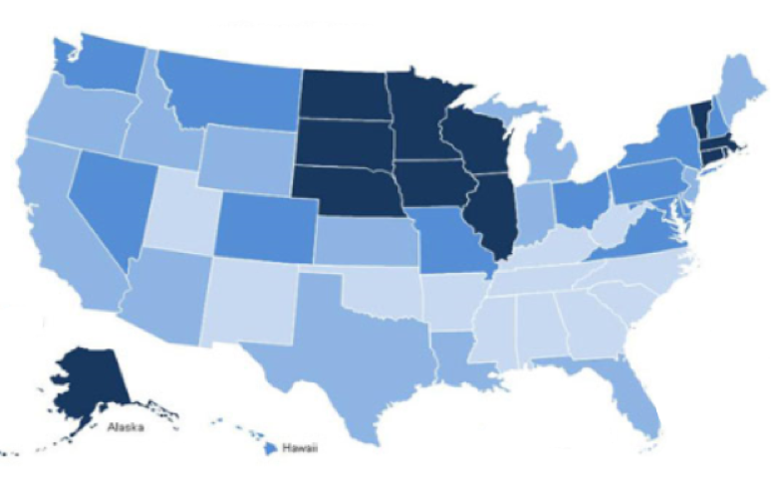
Other Benefits You May Be Eligible For
Check with your state to find out what other benefits HEAP
provides
Get involved with your LIHEAP in your state

