Slide 2
Your Fundraising Story how to tell it and share it

Slide 3
Why tell a story?
Make a connection with the donor
To your organization’s mission
To the people you serve
Impact!
People want to know that they are making a difference that they care about
Provide motivation
Call to action – act now

Slide 4
Story Architecture
Who are you –
Organization (simply put)
Mission
Trusted
Why should people care – connection to the cause
From the heart
Help get people back on their feet
What will a contribution do – Impact
Because of your gift, # more people will live in a warm home

Slide 5
Know your audience
Who will read / hear the story?
Philanthropic donors
Previous program recipients
Business/ corporation
Utilities
What motivates them to take action?
Impact
Societal benefit
Recognition

Slide 6
Words matter
Low-income Income-qualified Vulnerable families
Client Participant Recipient
Handout Hand-up Stability
Donors see themselves as:
Kindhearted Sympathetic Concerned citizens
Philanthropic Generous Leaders

Slide 7
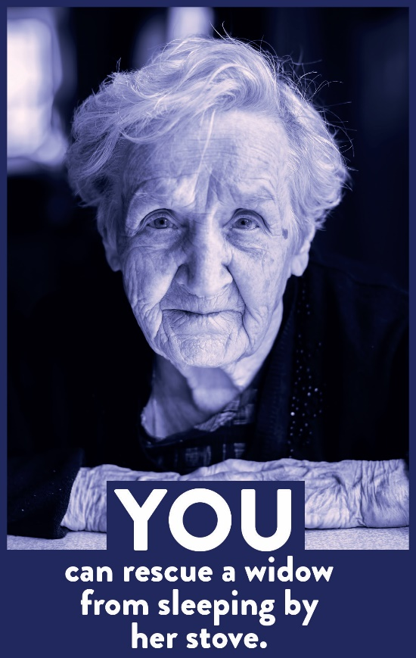
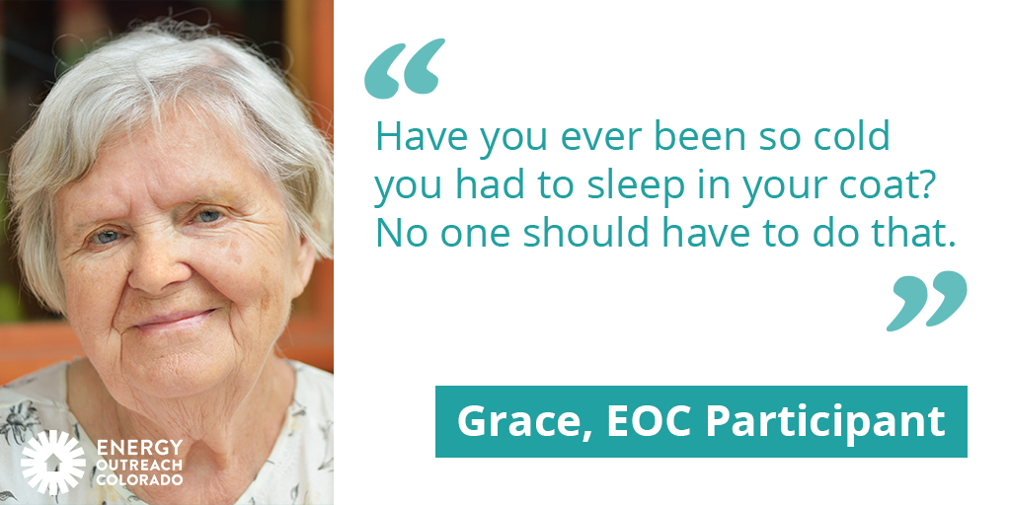
visuals – Illustrate your cause
OR

Slide 8
A call to action
The Story:
It’s unbearable to live in a home without heat. Whether you struggle to afford the energy bill this month or your furnace has stopped working and you can’t afford to fix it; living in a home with freezing temperatures is something no one should have to experience. Your gift will provide warmth, health and safety for a family today.
To the point:
Families are living without heat – and you can help. A gift of $$$ will provide comfort for a household in your community.

Slide 9
A story gives reason to give
“Touch” the donor:
James, as described by his neighbors Gwen and Mark, is a tough guy. As a senior, he has retired and is now living on a fixed income. With little extra money each month when James’s furnace stopped working, he couldn’t afford to fix it.

Slide 10
Does my $ really make a difference?
Your story can show the impact of a gift:
In the past year we provided over 16,000 households with energy assistance and paid 16,038 home energy bills to help income-qualifying Coloradans keep their heat and electricity on. Your support helps leverage resources to prevent seniors, veterans, teachers, and members of your community from living in the dark and cold.

Slide 11
“Why I Donate”
My mother raised nine children on her own after my father died. For over 30 years she saved every utility bill making notes in the margins about the weather trying to anticipate the next month’s utility bill. She was quietly vigilant in her effort to keep the heat on in the winter.
I donate to Energy Outreach Colorado Board because of their mission - specifically to help low-income households afford their utility bills. I want to ease that quiet burden parents bear over utility bills so their families can thrive.

Slide 12
Connect, relate, motivate
Bottom line – it’s all about relationships. Meet people where they are.
Connect with the audience
Get them to relate to the cause/mission
Motivate them to give

Slide 13
Denise Stepto
Chief Communications Officer
dstepto@energyoutreach.org

