Slide 1
One State’s Effort
June 3, 2019

Slide 2
Campaign Strategy
Awareness
Develop awareness of LIHEAP benefits and community impact.
Unite
Bring California LIHEAP Service Providers together with one common goal.
Call to Action
Call LIHEAP Service providers and LIHEAP applicants to action in support of the program and in opposition to elimination or reduction of funding.

Slide 3
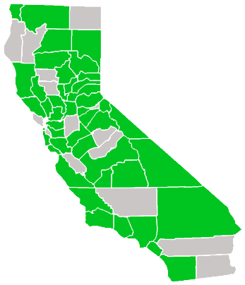
Outcomes
Campaign Representation

Slide 4
Campaign Strategy
The LIHEAP Helps California campaign was powered by
LIHEAP Service Providers and their ability to connect with their communities (applicants, Elected Officials, news media, etc.).

Slide 5
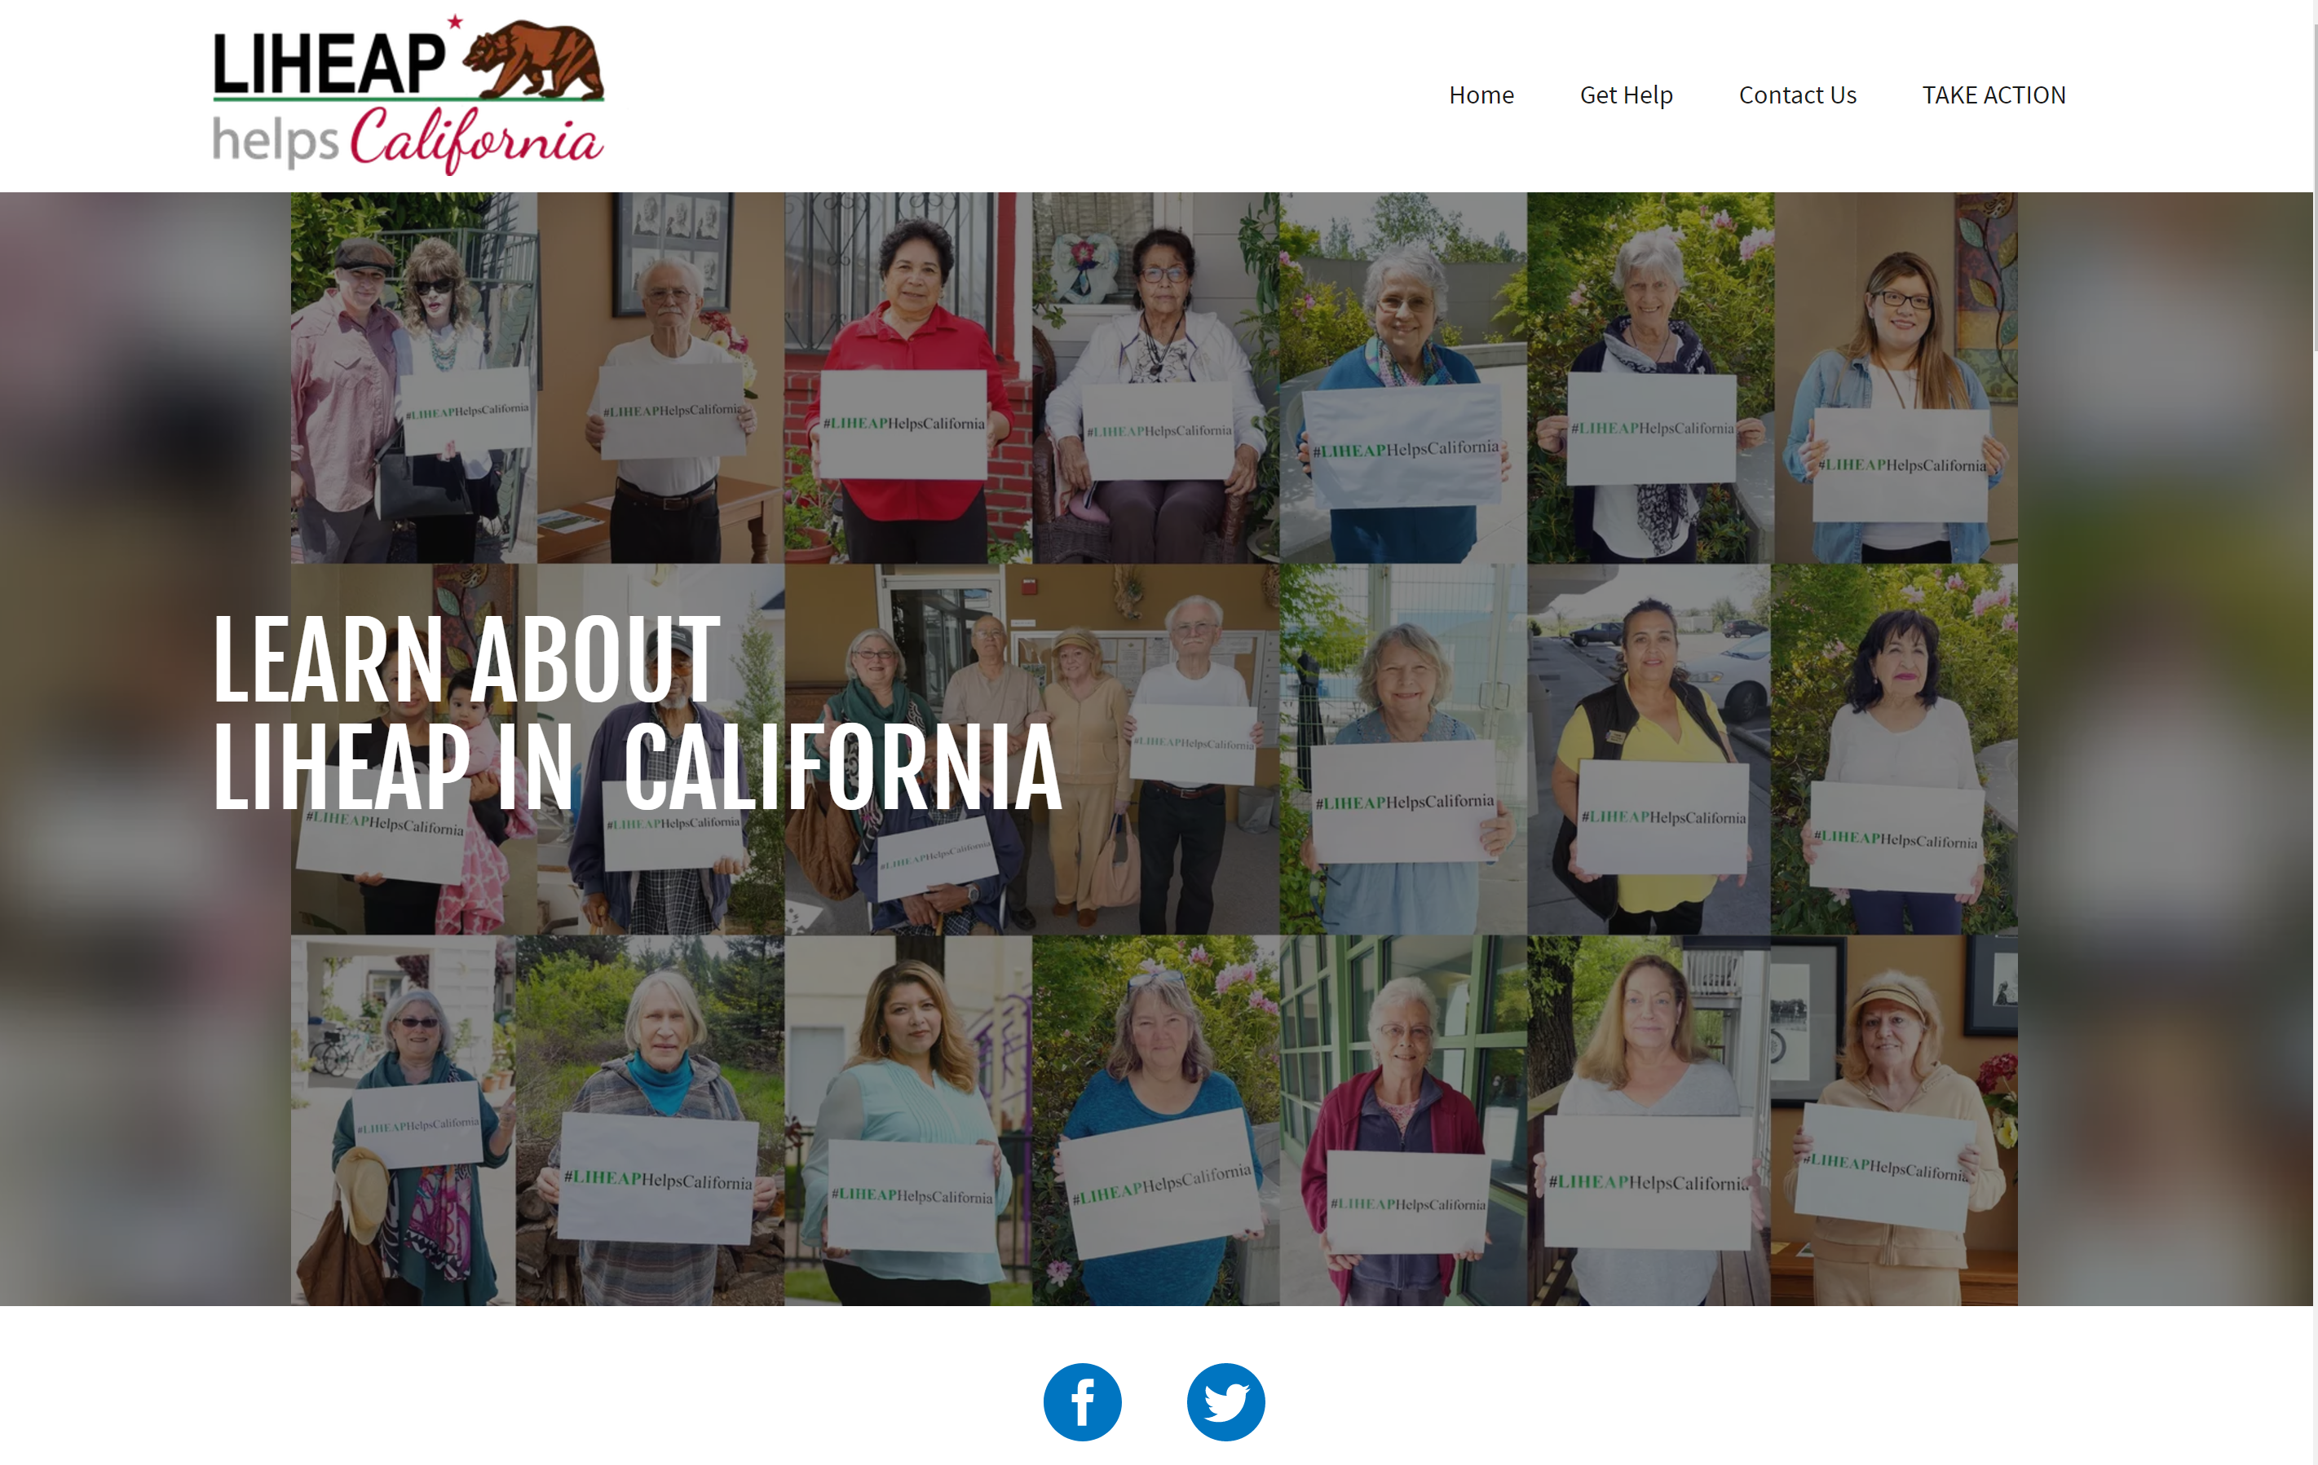
Elements of
the Campaign:
Website
www.LIHEAPHelpsCalifornia.org

Slide 6
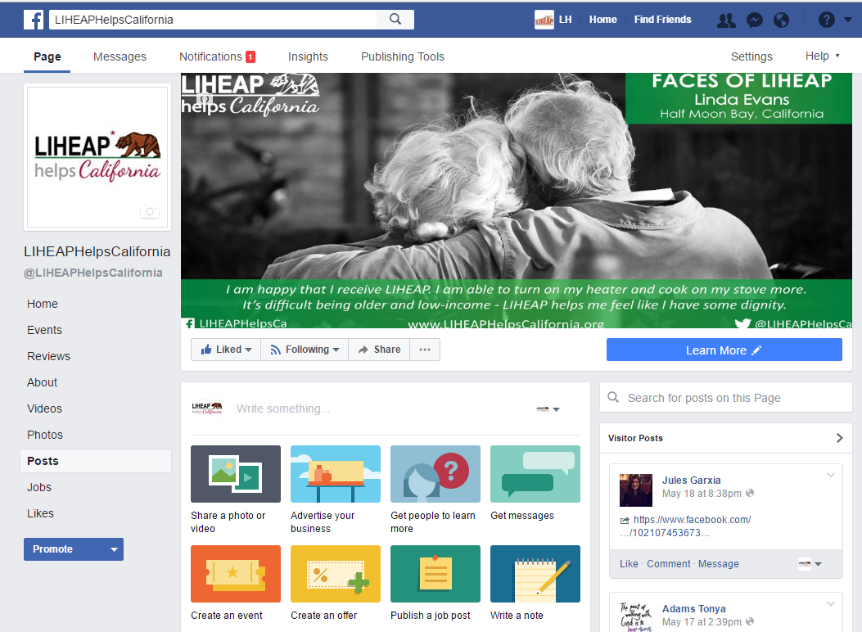
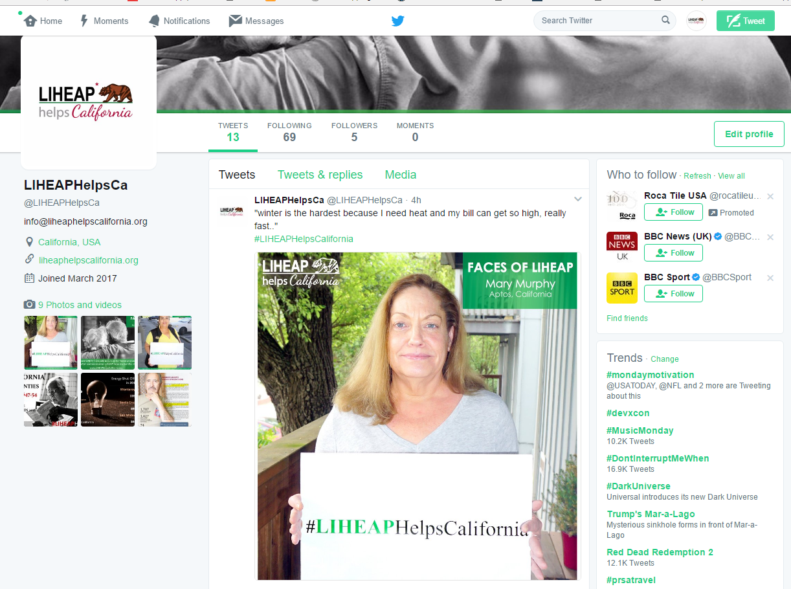
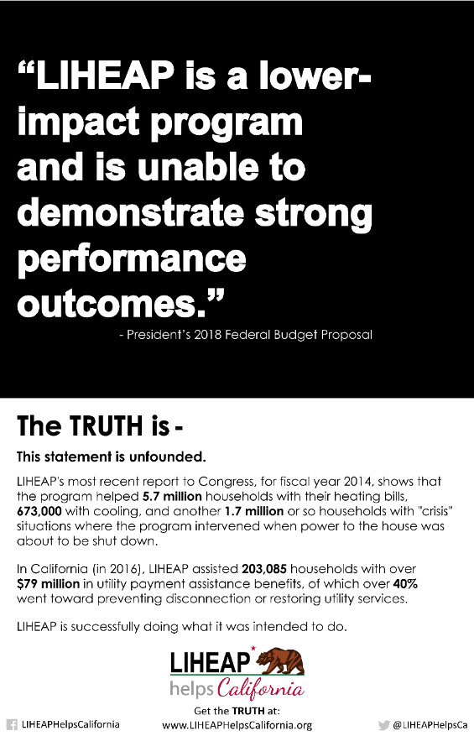
Elements of
the Campaign:
Social Media
Facebook
@LIHEAPHelpsCalifornia
Twitter
@LIHEAPHelpsCA
#LIHEAPHelpsCalifornia
#SaveLIHEAP

Slide 7
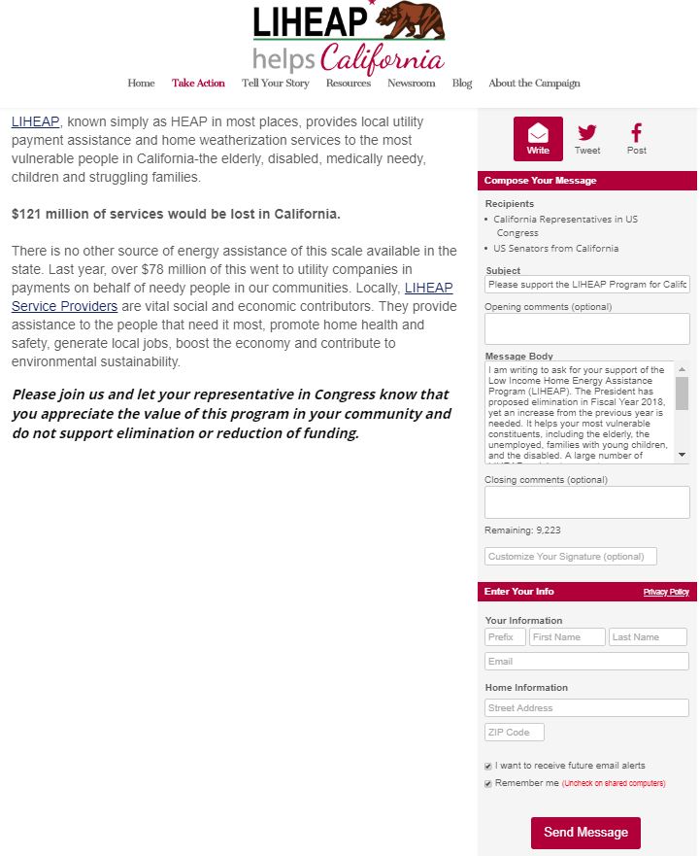
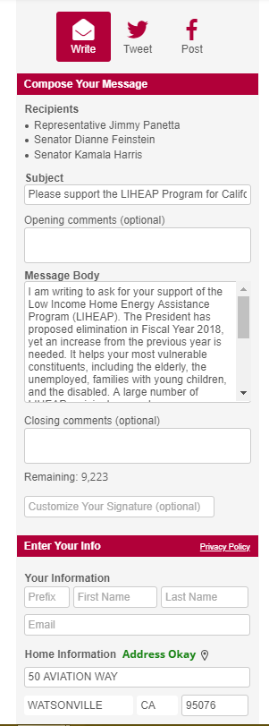
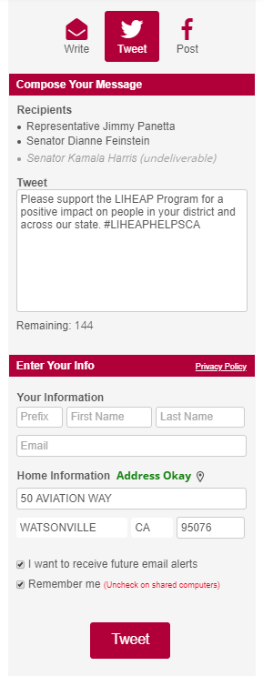
Elements of
the Campaign:
VoterVoice

Slide 8
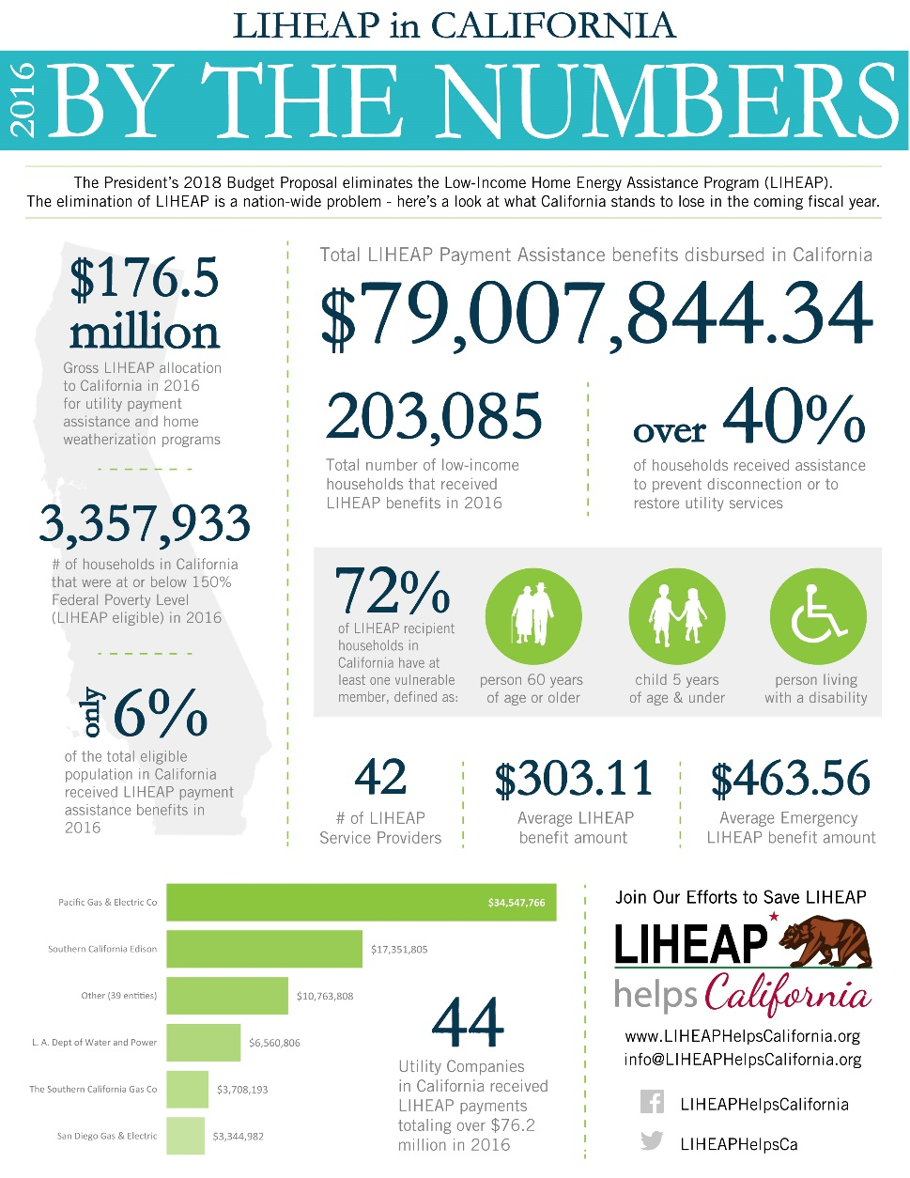
Elements of
the Campaign:
State-wide Overview

Slide 9
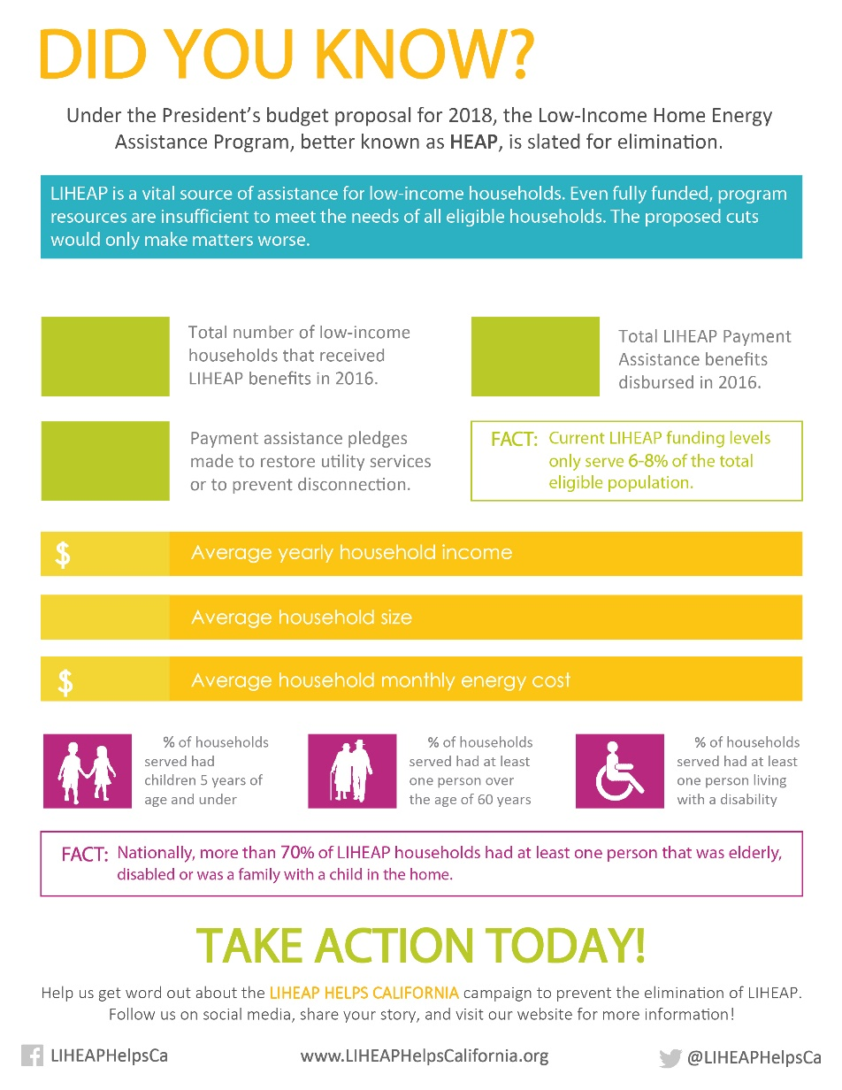
Elements of
the Campaign:
Service Provider Fact Sheet

Slide 10
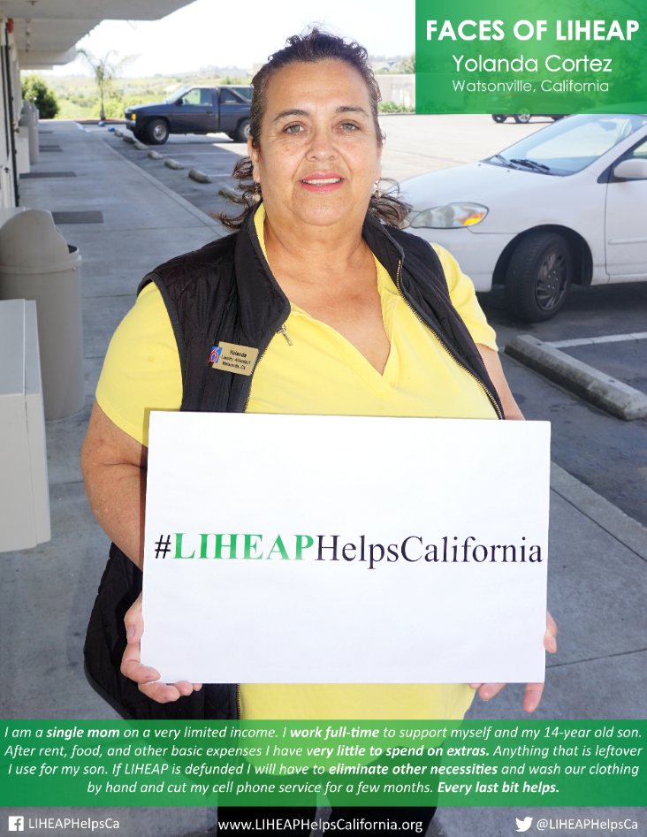
Elements of
the Campaign:
Faces of LIHEAP

Slide 11
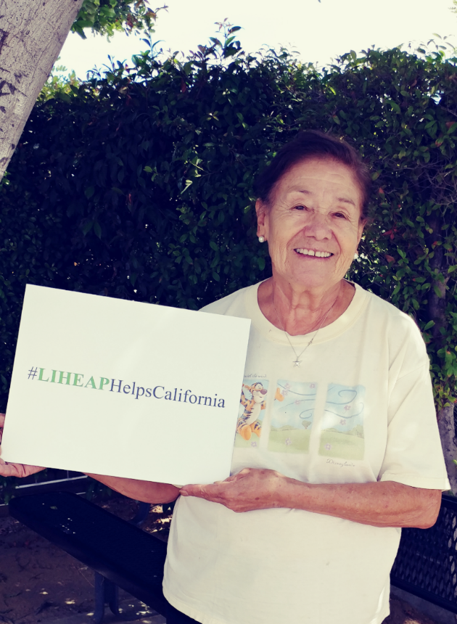
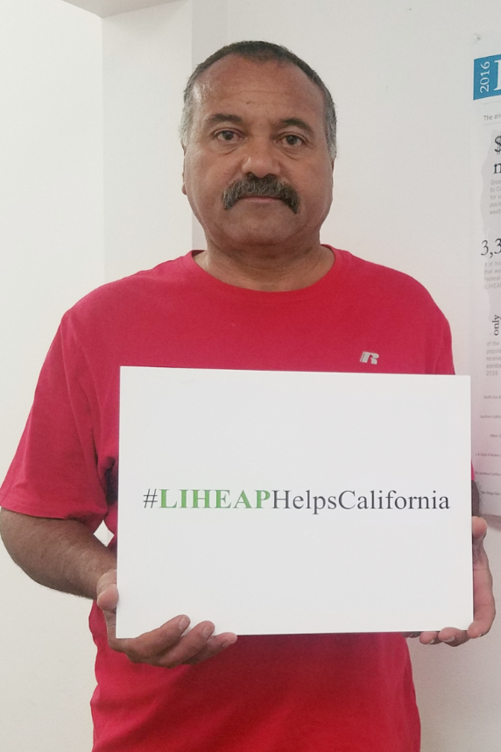
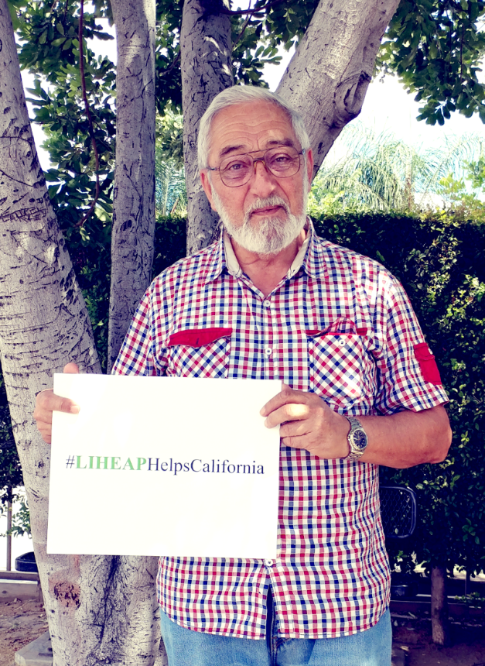
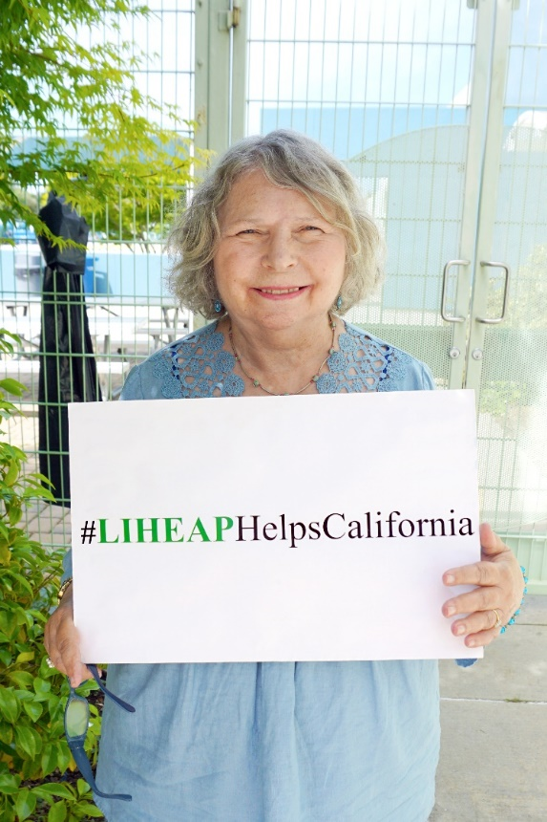
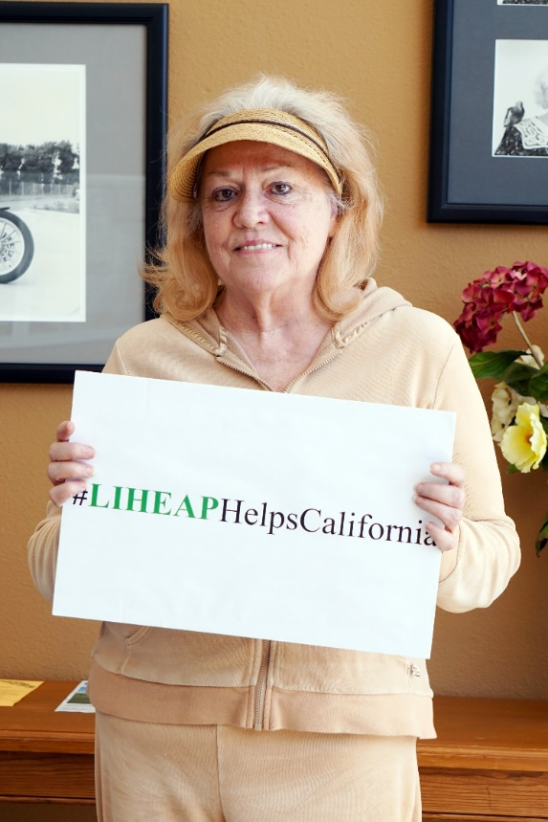
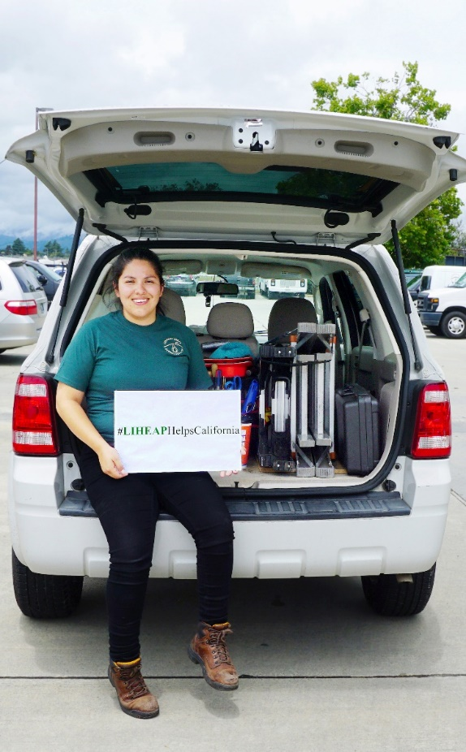
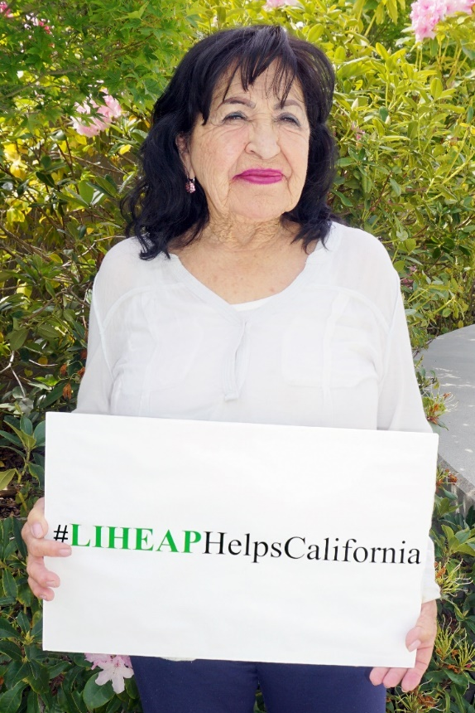
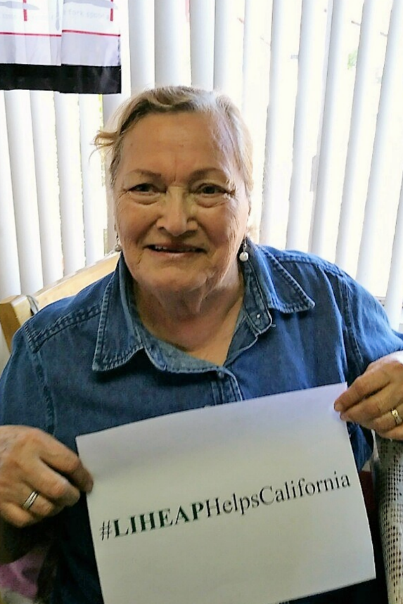
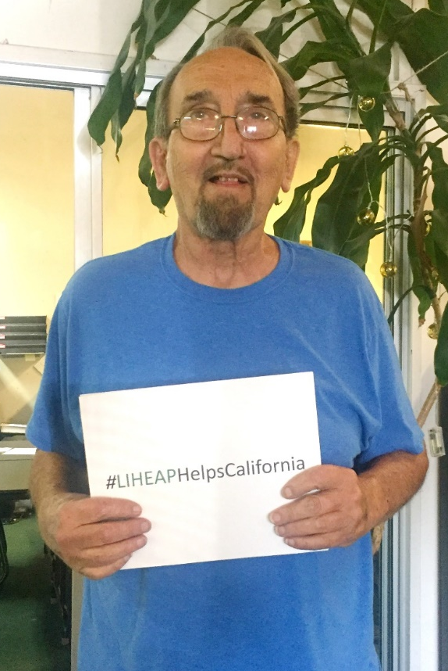
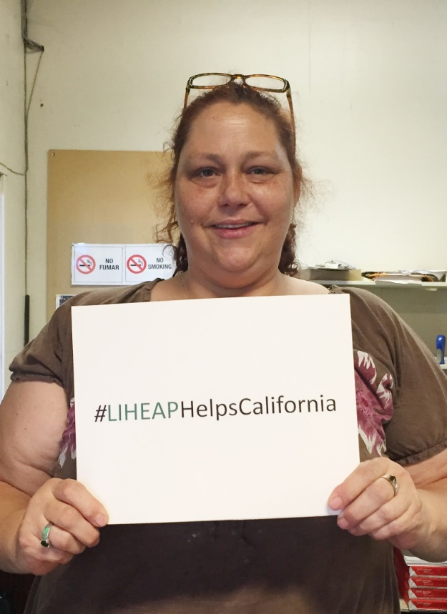
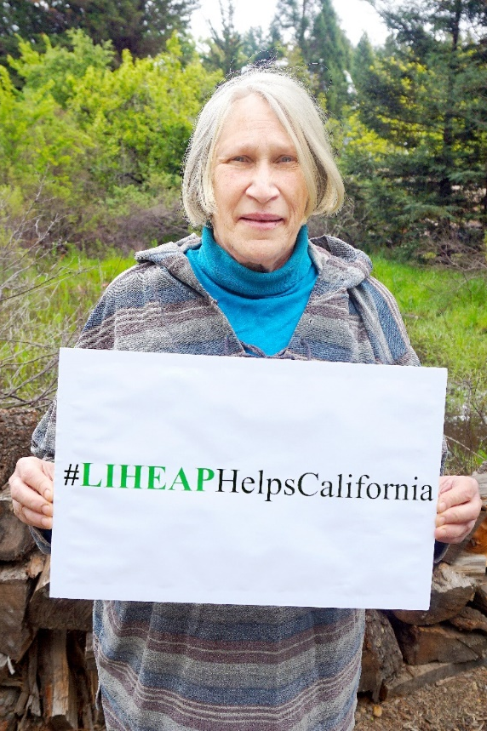
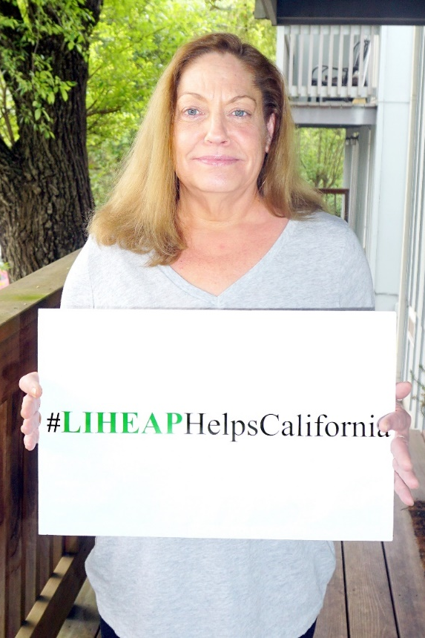
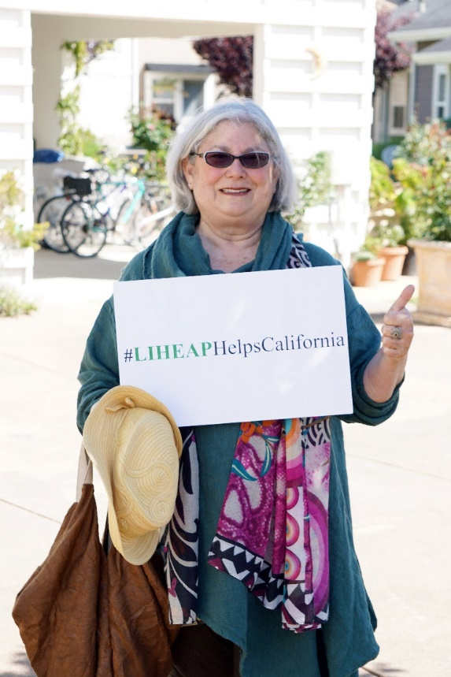
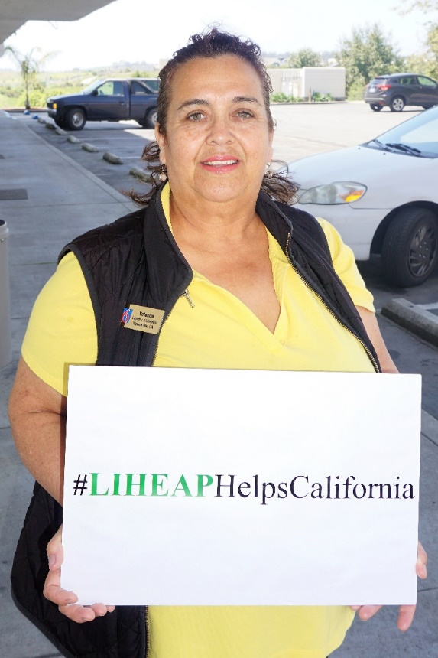
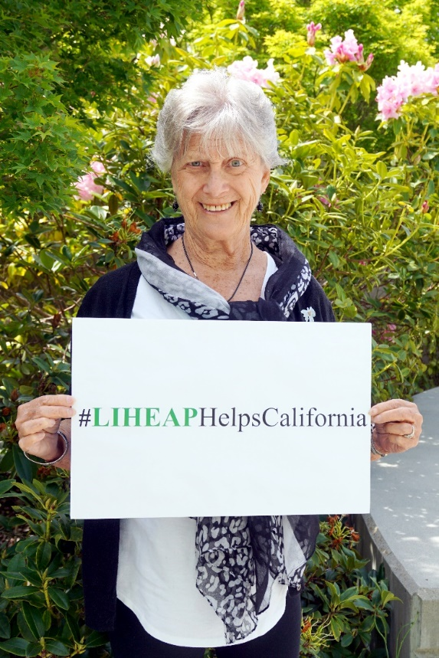
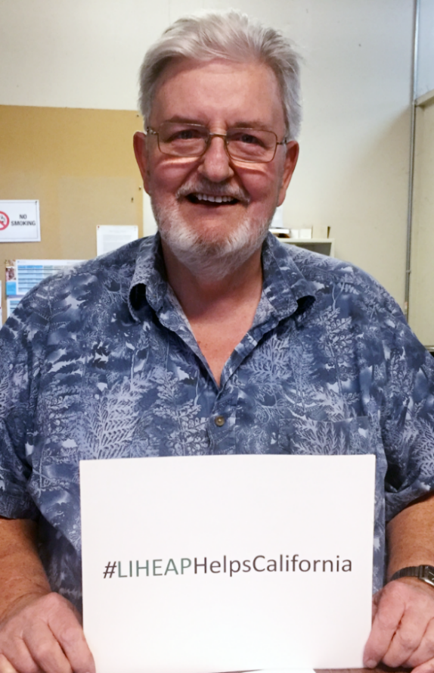
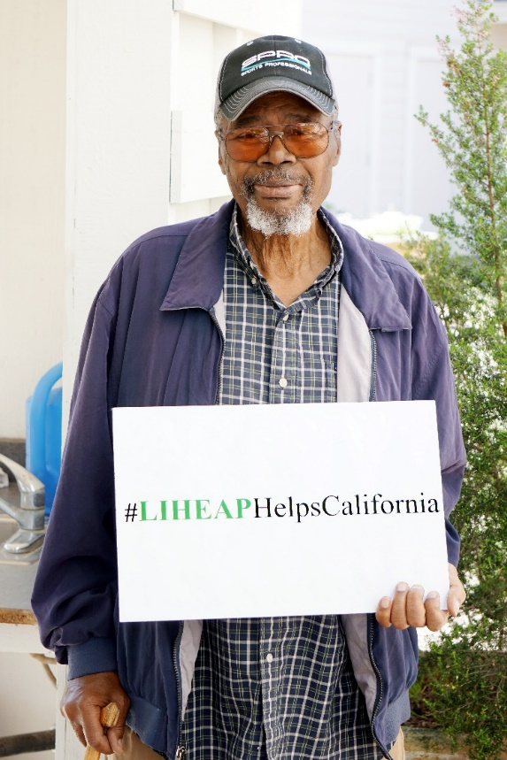
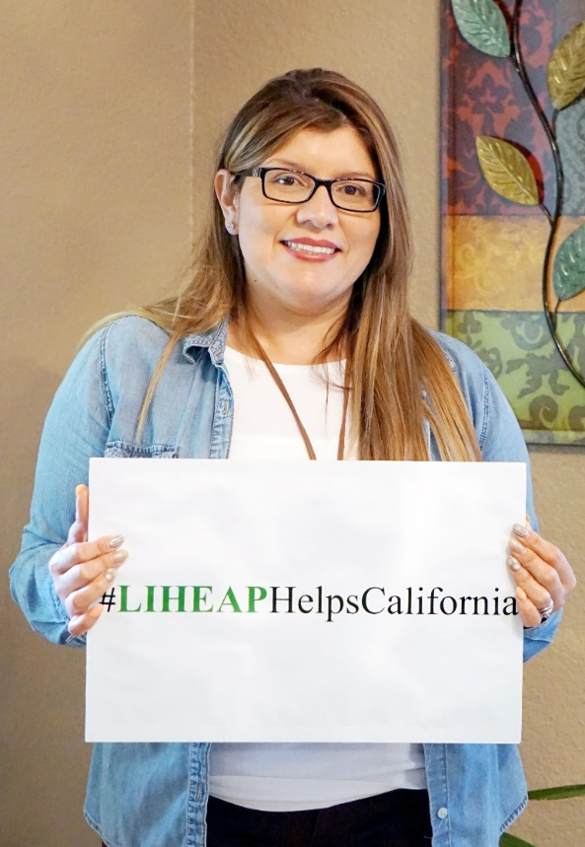
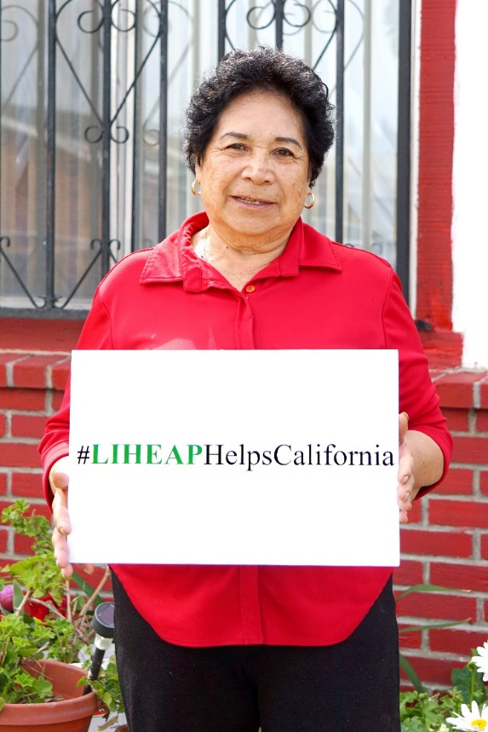
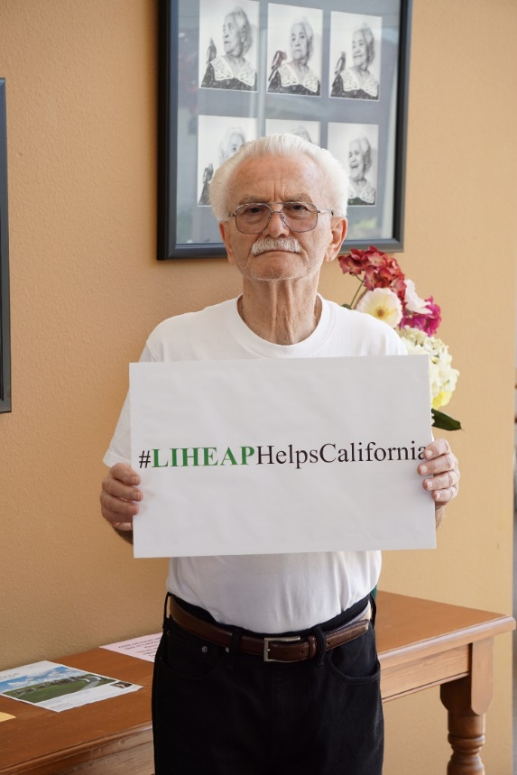
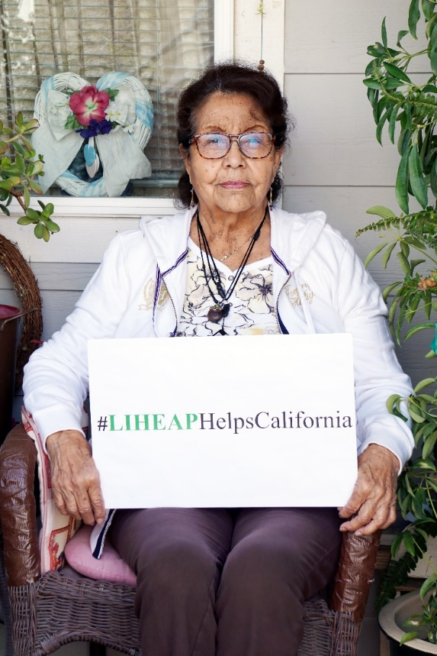
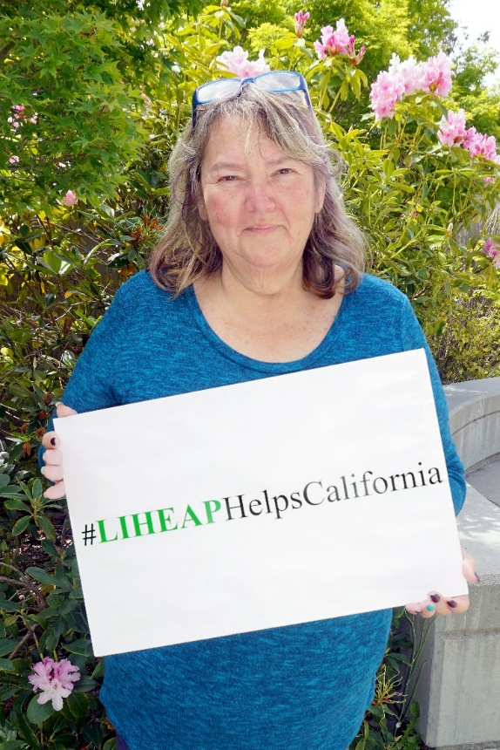
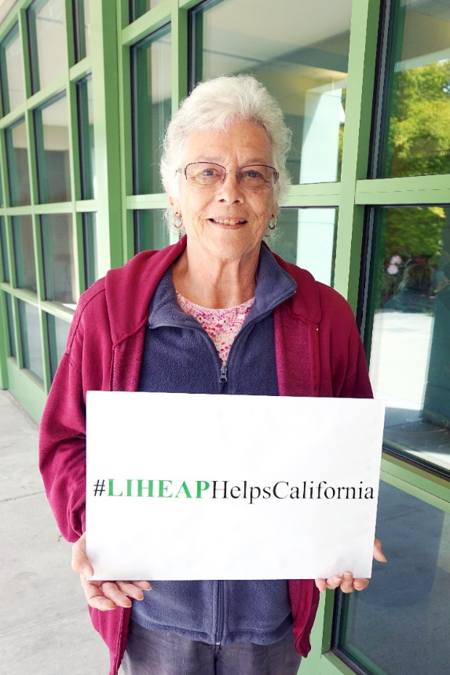
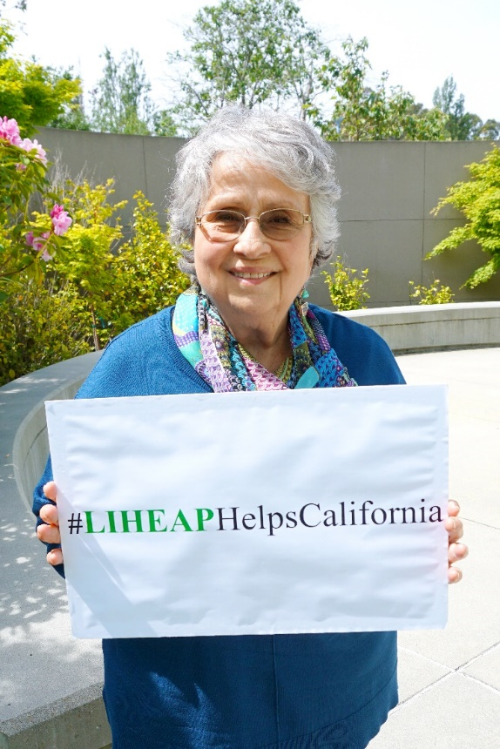
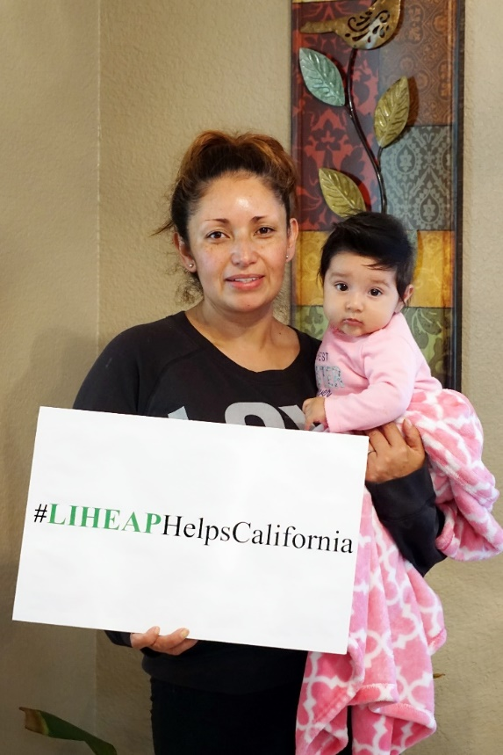
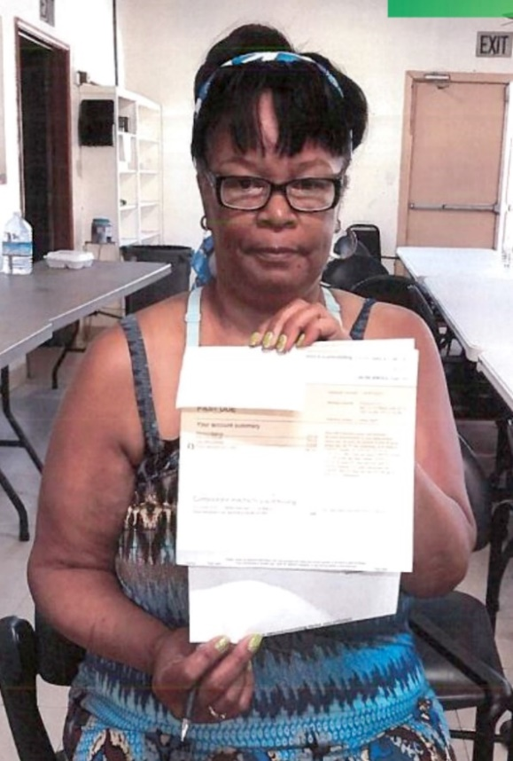
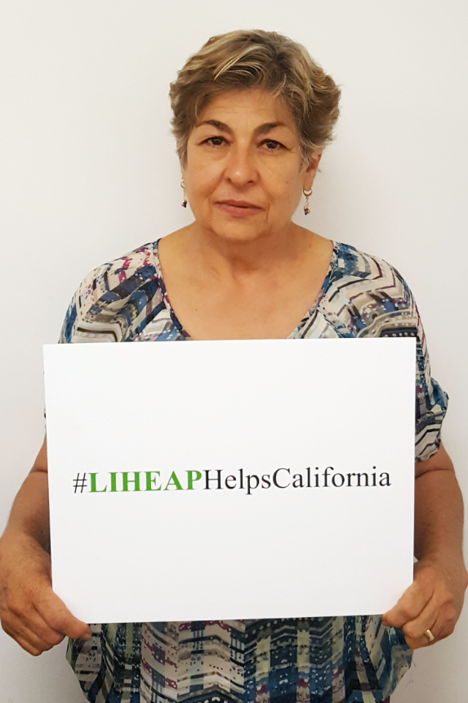
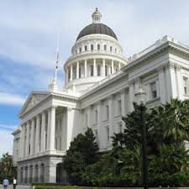
Advocacy & Lobbying
Advocacy
Information. Education. Enlightenment!
Importance and Value of LIHEAP
Opportunities to Magnify the Impact of LIHEAP
https://liheaphelpscalifornia.org/
Lobbying
Draft Legislation. Influence Passage or Defeat.
Organize.
http://saveliheapca.org/take-action/

Slide 12
Advocacy & Lobbying
“Only thing we have to fear is fear itself”.
FDR
Take a look for yourself, then act.
https://www.irs.gov/charities-non-profits/lobbying
https://www.irs.gov/charities-non-profits/measuring-lobbying-substantial-part-test
https://www.irs.gov/charities-non-profits/measuring-lobbying-activity-expenditure-test

Slide 13
Thank You
Contact Us:
Info@LIHEAPHelpsCalifornia.org
(831) 515-6591
Dennis Osmer
dennis@energyservices.org

