Slide 1
The Growing Need for Water Affordability Policies and Programs
NEUAC 2019 Conference
Hugh Wooden, Senior Analyst, KC Water
June 4, 2019

Slide 2
Agenda
Growing need for water affordability policies and programs
Summarize current policy discussions
Demonstrate how water affordability can be realized:
  Through rate design
  Through establishing an assistance fund
  Through partnerships
  Through management practices
2

Slide 3
Median Household Income

Slide 4
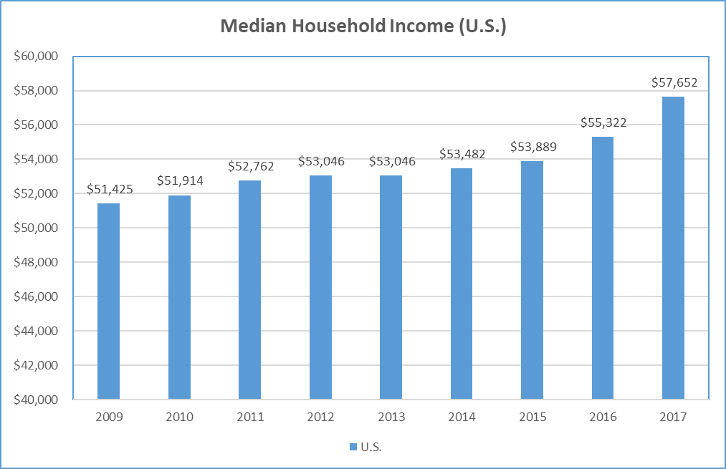
Median Household Income: U.S.
U.S. Annual MHI Growth since 2009 = 1.44% per year
Source: American Community Survey, Table S1903, 5-year estimates.

Slide 5
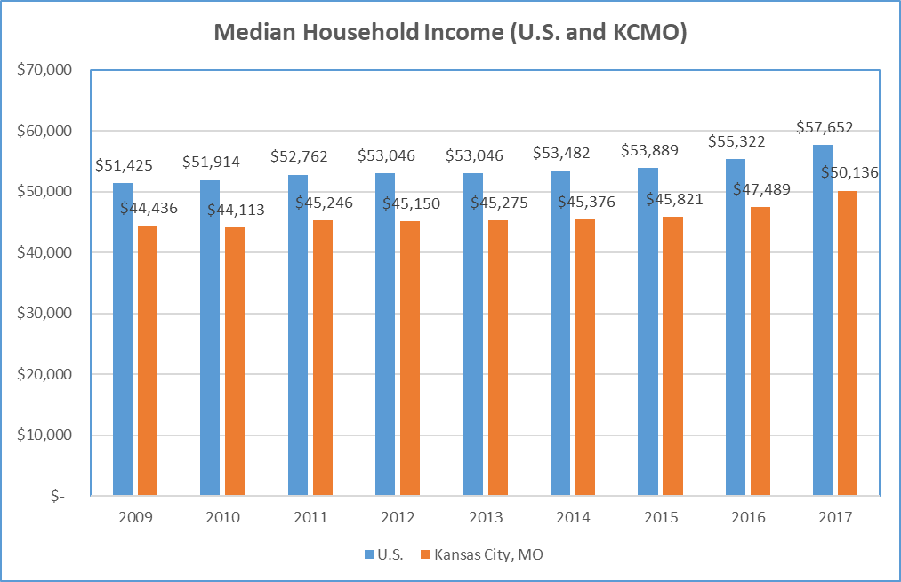
Median Household Income:
U.S. and Kansas City, MO
U.S. Annual MHI Growth since 2009 = 1.44% per year
KCMO Annual MHI Growth since 2009 = 1.52% per year
EPA Historical (1990’s) Wastewater Affordability of 2% of MHI
Source: American Community Survey, Table S1903, 5-year estimates.

Slide 6
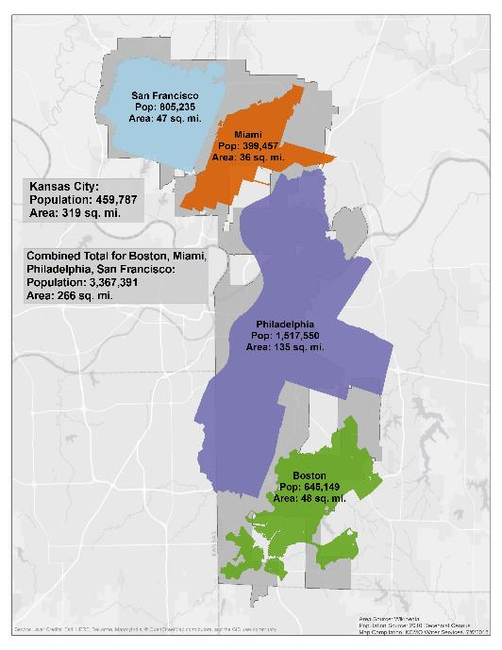
Large Service Area + Small Population = Higher Cost of Service relative to other cities
  Not one size fits all
    Density of Population
    Quality of Water Supply
    Water Rights
  KC Water services an area larger than San Francisco, Miami, Philadelphia and Boston combined (318 square miles vs 266 square miles)
  Kansas City’s population represents less than 14% (489,000 vs 3.4 million) of the combined population of the 4 other cities embedded on the map.
6

Slide 7
National Wastewater Rate Trends
Since 1985, Wastewater rates have increased 5.1% annually on a national basis.
Since 2008, Wastewater rates have increased 6.2% annually on a national basis.
Source: NACWA, 2017 Cost of Clean Water Index.

Slide 8
Industry Association Input
Current Policy Discussions

Slide 9
Balance
Utilities and Communities are faced with difficult decisions as they work to balance regulatory compliance with providing service at rates that are affordable.
AWWA, NACWA and WEF are working to develop some recommendations for the EPA for assessing household affordability and community financial capability to replace current guidance.
EPA’s Current Financial Capability Assessment (FCA) guidance:
  Residential Indicator (RI) – Examines financial capability in terms of impacts to households measured as average household wastewater cost as a percent of median household income (MHI) and compares it to a 2% threshold.
9

Slide 10
Views on Current Financial Capability Assessment
MHI might be a poor indicator of economic distress bearing little relationship to poverty or other measures of economic need within a community.
MHI does not capture the impacts on the most vulnerable population of a community.
The 2% of MHI threshold only includes wastewater costs and does not take into account drinking water and stormwater.
The 2% of MHI threshold provides a “snapshot”
  Does not take into account current and future trends of a community’s economic, demographic and social conditions.
10

Slide 11
Household Affordability Methodology and FCA Framework
Needs to reflect all water service costs
  Wastewater, Drinking Water, Stormwater
Needs to reflect the most economically challenged households
  Lowest quintile (bottom 20%)
Needs to reflect local essential costs of living
  Account for average housing, transportation, other utilities, etc.
Data should be easily accessible
  American Community Survey

Slide 12
Proposed Household Affordability Assessment Methodology
Household Burden Indicator (HBI) – Water service costs as a percent of the 20th percentile (lowest quintile of income, LQI) household income
  Households at or below the 20th percentile typically reflect those households that are the most economically challenged members of a community more so than MHI
  Many assistance programs have cut-offs at or near the 20th percentile
Poverty Prevalence Indicator (PPI) – Percentage of community households at or below 200% of Federal Poverty Level (FPL)
  The degree to which poverty is prevalent in the community

Slide 13
Combining Household Affordability and Financial Capability
The relationship between the utility’s financial forecast and the household burden illustrates how household affordability and utility financial capability are intertwined.
This relationship can serve as a better guide for communities and utilities to address economic considerations from the EPA coming from Clean Water Act and Safe Drinking Water Act requirements.
13

Slide 14
Realizing Water Affordability

Slide 15
Water Utility Assistance
Bill Discount – A reduction in the customer’s bill that can be applied to any aspect of the bill (e.g. fixed service charge, volume charge, etc)
Flexible Terms – Establishing payment plans for future payments. This can be done through bill timing adjustment, level payment plans, forgiveness of past due amounts.
Lifeline Rate – Customers pay a subsidized rate for a fixed amount of water, which is expected to cover a customer’s basic water needs.
Temporary Assistance – Utilities offering short-term or one-time assistance to prevent disconnection of service for households facing unexpected hardship.
Water Efficiency – Utilities provide financial assistance for leak repairs or offer rebates for certified fixtures, toilets, and other low flow appliances.
Kansas City offers customers a lifeline rate, payment arrangements and temporary financial assistance. We are looking into establishing a water efficiency program as well.

Slide 16
Affordability through Rate Design
Cost of Service
  Revenue Requirements – How much revenue is required to operate the utility?
  Allocation of Costs – How will costs by allocated to different functional components and to different customer classes (residential, commercial, inside city, outside city, etc)?
  Rate Design – How will the rate structure support the revenue requirements? How are rates designed for each customer class to achieve the revenue requirements?

Slide 17
Cost Allocation / Rate Design
Make Customer Assistance part of Revenue Requirements for the Utility
Bill Discounts through Cost Allocation:
  Allocation of Peak Capacity factors by Customer Class
    Shift more of the extra capacity costs to non-residential customer classes
  Allocation of some Demand Costs into Commodity Costs
    Move more O&M expense away from residential customer class
  Identify ancillary funds outside of the rate design through penalties, late fees and interest from income

Slide 18
Cost of Service Methods
Base Extra Capacity Method
  Base Costs, Extra Capacity Costs, Customer Costs and Fire Protection Costs
Commodity Demand Method
  Commodity Costs, Demand Costs, Customer Costs and Fire Protection Costs
Both methods recognize the varying costs related to rate of use and peak demand.

Slide 19
Customer Assistance Examples
Philadelphia – For household incomes at or below 150% of the federal poverty level, households will pay a set percentage (2% to 4%) of their monthly income towards their water bill.
Baltimore – For household income at or below 175% of the federal poverty level. Only available to property owners. Annual assistance up to $236. However, recent legislation has been introduced to go to an income based billing program similar to Philadelphia that would also cover renters.
Detroit – For household income at or below 150% of the federal poverty level. $25 monthly credit toward current bills with any arrears suspended for 12 to 24 months. Customers who successfully make their monthly payments for one year receive $700 credit toward deferred arrears.
Kansas City offers customers a lifeline rate, payment arrangements and temporary financial assistance. We are looking into establishing a water efficiency program as well.

Slide 20
Affordability through Partnerships
Engage Ratepayers
  In KC, Mayoral appointed Citizens Task Force to develop affordability solutions
  Advisory Board
Educate Lawmakers
  Make the CSO issue a priority on the legislative agenda
  Push for bill sponsorship of water ratepayer assistance programs
Work closely with your local EPA regulators
  Educate regulators on the affordability issues
  Regulators are ratepayers too
Pro-actively shape the story with Local Media
  Benefits derived from CSO spending
Utilize Industry Associations (AWWA, NACWA, WEF)

Slide 21
Affordability through Management Practices
Responsible Financial Management
  Monitor credit metrics
  Managing customer bad debt and collections
Prioritize projects within your Capital Plan (CIP)
  Coordination between Engineering and Finance organizations
Utilize Federal and State Subsidized Financing when available
  WIFIA
  SRF
Modification of Consent Decrees

Slide 22
QUESTIONS?

Slide 23
THANK YOU.
Hugh Wooden
Hugh.Wooden@kcmo.org
816.513.0294

