Slide 1

My Health My Resources (MHMR) of Tarrant County

Slide 2
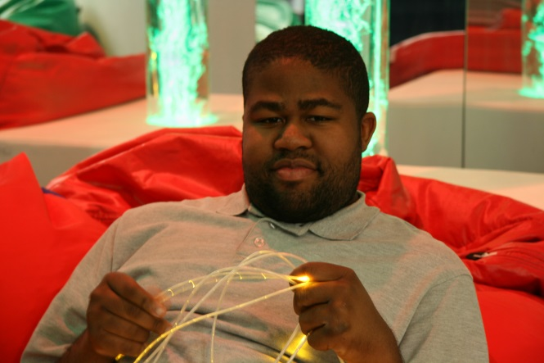

MHMR Tarrant
Our Core Values:
We CARE
We Connect People in Our Community.
We Provide Access to Services.
We Link People to Resources.
We Empower People.
Notes:
When you hear the term mental illness, what do you think of? Bring poster paper and write responses on the board

Slide 3

Understanding Mental Health and Taking Care of Yourself
Mental illness refers to a wide range of mental health conditions - disorders that affect your mood, thinking and behavior.

Slide 4
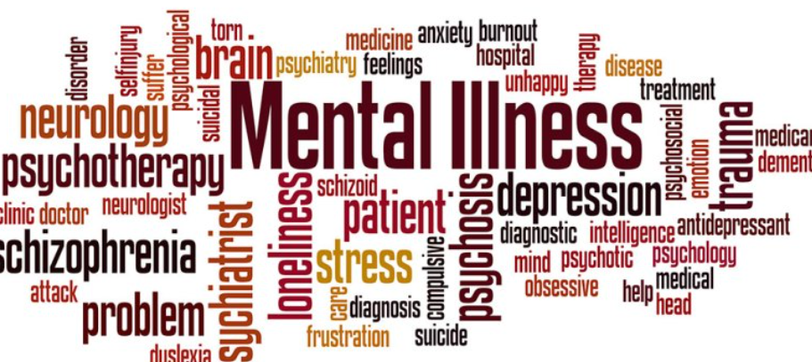
Is mental illness considered a disability?

Slide 5
“according to the World Health Organization, mental illness — that is, any mental disorder — accounts for more disability in developed countries than any other group of illnesses, including cancer and heart disease. Yet all we hear people talk about in the media time and time again is reducing your risk of these health problems. We rarely hear anyone talk about reducing your risk of anxiety or depression”

Slide 6
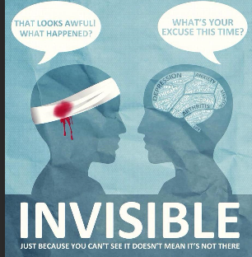

Slide 7

Understanding Mental Illness
Stigma of Mental Illness

Slide 8
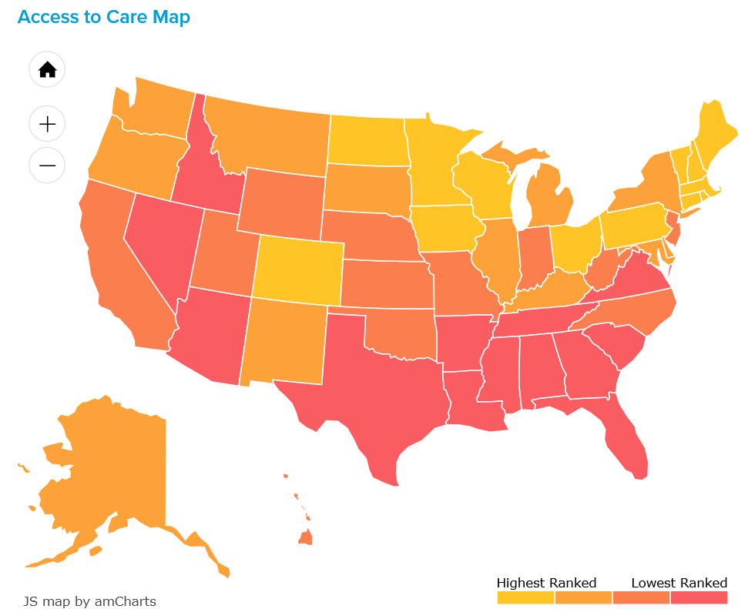

Slide 9
Statistics of Mental Illness
CDC an estimated 25 percent of adults in the U.S. reported having a mental illness in the previous year.
Two-thirds of people in nursing homes have a mental illness.
4.13% are experiencing a severe mental health illness.
Suicide is a major national public health issue in the United States. In 2016, there were 44,965 recorded suicides.
The estimated number of adults with serious suicidal thoughts is over 9.8 million.
Veteran suicide rate is 26.1 per 100,000.

Slide 10
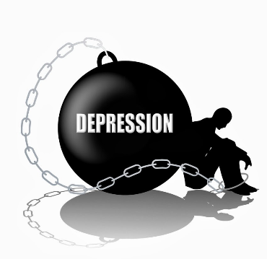
Depression
Sadness
Inactivity
Difficulty in thinking and Concentration
Significant increase or decrease in Appetite and sleep
Feelings of dejection and hopelessness sometimes Suicidal tendencies
Crying/irritability

Slide 11

Bipolar
Manic phase is characterized by:
Extreme happiness and excitement
Irritability, anger, and hostile behavior
Restlessness
Rapid speech
Poor concentration and judgment
Increased energy
Less need for sleep
Unusually high sex drive
Setting unrealistic goals

Slide 12

Anxiety
Feeling nervous, restless or tense
Having a sense of impending danger, panic or doom
Trouble concentrating or thinking
Having trouble sleeping
Experiencing gastrointestinal (GI) problems
Having difficulty controlling worry
Having the urge to avoid things that trigger anxiety

Slide 13

Schizophrenia
Delusions
Hallucinations and illusions
Lack of emotional expression
Disordered thinking
Inappropriate reactions
Notes:
Auditory exercise

Slide 14

Addiction
Inability to consistently Abstain
Impairment in Behavioral control
Craving; or increased “hunger” for drugs or rewarding experiences
Diminished recognition of significant problems with one’s behaviors and interpersonal relationships; and

Slide 15
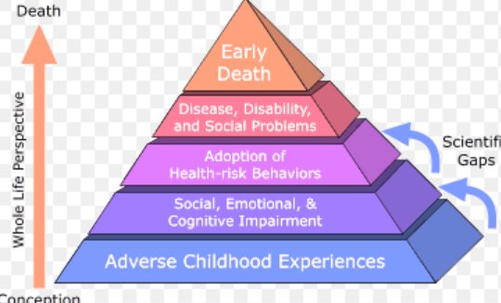
Adverse Childhood Experience Study (ACE)

Slide 16
ACE Study
Bipolar disorder
Addiction disorders
Trauma
Depression disorders
Anxiety disorders
Personality disorders
Psychotic disorder

Slide 17
Understanding Mental Illness
Mental illness refers to a wide range of mental health conditions - disorders that affect your mood, thinking and behavior.

Slide 18
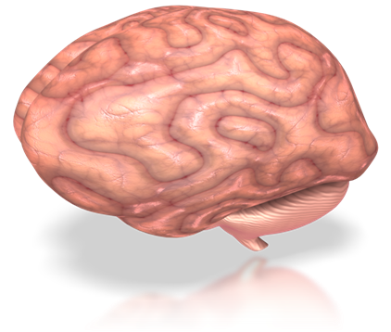
Touchstone Events
Event
Images
Emotions
Body Sensations
Negative cognitions

Slide 19
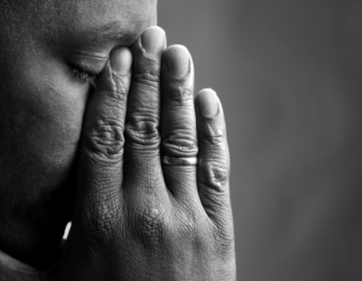
“Trauma is wounding.
Wounds need care and time to heal.
A little common sense and human connection go a long way in helping wounded people heal.”
- Jamie Marich

Slide 20

Physical Wounds and Scars
They come in all shapes and sizes
Open wounds are usually visible to others (lacerations, tears, abrasions, punctures)
Closed wounds are usually not obvious to others (contusions, bruises, tumors, slowly forming chronic wounds such as from diabetic ulcers)

Slide 21
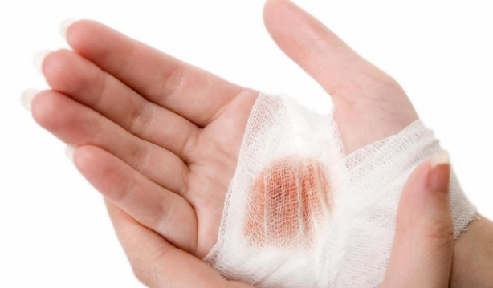
Physical Wounds and Scars
Before wounds can begin internal healing, steps must be taken to stop bleeding (bandages, gauze, stitches, sutures)
Failure to receive the proper treatment after wounding can complicate the healing process
They can leave scars (some wounds no longer hurt after scaring but some can cause ongoing irritation)

Slide 22

Emotional Wounds
Emotional wounds come in all sizes
The healing process is different from everyone
If the right conditions for healing do not take place, it will take longer to heal and in the meantime other symptoms emerge
If people prod the wound with insensitive comments, re-traumatizing occurs

Slide 23

Helpful Things to Say
Always believe the person
people need to be heard and understood
Remain Calm and Nonjudgement
avoid reacting in angry or defensive ways
provide support, listening, and reassurance
Instill hope
establish connection
Ask open-ended questions allow the person to express themselves
Don’t criticize
Share helpful resources and information

Slide 24
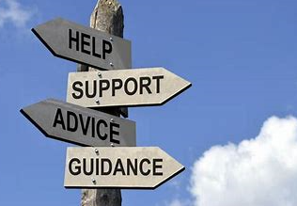
Types of Mental Health Providers and Resources
Licensed therapist
LPC, LCSW, LMFT, PhD
Peer Support Specialist
Medical providers
MD, APNs
Behavioral Health Treatment Centers
NAMI

Slide 25
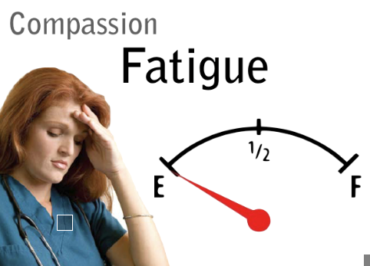
Definition of Compassion Fatigue
What is Compassion Fatigue?
How does it happen?
Why Does it happen?

Slide 26

Definition of Compassion Fatigue
The deep physical, emotional, and spiritual exhaustion accompanied by acute emotional pain.

Slide 27
Contributing Factors:
Secondary Traumatic Stress
Vicarious Trauma
Notes:
Compassion Fatigue in the service industry is contributed by Secondary Traumatic Stress and vicarious trauma
You may hear secondary traumatic stress and vicarious trauma used interchangeably

Slide 28

Contributing Factors:
Secondary Traumatic Stress
Natural and consequential behaviors and emotions resulting from knowing about a traumatic event and stress from helping or wanting to help a suffering person.

Slide 29
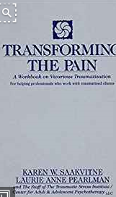
Contributing Factors:
Vicarious Trauma
A process of cognitive change resulting from chronic empathic engagement with trauma services

Slide 30

0
Secondary PTSD & Vicarious Traumatization
Cognitive Changes
Behavioral Changes
  Changes in sense of self
  Changes in worldview
    Safety
    Trust
    Control
  Changes in spiritual beliefs
  Avoidance Behaviors
  Social Withdrawal
  “Acting out”
  Changes in daily routines

Slide 31
Prevention of Compassion Fatigue
What are some Personal Strategies?
Know that is it okay to put yourself first sometimes
Attending to your own health
Get regular physical activity
Participate in non-work related interests
Engage in person debriefing and consultation
Spiritual wellbeing
Personal psychotherapy
Set effective boundaries personally and professionally
Notes:
Group Activity: Put up poster paper and ask group to take turn writing answering with markers provided

Slide 32

Mindfulness
  Mindfulness is the non-judgmental focus on emotions, thoughts, and sensations in the present moment
  Practicing mindfulness:
  Reduces fatigue, symptoms of illness and improves mental functioning
  Helps you focus more on work, take less sick time and feel happier

Slide 33

Practicing Mindfulness
Ways to practice mindfulness include:
  Walking
  Meditation
  Yoga
  Breathing exercises
Notes:
https://www.calm.com/session/cXBQRAMvFV
-complete 5 minute body scan on Calm
-ask participants for feedback, possibly set up by having participants write down the first 3 things that are causing them stress, then ask them afterwards if there is any difference
Or
-ask participants if they feel any different after the meditation
Having the lights dimmed and invite participants to close their eyes if they feel comfortable

Slide 34
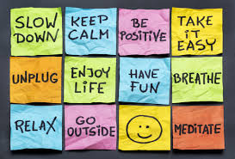
Self-Care Strategies
Aerobic Activities
Relational Activities
Play
Creativity
Spiritual Activities
Health Care
Sleep
Notes:
Group Activity:
Have everyone write down one good thing that happened to them so far today and include how it made you feel. Get index cards and have them go around the room sharing their index cards
Have participates share what sandtray figure they picked and the reason why

Slide 35
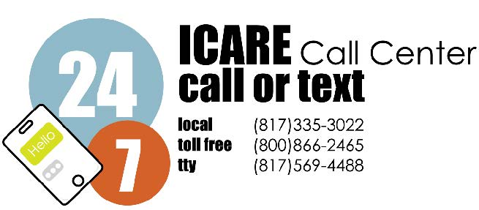
My Health My Resources of Tarrant County
For more information on any of our services, please visit:
www.MHMRtarrant.org
Facebook.com/MHMRtarrant

Slide 36
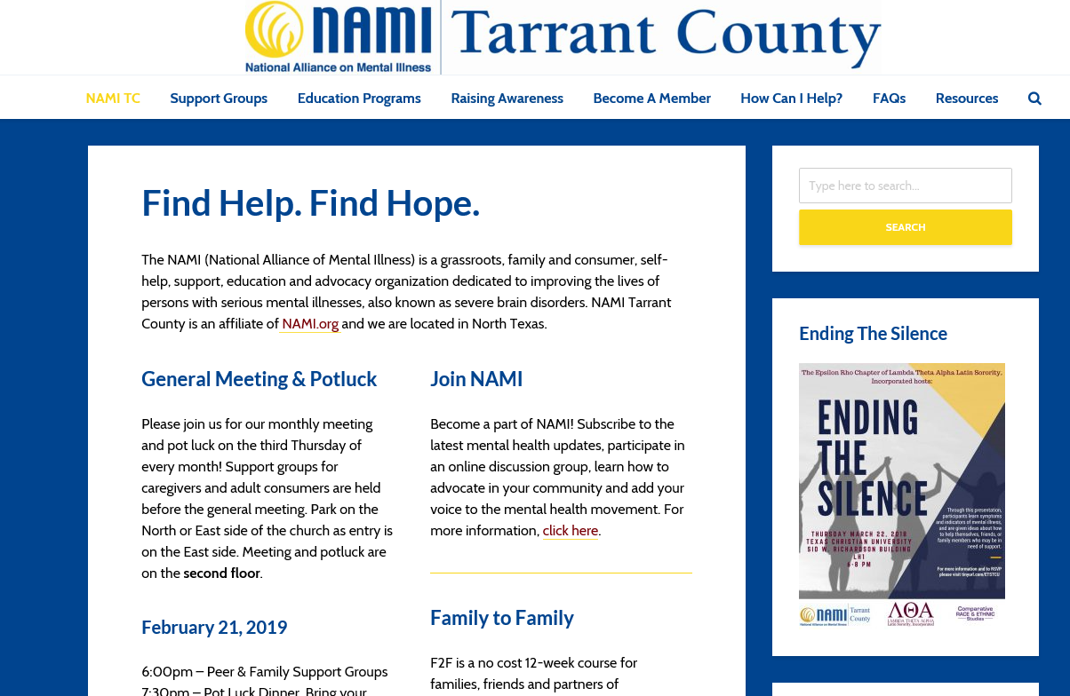
Resources
NAMI Tarrant County, 817-332-6677,
http://namitarrant.org/

Slide 37

Questions

