Slide 1

Welcome to Texas
National Energy & Utility Affordability Coalition Conference
Utility Affordability Roundup
Notes:
Good Morning & Welcome to the 2019 NEUAC Annual Conference – Utility Affordability Roundup!
This year’s theme is appropriate for Fort Worth’s long history of cattle drives…the city’s actually known as “Cowtown” which ties back to the late 19th century, when Fort Worth became an important trading post for cowboys moving their cattle up the Chisholm Trail to railheads in Kansas.
And, as important as the cattle drives and roundups are to Ft Worth’s history, Utility Affordability is important to all of us and that is why we are here attending this year’s conference.

Slide 2

Big state, consumption & competition
Texas energy market
Texas is the world’s 11th largest electricity market with
376 Billion MWhs
of energy consumption annually.
* ERCOT Fact Sheet
Notes:
To level set you on the Texas market, I thought that I’d share a few tidbits about Texas and its electric market.
Texas has electricity consumption of $24 billion a year, the highest among the U.S. states and comparable to that of Great Britain and Spain.
And, if Texas was an independent nation, its electricity market would be the 11th largest in the world. It also bears note that despite its reputation for fossil fuel production, Texas actually produces the most wind electricity in the U.S..^{[4]}
So you see, Texas can be a country into itself. ☺

Slide 3

Most active market in the U.S.
Texas energy market
376 billion MWhs consumed in 2018 *
More than 97%
of customers have AMS meters
Over
90%
have made a choice of provider or plan
Ranked 11th globally
in terms of consumption
1,000 / day
added to Texas population
Over 25 million
customer within ERCOT
3.6 million moves/switches per year
60+ Competitors
Nearly 300 plans
in each zip code
* ERCOT Fact Sheet
Notes:
Texas is also home to the most dynamic retail electricity market in the nation
Let me call out a couple factoids worth noting:
Thera are over 60 competitors active in Texas
There are nearly 300 plan options available to customers in each ERCOT zip code, many of which allow customers to tailor their plan selection to their usage profile
Over 90% of customers have made at least one choice of provider or plan
Nearly 4M times / year, the market see customers either moving into a new premise, or switching providers at a premise
So, in sum, Texas features a highly competitive and innovative market…which has been embraced by retail customers

Slide 4
Company overview
an Integrated power company
Notes:
Now I’d like to briefly introduce Vistra Energy for those who may not be familiar with us – we’re an integrated power company comprised of leading generation and retail business are we’re based in Irving, TX
Serve 2.9 million residential customers in five top retail states;
Serve ~240,000 commercial and industrial retail customers.
Employ ~5,400 people across 12 states.
Own ~40,000 megawatts of installed generation capacity.
Those are some of the headlines, not let me talk a little about some of the innovation that we’re bringing to market in the generation space, and the leading retail businesses we have

Slide 5

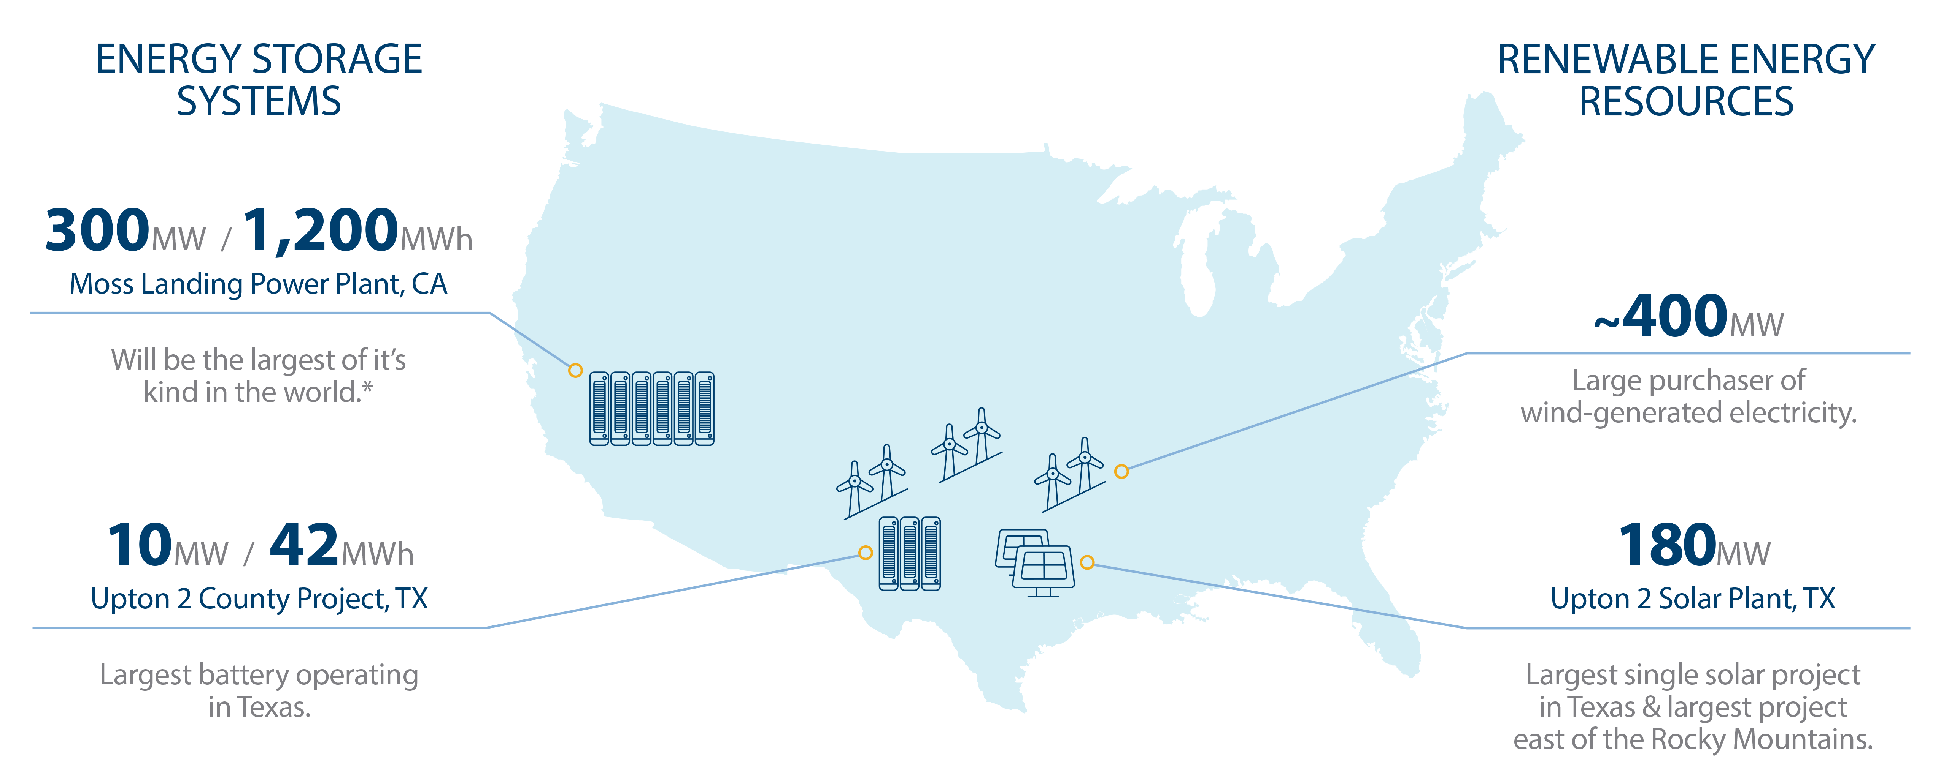
Innovative Investments
Company overview
*Estimated completion in 2020. **Completed & operational by 12/31/18. REV 012219
Notes:
Innovative Investments
Vistra is leading the way with an extensive and growing portfolio of renewable energy resources and energy storage systems through, Luminant, our power generation and development company.
The two basic facts of nature that challenge Renewable Energy, is that the sun sets and the wind stops blowing. Unlike coal and fossil fuels, renewable energy hasn’t been physically stored, meaning that wind and solar power is wasted if not used immediately. Batteries address this gap. Grid-grade batteries can capture and store attained sun and wind power until it is needed in the market. Addressing this challenge ensures a more reliable market and lower prices for everyone. Some examples of each:
Renewable Energy:
WIND:
Luminant is a large purchaser of wind-generated electricity…~400MW, which is sufficient capacity to power >100K average homes during normal weather conditions.
SOLAR:
Our Upton 2 Solar Power Plant achieved commercial operations in 2018. At 180 MW capacity, it is Texas’ largest operating solar facility. It consists of almost 720K photovoltaic solar panels on nearly 1,900 acres,
or roughly equivalent to 1,424 football fields.
Energy Storage Systems:
MOSS LANDING PROJECT:
Luminant is becoming the industry leader in grid-scale battery storage, developing the world’s largest energy storage project – a 300 MW battery project at the Moss Landing Power Plant site in California, slated for completion in 2020. Currently, the largest operating battery facility in the world is 100MW (ours is 3 times larger!)
UPTON 2 PROJECT:
Luminant’s Upton 2 battery storage system project completed construction and began operating late last year. This is the largest energy storage project in Texas and 7th largest in the US, and is located on the site of Luminant’s Upton 2 Solar Power Plant in Upton County, Texas. This energy storage system captures excess solar energy produced during the day and can release the power in late afternoon and early evening, when energy demand in ERCOT is highest.
Now, as to our Retail businesses…

Slide 6
retail Portfolio
Company overview
Notes:
Retail Customers / Portfolio
Our retail businesses include TXU Energy, Homefield Energy, Dynegy, and Brighten Energy, allowing us to compete in five top retail states and serve the residential, small and medium business and large commercial and industrial business segments
Today, TXU Energy continues to be the largest of the retail brands with more than 1.7 million customers; our Dynegy brand is well-known in PA, OH, IL MA, Brighten Energy serves customers in PA, OH, IL and Homefield is a recognized brand in Illinois. In total, we serve nearly 3M customers.
Core to our business philosophy and the success that we’ve enjoyed to date has been our innovative, customer-centric approach to retail. Let me talk a bit more about what this means at TXU Energy…and to the mission that we share to support customers in need

Slide 7



COMMITMENT TO CUSTOMERS
TXU Energy Aid
Working with ~80 social service partners across Texas to help families in times of crisis,
by keeping their homes powered and safe.
Notes:
One of TXU Energy’s brand platforms is caring for our customers.
In this spirit, TXU Energy created the TXU Energy Aid program 35 years ago and, since then, this program has provided more than $100 million in bill payment assistance to over 540,000 Texans.
TXU Energy Aid helps customers who are in crisis situations that are not necessarily classified as “low-income” and is funded by TXU Energy’s annual commitment of $4 million as well as employee and customer donations.
One of the keys to success with this program is our 80+ community partners across Texas that help customers with electricity bill payment assistance along with their other needs.
Our dedication to customers is evident through several initiatives: low-income program advocacy, community/agency partner engagement, our hands-on dedicated Energy Assistance Team and our capstone TXU Energy Aid program.
As the company expands in the U. S. we are evaluating how we continue this commitment to help our customers in crisis situations. And, there is indeed a substantial need here…

Slide 8

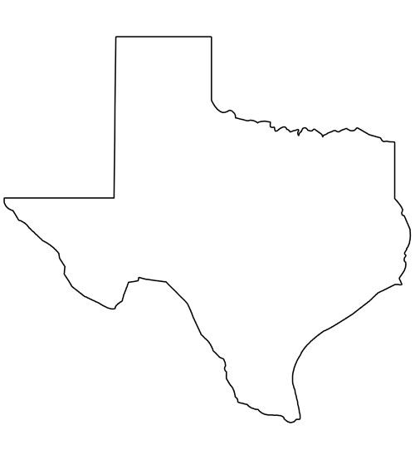
Poverty in the United states
Poverty
Of the 3 Million
in Mississippi
571K
19.8%
live in poverty.
29 Million Texans
4.3 Million
14.7%
live in poverty
Of the 1.3 Million
in New Hampshire
100K
7.7%
live in poverty.
Notes:
We are all here at this conference to learn more about poverty and the programs that impact low income/at-risk consumers. Unfortunately, the need is real for thousands of families in America.
In Texas, with a population of 29M people, over 4M live in poverty: 14.7%. These numbers are staggering.
You can see how that compares to Mississippi with the highest poverty rate and New Hampshire with the lowest.
The national average of poverty is 12.3% and, as you can see, Texas is above the national average.
At TXU Energy, we understand how important it is for every family to have access to basic everyday needs like electricity. We remain focused on working with the communities we serve to make them better places to work and raise a family, and that includes finding ways to also help our neediest and most vulnerable populations.
In a nutshell, that is why the work of NEUAC is so important to us!

Slide 9
Low income home energy assistance program Funding
poverty
In 2019 LIHEAP is funded at
$3.65 Billion
helping about 17 Million Americans
17% of those that qualify.
In Texas, LIHEAP is funded at
$161 Million
helping about 150 Thousand Texans
5% of those that qualify.
Notes:
To this point, we’ve partnered with NEUAC and its predecessor organizations for >10 years to advocate for the needs of low-income/at-risk consumers. This year, we joined many of you for the Low Income Home Energy Assistance Program…or “LIHEAP” Action Day to tell the story of our customers and how important this funding is to them.
Simply put, LIHEAP helps reduce the burden of energy costs for ~17 million Americans.
In 2019, LIHEAP is funded at $3.65B and the national average is that only 17% of those that are eligible qualify receive assistance. Of those funds, Texas received $161M and while we are grateful for that support, it only assists 5% of those that qualify. So, as you can see, there is still opportunity to make a difference; we have a lot of work to do.
At TXU Energy we provide several tools to help our customers and agency partners. These run the gamut of account alerts, outbound calls and emails to customers to raise awareness of LIHEAP funding, working closely with 2-1-1 partners, providing customers links to apply for assistance and an Energy Assistance web portal where agencies have everything at their finger tips to help their clients, our customers.
Like you, we will continue to work hard and advocate for those we serve.

Slide 10
Enjoy Fort Worth &
Have a Great Conference
Notes:
With that…thank you for your time and attention, and the opportunity to briefly speak about TXU Energy – a company that I am so proud to be a part of
I hope everyone can take away valuable learnings from this year’s conference, meet some new colleagues, and enjoy the culture of Fort Worth, Texas!
Thank you.

