Slide 1
Reaching the Unreachable:
Serving Individuals and families
with Challenging Circumstances
Presented by: Karen Dunn CSBG Program Manager
State of Washington
June 4, 2019

Slide 2
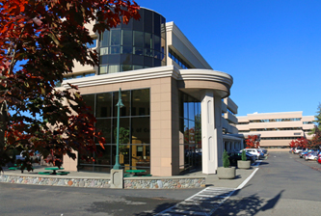
Washington State Department of Commerce
We strengthen communities…..
LIHEAP
Weatherization
CSBG
Offender Re-entry Program
Community Safety /
Crime Victims
Housing /
Community
Services
Community
Facilities
Infrastructure
Planning
Business
Assistance

Slide 3
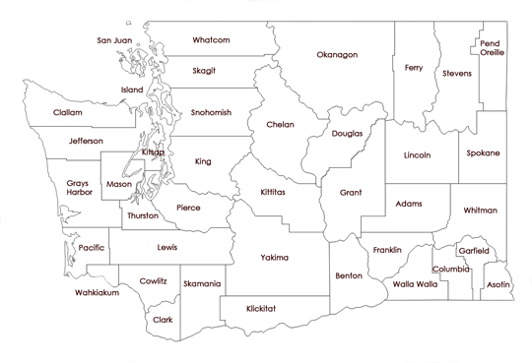
Washington State Counties
39 Counties
Population 7.66 M
Seattle
Spokane

Slide 4
Community Action in WA State
30 CSBG Eligible Entities
4 Public Agencies (Includes one Limited Purpose Agency/Seattle Conservation Corp.)
26 Non-Profit Agencies (Includes one Federally designated Farmworker Clinic/provides one of Washington’s larger low-income weatherization programs)
5 Tribes receive direct federal funding (not administered by State)
16 Agencies located in Urban areas
14 Agencies located in Rural areas
Washington State awards both State and Federal CSBG funds

Slide 5
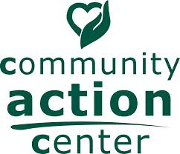
Rural CAA’s Washington State
Notes:
In Washington, we have 14 community action agencies that are located in “rural” areas, however many of the “urban” agencies serve clients that are located in what would otherwise be considered rural areas. An example of this would be The Opportunity Council is located along the I-5 corridor in Bellingham, however they also serve clients living in Island County which are remotely accessible only by boat or seaplane.

Slide 6
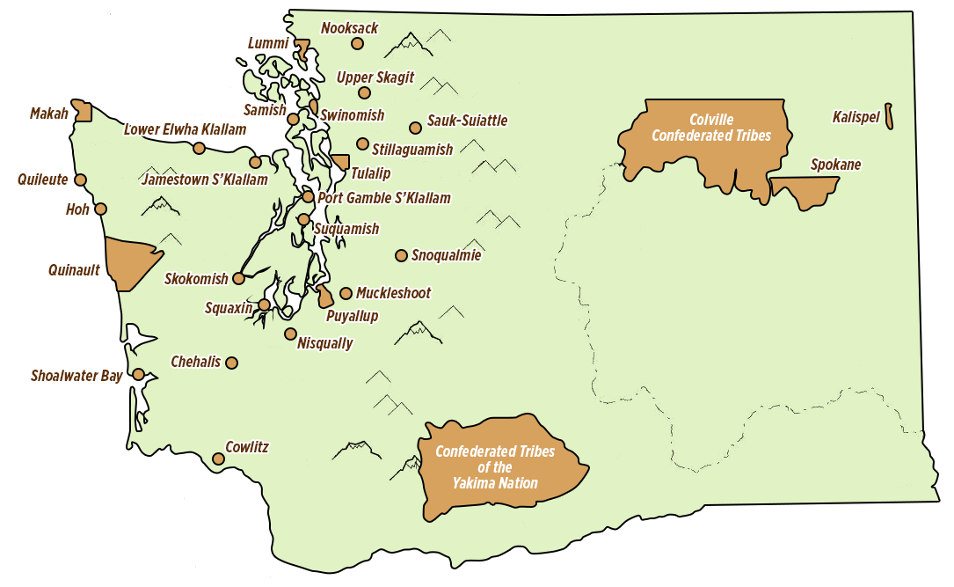
Native American Tribes in WA
29 Federally Designated Tribes in WA State
Notes:
29 Federally Designated Tribes in WA State

Slide 7
Reaching the Unreachable -
Sometimes the “Unreachable” are not only our clients

Slide 8
Making the Connections-
In late 2017 the State CSBG office was contacted by representatives of the WA State Supreme, District, and Municipal Court Systems. Their ask was for CSBG staff to provide statewide, regional Poverty Simulation events for court staff, leadership, elected officials, supreme court justices, prosecuting attorneys, court clerks.

Slide 9
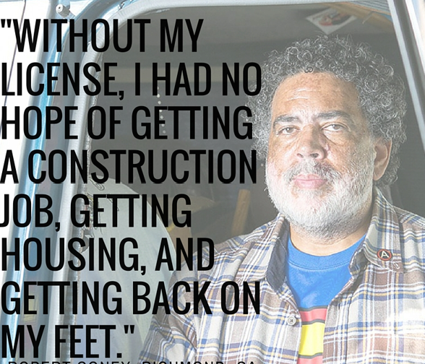
Making the Connections….
State CSBG staff provided numerous Poverty Simulation Events over the course of several months. We required that for all events, at least one community action agency would be included in the simulation so the participants could make connections with court staff and learn about services available to defendants within their court system (mostly due to unrealistic fines).

Slide 10
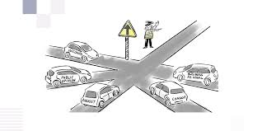
Making the Connections….
Biggest Discovery: Lack of known resources.
Best Takeaway: Connecting and referral of defendants to their local community action agency when they are struggling to pay off fines or having difficulty meeting court requirements.
Notes:
e

Slide 11
Reaching the Unreachable –
Challenges
beyond
physical
barriers….

Slide 12
Olympic Community
Action Programs
Agency Services:
Food Bank Distribution, Senior and Veteran Programs, Emergency Services, Head Start, RSVP, Weatherization, Energy Assistance, and Housing Assistance.
Location/Service Area: Two counties (Clallam and Jefferson). Service area largely rural geographic location of 4,900 acres.
Demographics: High number of veterans and an increasingly “graying” population. Senior population = 27.6%, double the statewide average of 12.7%. 19% of the population = Native American/Alaskan Native residents
Notes:
I was fortunate enough to participate one day in the Encore Program during a CSBG monitor visit to OLYCap. I often see youth programs and the benefits of these to the community but visiting with these precious individuals that day was truly something very special. These lovely people had light in their eyes, they connected with each other and the therapists in the room all because of music.
The photo on top shows one of the music therapists working with participants while they were singing and drumming.
The middle photo is the facility where the program is operated in Port Angeles.
The bottom two photos are of a delightful lady named Miriam who turned 99 years young this year. When she first joined the program Miriam was waiting for an available bed in a Nursing home. She wasn’t able to communicate in any way, did not recognize any family or friends, and lacked physical function.
I am happy to report that Miriam now requests the Tennessee Waltz by name and artist and sometimes even dances. She is a delight and truly a remarkable person who lives at home with her daughter and family. She eats on her own and if you as ask, her favorite actor is STILL Tom Selleck! All because of music therapy.

Slide 13
Olympic Community
Action Programs
Demographics:
High number of veterans and an increasingly “graying” population. Senior population = 27.6%, double the statewide average of 12.7%.
Native American/Alaskan Native residents comprised 19% of area population. Many tribal members did not live in close proximity to tribal service locations.
Agency Challenge:
Increased number of senior clients with vulnerability to health and socialization issues.
Families needing assistance with caregiving and relief care for elderly loved ones.
Notes:
I was fortunate enough to participate one day in the Encore Program during a CSBG monitor visit to OLYCap. I often see youth programs and the benefits of these to the community but visiting with these precious individuals that day was truly something very special. These lovely people had light in their eyes, they connected with each other and the therapists in the room all because of music.
The photo on top shows one of the music therapists working with participants while they were singing and drumming.
The middle photo is the facility where the program is operated in Port Angeles.
The bottom two photos are of a delightful lady named Miriam who turned 99 years young this year. When she first joined the program Miriam was waiting for an available bed in a Nursing home. She wasn’t able to communicate in any way, did not recognize any family or friends, and lacked physical function.
I am happy to report that Miriam now requests the Tennessee Waltz by name and artist and sometimes even dances. She is a delight and truly a remarkable person who lives at home with her daughter and family. She eats on her own and if you as ask, her favorite actor is STILL Tom Selleck! All because of music therapy.

Slide 14
Music Therapy is the clinical and evidence-based use of music interventions to accomplish individualized goals for individuals challenged with memory loss and developmental disabilities.
Activities include singing exercises for vocal abilities, music-movement for cognitive flexibility, memory wellness program, and musical mnemonics to enhance verbal memory.
WA State now has 50 nationally board certified music therapists, working in ten counties.

Slide 15
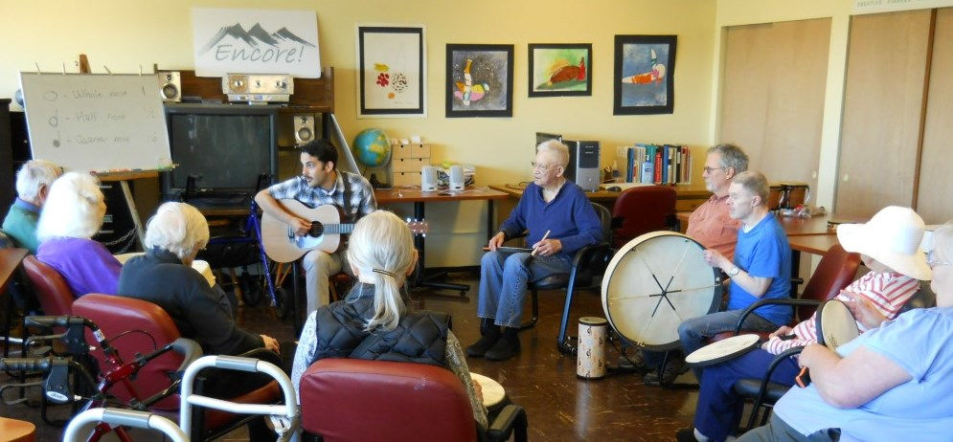
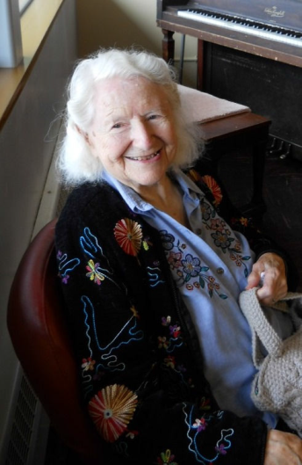
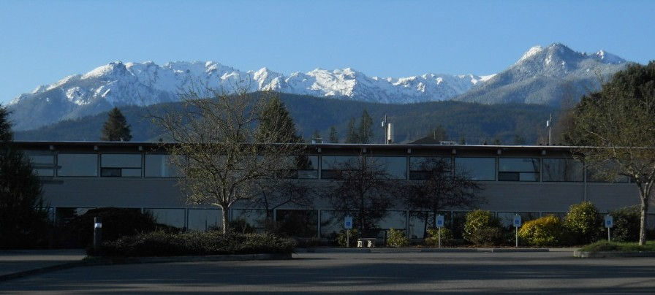
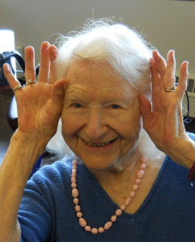
Encore! participants enjoy daily rhythmic exercises; requests (by title and artist) and sing favorite songs from memory; socialize with refreshments; participate in eye/hand coordination exercises; and work on brain fitness.
Photo of Encore! Program Facility in Port Angeles, WA
Happy 99th Birthday, Miriam! You are an inspiration to us all. We sang “I Could Have Danced All Night” (her favorite) all week.
Notes:
I was fortunate enough to participate one day in the Encore Program during a CSBG monitor visit to OLYCap. I often see youth programs and the benefits of these to the community but visiting with these precious individuals that day was truly something very special. These lovely people had light in their eyes, they connected with each other and the therapists in the room all because of music.
The photo on top shows one of the music therapists working with participants while they were singing and drumming.
The middle photo is the facility where the program is operated in Port Angeles.
The bottom two photos are of a delightful lady named Miriam who turned 99 years young this year. When she first joined the program Miriam was waiting for an available bed in a Nursing home. She wasn’t able to communicate in any way, did not recognize any family or friends, and lacked physical function.
I am happy to report that Miriam now requests the Tennessee Waltz by name and artist and sometimes even dances. She is a delight and truly a remarkable person who lives at home with her daughter and family. She eats on her own and if you as ask, her favorite actor is STILL Tom Selleck! All because of music therapy.

Slide 16
Reaching the Unreachable –
Physical Barriers &
Program Challenges

Slide 17
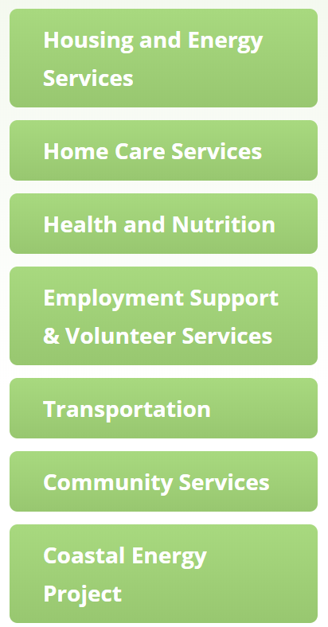
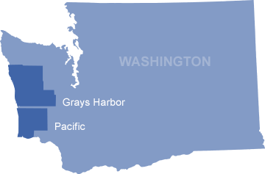
Notes:
Coastal Community Action is located in Aberdeen WA, which serves two counties along the pacific coast of Washington.
Primarily logging industry, now the highest unemployment in state of WA.

Slide 18
Representative Payee Program
Agency Challenges:
Serving large geographic area – two Washington counties, plus NW Oregon.
Staff time & resources to prepare, process, hand out 100 checks, twice per month
Client Challenges:
Homeless clients (checks often lost/stolen)
Lack of Identification (check cashing difficult / high cashing fees)
Public Transportation unavailable in all service areas
Weather issues (travel difficult)
Notes:
Representative Payee service works with individuals who receive Social Security, veterans’ benefits or pensions and who find themselves unable to manage their finances.
A representative payee manages your funds for you. The beneficiary and representative payee work to determine the financial needs and create a budget that works the individual. Having a family member or friend as your payee may work for some, but if personal conflict or disagreement should arise, often finances could be at risk. Having a representative payee will make sure the bills are paid in a timely manner.
Approx 100 clients served
A representative payee manages benefit payments for Social Security or Supplemental Security Income recipients who are incapable managing their benefits.
Representative Payee organizations use the funds issued on behalf of recipients to ensure the current and future needs of the beneficiary are met and in their best interests.
Payee representatives go beyond just managing payments and be actively involved in the beneficiary’s life. The following lists the required duties of a payee.
Representative Payee Clients receive small stipend amounts
Cost of time and resources to agency for program

Slide 19
Agency Benefits:
Individual Debit Cards to Payee Clients – no paper checks required
Program Staff time & resources reduced by 80 %
Significant increase in program enrollment (2016 = 100/2018 = 575)
Increase in service area coverage: now serving five counties plus three counties in NW Oregon.
95% of client payees use debit cards / 5% receive checks due to physical and/or developmental challenges using debit cards.
Case Managers have ability to view card transactions. This helps with financial education and coaching if needed.
Notes:
Coastal Community Action – Serves Grays Harbor & Pacific Counties in WA State
Grays Harbor County 73,000 population/ 16% live in poverty / 2,000 sq. miles of service area
Pacific County 21,000 population / 18.6% live in poverty / 1,200 square miles of service area

Slide 20
Reaching the Unreachable –
What happens when you can’t move a mountain?

Slide 21
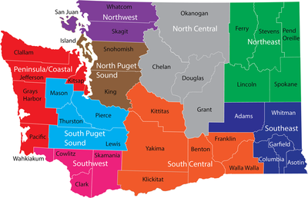
Rural Resources Community Action
Agency Services:
Child Abuse Assistance
Crime Victims Advocacy
Domestic Violence
Energy Assistance
Head Start & ECEAP
Housing Assistance
Employment Assistance
Senior Services
Sexual Assault
Transportation
Weatherization
Agency Demographics:
Rural communities serving over 4,600 square miles
Severe Weather Conditions
Lack of technology & Broadband
Low, qualified skilled work force availability
Staffs nine offices in 5 counties to provide client services.

Slide 22
Rural Resources Community Action
Issue:
LIHEAP services - clients are challenged to apply for benefits.
Some clients travel over 150 miles one way to access CAA office.
Transportation – limited routes
Lack of qualified, skilled Labor Force
Solution:
Opened up LIHEAP Intake (by phone) during evenings and Saturdays. Staff are available for phone intake during non-standard work hours.
Staff travel to various locations throughout service area to meet clients.

Slide 23
Questions ? ? ? ?

Slide 24
Presented by:
Karen Dunn Community Services Block Grant Program Manager (360) 725-2822 Karen.Dunn@commerce.wa.gov
www.commerce.wa.gov

