Slide 1
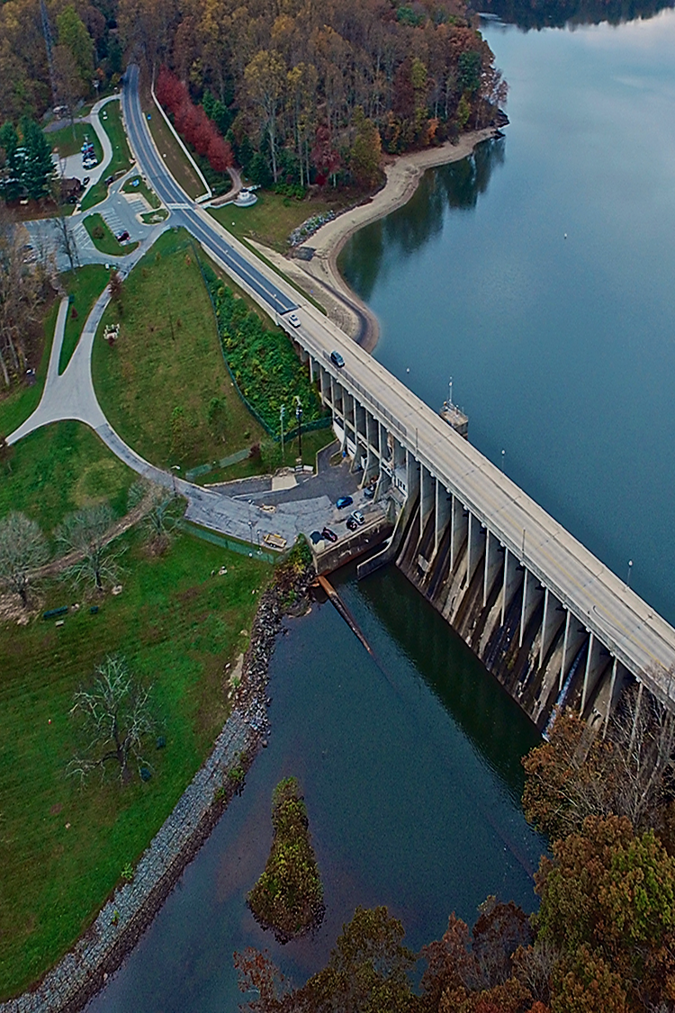
ADDRESSING AFFORDABILITY IN THE WATER SECTOR
Emerging Policies and Practices

Slide 2
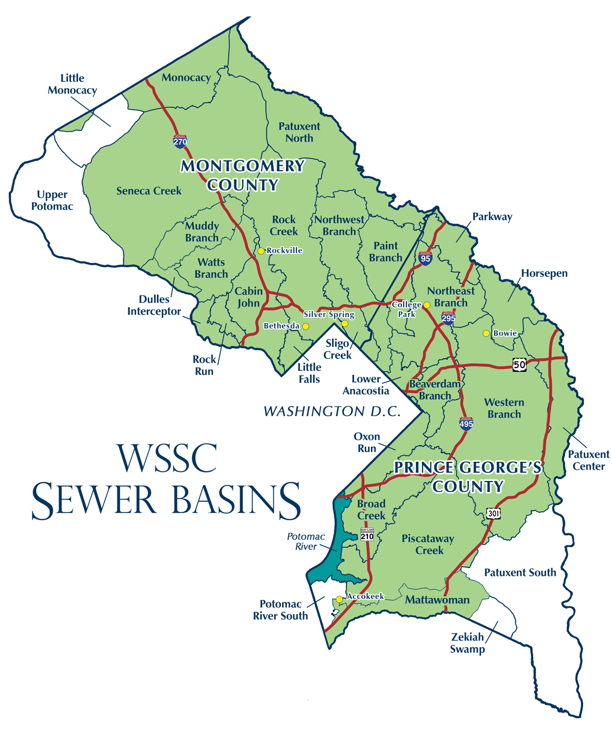
About WSSC
101-years old: NEVER had a drinking water quality violation. . . EVER
Service area = 1,000 square mile area in Prince George’s County and Montgomery County, Maryland
Largest water utility in Maryland
1700+ #H2O People!

Slide 3
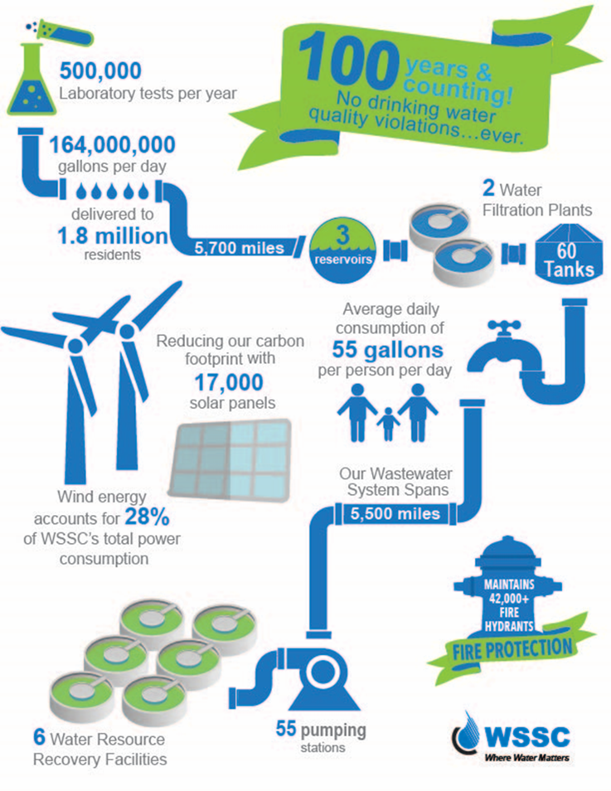
Size and Scope
FY 2020 Annual Budget:
$1.5 Billion
  $817M Operating
  $638M Capital
For every $1 invested, the ROI is:
  Capital Budget: $2.30
  Operating: $1.70
Bi-County agency created by the state
  Regulatory body

Slide 4

The Water Sector & Affordability
A Framework

Slide 5




#ThisOneDrop – WATER POLICY IS. . .
PUBLIC HEALTH POLICY
ENVIRONMENTAL POLICY
ECONOMIC POLICY
SOCIAL JUSTICE POLICY

Slide 6
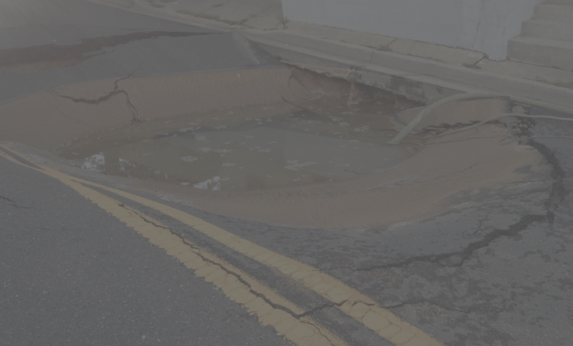



Sector Challenges: The “Triple A” Threat
Aging Infrastructure
Aging Workforce
Affordability

Slide 7
Affordability: A National View
EPA: Affordable water bills are 4.5% of household income
14 million households in jeopardy of not being able to pay their bill
Legislation comes close, but. . .
  Clean Water Act
  WRDA
  Low Income Assistance Act of 2018
Water Utilities left to manage with very little assistance

Slide 8
Maryland Affordability Legislation
2015: WSSC Customer Assistance Program
2017: Legislative Task Force on Tax Sales*
2018: All water utilities can develop and implement affordability programs
2018: Prince George’s County Master Meter Ban
2018: Pipeline Loan Program
2019: WSSC Indirect Customer Assistance program
2019: Water Taxpayer Protection Act of 2019 (Baltimore City)

Slide 9
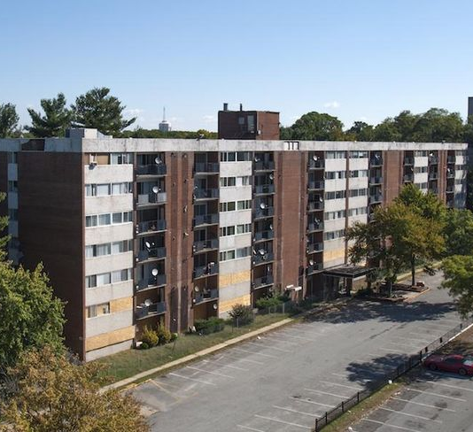
Banning Master Meters
2018: Prince George’s County banned master meters
Direct response to challenges with condominiums with low income population
Current studies in both counties to address housing affordability challenges centered

Slide 10
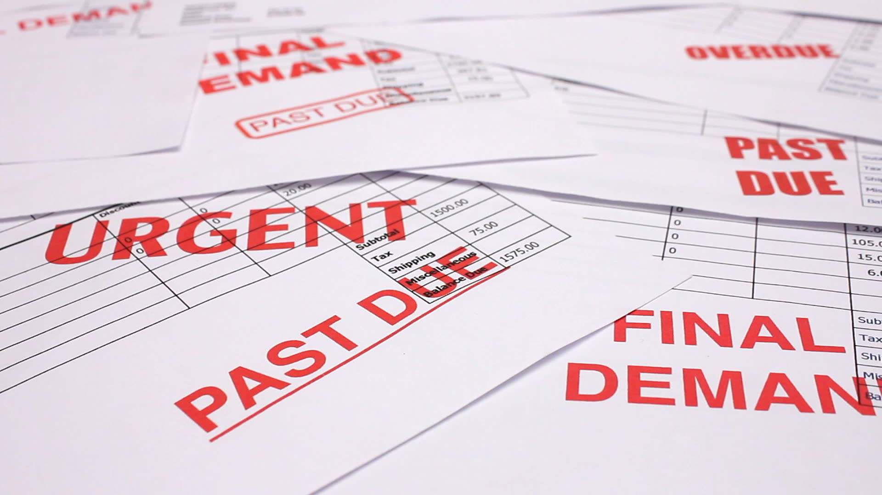
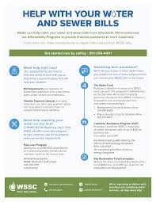
AFFORDABILITY IN ACTION
WSSC’s Commitment to
Water Access for All

Slide 11
WSSC’s Affordability Goals
Enhance assistance and billing/payment options
Improve annual fundraising and voluntary contributions
Reduce “total amount owed” by active residential customers
Adopt legislation to expand customer assistance programs

Slide 12
Affordability – Best Practices Model
Best Practice Affordability Program Model
Low-Income Bill Discounts
Arrearage Forgiveness
Financial Counseling
Strong Partnerships
Water Conservation Assistance
Flexible Payment Plans
Plumbing Repair Assistance
Aggressive Outreach & Marketing
Flexible Billing Options
Crisis Intervention Programs
Social Service referral
Robust Community Engagement
Notes:
Crystal: This slide represents the best practices framework used by Jay and Scott to evaluate our existing programs.
The practices include community engagement, arrearage forgiveness, social service referrals, flexible billing options, financial counseling, and water conservation.
The best practices are supported by a support system of communications performance monitoring, and technology.
Jay: This model was based on our review of programs in Portland (OR), Washington DC, Atlanta, Philadelphia, Chicago, Cleveland, and New York City and best practices described in various affordability publications including.
“Best Practices in Customer Payment Assistance Programs”, Joint Publication by EPA & Water Research Foundation, 2010.
”Drinking Water & Wastewater Utility Customer Assistance Programs”, EPA Publication, April 2016.
“Customer Assistance Programs for Multi-Family Residential and Other Hard-To-Reach Customers”, Water Research Foundation, 2017.
These represent the common elements that have been identified in some of the most comprehensive affordability programs. No utility has all of these best practice elements

Slide 13
Current Affordability Programs
Administrative
  Bill Payment Plans
  Payment Deferrals
  Adjustments for high-bills and leaks
Customer Assistance Program
Bay Restoration Fee Waiver
The Water Fund
Emergency Loan Program
Learn more: www.wsscwater.com/assistance

Slide 14
Customer Assistance Program (CAP)
Waives fixed-fees: up to $28/quarterly bill
  Also includes Bay Restoration Fee Exemption of $14/quarter
Current enrollees: 12,000
  Program cost of $990,000+ for FY2109
Partner with Maryland’s Office of Home Energy Programs to enroll customers
  Eligibility at 175% of federal poverty level

Slide 15

The Water Fund
Founded in 1994 by WSSC’s #H2O People (employees)
Total of $300/annually to eligible customers
Since inception, has awarded over $1.275 million to over 3,600 customers
Administered by The Salvation Army
“Round-Up” program

Slide 16
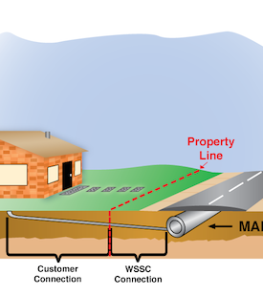
Emergency Pipeline Loan Program
$5,000 low-interest loan to repair an emergency break on the lateral
Annual investment of $100,000
Administered by the WSSC Federal Credit Union
Effective July 1, 2019 (based on legislation from 2018)

Slide 17
Expanding Assistance
Indirect Customer Assistance Program
Expanding eligibility for CAP
Increasing Water Fund assistance
Leakage adjustment for CAP customers
Water Conservation assistance
Extended payment arrangements

Slide 18
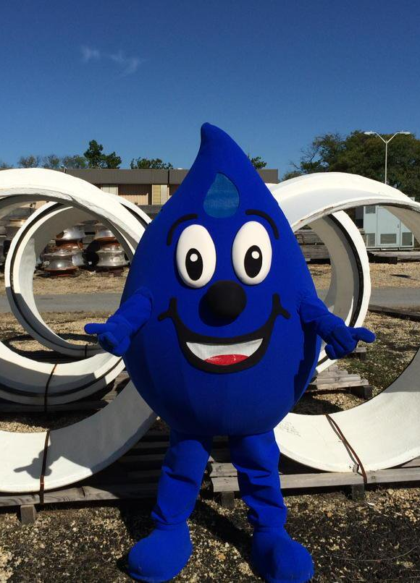
Thank you!
Karyn.Riley@wsscwater.com
Tweet me: @KR_H2O
Tweet WSSC: @WSSCWaterNews
LinkedIn: /karynriley

