Slide 1
Help the Customer Help Your Bottom Line
Kathleen Kerr
Director- Utilities AHA
June 2019

Slide 2
About AHA We make NJ a better place for all to live
Started in 1991 in Monmouth County to address overwhelming need for quality affordable housing in Monmouth County
Over 75 employees plus volunteer staff and community partners
The Alliance is a community catalyst that provides housing and related relief to all who need it, giving every NJ resident the opportunity to live a better life
Manage affordable rental properties
Offer rental assistance
Housing Counseling and First time Buyer programs
Mortgage counseling and foreclosure intervention
Financial Capability training
Housing Resource Recovery Center (Sandy Assistance)
Utility Assistance – LIHEAP, PAGE, Utility Programs
Homeless prevention
Summer STEAM camp and Mathnasium
Transportation program

Slide 3
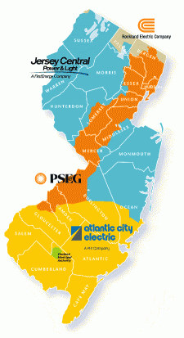
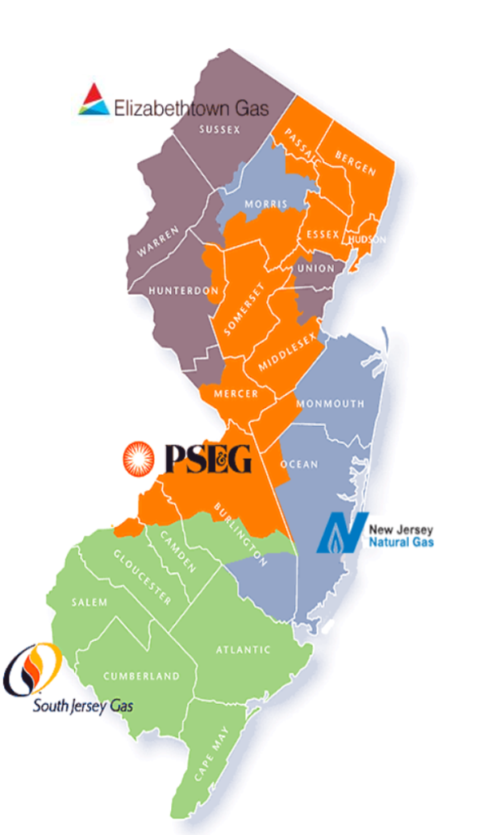
One state – 7 Utilities

Slide 4
Win-Win of Energy Assistance
Conservation = lower bills
Energy Efficiency = lower bills
Comfort Partners/Weatherization
Lower bills = more affordable
Energy Assistance reduces Utility Accounts Receivable
Communication! Communication!
Offering customers options such as equal payment plan
Power of persuasion
Payment
options
Help through
Energy Assistance

Slide 5
Partnership : Utilities and Non Profit
AHA encourages clients to communicate with the Utility Companies
Utility Companies refer customers to AHA (and other agencies) for assistance
Partnership on Marketing Promotion efforts
Email campaigns
Call campaigns
Postcard mailers
Partnership at Outreach events in the communities
Energy Assistance Days
Energy Summits with multiple agencies

Slide 6
AHA Utility Assistance
Universal Service Fund (NJ % income plan)
Low Income Home Energy Assistance (LIHEAP)
Payment Assistance for Gas and Electric (PAGE)
NJ Unclaimed Utility Deposits Trust Fund
NJ Natural Gas Gift of Warmth
Atlantic City Electric Helping Hands

Slide 7
PAGE - Program Overview
Low to moderate income families
One time, annual assistance
Eligible to receive up to $750, per utility
Must be past due, received disconnection notice, or already disconnected
Must have good faith payment(s)
Must not be receiving USF benefits
Must not currently be applying or receiving or have received any benefit through the HEA programs within the current heating season

Slide 8
AHA EXPERIENCE – UTILITY ASSISTANCE
AHA takes pride in the integrity of our process and we have been
administering Energy Assistance Grants successfully since 2011
We have processed at least 6,000 applications annually
Have distributed between $2.5 million and $4 million every year
Average Grant Award Quarter 1 2019:
Electricity $596
Natural Gas $557
Natural Gas and Electricity $963

Slide 9
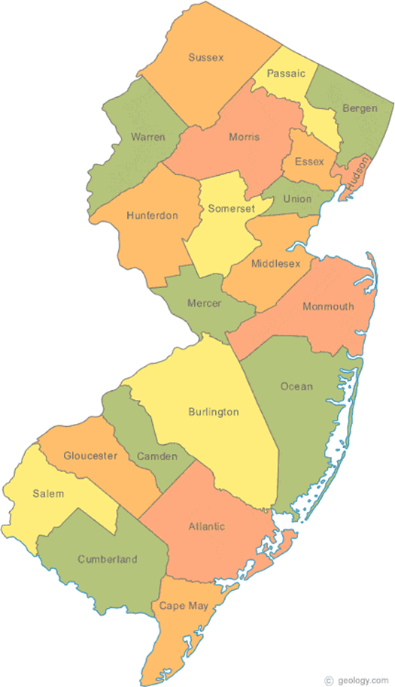
AHA Locations & Affiliate Agencies
Affiliates
AHA Locations

Slide 10
Working on behalf of clients to meet the Utilities’ Payment Request
Electric and Gas Companies focus:
Safety, Accounts Receivable, and Customer Relations
Atlantic City Electric (ACE)
Elizabethtown Gas (ETG)
Jersey Central Power and Light (JCP&L)
NJ Natural Gas (NJNG)
South Jersey Gas (SJG)
Rockland Electric (RE)
Public Service Electric and Gas (PSE&G)
$
USF
LIHEAP
PAGE
AHA
$
Customer/
Client

Slide 11
Share results with Legislative Districts

Slide 12
Contact Information
Kathleen Kerr
Director - Utilities
Email: aha-utilitydirector@housingall.org
Phone: (732) 982-8691

