Slide 1
Session E2
Welcome to Utility Assistance Track
Katrina Metzler
Executive Director, NEUAC
Notes:
NEED A TIMEKEEPER.
Going to expand on what we talked about this morning and have what I hope is a lively discussion on telling the story for our programs. I won’t focus exclusively on LIHEAP, these are tactics that will work for any program, but I do use some specific examples from LIHEAP to demonstrate several points.
I’ll do a little talking, you’ll do a little talking, it will be fun.

Slide 2
Drink some coffee and pretend you know what you’re doing.
Notes:
When you’re new, some days might be like this…even when you’re not new. I’m actually having one of those days right now. ☺

Slide 3
NEUAC Mission
Improve awareness and understanding of the nature and magnitude
of limited-income energy and utility challenges
Formulate and advance limited-income energy policy through compilation,
analysis, and dissemination of data
Provide technical assistance in the creation and development
of fuel funds and promote the development of statewide and regional fuel funds
Currently located in the DuPont Circle neighborhood of Washington D.C.,
NEUAC staff work with our committed members to advance our mission

Slide 4
Purpose of
UTILITY ASSISTANCE
Notes:
Going to expand on what we talked about this morning and have what I hope is a lively discussion on telling the story for our programs. I won’t focus exclusively on LIHEAP, these are tactics that will work for any program, but I do use some specific examples from LIHEAP to demonstrate several points.
I’ll do a little talking, you’ll do a little talking, it will be fun.

Slide 5
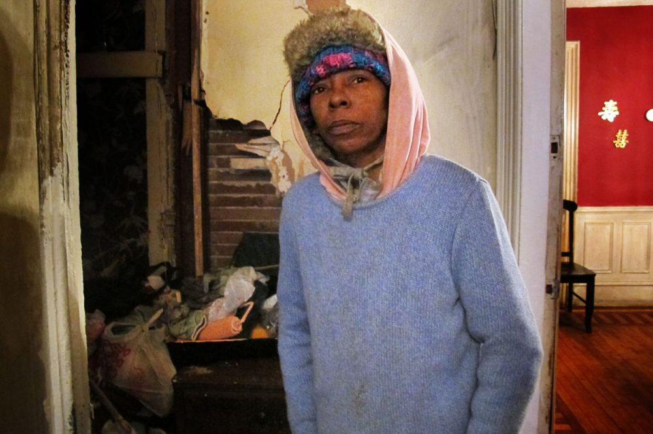
Utility assistance addresses serious challenges and social issues
Energy poverty/burden
Energy equity
Energy justice
Energy efficiency
Energy education
Notes:
Energy equity – what do you think that means? Does energy poverty affect all races, men, women, neighborhoods, segments of our culture the same?
Energy justice – the addressing of these inequities. How do you address in your agency?
Energy efficiency – weatherization passthrough – do you know if your state receives it? 48 do.
Energy education – my mother was weatherized and wanted all-electric home. Education is needed. “Light bill.”

Slide 6
What is energy burden?
ENERGY BURDEN
Definition: The percentage of household income spent on energy.
Example 1: $5,000/month income
$250/month energy costs
Energy burden is 5%
Example 2: $1,667/month income
$250/month
Energy burden is 15%
Notes:
At its heart, advocacy is simply education, and the best educators on your staff also could be the best advocates. The same arguments we make for our programs with policymakers work with our communities, as well.
Give specific examples. This is a generic one – do you have a specific one from a client at your agency with an energy burden of 30% or more? Because I saw those all the time when I was at the CAA level in Ohio. What is your agency’s average energy burden? And similiarly, you will want specific examples from specific clients, as often as you can.
Who are your customers? What’s your story?
A term that is very common in energy affordability circles, but outside our circle, people rarely understand the concept.
But it’s very basic…the % of hh income spent of energy.
Energy burden is 3x that of the family in the first example.
The equivalent would be $750 for the first family.

Slide 7
A math problem
2018 Federal Poverty Level was equal to $25,100 for a family of four, annually.
However, the average LIHEAP household
makes less than $20,000 ($1,667/month).
After taxes, take home pay would be about $18,000.
After rent or mortgage, reduced to $6,000,
or $500/month.
Notes:
That is MORE than 82% of LIHEAP recipients.
What’s left? Car payment, insurance, gasoline, utilities, food, school clothes, phone, internet, …
Keep in mind, at this income level, you are likely living in some of the worst housing stock in your community. Leaky windows, not well-insulated, not well-ventilated (mold, asthma), even some of the newer HUD housing built in the 1990s was built with little more than press board and a box of nails. A 1979 manufactured home with no skirting. Giant housing complexes. This is where our customers live.
Could you survive? What might you do to take care of yourself and your family given that scenario?
Would you take out a payday loan to buy groceries?
Would you sell something valuable for less than it is worth?

Slide 8
Resources for addressing
ENERGY AFFORDABILITY

Slide 10
Low Income Home Energy Assistance Program
Block grant, established in 1981
Congress appropriates funds annually
- Advocacy is important
$3.69 billion for FY19
$3.84 billion proposed for FY20
Nearly 6 million households were served in 2017
The mission of LIHEAP is to assist low income households, particularly those with the lowest incomes that pay a high proportion of household income for home energy, to help meet their immediate home energy needs.
Notes:
Let’s start with what we already know about the program. Who was president in 1981? Ronald Regan.
First person to answer this next question in their chat box gets the star for the day: who was president in 1981?
LIHEAP funds are not entitlement funds. What’s the difference? It’s an important one.
Block grants are fixed pots of money that the federal government gives to states to provide benefits or services. Block grants like LIHEAP have fixed levels of funding; as opposed to entitlement programs where anyone who is eligible for benefits or services can receive them and funding increases automatically and immediately to respond to increased need.
FY2020 Funding Level: $3.84 billion
Of that amount: $3.637 billion will be allocated to the states in the same way that it was in FY18; $37.2 million will be allocated as if LIHEAP received low funding this year; and the remainder will be allocated using the formula.
6 million sounds like a big number, but in the context of 28,761,009 households who are eligible for LIHEAP in the US, it demonstrates what a tremendous need we still have for LIHEAP. Conversations happening recently re: a push for an appropriations number…even at $5.1 B, not enough to serve all the demonstrated need in the country.
I’m sure those of you working in customer service are all too aware of that, given the number of customers with arrearages and late notices.

Slide 11
Fuel Funds: Two Types
Private 501 c 3
Utility sponsored
Notes:
What is the difference? How are they funded? Do you have either of these in your community?

Slide 12
Prominent Charitable Fuel Funds
THAW - The Heat and Warmth Fund
Dollar Energy Fund
Fuel Fund of Maryland
Oregon Fuel Fund
New Jersey Shares
Notes:
Others?

Slide 13
Where I can find a list of resources in my state?
LIHEAP Clearinghouse:
https://liheapch.acf.hhs.gov/dereg.htm (state listing of leveraged funding)
Other useful resources on Clearinghouse site:
https://liheapch.acf.hhs.gov/Disconnect/disconnect.htm (disconnect policies)

Slide 14
Where can I go to find resources in my community?
2-1-1
Community directories
Community/county websites
Example: DC Resource Guide
Where else?

Slide 15
Other common resources
Utility payments:
CSBG
United Way
Churches
PRC funds
Energy affordability:
Weatherization Assistance Program
CDBG
Notes:
Remember when I said LIHEAP is appropriated funds annually? Different from Food Stamps, TANF (entitlements)
That means the money runs out. If you have no fuel fund in your community, what then?
What else is available in your community?

Slide 16
Training
Staff at local agencies should be trained on the resources available in their communities. Why?
Who trained you?
Notes:
Because they are front line staff who speak directly to clients.
Probably no one. ☺ What kind of agency do you want to be? Do you only have time/people/resources to refer people, or can you schedule appointments for them? What kind of advocate do you want to be? If there aren’t enough resources in your community to address the need, it is up to YOU to start a movement.

Slide 17
LIHEAP Action Day: NEUAC Event
March 3-4, 2020 - Washington, D.C.
2019 - hosted more than 170 attendees
200+ meetings with legislators
Education and impact
#ProtectLIHEAP
#LIHEAPAction #LIHEAP

Slide 18
Open Letter to Congress
2020 all-parties letter to congress in support of LIHEAP had more than 1,000 signatures
This is the easiest, best way for your utility to show support for this program.
View here:
https://neuac.org/2020-all-parties-letter/
Notes:
We have not put in a # for LIHEAP

Slide 19
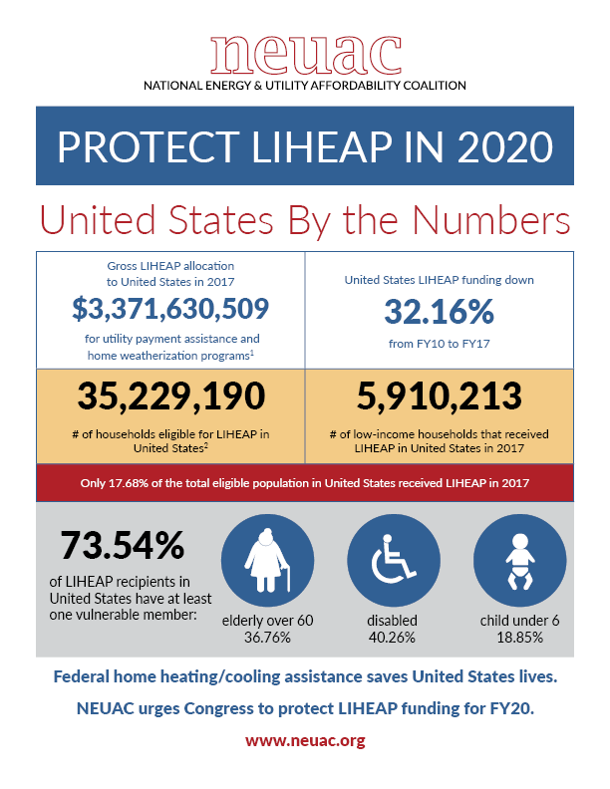
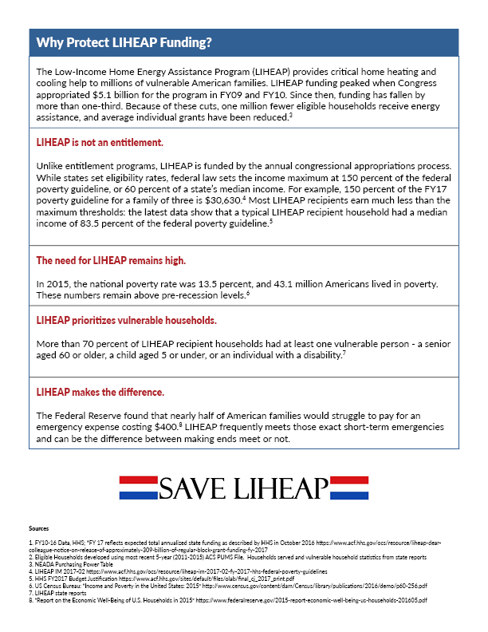
https://neuac.org/liheap-state-by-state-metrics/
Notes:
neuac.org and search for state sheets

Slide 20
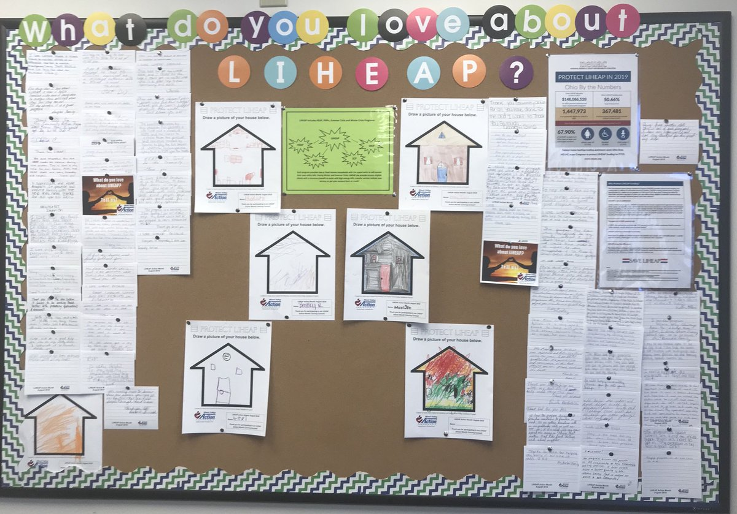
LIHEAP Postcard Project
Notes:
These are other things you can share at your meetings: postcards, thank yous, letters from clients, pictures from children.
Can you hang these in a local bank? Have a coloring competition?
What do you do to teach the community about your programs? Best outcome at a speech was when someone wrote me a personal check for $1,000 after I told them the story of Henry, the homeless guy who had lived under a bridge on the highway for 10 years or more. Everyone knew him. But hearing the story of how we back up a pickup truck to his bridge and packed him up, and how he rides his bike to work every day and has been moved up to trainer, and how he still stopped by the feed his cats every morning and every evening because he considers them his family … that time, someone wrote me a check, and I didn’t even ask for money. It all starts with good work, right?
Let’s share a few ideas of community participation at your agencies. How do you tell people about what you do? Anybody? THIS IS ALL ADVOCACY.

Slide 21
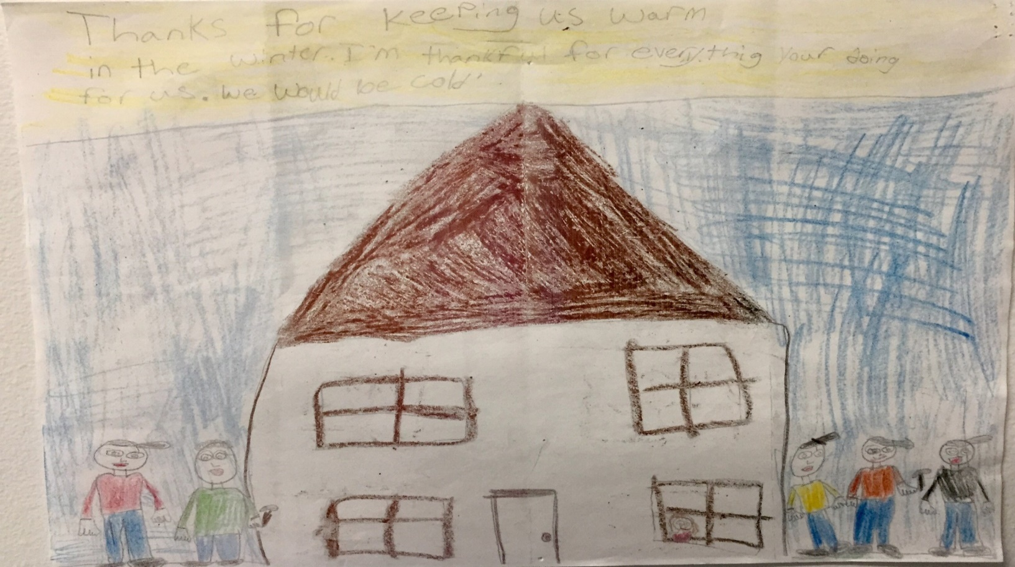
What we do matters.
Notes:
Do you all have a thank you like this? A picture speaks a thousand words. Stay inspired to do what you do.
Let your community participate in your program, give them a chance to say thank you, and make them your best advocates for your programs.

Slide 22
Questions?
Katrina Metzler, Executive Director
National Energy and Utility
Affordability Coalition
1850 M St. NW, suite 610
Washington, D.C. 20036
202-530-2210
info@neuac.org

