Slide 1
Incorporating Education into Low-Income Energy Assistance and Energy Efficiency Programs:
The ABC’s of Client Engagement

Slide 2
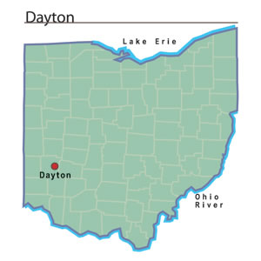
Service Area Snapshot
Serving two rural and two urban/suburban counties
Clients with various needs ranging from seniors with fixed incomes to transient populations with very low/no income
Customer surveys show 84% of utility assistance program information is transmitted by “word of mouth”
Goal by 2023: Enable clients and key community players to provide a two-minute, informed “elevator speech” on the benefits and requirements of the PIPP+/HEAP programs

Slide 3
“A”: Accessibility
Meeting clients at their “current location” on the journey to self-sufficiency
Hiring specific staff for this purpose
Attendance at a variety of community events with the ability to process applications; appropriately communicate program benefits and standards
Updates to scheduling systems with clear, concise instructions as to how to obtain an appointment
Program brochures and handouts with understandable, almost informal, language describing client responsibilities when participating in programs

Slide 4
“B”: Balance the Perception
Minimize the stigma associated with client budgeting programs
i.e.—”PIPP+ is not a handout; it’s a budget management tool.”
Encourage positive, outcome-based conversation between clients and community partners
Explain, at an accessible level, the advocacy efforts put forth by participating agencies, on behalf of the client
Encourage clients, through in-office activities, to participate in their own program advocacy
Reframe the “agency” stereotype

Slide 5
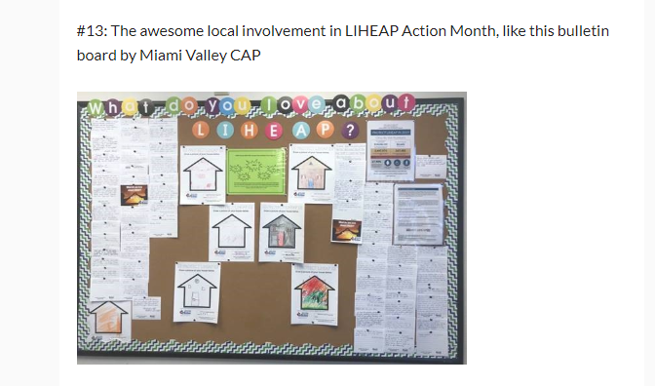
MVCAP LIHEAP Action Month Bulletin Board: August 2019

Slide 6
“C”: Communication
Encourage employees and teammates to communicate with clients in a clear, effective manner
Never underestimate the value of explaining compliance procedures; engage clients in the larger picture of your program
Application of Simon Sinek’s “Start with Why” model—boosts communication within your team and transmission of empathetic, accessible information to clients
“There are two ways to influence human behavior: you can manipulate it or you can inspire it.” –Simon Sinek

Slide 7
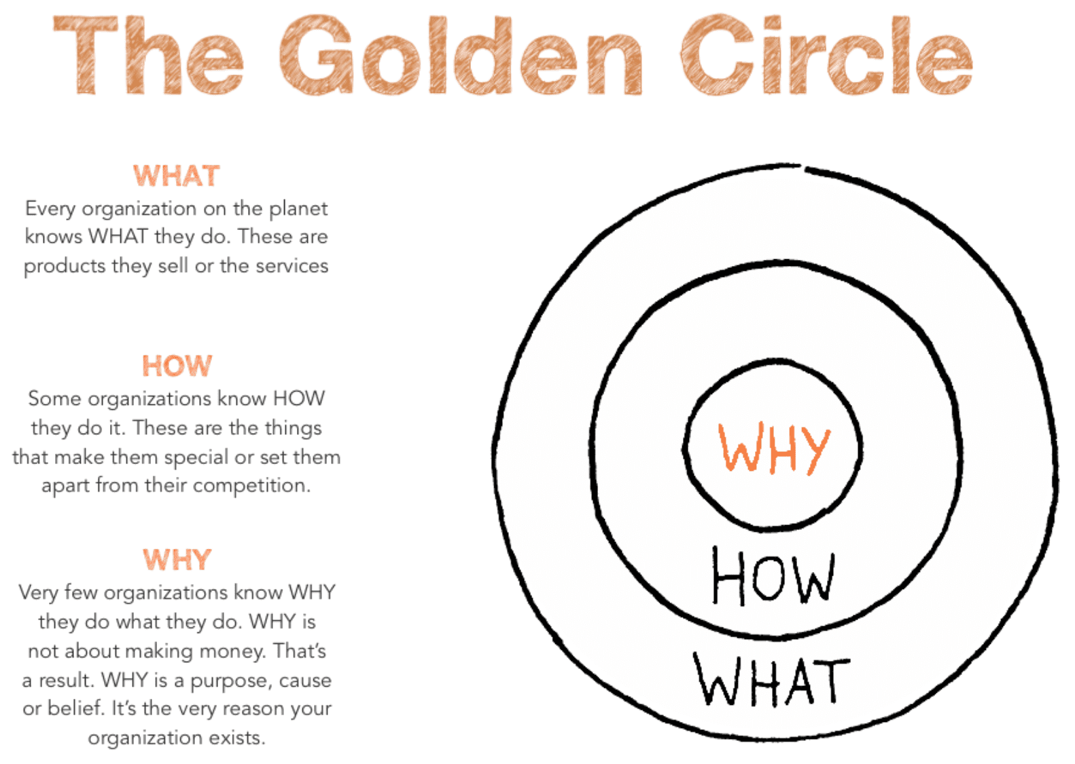
Understanding the “WHY” elicits empathy from our team and provides an improved customer service experience for our clients. The “WHY” engages, empowers, and mobilizes internal, individual action.
Start With Why: How Great Leaders Inspire Everyone to Take Action, Simon Sinek, 2009

Slide 8
Keelie M. Gustin Director, Energy Assistance Programs
We grow through the exchange of ideas—please reach out! I’d love to hear about your strategies!
Miami Valley CAP 719 S. Main St. Dayton, OH 45402 937.260.5534 keelie@mvcap.com

