Slide 1
LIHEAP 101
Libby Perl, Congressional Research Service 2019 National Energy and Utility Affordability Conference
June 4, 2019

Slide 2
Congressional Role in LIHEAP
(1) Program Authorization
Law that establishes and governs LIHEAP
Can be changed, though nothing recent
(2) Funding LIHEAP
Authorization of Appropriations — Guidance
Appropriations Bills — Actual Funding

Slide 3
Funding LIHEAP: Two Main Pots
Regular Funds
How? Distributed automatically via formula
Who? All states, tribes, and territories
When? Appropriated and distributed every year since enactment
Emergency Contingency Funds
How? Distributed in case of “natural disaster or other emergency”
Who? One or more states, tribes, or territories
When? Not always appropriated, and not always distributed (creates uncertainty)

Slide 4
LIHEAP Appropriations
President’s Budget Introduced: February preceding the start of the fiscal year in October
House & Senate Pass Budget Resolution: By April 15th
House and Senate Pass Appropriations: By October 1st
(Rarely Stick to Schedule)

Slide 5
FY2019 Appropriations
Signed Into Law September 28, 2018
First time in years that LIHEAP was funded before start of fiscal year.
Regular Funds — $3.69 billion, $50 million more than previous year.
Amount Distributed — Reduced by 1% due to transfers

Slide 6
FY2020 Appropriations
President’s Budget
Would eliminate funding for LIHEAP
House and Senate
Need not follow President’s budget, and often don’t for LIHEAP
Constrained by
Budget Control Act Caps
Budget Resolution
Status: House Committee-passed bill: $3.84 billion (no bill in Senate yet)

Slide 7
Recent LIHEAP Appropriations (dollars in millions)
Fiscal Year | Regular Funds | Emergency Contingency Funds | Total
2009 | 4,510 | 590 | 5,100
2010 | 4,510 | 590 | 5,100
2011 | 4,501 | 200 | 4,701
2012 | 3,472 | 0 | 3,472
2013 | 3,253 | 0 | 3,253
2014 | 3,425 | 0 | 3,425
2015 | 3,390 | 0 | 3,390
2016 | 3,390 | 0 | 3,371*
2017 | 3,390 | 0 | 3,390
2018 | 3,640 | 0 | 3,640
2019 | 3,690 | 0 | 3,653*
Source: U.S. Department of Health and Human Services. * Amount distributed.

Slide 8
LIHEAP Funding Since FY1982

Slide 9
Appropriations and the LIHEAP Formula
Three Ways Congress Has Distributed Funds
(1) “Old” Formula
Developed in 1981, used most years from FY1982 to FY2007
(2) “New” Formula
Developed in 1984, used in FY1985, FY1986, FY2006, and FY2008
(3) Hybrid of “Old” and “New” Formulas
Inserted into appropriations language, used from FY2009-FY2019

Slide 10
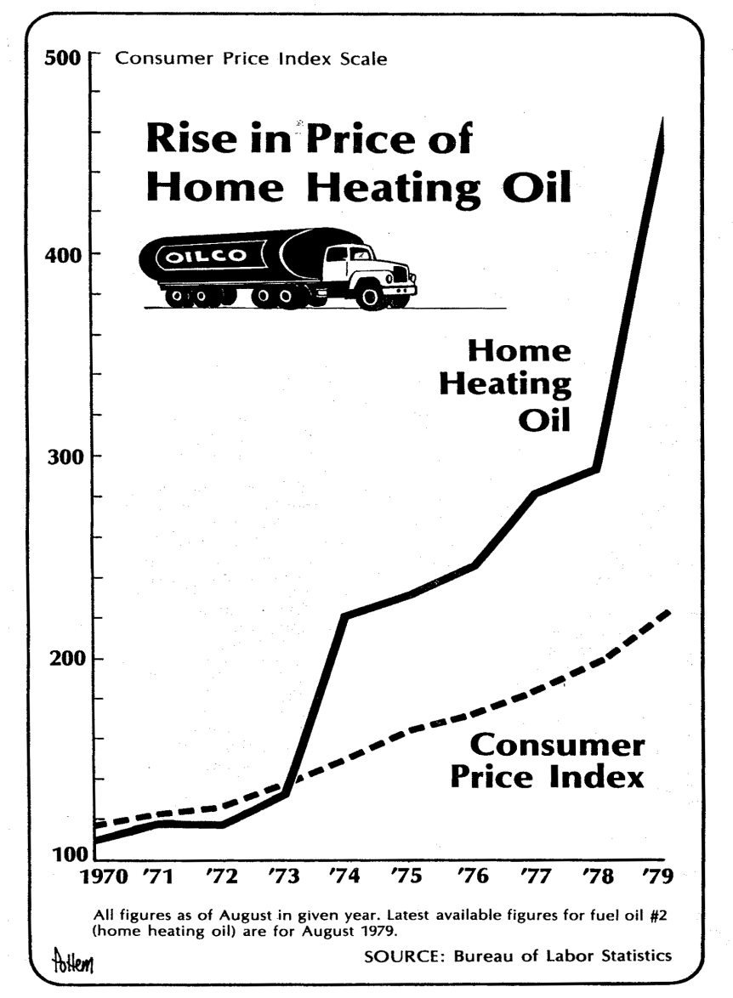
“Old” Formula
Reason Enacted: 1970s high oil prices meant focus on heating need.
What It Does: Fixed % of funds for states using static data.
Relevant Factors:
Heating degree days
Residential energy expenditures
Number of low-income households

Slide 11
“New” Formula
Reason Enacted: To apply comprehensive and updated data
What It Does:
Uses low-income household expenditures on heating and cooling.
Incorporates hold-harmless provisions
Requires recent data
Relevant Factors: Population shifts, energy prices, increased usage

Slide 12
Why “Old” Formula Still Matters
Applies to Appropriations Less Than $2 Billion:
Used most recently in FY2007
Hold-Harmless Provisions:
Old formula amounts are the benchmark for holding states harmless
Congressional Actions:
From FY2009 through FY2019, large share of LIHEAP funding was distributed using the old formula

Slide 13
How the “New” Formula Works
Low-Income Household Costs to Heat and Cool
Btus x Price
Natural gas, electricity, heating oil, coal, kerosene, propane, and wood
Add Low-Income Household Costs for Each State
E.g., for Texas, $1.735 billion
Divide Costs for Each State by Total U.S. Costs
$1.735 billion/$22.156 billion = 7.83%

Slide 14
LIHEAP “Old” and “New” Formula Rates by State, FY2019
State | “Old” Formula Rate | “New” Formula Rate | State | “Old” Formula Rate | “New” Formula Rate
Alabama | 0.860 | 1.719 | Missouri | 2.320 | 2.173
Alaska | 0.549 | 0.438 | Montana | 0.736 | 0.342
Arizona | 0.416 | 1.543 | Nebraska | 0.922 | 0.504
Arkansas | 0.656 | 0.904 | Nevada | 0.195 | 0.726
California | 4.614 | 5.991 | New Hampshire | 0.795 | 0.731
Colorado | 1.609 | 1.438 | New Jersey | 3.897 | 3.247
Connecticut | 2.099 | 2.069 | New Mexico | 0.521 | 0.595
Delaware | 0.279 | 0.383 | New York | 12.725 | 8.539
District of Columbia | 0.326 | 0.193 | North Carolina | 1.896 | 3.000
Florida | 1.361 | 4.372 | North Dakota | 0.800 | 0.242
Georgia | 1.076 | 3.312 | Ohio | 5.139 | 3.957
Hawaii | 0.108 | 0.148 | Oklahoma | 0.791 | 1.338
Idaho | 0.628 | 0.362 | Oregon | 1.247 | 0.843
Illinois | 5.809 | 4.361 | Pennsylvania | 6.835 | 5.278
Indiana | 2.630 | 1.786 | Rhode Island | 0.691 | 0.628
Iowa | 1.864 | 0.978 | South Carolina | 0.683 | 1.458
Kansas | 0.856 | 1.053 | South Dakota | 0.649 | 0.237
Kentucky | 1.369 | 1.546 | Tennessee | 1.386 | 1.952
Louisiana | 0.879 | 1.587 | Texas | 2.264 | 7.831
Maine | 1.360 | 0.936 | Utah | 0.748 | 0.588
Maryland | 1.607 | 2.371 | Vermont | 0.596 | 0.461
Massachusetts | 4.198 | 3.606 | Virginia | 1.957 | 2.703
Michigan | 5.515 | 4.249 | Washington | 2.051 | 1.513
Minnesota | 3.973 | 1.855 | West Virginia | 0.906 | 0.793
Mississippi | 0.737 | 0.938 | Wisconsin | 3.576 | 1.991
 |  |  | Wyoming | 0.299 | 0.194

Slide 15
Implications of “New” Formula
“Winners” — Warmer weather states, largely southern
E.g., Nevada, Arizona, Texas
“Losers” — Most northern states (but not always)
E.g., Wisconsin, Iowa, Oregon, Colorado
Sometimes a few New England states have done better under the “new” formula

Slide 16
Implications of “New” Formula, Cont’d
FY2019 Formula Rates

Slide 17
Implications of “New” Formula Cont’d
First Hold Harmless
States with biggest gains are reduced
States with losses are ensured their share at $2 billion appropriation under the “old” formula
Second Hold Harmless
Certain small population states receive a bump up in their formula percentage rate (e.g., District of Columbia, Montana, Vermont)
States with biggest gains are again reduced

Slide 18
Hybrid “Old” & “New” Formulas
FY2009: First time Congress used this method.
All but $840 million “shall be allocated as though the total appropriation for such payments for fiscal year 2009 was less than $1,975,000,000.”
Basis for Divide:
“New” = 1/3 of amount above $2 billion
“Old” = everything else
FY2019:
“New” = $716 million
“Old” = $2.974 billion

Slide 19
Resources
LIHEAP: Program and Funding, https://crsreports.congress.gov/product/pdf/RL/RL31865
The LIHEAP Formula, https://crsreports.congress.gov/product/pdf/RL/RL33275

