Slide 1
The reality of ReEntry
Laura Saintey, NCRT
Marie Francis, CCAP
Karen Keith

Slide 2
International Rates of Incarceration per 100,000
Notes:
https://www.sentencingproject.org
The United States is the world’s leader in incarceration. The US is 5% of the world’s population, yet holds 25% of the world’s incarcerated people.
There are 2.2 million people in the nation’s prisons and jails—a 500% increase over the last 40 years.

Slide 3
state imprisonment rates
Notes:
Texas has the 7th highest state imprisonment rate. The highest states are across the south.

Slide 4
U.S. State and Federal Prison Population to Texas Population, 1972-2016
Notes:
State and federal prison populations have continued to increase at a rapid rate over the past 40-50 years. Why?
Are the causes and conditions identified in your Community Assessment?
Do you have partnerships, collaborations to help address this rising problem?
Do you have initiatives to address reentry?

Slide 5
U.S. People in Prisons & Jails for Drug Offenses
Notes:
One major cause of increased imprisonment is drug offenses.
Are people being connected to recovery programs, rehab centers, support groups? Do you refer clients to AA, NA, AlAnon?
What resources are in your area?

Slide 6
Lifetime Likelihood of Imprisonment for U.S. Residents Born in 2001
Notes:
Just take a look at this slide for a moment.

Slide 7
Texas Total Corrections Population, 2016
Total Incarcerated | 224,113
Prison Population | 157,903
Jail | 66,210
Probation Population | 378,514
Parole Population | 111,892
Notes:
Those on probation and parole are potential clients; close to half a million people across Texas.

Slide 8
Texas Race/Ethnicity
Notes:
I don’t need to say anything more…

Slide 9
Texas: Gender
Gender | Number
Men in prison | 144,928
Women in prison | 12,975
Incarceration increase from 1980-2016 | Percentage
Males | 396%
Females | 908%
Women in Texas Criminal Justice System
Texas ranks #1 in women’s incarceration in the nation
64% are incarcerated for nonviolent crimes; mostly drug possession or delivery
81% are mothers
Notes:
Female incarceration in TX has increased 908% over a 36 year time period.
TX ranks #1 in the nation for incarcerated women; most are mothers.
Women awaiting trials in TX totals around 6.300 (a 435% increase since 2011).

Slide 10
Texas: Juveniles
Total Juveniles in custody | 4,299
Committed | 2,433
Detained | 1,740
Diverted | 54
Juvenile Custody Rate (per 100,000) | 153
White custody rate (per 100,000) | 94
Black custody rate (per 100,000) | 417
Latino custody rate (per 100,000) | 138
Native American custody rate (per 100,000) | 99
Asian custody rate (per 100,000) | 10
Notes:
Again blacks rank highest.
Think about how this plays into generational poverty?

Slide 11
Texas
Prisons | 106
Released/Year | 67,603
Parolees under supervision | 113,363
Offenses:
Violent | 22%
Drug related | 25%
Property | 16%
Notes:
Violent offenders are the most difficult to impact.
However, if you can address the “habit”—you can impact the last two.

Slide 12
How can community action and social service agencies help?
LIHEAP
CEAP & WAP
Community Services Block Grant (CSBG)
≤ 125% Federal Poverty Guidelines
Emergency Services
Stability for vulnerable
Removing barriers so that individuals/families can transition out of poverty
≤ 150% Federal Poverty Guidelines
Vulnerable are given priority:
Elderly ≥ 60 years of age
Disabled
Children ≤ 5 years of age
Energy Conservation Education
Weatherization
Notes:
Utility Assistance is typically what brings folks to CAAs. Of these, a percentage receive weatherization and others are eligible for CSBG, and of those a percentage are those that are formerly incarcerated. Helping to remove the barriers to self-sufficiency is tough---but for the formerly incarcerated there are barriers to the barriers.
Do you hire the formerly incarcerated? Who here offers second-chance employment?

Slide 13
How CAN CSBG come into play?
By removing barriers that make it harder for individuals with criminal records to turn their lives around.
Basic Needs: clothing, food
Housing: transitional to permanent
Transportation
Obtaining Identification Documents
Money Management
Health: counseling, substance abuse programs, mental healthcare, physicals, medications
Employment: job readiness skills, tools, uniforms, second-chance employers
Education: financial aid, GED, certifications
Notes:
When I review the demographics of individuals/families served by CAAs across TX, I typically see high numbers of single-parent female households. Drivers of female incarceration are: 81% have children, 52% report less than $10,000/yr, 58% report sexual abuse or assault as a child, unemployment, lack of education/stable housing, lack of mental health treatment. (TCJC-Women Justice Quick Guide)
Turn over to Marie

Slide 14
identification
How do we find out if the person in your office was formerly incarcerated? Many won’t tell you, as they are embarrassed and afraid of rejection.
Work history: is there a large gap in their work history? Ask why….
Self-Assessment: do they address certain barriers, such as inability to rent an apartment? No access to documents such as picture ID or voter registration card? Ask why….
Housing: where do they live? Is it with relatives? Is it in a half-way house? Transitional housing? A shelter? Ask why….

Slide 15
Complex transition with barriers
Difficult transition from incarceration to the community
Limited housing options
Substance abuse
Mental health issues
Lack of adequate education
Poor or non-existent job skills

Slide 16
Collateral consequences
Not limited to only those who have been incarcerated but also to those with misdemeanors.
They last indefinitely, even after an individual is “rehabilitated”.
Denial to access government benefits and program participation (student loans, housing, contracting, voting, civic engagement).
Affects employment and business opportunities.

Slide 17
Csbg’s role
Assist in securing documentation, such as birth certificates, picture IDs, driver’s license etc.
Housing deposit
Skills training/education
Employment
Nutrition
Medical Access
Mental health Access
Substance Abuse
Notes:
rent but also interaction with prospective landlords.

Slide 18
Partnerships
One agency alone cannot do it all
Developing partnerships is crucial
Key players
Stakeholder input
Funding and leveraging

Slide 19
The future
No “box” on employment applications
Better legislation
Better communication with court system
Better police interaction and involvement

Slide 20
What does reentry look like?
Notes:
Reentry looks like me, it looks like you and all the people around you in that room, on the street, in your neighborhood and in your family.

Slide 21
Then. . .

Slide 22
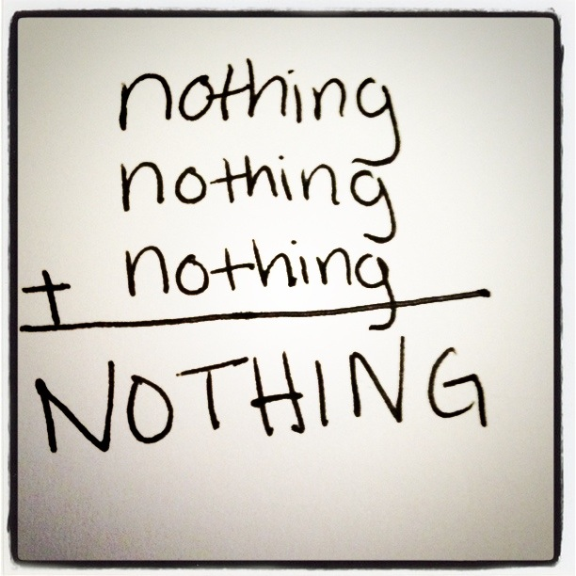
Starting over…beginning with nothing
No home
No family
No job
Nothing but the clothes on my back
Notes:
On December 15, 2015, I walked out of a Texas prison after serving almost 3 years on a 7-year sentence. On April 19, 2020 I will truly be free having completed my sentence on April 18th, 2020.
Starting over at 59 is never easy even in the best of circumstances, but starting over at 59 after being released from prison is harder than you think. If I was a victim of a natural disaster, people just might be eager to help me restart my life, but coming from prison the outcome is much different, the level of eagerness to help reduces to almost none.
Starting over with no home to go home to, acceptance into a transitional house in Austin was the best I could hope for, an acceptance I am so very grateful for.
Starting over knowing that my choices are the reason why my 3 children or 3 grandchildren are no longer a part of my life, brings new meaning to the words NO family.
Starting over with nothing does not mean I am nothing, it just means that I have no home, no family, no friends, no job, and just the lovely outfit I walked out of prison in…but starting over is just what I have done.

Slide 23
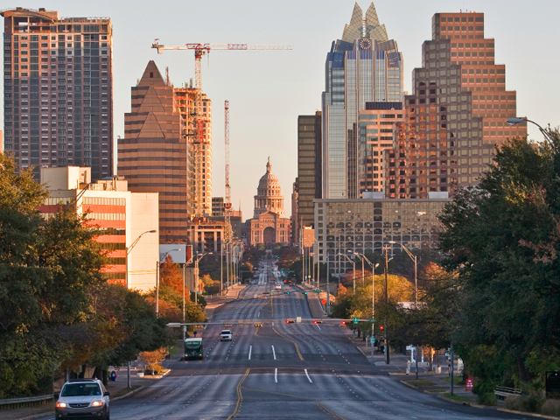
New City
Austin, Texas
Transportation
Where to go
Who will help

Slide 24
New Choices
An apple or an orange?
Steak or shrimp?
Bluebell or Blue Bunny?

Slide 25
New Understanding

Slide 26
New Feelings
Fear
Loneliness
Depression
Anxiety, Stress
Rejection

Slide 27
New View
The SCARLET Letter - F
Notes:
Many of us being released believe we have a big red F on our foreheads, a scarlet letter – the marking that reveals you are a Felon. We think every police officer, sheriff, constable and even those we meet in a market or on the street can see the big F painted on our foreheads. BUT, I am NOT a scarlet F. It took time along with the kindness of others for me to no longer feel this way. If you don’t receive kindness, how do you ever get over this sense of being an F in all things?

Slide 28
New People and Old People
Big Daddy
Margie & David
Brittny & Vera
Lauren
Annette
Dara
Helen
Kenneth
Kelly
Reggie
Darwin
Doug
Terri
Brooke
Michael
Gavin
Laura
Jason
Naomi
Rita
Cris
Rocky
Talina
Jim
The Chad
Jan
Cindy
Page
Sue
Jen
Sheryl
Linda
Kathy

Slide 29
New Barrier
Permanent Reentry

Slide 30
Community Action and Social Services Agencies
Who are you?
Where are you?
What do you do?

Slide 31
New Job
Goodwill Staffing Group – a temporary assignment
Where does it lead?

Slide 32
New Opportunity
How does a single cup of coffee change your life and the path you thought you would be on?

Slide 33
New Home
A friend who takes you to lunch and ensures you now are safe and welcomes you home – at her home – and the day you realize you are really home.
Notes:
Eighteen months after release, still living in transitional housing, a friend took me to lunch and said, “I’ve been thinking about something for a while and want to know if you would like to move in with me, I have a spare bedroom.” The kindness of that friend has allowed me to live in a safe, lovely home. A room to myself – a haven to go to at the end of the day.
Not everyone is this lucky. My friend, Chad, and I went out looking for apartments recently and we kept ending up in the worse neighborhoods that are considered “second chance” housing. Then it hit me – that my friend had saved me from this. Had she not, I would have to go live in one of the worse neighborhoods in my community.
In Texas, currently most decent apartment complexes require someone to be “off paper” for 10 years. That would make me eligible to live in those places in 2030.

Slide 34
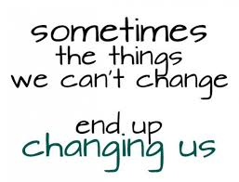
New Purpose
Prison – the choice was did I let it change me for good purposes or ruin me for good?

Slide 35
New Beliefs

Slide 36
Before
After

Slide 37
1

Slide 38
Questions?
Marie D. Francis, CCAP
marie.francis@fortworthtexas.gov
Laura Saintey, NCRT
laura.saintey@tdhca.state.tx.us
Karen Keith
karen.keith@tdhca.state.tx.us

