Slide 1
Sharing Your Mission Powerfully So People Take Action

Slide 2
Thank You!

Slide 3
Thank You!

Slide 4
Lori L. Jacobwith, Founder, Ignited Fundraising
@LJacobwith
#IgnitedFRStorytelling

Slide 5
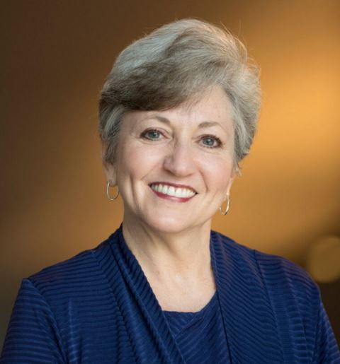
Lori L. Jacobwith
Since 2001 - Helping nonprofits raise $300 million from individual donors. And counting.
Named one of America’s Top 25 Fundraising Experts
Former Executive Director, CEO, Development Director
Speaker, Trainer, Coach, Author
www.ignitedfundraising.com
LJacobwith
@LJacobwith

Slide 6
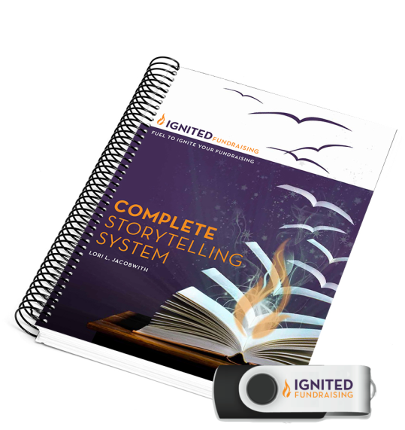
Master Storyteller
Fundraising Culture Change Expert 4500+ organizations
Trainer - 500,000+ people
Author
Complete Storytelling System
Nine Steps to A Successful Fundraising Campaign
Fire Starters Weekly Blog

Slide 7
What I Do
What I Do

Slide 8
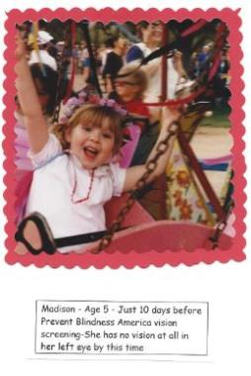
The Power of One Story

Slide 9
What I inherited:
2 ½ years later:
1 Staff
12 Volunteers
$80,000 Budget
Screening 250 children each year
5 Staff
890 Volunteers
$1.2 million Budget
Screening 25,000 children each year

Slide 10
What Do YOU Want People To Do?

Slide 11
Success

Slide 12
The BIG Secret

Slide 13
Success for ANY Organization:
Communication
Communication
Communication

Slide 14
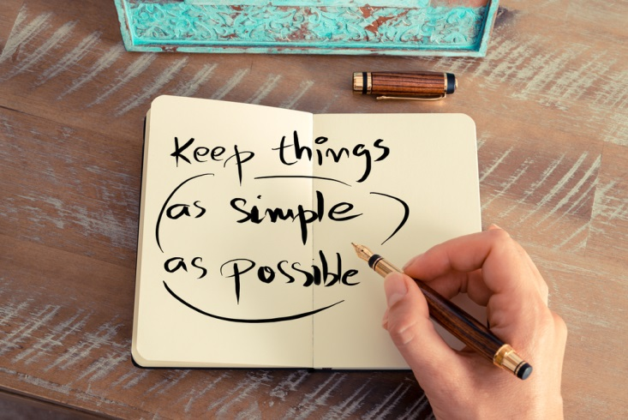
Successful Organizations:

Slide 15
A “Failure to Communicate”
Notes:
Our reality - More than 50% of your donors stop giving for reasons connected to a “failure to communicate.” -~ Penelope Burk & Cygnus Applied Research

Slide 16
Are People Paying Attention?
Notes:
10,000 ideas come at people every single day. Is your message 10,001? Or does it not even make the radar?

Slide 17
Choose a New Path

Slide 18
I Want to Feel My Impact
Put a Story and Face to What I Cause
Photo: Marcela Gara, Resource Media – from DCSEU Facebook
Notes:
From Instagram: theunionomahaObed Sanchez is a familiar face around our Co-Op ceramics studio. Obed is an artist, entrepreneur, and owner of @grainolia Bakery. Born in Acapulco, Mexico, Obed’s palette as a chef transcends borders. His Brazilian cheese breads and Salvadorian quesadillas have been crowd favorites at Omaha farmers markets.

Slide 19
And Share it Everywhere
Notes:
And share it EVERYWHERE…

Slide 20
Fundraising vs Development

Slide 21
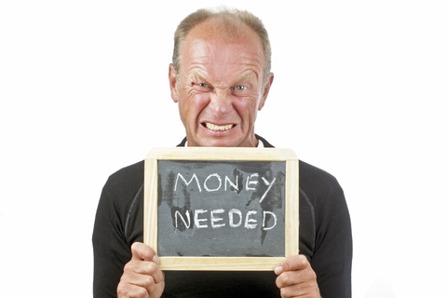
Fundraising
The raising of assets and resources from various sources for the support of an organization or a specific project.
~ Source: AFP Fundraising Dictionary, (Association of Fundraising Professionals)

Slide 22
Development
The total process by which an organization increases public understanding…
~ Source: AFP Fundraising Dictionary, (Association of Fundraising Professionals)

Slide 23
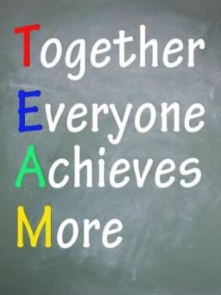
Development: Everyone’s Job

Slide 24
Clear, Bold Communication

Slide 25
Support Moves Toward Boldness & Clarity Of Communication

Slide 26
Quickly: Be Clear & Bold
In Pairs
Introduce the work of your organization.
Use up to 3 sentences.
Do this without using your organization name.

Slide 27
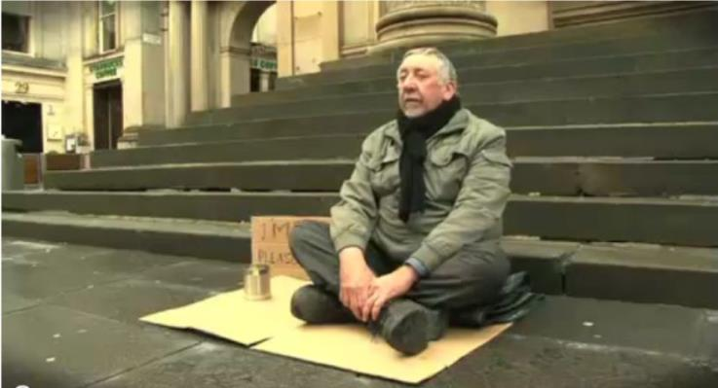
Words Create Experiences

Slide 28
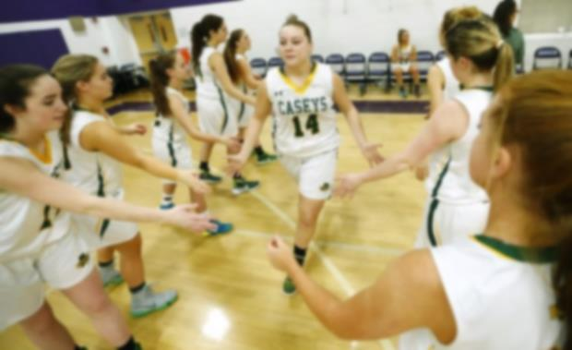
First Impressions Can Take Seconds

Slide 29
Skip The History Lessons

Slide 30
Utilitarian Communication

Slide 31
Utilitarian Communication
Donate
Attend
Help Us
Give More
Give Again
Invest
See Your Impact
Who Will Your Gift Help?
Long-Term Partners

Slide 32
Scarcity Communication

Slide 33
Scarcity Communication
Hard
Donor Fatigue
We Can’t
Not Enough…
They Won’t
Learning To…
Inspire You
What if We Could
The Very Right People
Long-Term Partners

Slide 34
Clear, Bold Communication
Notes:
A meaningful reconnection of a donor’s investment in your work.
Often organizations do not dig in deep here and run the risk of losing their donors, especially multi-year donors.

Slide 35
Clear
Clear Adjective
1. Free from doubt or confusion
2. Certain in the mind; sure
3. Easy to see or hear; distinct
4. Evident or obvious
Collins Essential English Dictionary
2nd Edition 2006 © HarperCollins Publishers 2004, 2006
Notes:
A meaningful reconnection of a donor’s investment in your work.
Often organizations do not dig in deep here and run the risk of losing their donors, especially multi-year donors.

Slide 36
Bold
Bold Adjective
Courageous, confident, fearless
Immodest
Standing out distinctly, conspicuous
Collins Essential English Dictionary
2nd Edition 2006 © HarperCollins Publishers 2004, 2006
Notes:
A meaningful reconnection of a donor’s investment in your work.
Often organizations do not dig in deep here and run the risk of losing their donors, especially multi-year donors.

Slide 37
Craft One Phrase for Each
Clear Bold

Slide 38
Be Clear & Bold
Use this clear value statement & introduce again: [different partner]
We are _________________
We specialize in working with (or serving)
We help them (to do what?)

Slide 39
Mission Moment Stories

Slide 41
Mission Moments
Create Unforgettable Emotional Connections
and Empathy
Notes:
The ability to understand and share feelings of another.

Slide 42
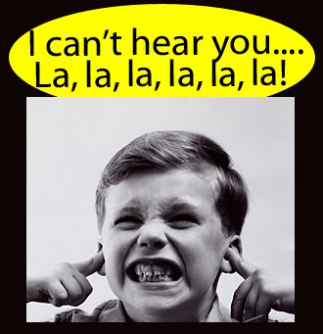
Donors Don’t Care What YOU Need

Slide 43
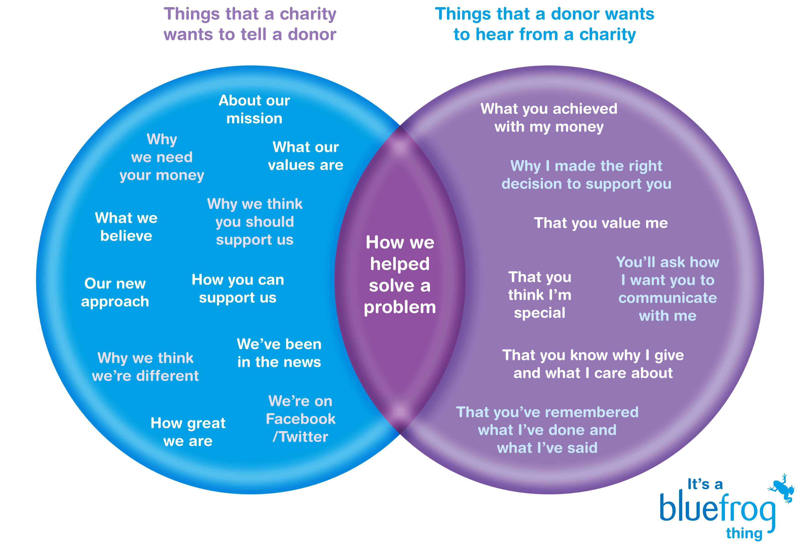
Tell Me What I Care About

Slide 44
We “THINK” in Story
Every decision we make is based on a story we tell ourselves
If we don’t feel something we can’t make a decision

Slide 45
Conventional Wisdom
Notes:
Conventional wisdom in psychology is that the brain has 2 independent systems at work at all times. The emotional side: that feels pain and pleasure. And the rational side, that is often described as the reflective or conscious system. This is the part of the brain that deliberates and analyzes and looks into the future.

Slide 46
Uniting Both Minds
Notes:
In the past few decades scientists have begun labeling the two sides of the brain the Planner and the Doer.
The truth is there is a continual TENSION between the two sides of the brain…that is always present. The story from

Slide 47
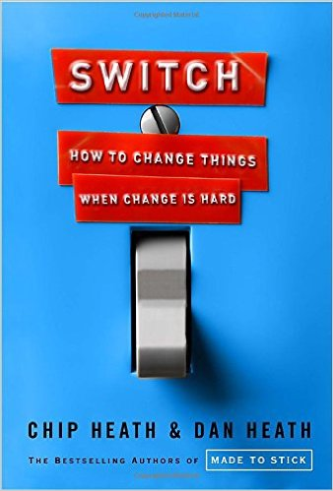
From SWITCH
…our minds are ruled by two different systems: the rational mind and the emotional mind – that compete for control…
Notes:
Why is it so hard to make lasting changes in our companies, in our communities, and in our own lives? The primary obstacle, say the Heaths, is a conflict that’s built into our brains. Successful changes follow a pattern, a pattern you can use to make the changes that matter to you, whether your interest is in changing the world or changing your waistline.

Slide 48
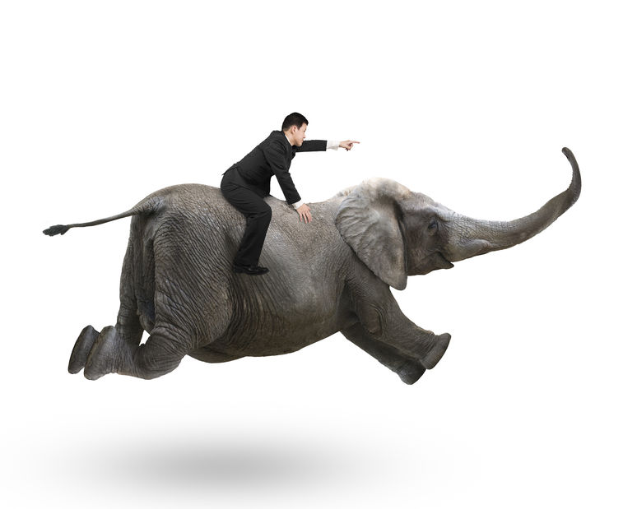
Brain Tension
Story from SWITCH
Source: The Happiness Hypothesis by Jonathan Haidt
Notes:
Our emotional side is the Elephant and our rational side is its Rider.
Sitting on the elephant, the rider hold the reins and SEEMS to be the leader.
But the rider’s control is precarious – due to size.
Anytime the elephant and the rider disagree about which direction to go, the rider is going to lose. He’s overmatched. - We are all pretty familiar with this outcome if we’ve hit the snooze button numerous times, overeaten, procrastinated, you get it.
While the Elephant may appear, at first glance as lazy or over emotional – the Elephant has enormous strengths too. And the Rider has some crippling weaknesses.
Emotion is the Elephant’s turf: love, compassion, sympathy and loyalty.
That fierce instinct to protect our loved ones against harm. And if you want to make a change: the Elephant is the one who gets things done.
The Rider tends to overanalyze and over think. Which can create a weakness of spinning his wheels.
If you want to change things: secure a first-time or larger gift, keep people giving longer, you HAVE to appeal to both the Rider AND the Elephant.

Slide 50
Empathy
Creates Connections

Slide 51
Mission Moments
Lori’s Definition:
“Any short, inspirational, example of how your organization is making an impact.”
Must be about a person.
Could be a partner agency, donor, client, staff, volunteer, board member, vendor, or?
Photo: Marcela Gara, Resource Media – from DCSEU Facebook

Slide 52
Watch Out For: Uninspired & Lazy

Slide 53
Stories are up to 22 times more memorable than just statistics*
*Source: Ohio State University Study
Notes:
ALL WAYS: In person, notes, letters, emails, online, website homepage, website donate page, story page, Social Media, EVENTS!,
Meetings: board, staff, PTO, Teacher, Community
Asking for money
Your #nonprofit online donation & homepages matter. People decide in only .05 seconds if they’ll stay or leave.
Thanking
Inviting
Print Materials – Annual Report

Slide 54
Share A Mission Moment

Slide 55
Turning Mission Moments Into Stories

Slide 56
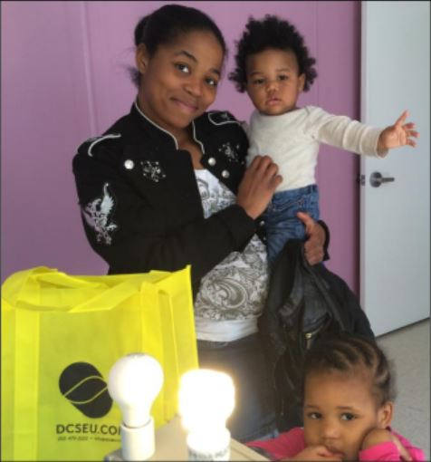
Six Step Process
Step 1: Identify one person.
Image Source: DCSEU

Slide 57
Six Step Process
Step 2: Learn & jot down as much about them as possible.
Step 3: Write down all of the exact results.

Slide 58
Six Step Process
Step 4: Make a list of transformations due to your involvement and/or their own efforts

Slide 59
Six Step Process
Step 5: Circle the words that stand out and are emotionally connecting.

Slide 60
Pay Attention to Word Placement
Ashamed
Broken Inside & Out
Eyes Pooled With Tears
Leathery Hands
Numb with Shock
Precious Newborn
Yours?

Slide 61
Six Step Process
Step 6:
Now fit the story into the framework. And share your story. Using various formats.
Often.

Slide 62
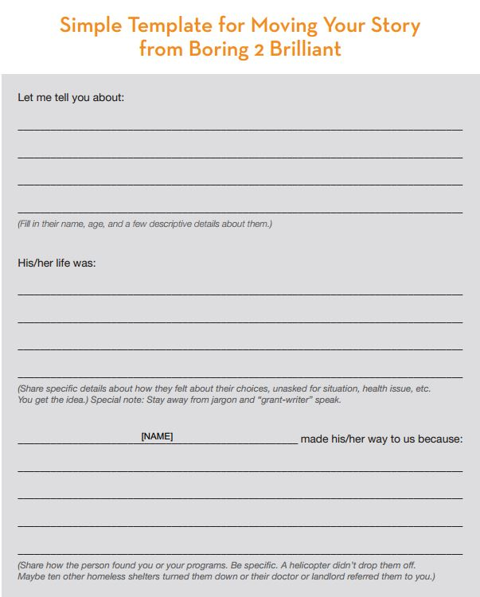
Simple Framework
Let me tell you about…
[Insert name] had a life of…
Here’s why and how [name] found their way to us…
www.Boring2Brilliant.com

Slide 63
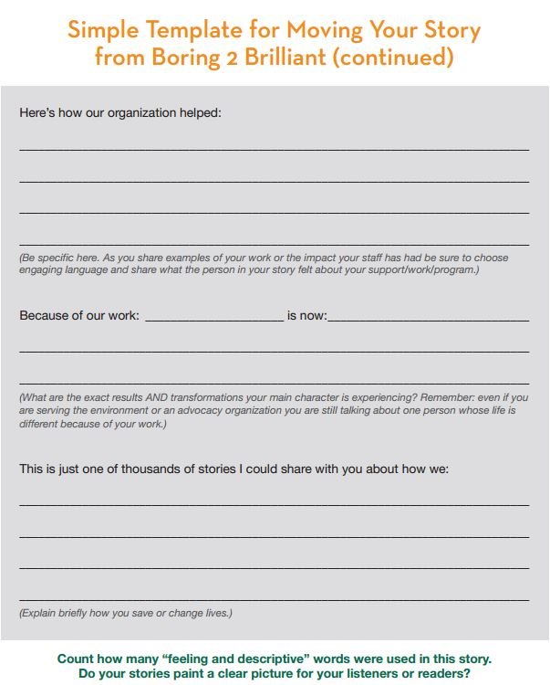
Simple Framework
Here’s how [name] felt...
What [name] accomplished because of [program name]…
And because of your support [name] is now…
www.Boring2Brilliant.com

Slide 64
Sondra’s Story

Slide 65
Sondra’s Story

Slide 66
Sharing YOUR Stories

Slide 67
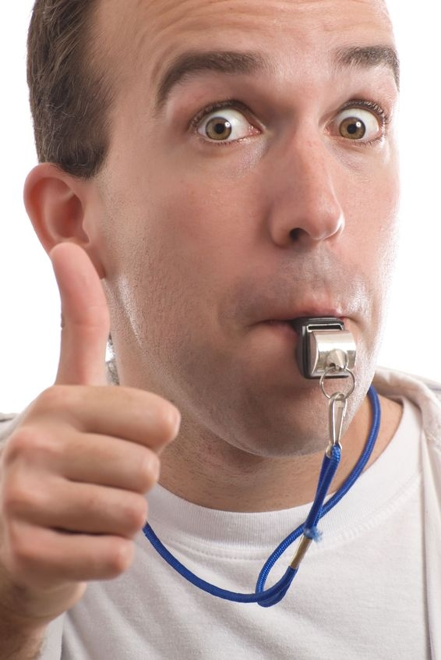
Listen & Coach One Story

Slide 68
For This To Work It Takes Practice

Slide 69
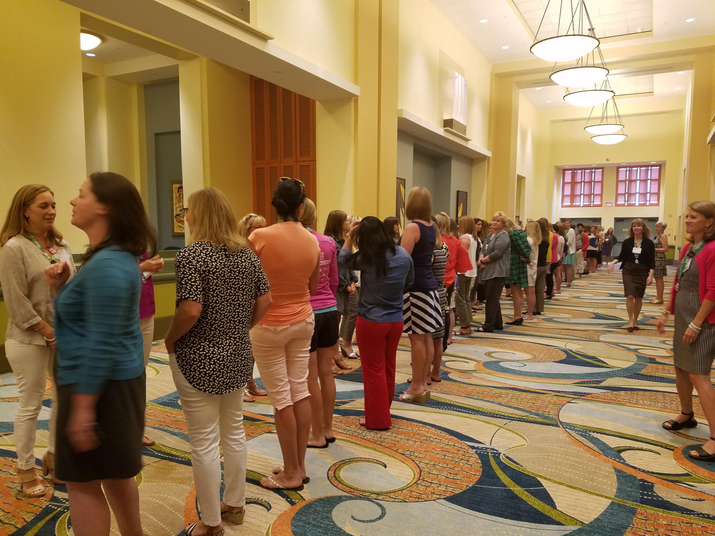
Speed Storytelling

Slide 70
Share YOUR Mission Moment Story
Count off: 1, 2, 1, 2
Line up in two lines facing each other - Find your partner, quickly!
Share a 2 minute mission moment story.
Receive coaching & feedback.
Switch and 2nd person tell story.

Slide 71
What Works When Sharing A Story?
Let’s make a list…
Notes:
Let’s make our own list: an executive summary if you will.

Slide 72
Share More. Raise More.
Website Home Page
Donate page
Newsletters & eNews
One-on-One Meetings
Staff & Board Meetings
Appeal Letter
Social Media
When People Least Expect It
Notes:
Storytelling and marketing is the new power couple. There is no better way to connect, engage, and reach your customers. Period.
A great story is powerful and moving. It has heart and soul. But not every brand story will meet this criteria. The stories you tell don’t all have to move people to laughter or tears, they just have to be authentic, open, and honest. Show that your company and your customers are real people with real stories to tell. Share what your brand is all about: your core values, purpose, beliefs, and mission. Create and share content, cultivate an active community, and tell the stories that matter to them.

Slide 73
Six Word Stories

Slide 74
One Final Mission Sharing Tool

Slide 75
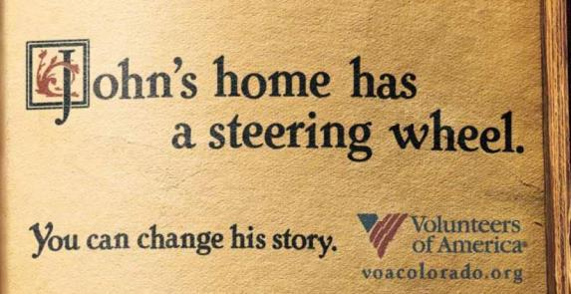
Six Word Stories

Slide 76
Six Word Story Framework
Emotional connection to a real person
Compelling fact
Bonus: Call to action

Slide 77
YOUR 6 Word Story
Identify one person for your story.
Create and share one 6 word story now.

Slide 78
Inspire Us With Your 6 Word Story

Slide 79
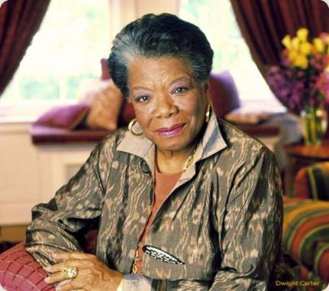
People will forget what you said.
People will forget what you did.
But people will never forget how you made them feel.
~ Maya Angelou

Slide 80
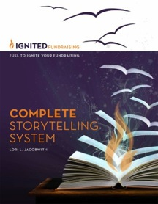
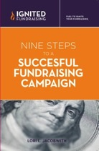
Staying Connected
Lori Jacobwith – Ignited Fundraising
@LJacobwith
Fire Starters Blog
Free Resources
IgnitedFundraising.com
Lori L. Jacobwith
Master Storyteller & Fundraising Culture Change Expert
To Talk With Me:
http://bit.ly/StrategizeWithLori

Slide 81
Sharing Your Mission Powerfully So People Take Action
Thank You!

