Slide 1
LIHEAP during Disasters
NEUAC June 2019
Michael De Young – State of Texas

Slide 2
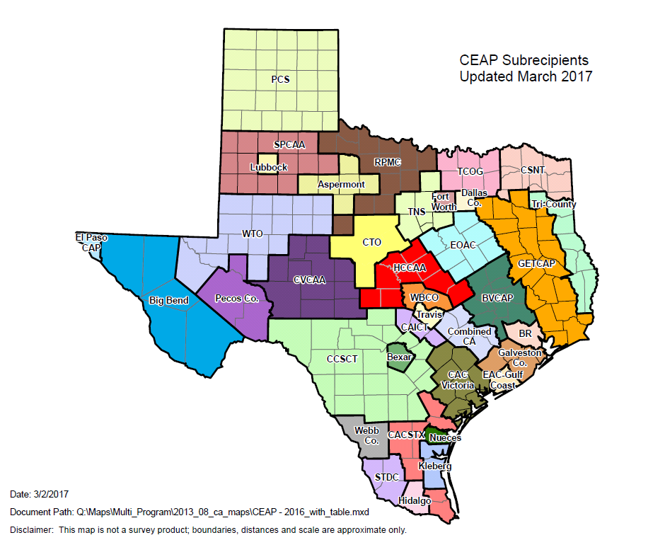
The Agencies

Slide 3
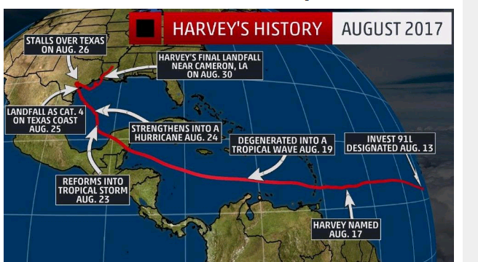
The Path

Slide 4
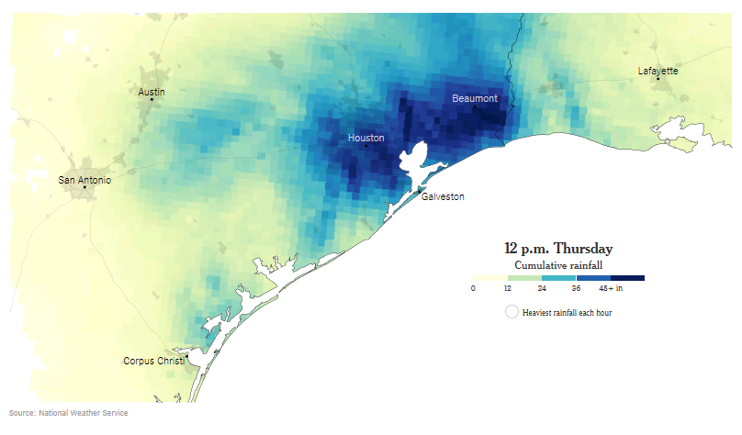
The Rainfall

Slide 5
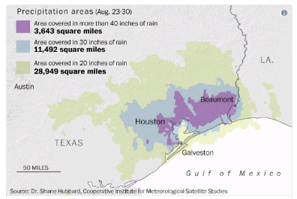
The Square Miles

Slide 6
LIHEAP Plan
In the Texas State Plan we :
Identify the option of using 60% Area Median instead of the 150% of Federal Poverty
Tie that to a Presidential or Governor declaration
Require prior written approval from state office
Allow for Placed Based and Displaced HHS assistance

Slide 7
TDHCA Requests Coastal Agencies to:
Pre-procure hotels annually (w/vendor agreement)
Identify evacuation routes and shelter locations
Initiate communication with County Disaster Coordinator
Manage expectations appropriately
Participate in a pre-landfall conference call:
State and federal flexibility
Eligibility guidelines
Key staff contacts (State and local agency)
Alternative Communication methods (State and local agency)
Back up plans – social media – be careful
Establish conference calls times and conference lines

Slide 8
Best Practices
Agency Disaster team
Outside agencies mobilization to assist affected agencies?
Staff reassignments (WX to LIHEAP?) Training?
Interagency or inter-local agreements
What's covered: costs, who reports, deliverables and liabilities
How to avoid duplication of benefits
Care of CAA employees who are impacted
Uniform Benefit matrix for the agency
Social Media – Blessing or curse?
Manage Expectations – this starts early
Mobile Units:
Generators for air conditioning, lighting
Computers, Printers, Hot spots
Tents and Chairs
Magazines coloring books
Water in coolers, snacks and personal items

Slide 9
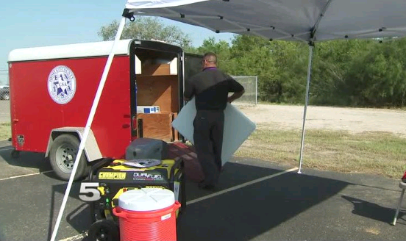
Hidalgo County Community Action Agency

Slide 10
What States and Tribes Need from OCS
States should reach out to OCS for a pre disaster Conference call
Potential topics to discuss:
Any decisions the states need vetted
Any flexibilities that are available
Coordination of communication and requests
Identification of key state/tribe personnel and OCS point person
Reasonable requests
Reasonable response times
Decisions in writing

Slide 11
Contact Information
TEXAS DEPARTMENT OF HOUSING
AND COMMUNITY AFFAIRS
Michael De Young
Email: michael.deyoung@tdhca.state.tx.us
Phone: 512-475-2125
Web: www.tdhca.state.tx.us

