Slide 1
Outreach to Vulnerable Populations
Tribal Track
Monica Toya
June 3, 2019
National Energy and Utility Affordability Coalition Conference

Slide 2
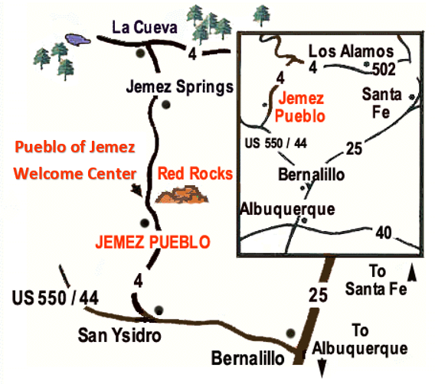
Program Background: Low Income Home Energy Assistance Program
Walatowa -
Pueblo of Jemez, NM
Housed under the Senior Citizens Program, JHHS.
Funding is minimal.
Service Boundary is defined by the reservation boundary.
Notes:
1st Year program became directly funded?
Housed under the Senior Citizens Program which is under the Jemez Health and Human Services Department.

Slide 3
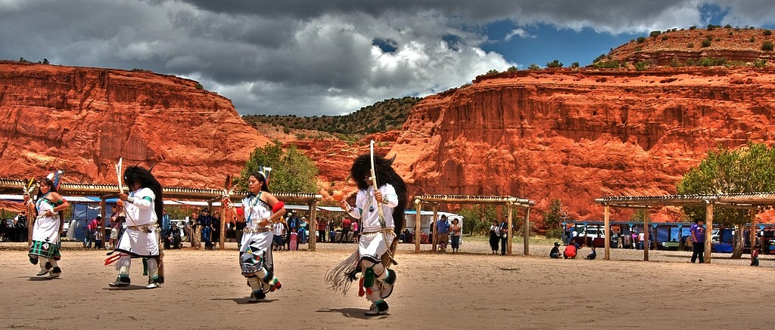
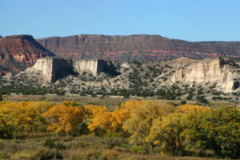
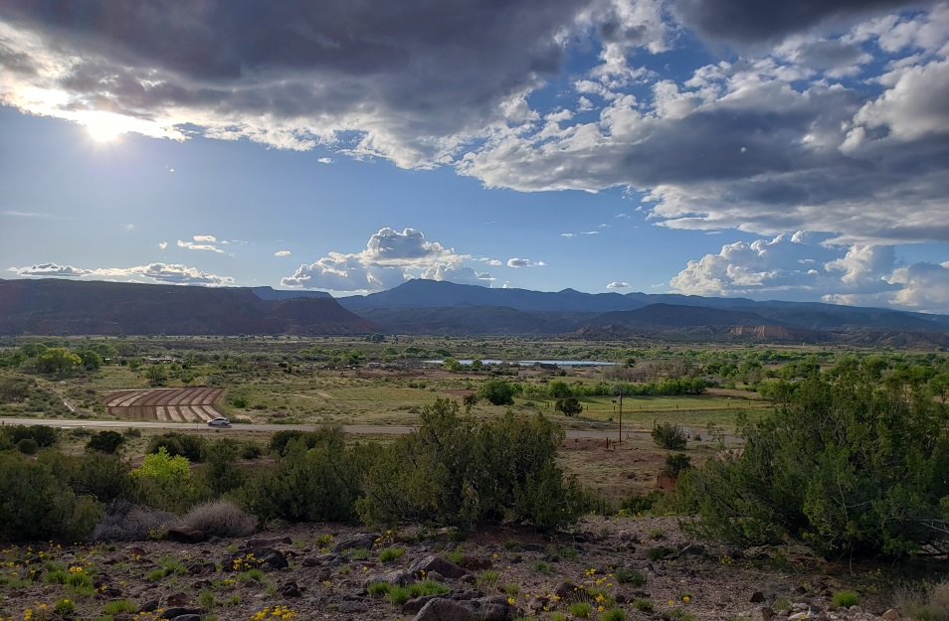
Photo Credit: Indianpueblo.org
Jemez Pueblo, NM
Photo Credit: earthwalks.org
Photo Credit: Self

Slide 4
Notes:
Story of Self- Lights/Electricity accidentally shut off.

Slide 5
Outreach Populations
Working Low-Income Consumers
Fixed Income Consumers
Self-Employed
Unemployed
Temporarily Unemployed

Slide 6
Vulnerable Household Members (As defined by LIHEAP)
Elder 60+, Child 5 and Younger, Disabled Individual

Slide 7
Key Factor in Outreach: Developing Relationships
Collaborators/Collaborations
Resources
Clients: What’s your part in their story?

Slide 8
Collaborations
Identifying Local Collaborators

Slide 9
Identifying Local Collaborators: Know Who Your Partners Are
My Collaborators/Partners:
Jemez Senior Citizens Center
Jemez Housing Department
Jemez Vocational Rehabilitation Program
Jemez Natural Resource Department
Walatowa Timber Industries
Local Schools
Local Utilities
NM Energy$mart Program
State LIHEAP
Other Programs: Jemez Social Services, JHHS Medical Benefits Coordinator/Program, Jemez Behavioral Health, Hemish Public Health

Slide 10
Jemez Senior Citizens Program
GOAL: Ease of Access to one of the most vulnerable populations, elders.
LIHEAP office located within the Senior Citizens Program building.
Outreach during lunch to congregate recipients, flyers distributed to homebound meals recipients, and during other programmatic or clinical functions.
Will conduct home visits as needed.

Slide 11
Jemez Housing Department
GOAL: To weatherize homes and ensure safe, healthy environments for families to live in.
Weatherization Program Partner
Meet twice annually to discuss partnership successes or to suggest improvements for the coming year.
Allows increased service provision with limited funding.
LIHEAP Provides the materials, the Housing Department force crew provides the labor.
Referrals
Notes:
Audit of homes
Referrals to other outlets that can provide more extensive service such as federal grants or home improvement loans, for those that qualify.
Helps identify services needed within the community.

Slide 12
Jemez Vocational Rehabilitation Program
GOAL: To assist in reaching disabled individuals and to create financially self sustaining households.
Annual Financial Management/Education Class
Use several methods including envelope method and the Consumer Financial Protection Bureau (CFPB) Behind on Bills? Start with One Step curriculum.
Presenter is trained by CPFB
Referrals

Slide 13
Jemez Natural Resources Department & Walatowa Timber Industries
GOAL: To supplement LIHEAP services provided to clients who are 55 years of age and over, including those not eligible for LIHEAP.
Made possible by a forest thinning grant awarded to NRD.
Provides ½ cord of fire wood to each home.
Must have a wood burning stove in their home.
LIHEAP & Senior Center: intake, WTI: wood, NRD: contracts with a tribal member to deliver.
Referrals
Notes:
Forest Thinning Grant
Allowed those not eligible for LIHEAP services to receive a service.
Outreach for LIHEAP by word of mouth and seeing others get wood so some clients come in to apply for service.

Slide 14
Local Schools
GOAL: Energy Efficiency Education & access to another vulnerable population, the youth.
2 local elementary schools and one middle school
Present to individuals classrooms.
Provide educational materials that will serve as reminders to students. I.e. bookmarks, coloring books, playing cards, etc.
Gives a sense of responsibility to students for energy efficiency in their homes.
Referrals
Notes:
Isadore’s story of having his mom unplug her curling iron and cell phone charger.
Story of student who urged her mom to come get assistance
Sometimes adults may not want to admit to needing assistance but the kids will have no problem tell you like it is.

Slide 15
Local Utilities
GOAL: Improved working relationships for client advocacy.
Jemez Mountains Electric Coop
Educational Presentations: How to Read Your Bill, Shut-off Moratorium
Propane Companies – 5 Local Vendors
Contracted Wood Vendor
Walatowa Timber Industries – Wood and Pellets
Referrals
Notes:
Exchange Cell Phone Numbers

Slide 16
NM Energy$mart Program
GOAL: To provide a broader array of weatherization services to the Pueblo of Jemez community.
State Program - funding received by DOE with specific allocation for tribes.
LIHEAP conducts intakes but is not part of approval process.
Conduct Extensive Home Audits
Higher Budget Per Home
LIHEAP can supplement service, if needed.
Referrals
Notes:
If we don’t use our portion it is redirected to other tribes.

Slide 17
Other Programs
Jemez Social Services, JHHS Medical Benefits Coordinator/Program, Jemez Behavioral Health
Referrals completed by staff of all programs.
Hemish Public Health
Conducted tribal survey with help of Albuquerque Area Southwest Tribal Epidemiology Center.
Allows the tribe to get a snapshot of behavioral risk factors and how it relates to service provision.
Community Health Representatives assist in referral/intake process.
Notes:
Behavioral Risk Factors Surveillance System (BRFSS) Survey

Slide 19
Resources
Program Advertisements and Announcements
Local Newsletter/Newspaper
Social Media
Flyer Distribution
Organization wide E-mail
Tribal Marquee
Energy Efficiency Outreach Materials
Federal LIHEAP Office
Tribal Manual
LIHEAP Virtual Library https://liheappm.acf.hhs.gov/assessment/#nb
Annual trainings create opportunities for networking.

Slide 20
Resources
Consumer Financial Protection Bureau
We aim to make consumer financial markets work for consumers, responsible providers, and the economy as a whole. We protect consumers from unfair, deceptive, or abusive practices and take action against companies that break the law. We arm people with the information, steps, and tools that they need to make smart financial decisions.
Aides in goal of creating financial self sustaining households
Vast amount of resources
Train the Trainer
Consumer Direct Education
Available for print or you can request material to be mailed to you.
Consumerfinance.gov

Slide 21
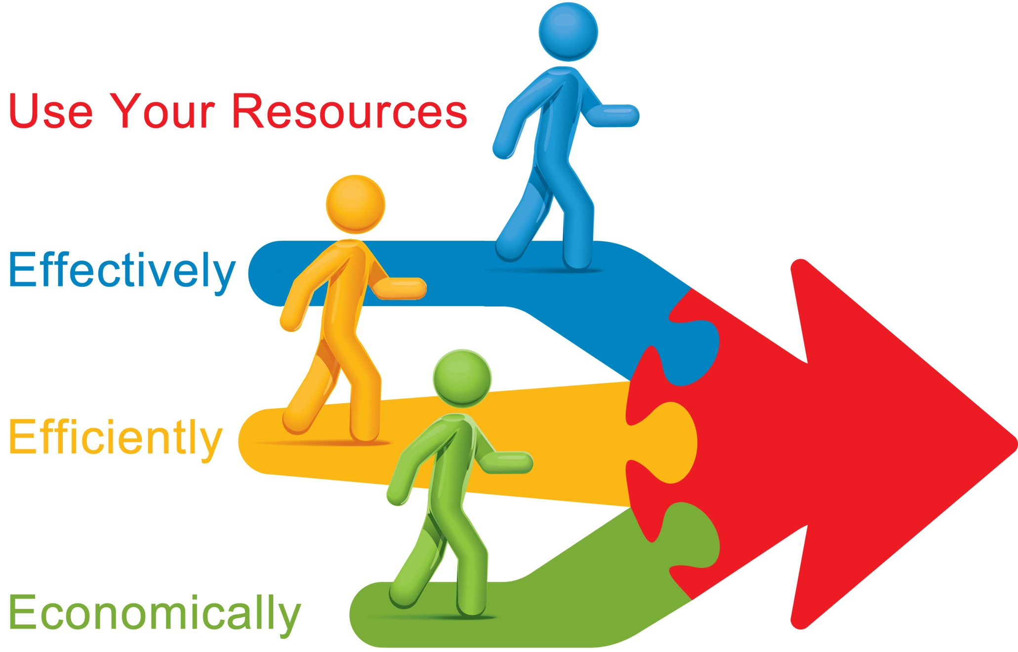

Slide 22
What You Do Now Can Make a Difference Later
Meet Monique Fragua
Currently, Vice-President of Commercial Enterprises, Indian Pueblos Marketing Inc. and Indian Pueblo Cultural Center
Invited to speak at TedxABQ
Favorite Quote: “We’re looking for a hand up, not a handout.”
Notes:
Background of Monique Fragua
Teen Mother
Schooling – Bachelors in , Masters in
United Way – Don’t make decisions about me without me.

Slide 24
Everyone Has a Story
Everyone is someone’s child.
Look at the similarities between ourselves and others. What got them in that situation? That could be me.
Get away from stereotypes
Notes:
Use example of couple from Washington D.C.

Slide 25
What’s Your Place in Their Story?
Listen to understand
Build Trust
Be their biggest advocate, become a momma bear when needed.
Use what you know and draw from it.
“Take the wheel and steer it.” – Andrew Stanton
EMPOWER
“Frankly, there isn’t anyone you couldn’t learn to love once you’ve heard their story.”
(social worker via Ted Talk by Andrew Stanton)
Notes:
Unconscious Goal
Ambitious and Assertive – Sometimes we put a little bit more effort if that was our family.

Slide 27
What will you do to make a difference in someone’s life today? What is your place in their story?

