Slide 1
A look Into Rural America:
Rural Electric Cooperatives Advancing Energy Access for All and Building Communities
Adaora Ifebigh, Program Director, Energy Access at NRECA
Deb Roepke, PI/Technical Advisor ACCESS project, Evigglad LLC
David Lambert, Manager Member Services, Withlacoochee Electric Cooperative
Marshall Cherry, COO, Roanoke Electric Cooperative

Slide 2
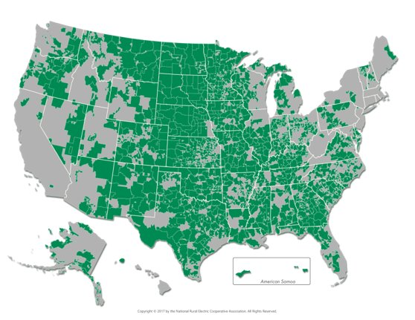
Electric Cooperatives: Who We Are

Slide 3
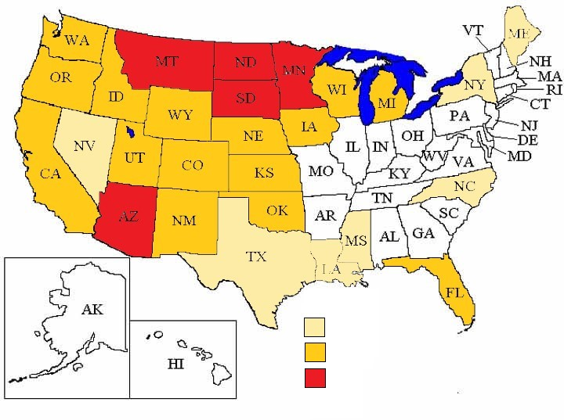
~134 Co-ops Serve Tribal Communities
1-2 co-ops
3-9 co-ops
10 or more co-ops serve tribes

Slide 4
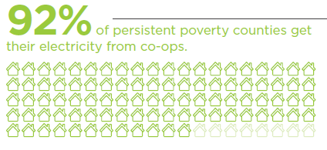
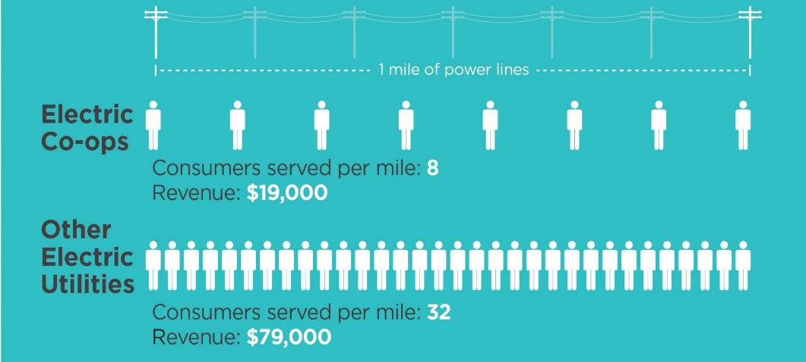
Rapid Pace of Change & Member Challenges
Income inequality
Barriers to RE adoption
Energy affordability
Notes:
The reason we went after this project relates to our larger initiatives which I will talk about in subsequent slides. Challenges have emerged as the U.S. and global economies continues to evolve and the electric industry undergoes a
transformation driven by technology:
• Income Inequality — Income equality in America has worsened over the past three decades. Income disparity
between urban and rural areas has increased significantly since rural electrification started. (Co-ops serve 92% of PPC)
• Barriers to Adoption of Renewables — As the utility industry continues to deploy renewable
resources, some segments of the consumer population, especially rural America, are at risk of being
left behind.
• Energy Affordability — Energy affordability remains a key challenge. The percentage of disposable
household income that goes to pay a family’s energy bills disproportionately affects consumers in
rural areas. In some U.S. counties, low-income households face an energy burden that is 6 to 7 times higher than moderate or affluent households. “Energy affordability” is generally defined by advocates as total combined monthly household spending for energy, transportation and housing of less than 45% of monthly income; then you add in other costs such as healthcare and housing, things get harder for rural communities.

Slide 5
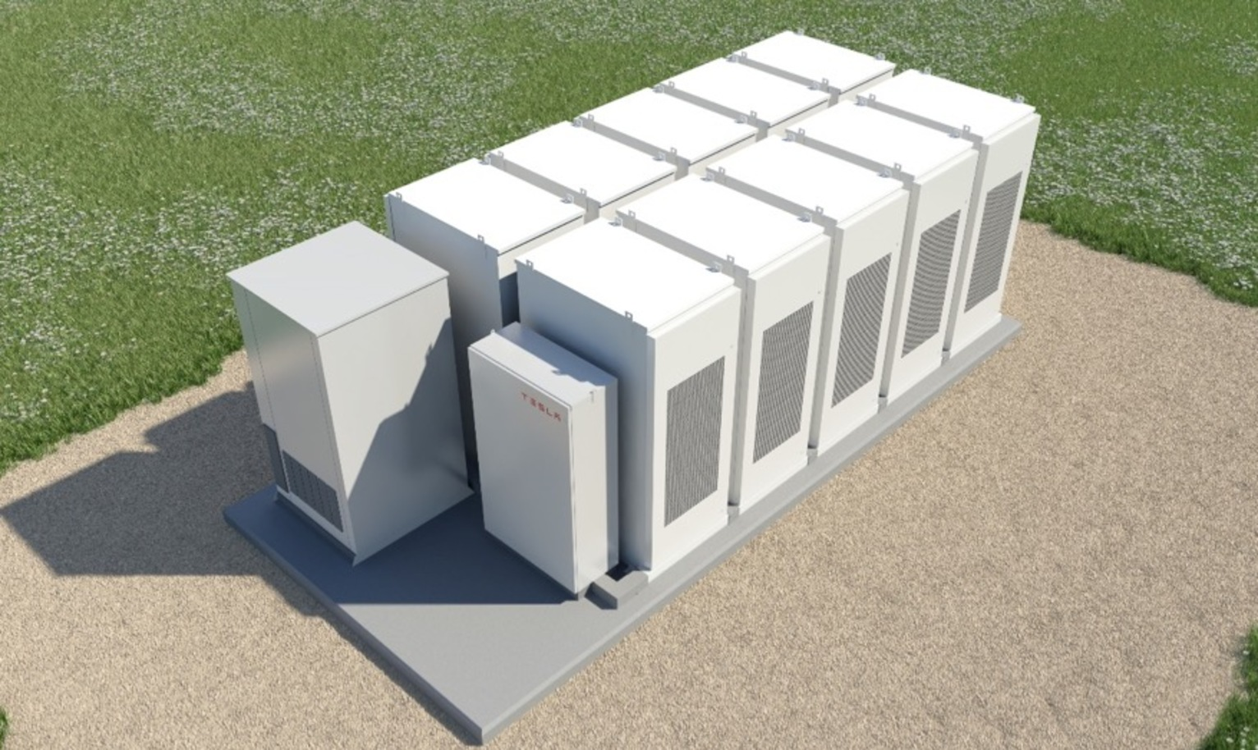
Achieving Cooperative Community Equitable Solar Sources (ACCESS)
Research how to make solar energy affordable for communities with fewer financial resources
Extend the benefits of solar development to low-and moderate-income (LMI) consumers.
Explore & amplify the use of innovative, cost-effective energy access programs to serve co-ops’ consumer members in need.
ACCESS is part of NRECA's new Energy Access for All Program
Notes:
The ACCESS project aims to decrease energy burden on low-income members, while increasing grid benefits and opening opportunities for economic growth through rural cooperative solar initiatives. Importantly, we seek to reduce the costs of solar investments for the co-ops as well, in order to further facilitate the ability for co-ops to provide solar options for all of their consumer-members. A key component of this effort is to extend beyond initiatives that currently exist and develop new financial models and program designs, which will be field tested by the Leader Co-ops.
ACCESS co-ops – 6 of them

Slide 6
Withlacoochee River Electric Cooperative

Slide 7
Withlacoochee - Background
Headquartered in Dade City, FL
~220,000 consumer-members
12th Congressional District
~ 14% are in poverty
~40% of membership households make less than $50K

Slide 8
Energizing Community Investment
Economic prosperity is critical to leverage Community Impact!
WREC has developed 3 industrial parks that support thousands of jobs in the community!

Slide 9
Investing in Mental Health
Vincent House Pasco
10,000 sf. “Recovery Through Work’ mental health center
Cost: 3 million dollars
Serves members over the age of 18 with a mental health diagnosis

Slide 10
Investment in our Youth
Boys and Girls Club
Provides services to youth in the poorest area of the Cooperative’s Service Territory
Children receive tutoring, mentoring, meals, and training at the club.
16,000 sf. with full gymnasium, stage, and commercial kitchen, computer lab
2.2-million-dollar facility

Slide 11
Investing in Community Health
Federally Qualified Health Center
Premier Community Health is a federal qualified health center.
Premier provides essential medical services to a community that did not have health services.

Slide 12
Mobile Health Care
Pasco County Mobile Medical Unit
WREC provided the first donation to purchase the mobile medical unit in 2012.
Medical unit provided medical care to the uninsured which has helped dramatically in providing care to the homeless
WREC actively pursed Cares Act Funds to buy a new mobile medical unit.

Slide 13
Education is critical to Success.
Strengthen the Foundation for Success!
2084 Scholarships awarded since 1997.
14.5 million dollars in scholarships awarded.
Currently 110 scholarships awarded each year at $12,000.00 each.

Slide 14
Safety Net
Helping members weather the storm!
Since 1994
Awarded 2.2 million in assistance
634 families helped

Slide 15
Economic and Community Impact
Improved our Community and Thousand of Lives
1.8 billion contributed to Florida’s Gross State Product 2013-2017
437.5 million in state and local taxes paid
2,148 jobs supported annually

Slide 16
Roanoke Electric Cooperative

Slide 17
Roanoke - Background
Headquartered in Aulander, NC
14,200 meters
1st Congressional District
Over 17% of families below the poverty line
40% of membership households make less than $50K
35% of households average more than $250 average bill

Slide 18
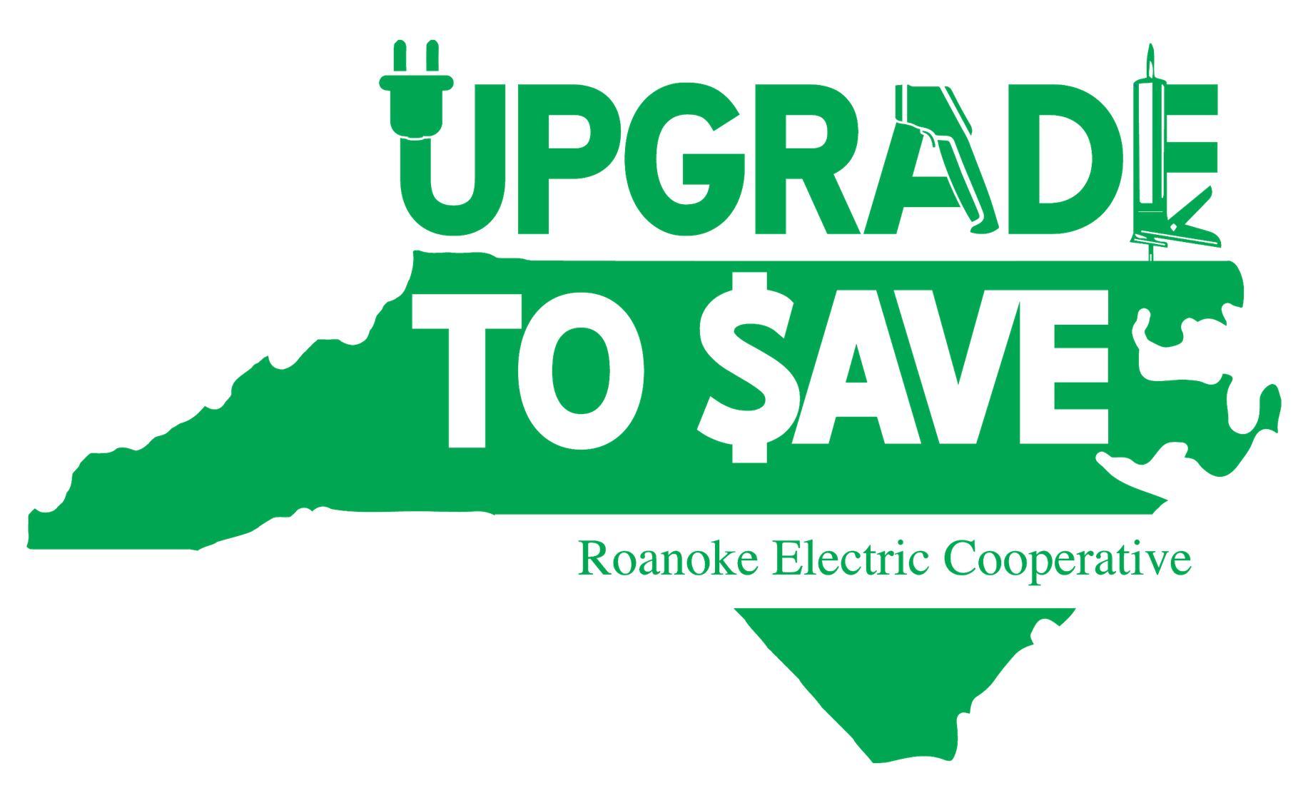
Upgrade to To $ave
USDA Financing
Roanoke Electric
Roanoke Electric
ON-BILL
COST RECOVERY
TIED TO METER
Metered Site
Local
Contractors
Program Operator
INVESTMENT
IN UPGRADES
Roanoke EC Member-Owner
Based on the Pay As You Save® system developed by EEI.

Slide 19
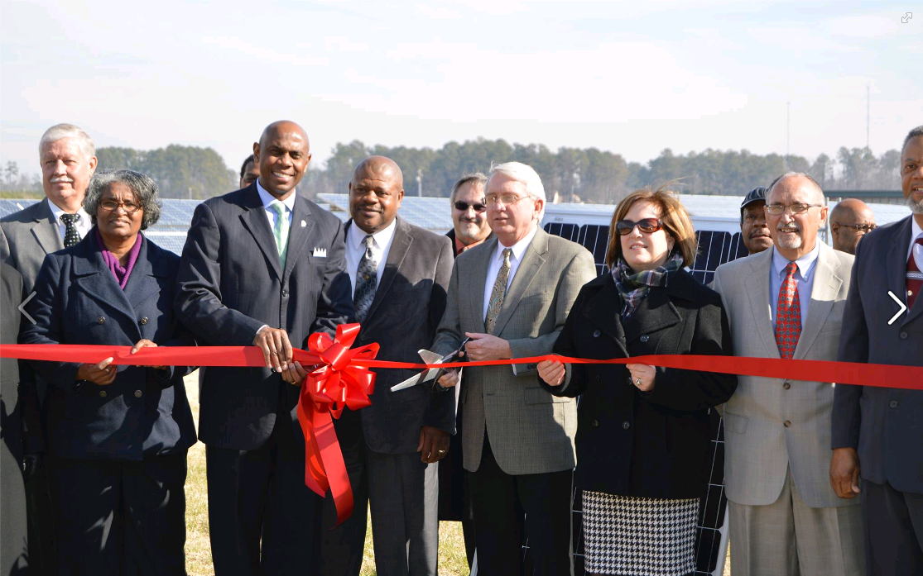
Roanoke Electric Cooperative Programs

Slide 20
Community Solar

Slide 21
Connecting LMI Solar and TOBF Energy Efficiency Financing
Environmental partners and philanthropic programs interest in supporting LMI participation in community solar
Grant dollars donated to LMI member-owner for purpose of owner panel subscriptions
Member-Owner will receive solar energy credits through a predetermined expiration of panel ownership
Leverage the credits available to LMI member-owner to offset investment needed to address Upgrade 2 $ave health and safety concern

Slide 22
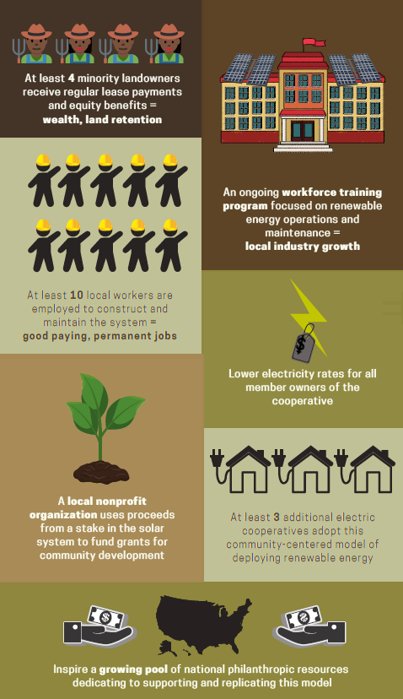
Solar + Storage Benefits to Community
Lease payments to landowners participating in the forestry initiative, aiding family land retention.
10 temporary construction and 1-2 ongoing maintenance jobs created
Workforce training for entry into the North Carolina solar industry
Philanthropic funds leveraged to provide profit sharing to The Roanoke Center and landowner site hosts.
Cooperative’s crowdfunding program invests profit-sharing proceeds into low income efficiency improvements and community solar programs.

Slide 23
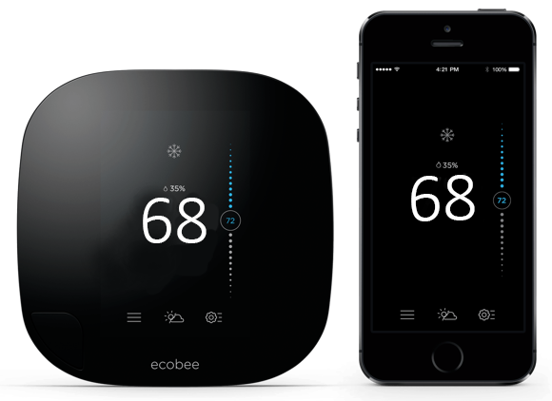
Smart Energy Savings
Beneficial Electrification Programs

Slide 24
Roanoke’s EV Home Charging Program
EV owners can now enjoy the convenience of “re-charging” at home with the new home charging station
Fast charging available from 10:00 PM to 5:00 AM daily.
24-hour fast charging available on some holidays.
REC will professionally install chargers at no upfront cost to the member-owner – a $1,700 value
Additional EV benefits
Spend very little money on maintenance costs, such as oil changes, since EVs have no engine or transmission that requires maintenance and repairs
Just a very powerful battery

Slide 25
Continuing the Learning
If interested in keeping up with the ACCESS project, email us and we can help you get on the NRECA/BTS newsletter.
Please email our team at: SolarAccessProject@nreca.coop
For more information about ACCESS, please visit our website:
https://www.cooperative.com/programs-services/bts/access/Pages/default.aspx

