Slide 1
Customer Experience Research to Improve Energy Assistance Programs
National Energy & Utility Affordability Conference
Session #C4: Policies to Increase Access to Low-Income Energy Programs
June 3, 2019, Fort Worth, Texas
Nat Treadway, DEFG

Slide 2
Welcome to Texas! … a land of tradition and innovation
ERCOT-ISO, the 3rd interconnection (after the Eastern and Western)
25% of wind power in U.S. (TX #1 wind power state); more electricity from wind than the 4 nuclear units
By far the most competitive retail electric market in North America*
100% penetration of advanced meters in competitive market
Low prices for frequent shoppers
Extraordinary time-of-use pricing choices (designed for consumers)
Ability to lock in electricity prices for a year or longer
Wholesale / Bulk Power
Retail / Energy Services
* No default service since 2007; regulated wires utilities do not own or sell kWh; you pay one retailer who pays utility

Slide 3
Services not commodities
Regulators ought to reexamine all components of energy service, as well as consumer preferences and behaviors
All of these transactions affect the customer experience
Low Income Customer Services
Delivery of Commodity
Rate or Bill Discounts
Education & Outreach
Energy Efficiency Programs
Energy Assistance
Contact Center Inquiries
Payment Arrangements
Fees & Pay Processing
Bill or Rate Stability
Bill Pay Choices
Arrearage Management
Alerts & Notification
Rate / Std. Tariff
We are focused today on these services and the customer experience
“Too many electric industry stakeholders have a habit of describing the electric industry in pure commodity terms, but that language is detrimental to reform”

Slide 4
What was the research approach?
“Low Income Energy Assistance Customer Experience Research” took a detailed look at the customer experience as people applied for and received energy assistance
The sponsors want to improve their services to income-qualified retail utility customers and to local agencies (non-profit and governmental partners)
Nine utilities participated; five of these identified retail customers for twenty-five, one-on-one interviews; one utility conducted two focus groups
Heart of the Customer—a specialized journey mapping company—conducted the customer interviews and created customer journey maps

Slide 5
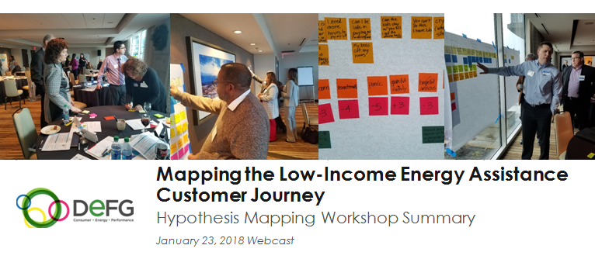
What was the research approach?
Background research
White papers & presentations: Low Income Energy Issues Forum, 2013-18
Focus groups in four cities on utility bill affordability and programs, 2016-17
Southern Company portal research and agency partner interviews, 2016-17
PG&E customer journey mapping research report, 2018
Hypothesis mapping workshop exercise, 2017
DEFG annual customer surveys on affordability and utility services, 2014-18
Low Income Energy Issues Forum database of low income programs, 2017-19

Slide 6
What was the research approach?
Source: “Lessons from Other Industries, Framework Review,” a presentation by Judith Schwartz to the Low Income Energy Issues Forum, February 17, 2016, DEFG LLC.

Slide 7
What was the research approach?
Current research
Frontline employee interviews (DEFG)
Local agency interviews (DEFG)
Utility executive interviews (DEFG)
Focus groups (2) in Syracuse, NY (Drive Research)
Interviews with customers (25) from five utilities (Heart of the Customer)
Customer journey maps; action workshop (Heart of the Customer)

Slide 8
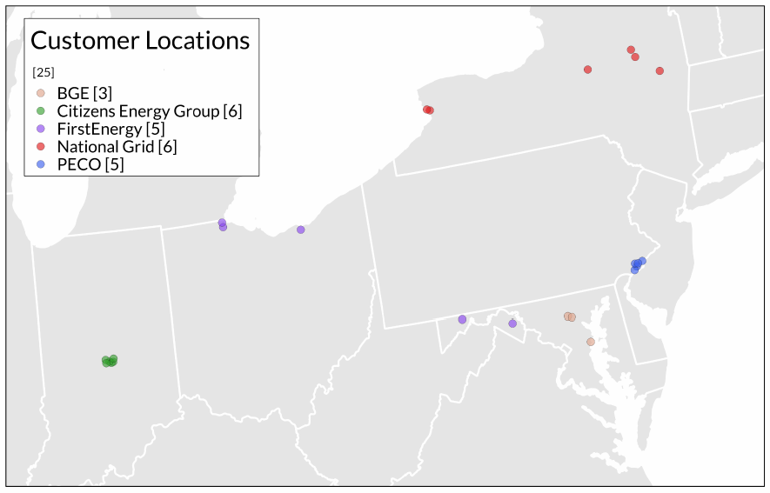
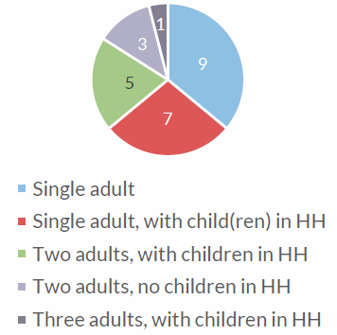
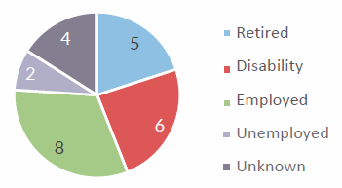
What was the research approach?
Customer Immersion / 25 Customer Interviews
Household Size & Composition
Source: "The Low-Income Energy Assistance Customer Journey: Mapping and Improving the Experience. Insights Report.” Slides 5, 6 & 7. May 13, 2019. Prepared by Heart of the Customer for DEFG LLC.

Slide 9
What was the research approach?
Customer Journey Map (Inexperienced Applicant)
Source: “UCRC Low Income Energy Assistance Customer Experience Research” Workshop document, May 22, 2019, prepared by Heart of the Customer for DEFG LLC.

Slide 10
What did we learn?
Observations from interviews, focus groups, customer journey maps, and the workshop

Slide 11
What did we learn?
Gratitude is the prevailing emotion
#2: anxiety
#3: relief

Slide 12
What did we learn?
Pride, shame, and stigma are extremely important
Ongoing outreach and education are needed—it’s very important to ensure awareness, overcome pride or shame, and broaden access
Respectful treatment during intake is extremely important (and does not always occur)
More research is needed to understand customers’ emotions and feelings
To do: Study ways to broaden access by overcoming pride

Slide 13
What did we learn?
Few applicants do independent research before applying
(frontline employee quotes)
Source: "Frontline Utility Employee Interviews," UCRC Low Income Energy Assistance Customer Experience Research. Presentation: Webcast Summary of Telephone Interviews. Conducted by Nat Treadway, DEFG LLC. February 8, 2019.

Slide 14
What did we learn?
Segmentation is very important
Younger customers may not know about energy assistance
Many customers prefer digital interactions, yet digital does not suit everyone
Age, income, gender, … pay attention to all demographic groups as well as differences among households and individual preferences
Do not treat income-qualified customers as if they are bad actors
To do: Examine DEFG’s work on customer segmentation http://defgllc.com

Slide 15
What did we learn?
“Fast and simple” matters
Income-qualified customers suffer from lack of time as well as income
Process is confusing and burdensome for new/inexperienced applicants
In-person appointments and extensive documentation requirements are hurdles
Transportation and parking increase the cost of in-person interviews
Redundant documentation requirements are frustrating
Program administration must be reformed to simplify applications and intake
To do: Follow the activities of utilities that are relying on customer self certification

Slide 16
What did we learn?
“Seamless intake” is highly valued
Make it easy to enroll in everything at once (everything for which customers are eligible)
Integrate programs from a customer perspective
Build systems that integrate with other organizations (if authorized to do so)
To do: Identify energy assistance programs that are well integrated with other income-qualified programs (future topic for a presentation to the Low Income Energy Issues Forum)

Slide 17
What did we learn?
Lack of updates and communication are frustrating
Worried customers call the utility or the local agency
They call to learn when benefits will start or appear on their bill
This creates inefficiencies
To do: Identify excellent notification systems and utility best practices (future topic for a presentation to the Low Income Energy Issues Forum)

Slide 18
What did we learn?
Data analytics are important
More utility employee training is important, but there is also a need to install smarter systems to support utility employees
Utility executive: “The call center and back office [employees], both, will have more training. But that is a lesser of my goals. The systems need to be smarter. We need more data to understand customers’ needs.”

Slide 19
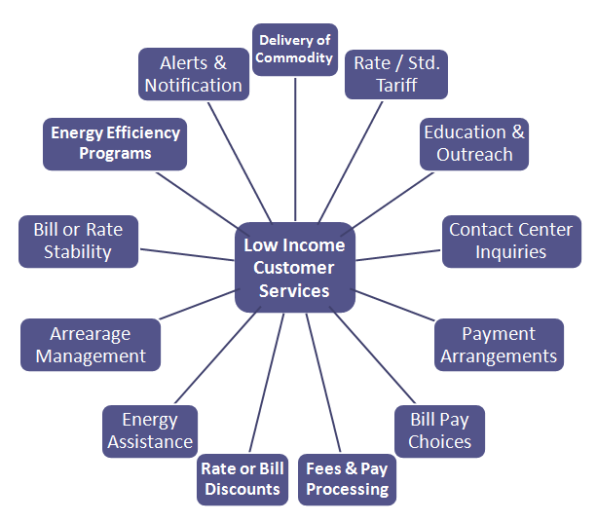
What did we learn?
Burdensome requirements may reduce access (… people won’t participate)
Other utility programs and services tied to EA Program
Energy Assistance Program
Payment Arr.
Budget Bill.
Arrearages
Element 1
Discounts
Element 2
En. Effic. Prog.
Element 3
Supplier Choice
________*
Energy assistance program administration and execution
* This is not intended to be an exhaustive list

Slide 20
What did we learn?
Portals that support local agencies are useful
Many utilities have portals; others are building them
Local agencies would benefit from easier access to the customer account data they are authorized to view
Local agencies want help with digital processing and tracking metrics
To do: Follow the work of the Low Income Energy Issues Forum on agency portals

Slide 21
What did we learn?
Empowered
Supported
Trusted
Source: “UCRC Low Income Energy Assistance Customer Experience Research” Workshop breakout group activity, May 22, 2019. Conducted by Heart of the Customer for DEFG LLC.

Slide 22
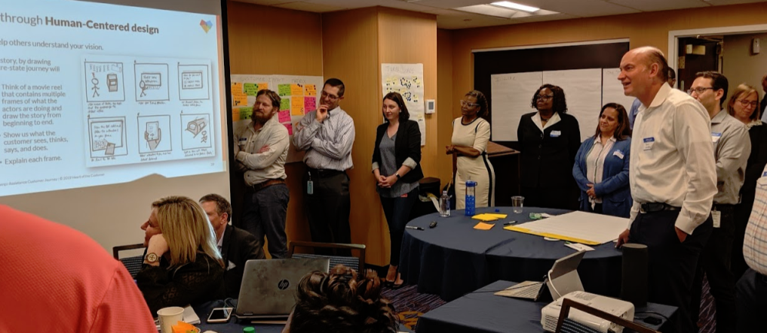
What did we learn?
Five Breakout Group Ideas
Welcome Package
Letter / package with information about programs
Life Event Triggers
Proactive outreach after job loss, military deployment, etc.
Self Certification for Enrollment
Customers take responsibility for self-certification process
Grant Notification Process
More communications about when the grant is applied to account
Pledge to Pay
Utility assumes the financial risk of a pledge
Source: “UCRC Low Income Energy Assistance Customer Experience Research” Workshop breakout group activity, May 22, 2019. Conducted by Heart of the Customer for DEFG LLC. (These five ideas were selected by the groups.)

Slide 23
What did we learn?
Source: “UCRC Low Income Energy Assistance Customer Experience Research” Workshop breakout group activity, May 22, 2019. Conducted by Heart of the Customer for DEFG LLC.

Slide 24
Final Thoughts
Observations on the customer experience

Slide 25
Final Thoughts
Great transactions may not result in a great customer experience
From interviews with utility executives:
“Currently our customer interactions are very transactional. We have a lot of processes established to resolve a customer’s situation. [However,] the processes don’t take into account the customer’s experience”
“While transactions are the exchanges or interactions between these two parties—the utility and the customer—the experience is the customer’s perception of these events, including the recollection of what happened”
To do: Conduct more research on the customer experience as revealed through customer perceptions and memories about transactions. Conduct more research on consumer emotions and behaviors

Slide 26
Next workshop November 7-8, 2019 in Bellevue, WA
Send me an app message or hand me your:
Business card
My cell #
Day/Time

Slide 27
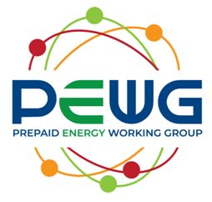
Contacts
Nat Treadway, DEFG
713-729-6244
ntreadway@defgllc.com
Project Lead — Low Income Energy Issues Forum (LIEIF)
DEFG believes retail customers are the future of energy. We partner with clients to improve all aspects of the customer relationship. We identify opportunities to create value in a commodity marketplace.
Persons interested in low income energy issues should “Join Our Mailing List” and receive the publication announcements at: http://defgllc.com/publications/
DEFG Research Consortia

