Slide 1
Over Budget: Mapping Compounded Transportation, Housing, and Energy Burdens in CT
GANNON LONG POLICY & PUBLIC AFFAIRS DIRECTOR, OPERATION FUEL
EMILY BASHAM SENIOR MANAGER OF PARTNERSHIP DEVELOPMENT, CONNECTICUT GREEN BANK
Notes:
What Who When Why
Where (transition to CT snapshot slide)

Slide 2
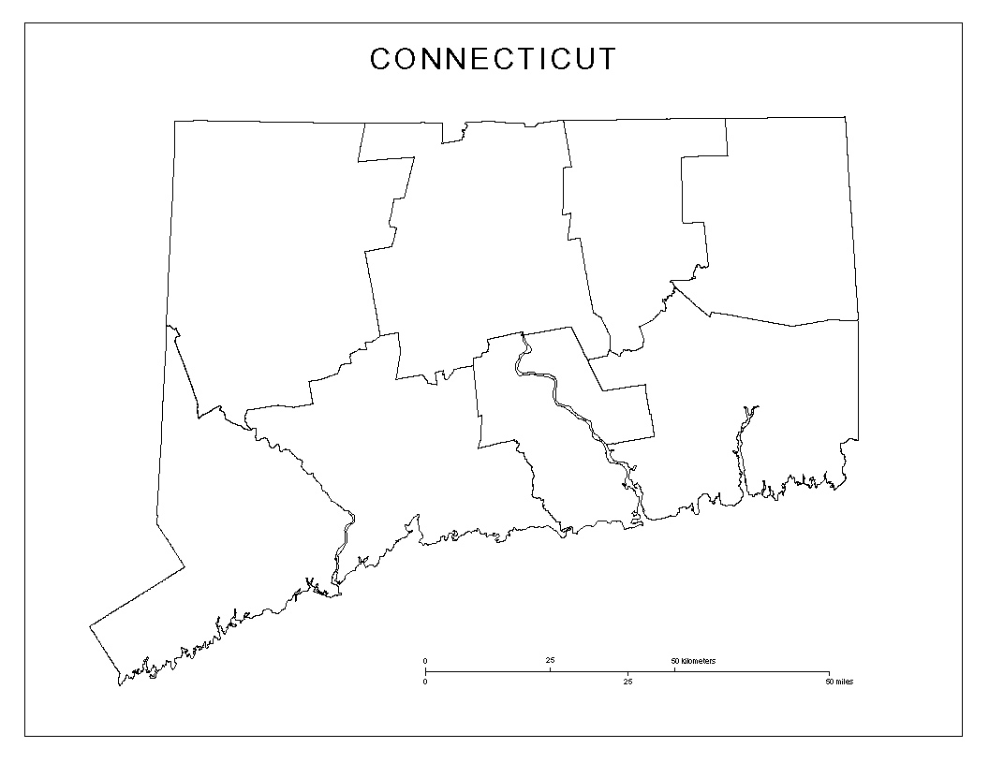
CT Snapshots: Geographic Diversity, Wealth Inequality
Capital area
UConn territory (Eastern CT)
Fairfield County
Notes:
CT median income roughly $71k. Wealthiest state in US via per capita income. Roughly 10% people in CT live in poverty.
This map shows our counties, which are geographical boundaries but otherwise largely meaningless in CT (unique property tax, small town governance model; contrasts with most other states with regionally managed & shared assets; governance model perpetuates inequality. In Hartford, life expectancy is 12 years shorter than in border suburb West Hartford. (CT Mirror) Note for VEIC study which cites “area median incomes” - In Westport CT, median income is roughly $188k, vs Bridgeport next door, median income is closer to $44k.
Reference – Greenwich zip code 14th wealthiest in US - Bloomberg https://www.bloomberg.com/news/articles/2020-11-27/richest-american-zip-codes-it-takes-2-2-million-a-year-to-live-in-us-no-1#:~:text=Fisher%20Island%2C%20a%20216%2Dacre,a%20third%20to%20%241.72%20million.

Slide 3
VEIC Study: Baseline Definitions
Affordability gap: Difference between an affordable level of spending (based on census tract income) vs actual costs.
Burden: Spending as a % of household income.
Transportation 15%
Energy 6%
Building (housing & energy): 30%
Combined: 45%
Notes:
Recommended spending levels based on % of income for basic needs.

Slide 4
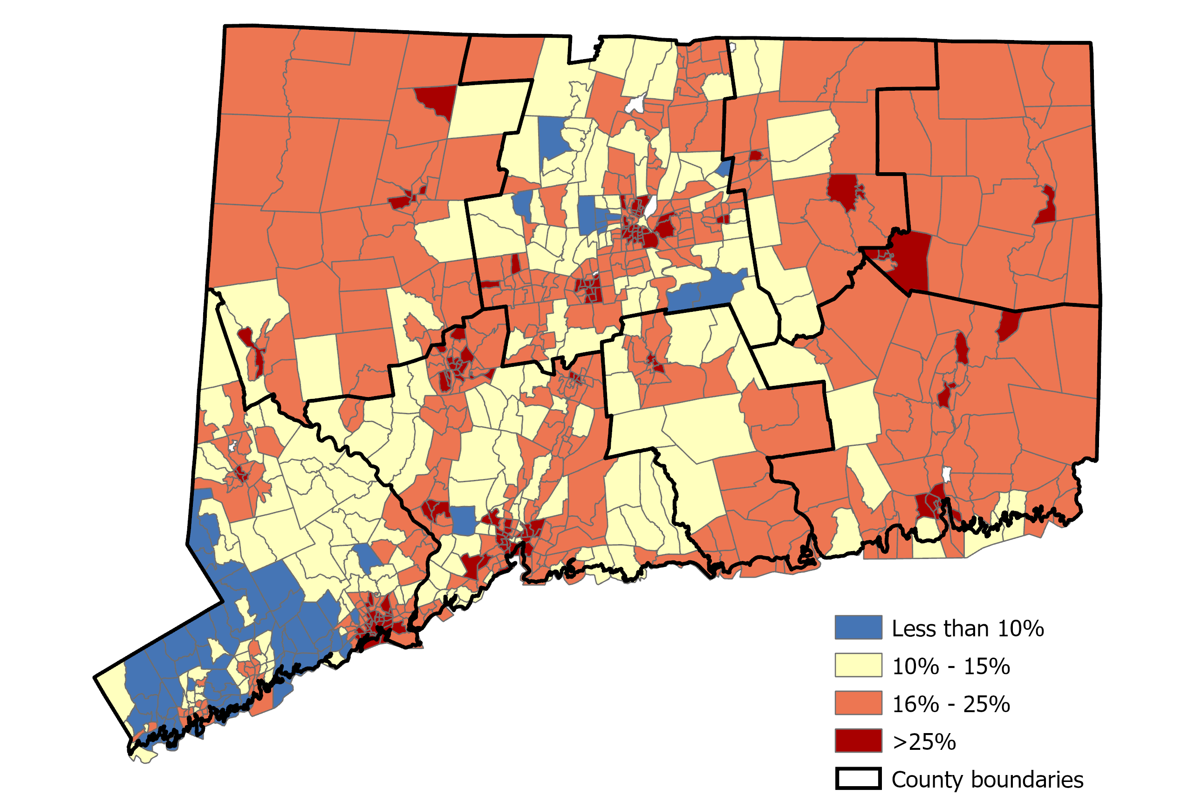
CT Transportation Burden by Census Tract
Transportation burden:
High almost EVERYWHERE in CT
Unaffordable in 75% census tracts
Mobility is restricted without a private vehicle
Rural cost drivers: car ownership & maintenance costs, Vehicle Miles Traveled; lack of alternatives
Urban: low incomes; high energy burdens clustered in high density areas; old/ inefficient housing stock
Figure 6. Transportation burden by census tract.
Notes:
Two of the primary findings from VEIC’s study are that that transportation burden is high throughout the state; and that without a private vehicle, mobility is quite limited. This is why we advocate for better public transportation service and active transportation infrastructure.
Requiring folks to own a car so that they can get to school, work, and medical appointments reduces net income, and erodes economic mobility.
Main drivers of transportation burden in rural areas include high costs of private vehicle ownership; maintenance costs go up with vehicle miles traveled.
Main drivers of transportation burden in urban areas center around low incomes, derived from decades of policy designed to segregate and disenfranchise poor people. [Keep in mind that the highest salaries in our capital city are very rarely earned by people who live there.] City dwellers are also likely to experience unaffordable energy and housing costs, with decades of underinvestment in older, energy inefficient housing stock.
We understand all of these burdens to be exaggerated by high unemployment & COVID. (55 seconds)

Slide 5
CT Transportation Affordability Gap by Census Tract & Area Median Income
Census Tract AMI Band | Mean Household Transportation Affordability Gap
<60% AMI | $5,097
60-80% AMI | $3,464
80-100% AMI | $2,050
100-120% AMI | $1,067
>120% AMI | No gap
Table 5. Transportation Affordability Gap by AMI Band
Income bands are based on Census Metropolitan Statistical Area.
Figure 7. Transportation spending affordability gap by census tract.
Notes:
The affordability gap for transportation is high throughout CT. Additional data suggests even higher transportation burden for Study uses AMI. Remember that with stark income inequality in neighboring towns – Westport’s median income is more than 4x Bridgeport’s; West Hartford’s life expectancy is more than 12 years longer than in Hartford

Slide 6
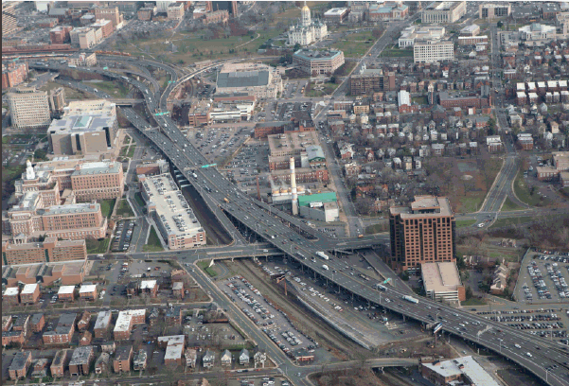
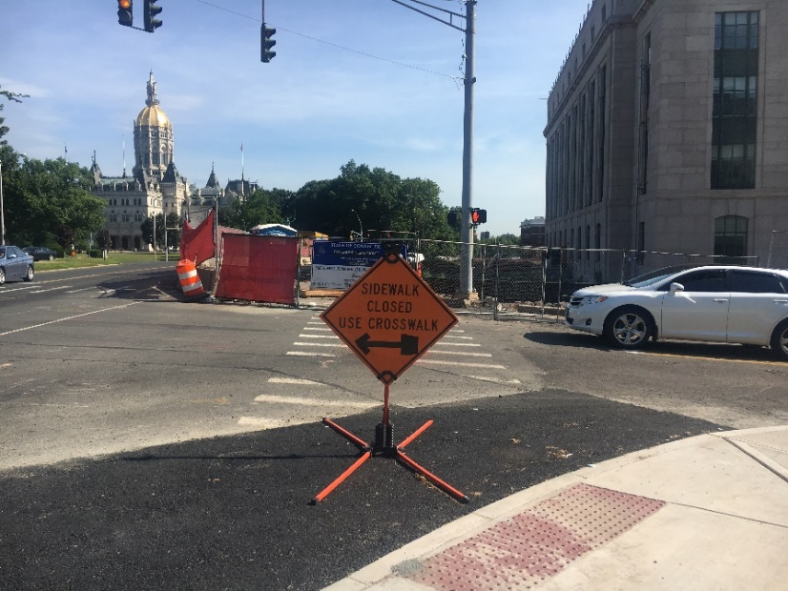
Transportation Burden in CT: Opportunity Costs
Left: Route 84 runs through Hartford, dividing & polluting neighborhoods throughout the city. Above: Pedestrian access only through oncoming traffic near the Capitol.

Slide 7
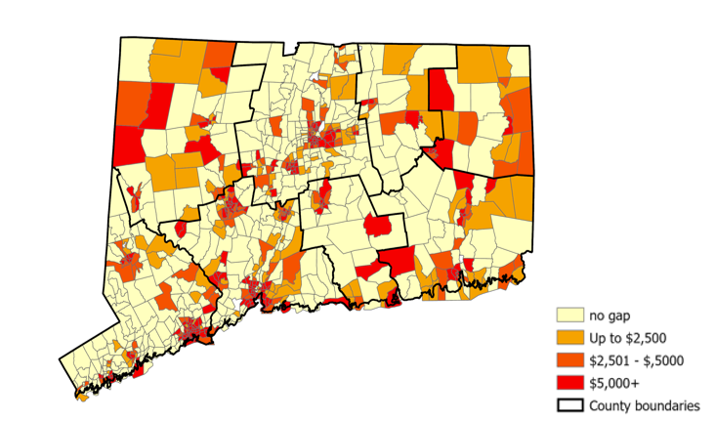
Combined Energy, Transportation, Housing
Figure 9: Combined energy, transportation, and housing affordability gap by census tract
Notes:
Even households above traditional low income thresholds struggle with the combined affordability of building energy, transportation, and housing
Combined MONTHLY spending on energy, transportation, and housing and remaining income for Connecticut census tracts by AMI band.

Slide 8
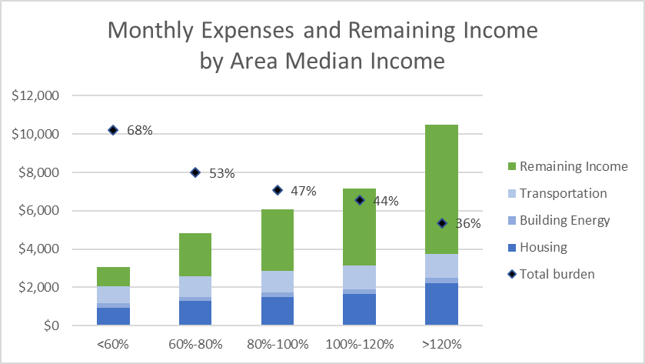
Combined Energy, Transportation, Housing
Figure 13: Combined monthly spending on energy, transportation, and housing and remaining income for Connecticut census tracts by AMI band
Notes:
Even households above traditional low income thresholds struggle with the combined affordability of building energy, transportation, and housing
Combined MONTHLY spending on energy, transportation, and housing and remaining income for Connecticut census tracts by AMI band.

Slide 9
Key Takeaways
Important to include transportation and housing costs to understand affordability
Energy burden is highest among low-income households: 6-7 times higher
High energy burdens are clustered in urban areas
Combined efficiency and solar can close the building energy affordability gap for many low- and moderate-income households
Transportation costs are high across the state
Reducing transportation costs is crucial to preserving affordability
A personal vehicle is needed almost everywhere for an acceptable level of mobility

Slide 10
Recommendations
Understand your state’s energy and transportation burden and energy affordability gap
Consider equity and access in program expansion or creation
Coordination cross state agencies and programs
Income-eligible EV programs: overcome higher upfront costs to provide access to fuel savings
Income-eligible electric bike
Expansion of transit services (microtransit and transportation network companies)
Transportation and Climate Initiative would provide dedicated funding to reduce emissions and increase mobility

Slide 11
Big Picture
Where are we going, and how do we get there?
Notes:
We began looking in from the hills at a beautiful view of our state Capitol in Hartford. We zoomed in closer to realize there are more obstacles to safe, clean, reliable transportation than it may seem.
We discussed our state’s transportation burden, and the equity, health, economic, and educational benefits of reducing reliance on private vehicles & the fossil fuel infrastructure they rely on.
Now we’re ready to invest in a system that will work for all of us, long into the future. Here is my little train-obsessed 4 year old nephew, August “The Conductor” Long, shown reading a passenger train safety manual, wearing his Amtrak overalls & cap.
Here’s the question: When August turns 78 like Amtrak Joe, will the world be any less reliant on cars than we are today? To make sure, we have to start right now.
To achieve climate, economic, and equity goals in CT, we need a major shift in how we analyze and fund transportation needs. Where these burdens are highest present the greatest opportunities to invest in equity including transit oriented development, housing, building, efficiency, and other incentives.
Without intentional intervention, inequality inevitably reproduces.
What would our future be if we treated inequality, racism, and climate change with the existential urgency with which we respond to COVID?
Thank you all so much for being here with us today.

Slide 12
Continuing the Learning
Contact:
Gannon Long, Policy & Public Affairs Director, Operation Fuel Gannon@operationfuel.org
Emily Basham, Senior Manager, Partnership Development, Connecticut Green Bank Emily.Basham@Ctgreenbank.com
“Mapping Household Energy & Transportation Affordability in Connecticut” study: https://www.ctgreenbank.com/wp-content/uploads/2020/11/Mapping-Household-Energy-and-Transportation-Affordability-Report-Oct-2020.pdf

