Slide 1
Education and Outreach to Low-and-moderate Income Consumers Sandra Mattavous-Frye, People’s’ Counsel for the District of Columbia
NEUAC Conference June 3-5, 2019 Fort Worth, Texas

Slide 2
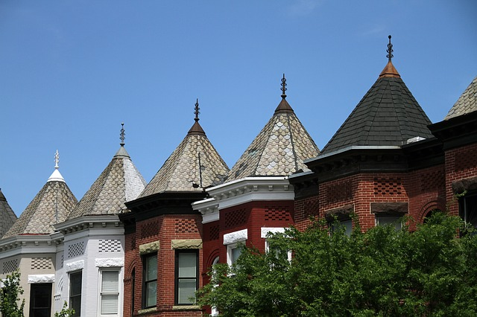
ABOUT US
The Office of the People’s Counsel for the District of Columbia
We are 47 employees dedicated to representing the interests of all District of Columbia utility consumers.
OPC is mandated to advocate for consumers before the DC Public Service Commission, other regulatory bodies and the courts, conduct consumer education and outreach, and assist consumers in resolving utility complaints
We serve natural gas, electricity, telecommunications and water ratepayers

Slide 3
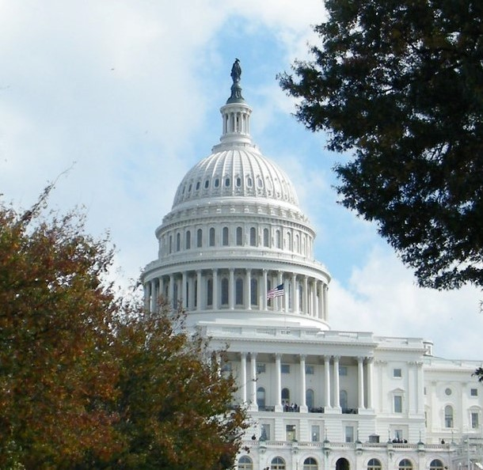
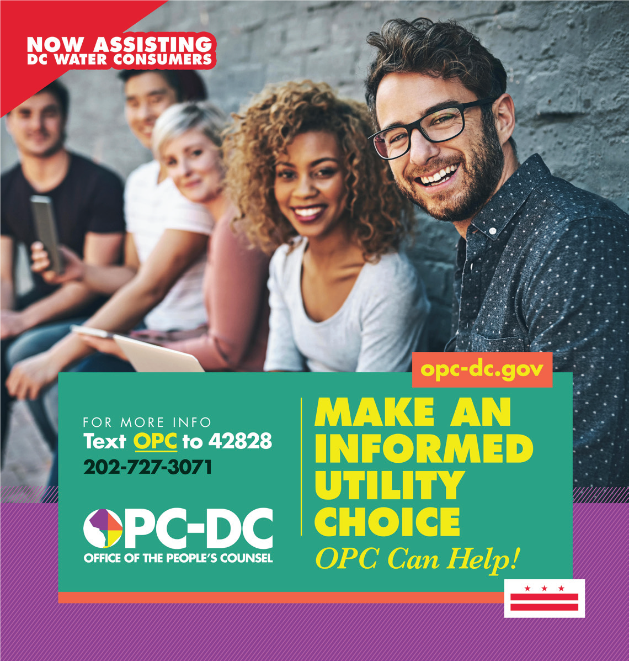
THE CHALLENGE
A Tale of Two Cities:
DC is reported to have the highest income inequality in the nation with the top 20% of the population having incomes 29X higher than the lowest 20%
DC Median Income of $77,000, is 20% above the national average ($61K)
48.6% of Americans earn less than $30,000. Over 133,000 District residents have incomes of $25,000 or less.
High number of single parent households and senior/retiree households at or near the poverty level ($25,000), more than 1 in 4 children living at or below poverty level.
10 years of rapid population growth is increasing the cost of living for housing and retail goods

Slide 4
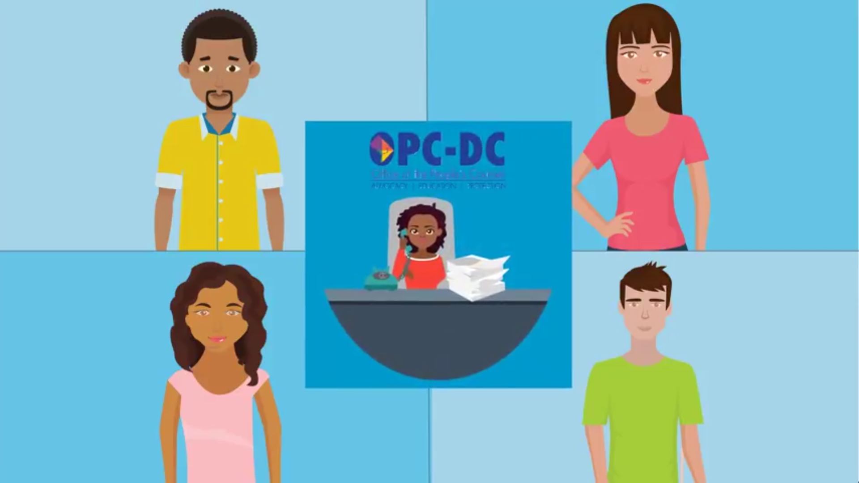
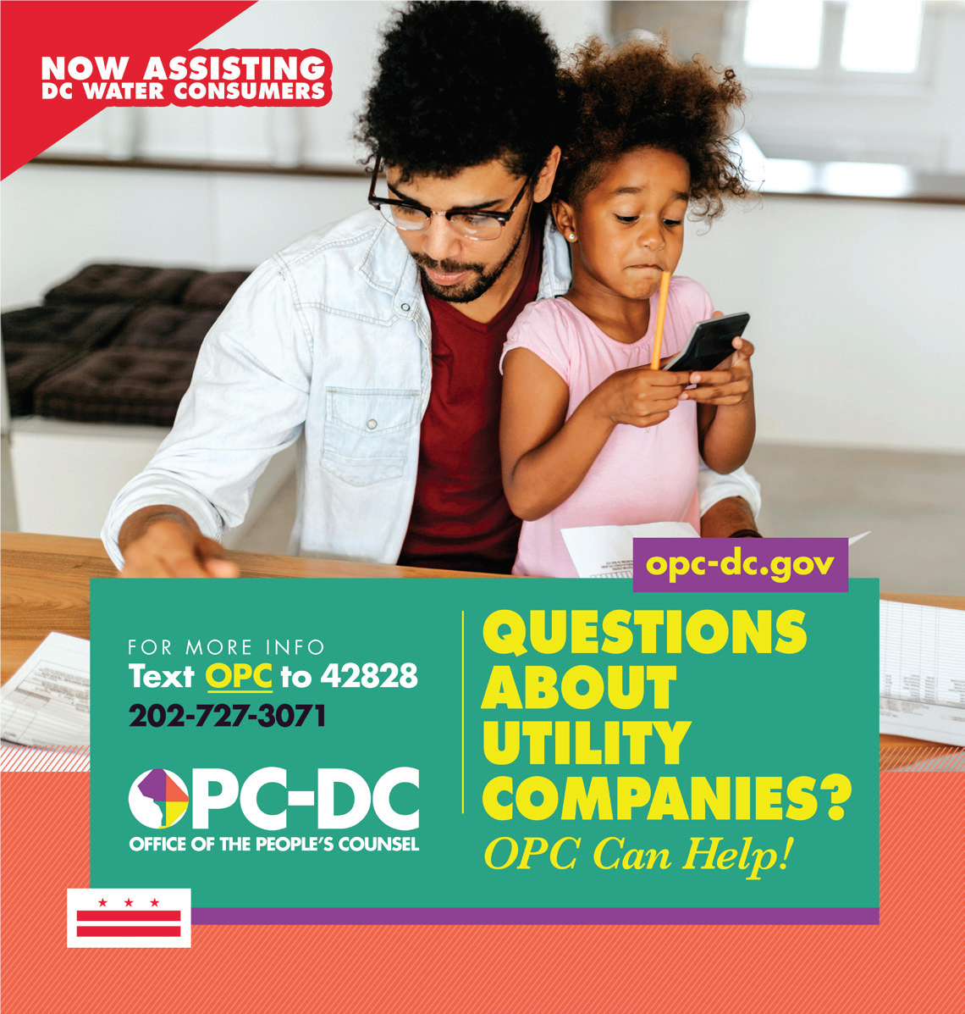
THE RESPONSE
Use a variety of tools, no one communications approach is likely to be effective for a broad range of consumers
Social Media, including email “blasts” contact management software, and yes, Facebook and Twitter are your friends
Video, Radio, Public Space awareness ads all help to reinforce your message
Consider using outside resources such as publication design or grants to fund a project, study or awareness campaign

Slide 5
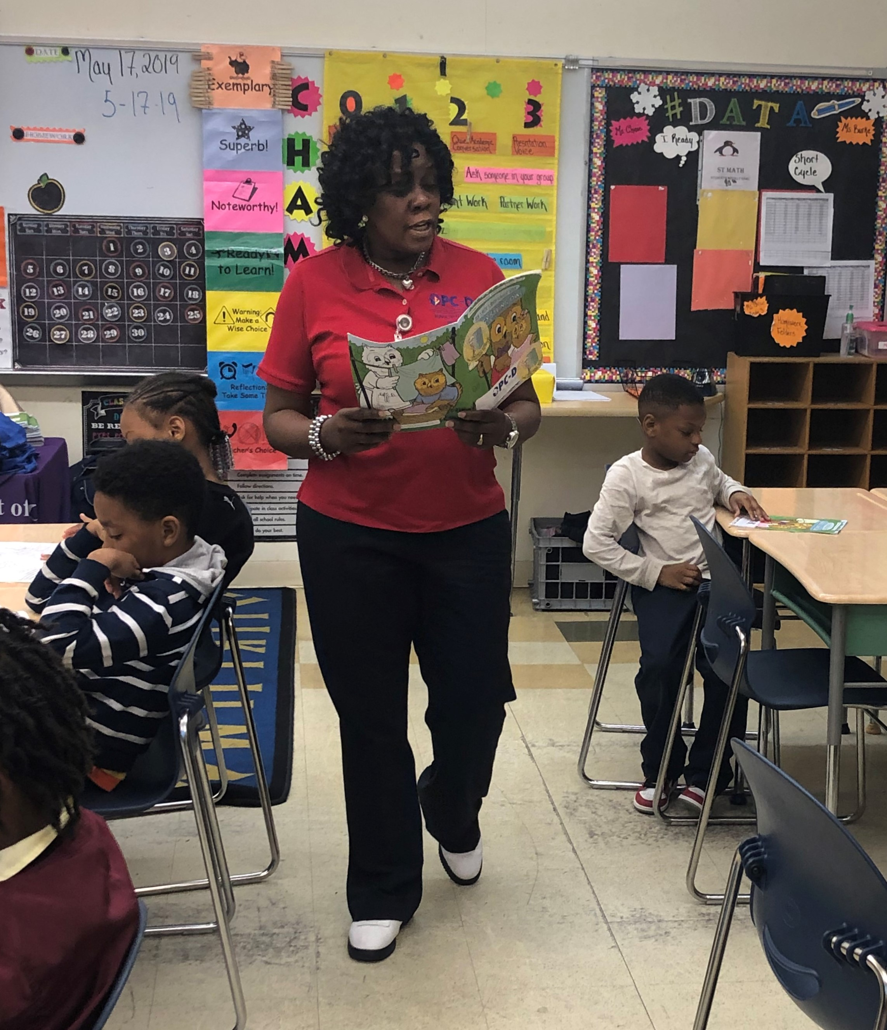
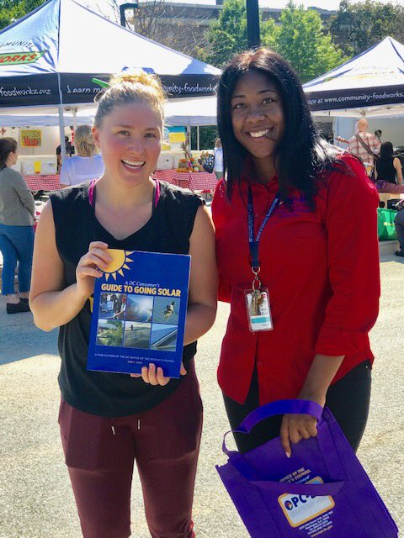
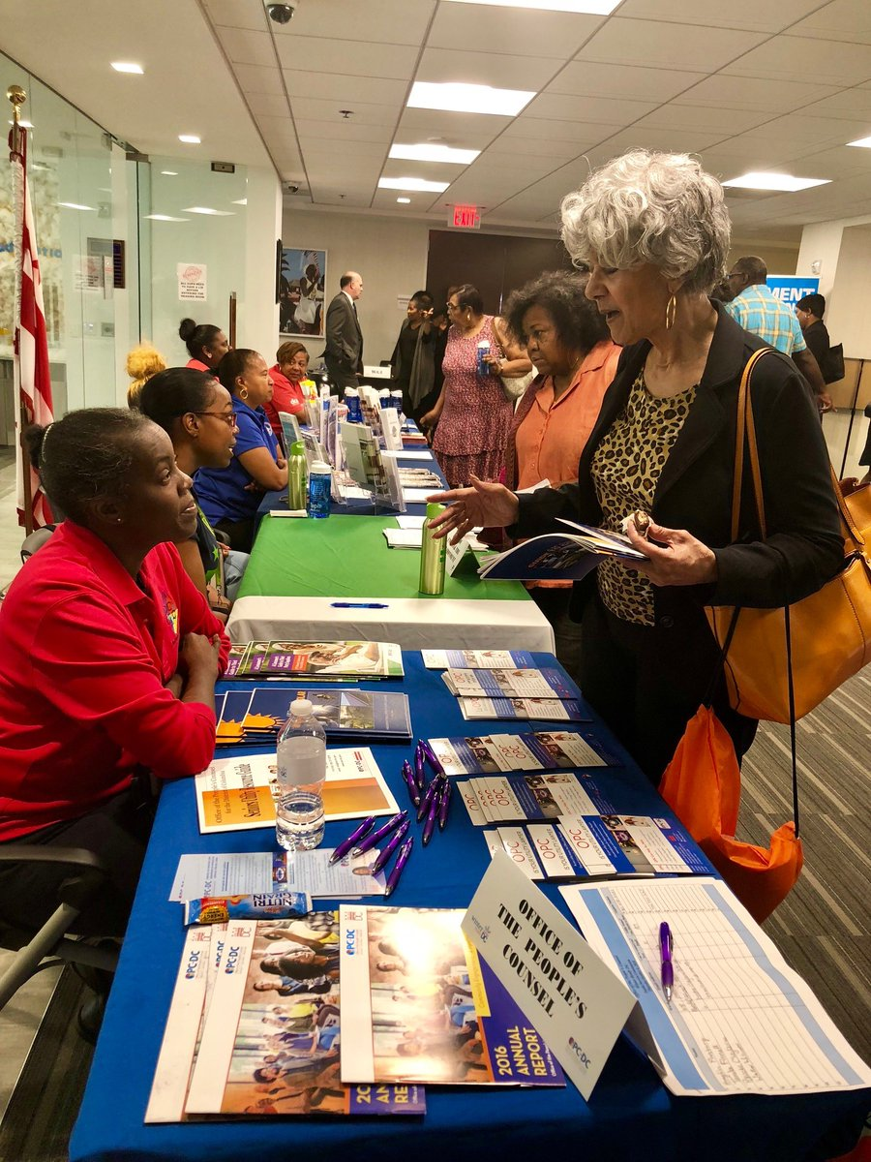
BEST PRACTICES
Know your consumers
Keep your team aware of the day to day customer experience with utility services, what consumers say they need and how they use utility services
Communicate change to consumers
New service offerings, new utility providers, rates changes and utility scams need to be explained in lay language and shared in real time
Budget for Outreach
Expanding consumer engagement to tell your story will often require professional resources beyond your staff, graphic arts, social media, photography, printing etc.
Collaborate
Other government and non-government groups that share your constituents (housing, employment, taxation, DMV) can be valued partners in sharing your message

Slide 6
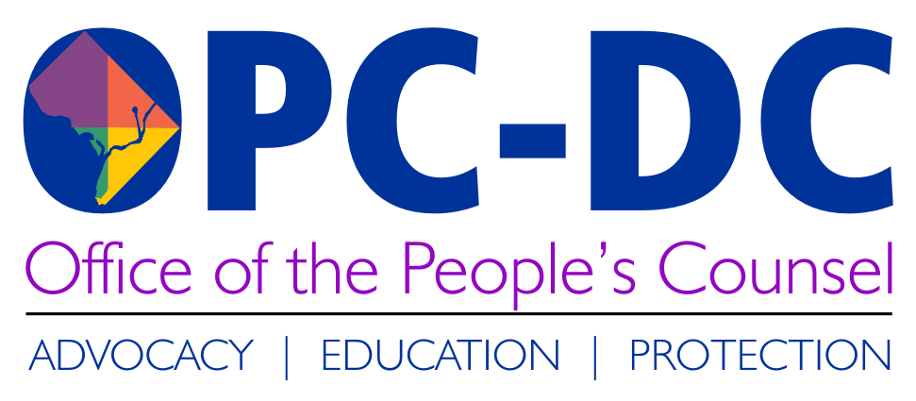
Contact OPC
1133 15th Street NW, Suite 500
Washington, DC 20005
202.727.3071 (office)
202.727.2876 (hearing impaired)
info@opc-dc.gov
www.opc-dc.gov
@DCOPC (Twitter/Instagram)
@DCPeoplesCounsel (Facebook)

