Slide 1
New to Customer Assistance and All That Goes with It! An Introduction
Libby Perl, Congressional Research Service
2019 National Energy and Utility Affordability Conference
June 3, 2019

Slide 2
Sources of Energy Assistance
Charitable Assistance
State Appropriations
Utility Funds
Federal Programs (LIHEAP & Weatherization)

Slide 3
What is LIHEAP?
LIHEAP Is… a federal grant program, enacted in 1981, that assists low-income households with their energy needs.
Grantees Are… States, tribes, and territories.
DC is treated as a state, Puerto Rico a territory.
Grantee Discretion Includes…
Types of assistance to provide,
Who is eligible,
How funds will be administered.

Slide 4
How Are Funds Used?
Heating ― Provided by all 51 states; 51% of funding.
Cooling ― Provided by 19 states; 7% of funding.
Crisis Assistance ― Provided by all 51 states; 17% of funding.
Weatherization ― Provided by nearly all (48) states; 11% of funding.
Source: Department of Health and Human Services, LIHEAP Data Warehouse. FY2017 data (preliminary), https://liheappm.acf.hhs.gov/.

Slide 5
Who Is Eligible?
Income Limit: Households with incomes at the greater of 150% of federal poverty level or 60% of state median income.
E.g., Texas — ~ $39,000 or ~ $45,000 for a family of four.
Income Floor: States may not make ineligible any households with incomes less than 110% of poverty.
~ $28,000 for a family of four.
Categorical Eligibility: States may make eligible any household where a member receives:
TANF
SNAP
SSI
Certain Veterans Benefits

Slide 6
LIHEAP State Eligibility
Maximum Income: In FY2019,
Most states (42), including DC, have maximum income limits of at least 150% of poverty for heating benefits.
9 states have income limits below 150% of poverty.
States might have different eligibility levels for crisis assistance and weatherization.
Categorical Eligibility: 20 states have eligibility based on TANF, SSI, SNAP, or VA benefits.
Asset Tests: 11 states have asset tests for heating assistance.
Source: LIHEAP Clearinghouse, https://liheapch.acf.hhs.gov/.

Slide 7
Other Eligibility Considerations
Energy Burden: Households that should receive the highest benefits have:
Lowest Incomes
Highest Energy Burden (energy costs ÷ income)
Special Needs Populations: States should conduct outreach to eligible households, especially:
Those who are “elderly”, have a disability, or a high energy burden.
Renters: The LIHEAP statute provides that owners and renters be treated “equitably.”

Slide 8
LIHEAP Recipient Households (Heating)
“Elderly” (60+) Member: 37% of households
Person with a Disability: 39% of households
Child ≤5: 18% of households
Households in Poverty:
66% at or below poverty
39% below 75% of poverty
8% above 150% of poverty
Source: Department of Health and Human Services, LIHEAP Data Warehouse. FY2017 data (preliminary).

Slide 9
Average Benefits, FY2017
* Cooling range includes only states participating in cooling.
Source: Department of Health and Human Services, LIHEAP Data Warehouse. FY2017 data are preliminary.
Type of Assistance | Average Benefit | Range
Heating | $383 | $138 — $814
Cooling | $322 | $134 — $749*
Winter/Year Round Crisis Assistance | $235 (winter)/ $118 (year-round) | $43 — $1,194

Slide 10
LIHEAP Funding Since FY1982

Slide 11
Types of Funding, Historically
Regular Funds
Distributed via formula
All states, tribes, and territories
Emergency Contingency Funds
Cases of “natural disaster or other emergency”
Terms are broadly defined
HHS has discretion over whether/when distributed
One or more states, tribes, or territories
Both pots can be used for all LIHEAP purposes.

Slide 12
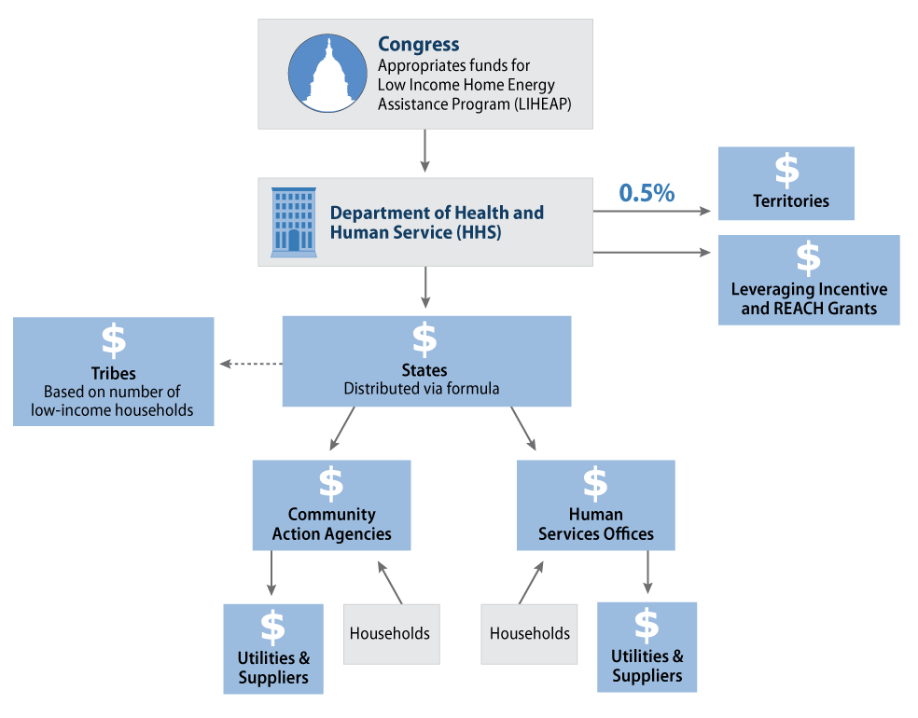
LIHEAP Administration and Mechanics

Slide 13
LIHEAP Performance Measures
Collected by States in collaboration with Utilities and Fuel Suppliers
What’s Collected? Data for LIHEAP-recipient households:
Reduction in Energy Burdens
Prevention of Loss of Energy
Restoration of Services

Slide 14
Resources
LIHEAP: Program and Funding, https://crsreports.congress.gov/product/pdf/RL/RL31865
The LIHEAP Formula, https://crsreports.congress.gov/product/pdf/RL/RL33275

