Slide 1
Speed Dating for Development and Fundraisers Session 1-D
Jody Robertson
Director of Communications, Dollar Energy Fund

Slide 2
Using Radio to Reach New Donors

Slide 3
Dollar Energy Fund’s Donor Base
Engaged in surveys and conducted research to determine demographics for our donor base/potential donor base
Results confirmed what we already knew about existing donors and assumed about potential donors:
More Female than Male
35-55, 55+ years old, married, employed
Suburban homeowners
Household income $80,000+
History of charitable giving
Research and surveys have shown a lack of mission recall among potential donors, but they have interest in supporting an organization that provides utility assistance

Slide 4
Using Radio to Fundraise & Reach New Donors
Needed a way to reach our target audience to educate them on our organization and our mission
Partnered with iHeart Media to establish a signature event on 94.5 3WS, their Classic Hits station – listener base aligns with our donor base
Partnership included pre- and post-event media buy investment
Commercials promoting general awareness for the organization
Weather report naming rights
Live remote broadcasts
Event-related promotional spots

Slide 5
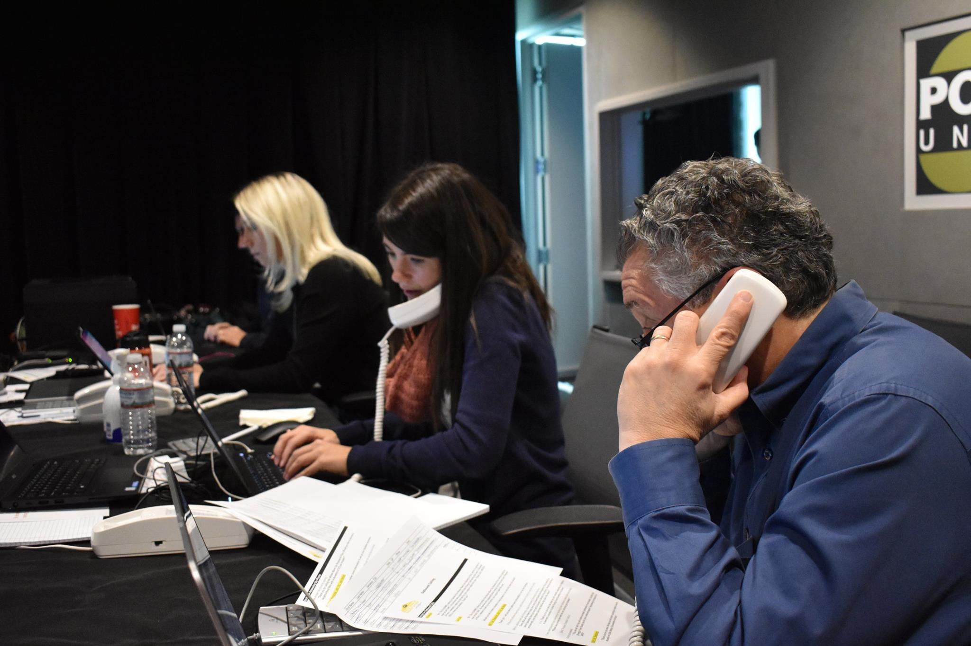
The Winter Warm-Up Request-A-Thon
Two-day event where listeners could make a donation in exchange for a song request, any song would be played
Donations could be made online or via phone
On-air talent heavily promoted $15/month donation option
Additional incentives were available for specific donor levels
Corporate sponsors and utility partners engaged in live broadcast interviews
Client testimonials were played throughout the event
Recorded messages from celebrity supporters gave credibility and established a connection

Slide 6
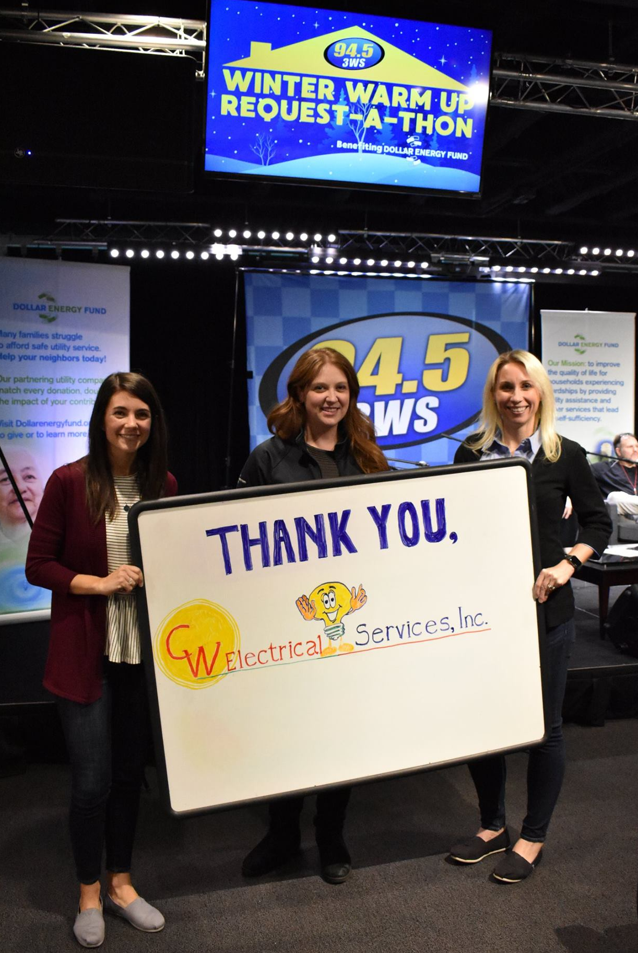
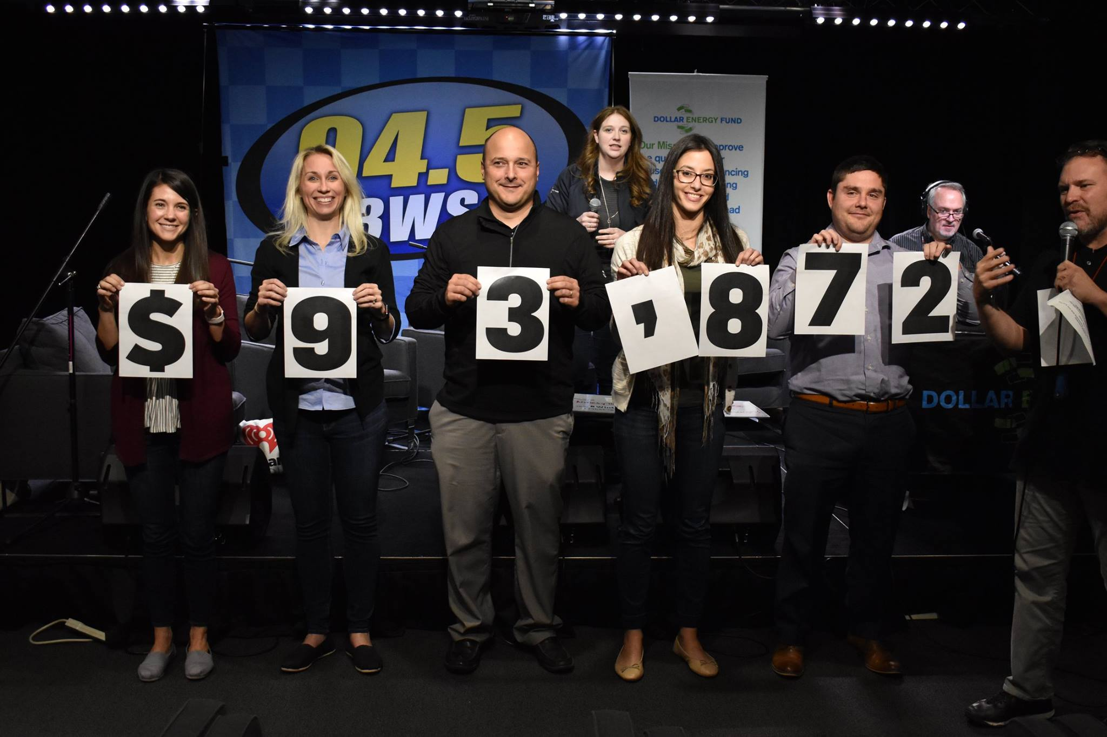
Results from the Request-A-Thon
Year one: $77,352 raised, 220 families helped
140 donors - Almost all were brand new to the organization
Year Two: $93,872 raised, 270 families helped
210 donors – approx. 2/3 were new to the organization
Year-over-year changes and improvements resulted in a higher average donation and more corporate support

Slide 7
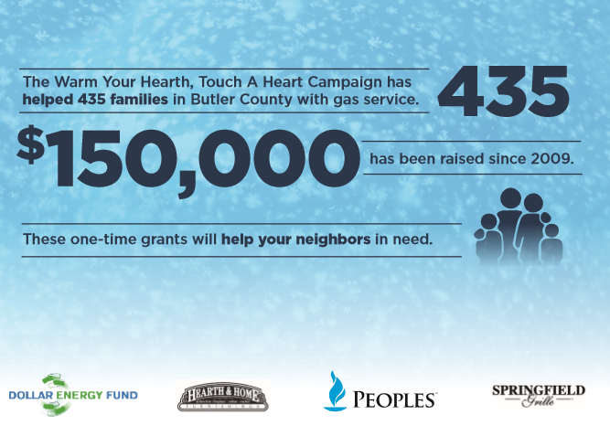
Utilizing Small Business Partnerships to Cultivate Donors
The Warm Your Hearth, Touch a Heart Campaign started in 2009 and is partnership between Hearth & Home Furnishings, Dollar Energy Fund and Peoples
Hearth & Home Furnishings, which sells gas fireplaces and fireplace inserts, wanted a tie-in to what they do as a business, so their partnership and goal to keep low-income households in the community warm has been a good fit for our organization.

Slide 8
The Fundraiser Includes:
Campaign period where a portion of store sales are donated
In-store reception to kick-off the campaign, which features:
Music (DJ Services donated)
Food (donated by local restaurant)
Silent Auction
Ticket Auctions
Raffles
Door Prizes
Ticket Sales
Third-party vendors donating a portion of their sales

Slide 9
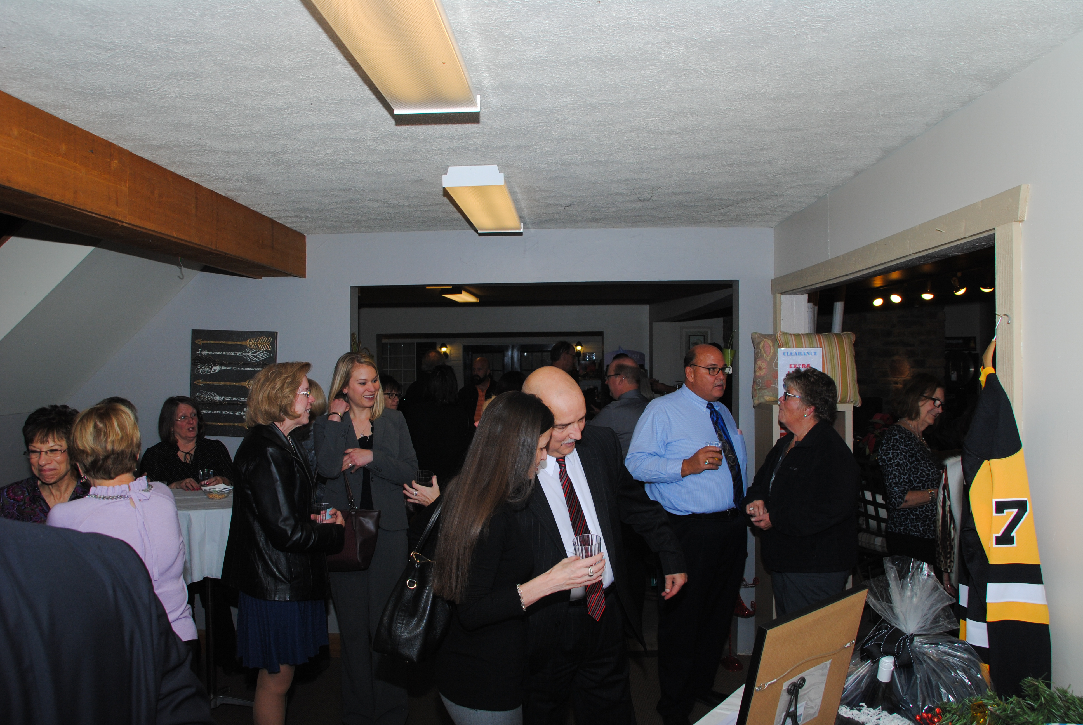
Low-key, evening reception:
inclusive of donors at many giving levels
provides an opportunity to cultivate donor relationships
Allows for introduction to additional potential partnerships in the community

Slide 10
Warm Your Hearth Results – 10 years
The overall total for the campaign is now at more than $160,000
Approximately 460 families have benefitted from our combined efforts over the years
Hearth & Home’s growing customer base brings new donors
65-100 people attend the event each year – old and new faces
Receive consistent media coverage, as well as inclusion in Chamber communications

Slide 11
Questions? Please reach out!
Jody Robertson
Director of Communications
Dollar Energy Fund
jrobertson@dollarenergy.org
412-390-3882
www.dollarenergy.org

