Slide 1
Fundamentals of Utilizing Data for Organizational Outreach
Stephen Marencic
Consumer Outreach Specialist
DC Office of the People’s Counsel
smarencic@opc-dc.gov

Slide 2
“Data is the New Oil”-Clive Humby, UK Mathematician

Slide 3
Goals for this presentation:
Introduce the value of using data to direct outreach efforts
Give a few examples that have proven successful for OPC from two specific case studies
Introduce digital data tools available for use in email, search engine optimization, website design and social media outlets
Offer ways of evaluating success
Create interest in starting similar conversations in your own organizations
Q&A

Slide 4
Case study One: Senior Outreach Awareness and Energy Efficiency Education Campaign
Goals of the Campaign-
Quantify and enhance outreach operations for DC Senior communities with respect to utility service and energy efficiency issues
OPC convened a low- and limited-income senior focus group, comprised of a diverse group of senior residents, community leaders and organizational stakeholders
Some of the most important data that we used to determine outreach strategies came from housing trends from the DC Office of Planning available on their public website

Slide 5
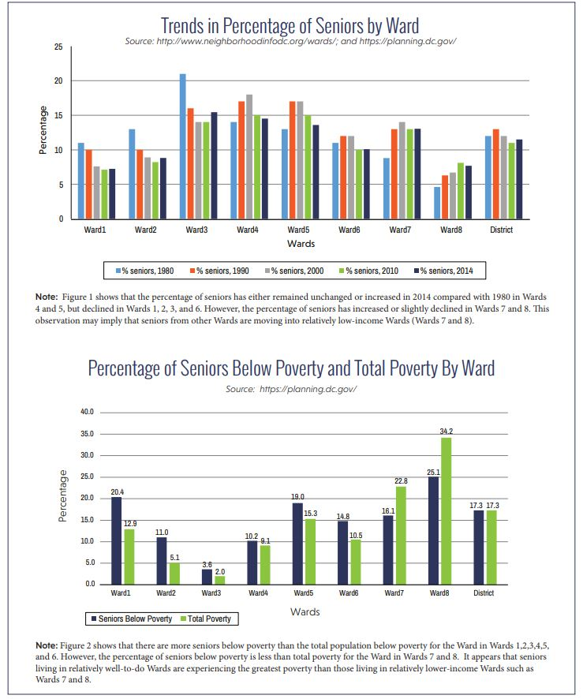

Slide 6
What we learned: -Using this data, we were able to determine which areas of the city housed the largest populations of seniors living below the poverty level. -Targeted outreach strategy could be created to reach audiences in the areas of the city where the need for utility assistance for seniors was greatest.

Slide 7
Next Steps:
Contracted with an outside vendor to distribute OPC literature through traditional door-to-door marketing
Disseminated information to 8,358 low-income and senior households in Wards 5, 7 and 8.
Conducted an extensive outreach campaign including print materials and transit and radio advertisements generating an estimated 109,000 views in newspapers, 3.3 million on bus and train ads, and 1,020,600 listeners on radio stations

Slide 8
Liheap’s Own Data Portal Can Be Informative-https://liheappm.acf.hhs.gov/ What type of information could be useful from this data set? -Number of households with elderly members -Percentage of income eligible homes served -Type of assistance

Slide 9
Case Study Two-Third Party Energy Suppliers
DC is a de-regulated energy market
Spike in consumer complaints during 2013-2014 Polar Vortex
100% Increase in complaints received over two year span
18% of all complaints received
Compiled all data from consumer intake into database

Slide 10
Types of issues with TPS
Deceptive marketing
Confusing contract terms
Variable vs. fixed rate products
Contacting customer service
Canceling accounts

Slide 11
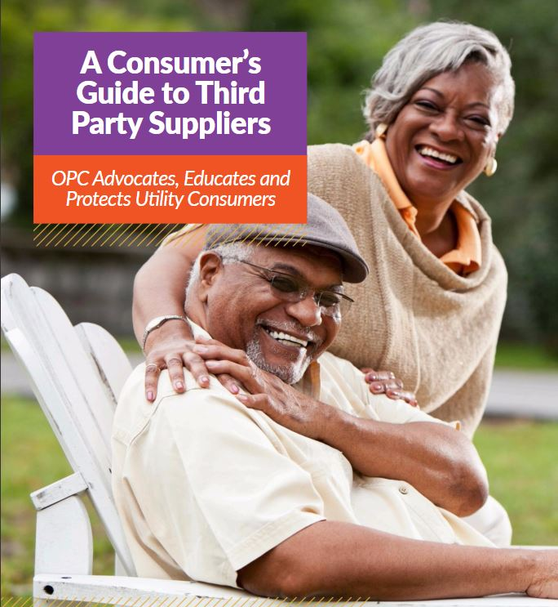
Next Steps:
Formal legal action before Public Service Commission
Settlement agreement resulting in $100,000 TPS company donation to fuel fund, aiding 208 applicants.
Targeted awareness campaign using data from intake software led to creation of “A Consumer’s Guide to Third-Party Suppliers”

Slide 13
Community Outreach: A New Digital World
A 2017 survey of over 1200 government employees found that the No. 1 way respondents identified feedback from citizens was via telephone calls.
However, over 50% of respondents indicated that their main priority for communications in the future was to increase digital engagement.
Respondents indicated that they were currently using website 93%, email 80% and social media 79% of the time to direct information to their audiences.

Slide 15
OPC has used the following more modern methods to improve our outreach:
-Generating more relevant email content
-Creating a monthly newsletter called the “OPC Connection”
- Creating targeted media campaigns including a “text to join” email list option
-Modernizing our website to focus on a more user-friendly approach
-Increasing our Social Media presence
-Subscribing to and participating on local electronic newsletters (called listservs) and blogs

Slide 16
Tips for Improving Email Performance
Collect as many email addresses as possible
Add a “subscribe to our email” overlay option to your website and all current email or newsletters that you currently send
“Text to Join” email option
Segment your audience
A/B Test what works

Slide 17
Examples from OPC

Slide 19
Issues:
Logos are different and one is much too large
Font and color schemes are dated
Headline is too wordy to be easily scanned
Heavy use of “legalese”
Address is listed twice, but not website at the top
There is no preheader text for the email
No relatable imagery to draw a reader’s attention

Slide 20
-Easier to scan headline
-Larger more modern font
-Preheader text added
-Logo is smaller, but still prevalent
-Use of high-resolution relatable imagery (here a DC city street)
-Added “social promotion” option and shared the email message to our Facebook and Twitter pages which increased total engagement with our audience

Slide 21
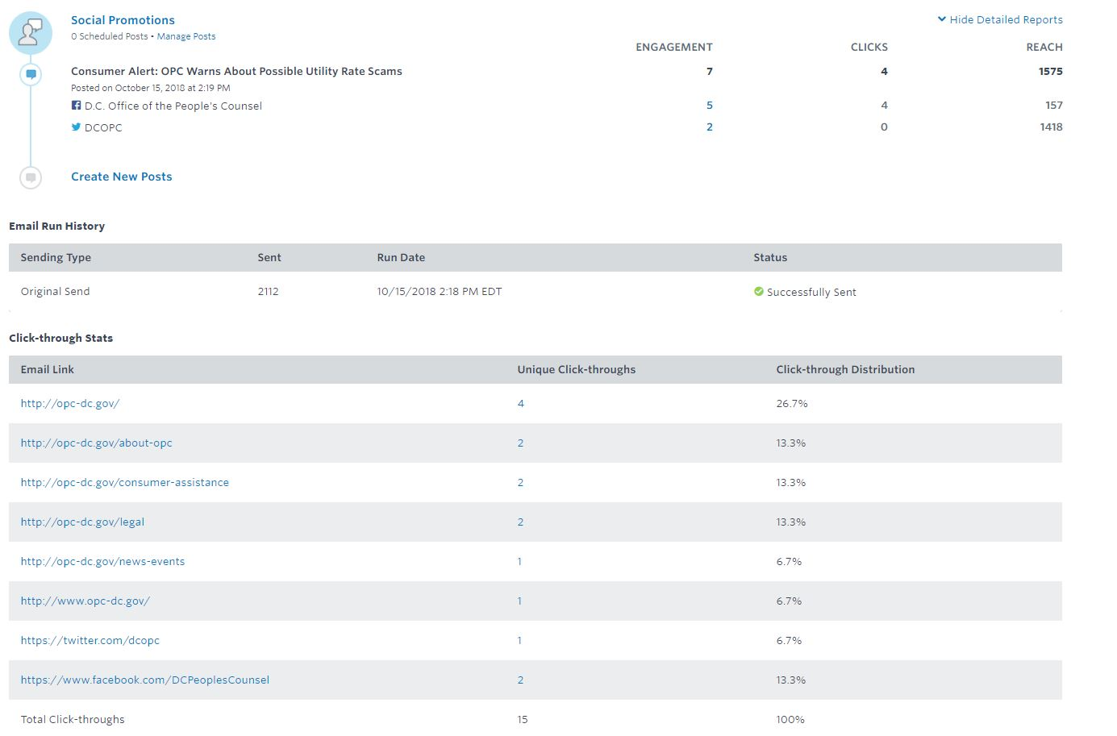

Slide 22
Website Improvements
What message is your website telling your audience?

Slide 24
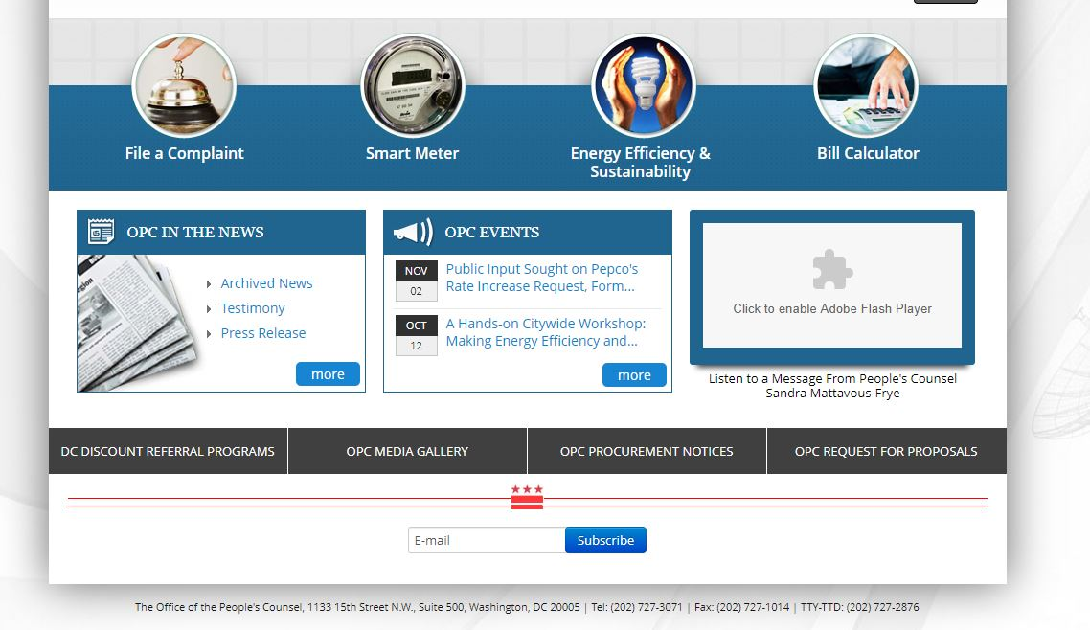

Slide 25
It is estimated that people spend as little as fifteen seconds on webpages. If what you want to convey to your audience isn’t readily available, you will lose them.

Slide 27
What has improved?
Better logo and more modern fonts
High resolution imagery relevant to subject and fewer text
Immediate call to action to subscribe to email list
Immediate access to most popular portions of the website including how to file a complaint and how to read a utility bill
Call to action “View DC Water”
All this information is available “above the scroll”

Slide 28
Using Analytics to Improve Your Website

Slide 29
Google Analytics is one of the most common sources for this data. By creating an account, a user adds a small amount of code to webpages that allows google to track a variety of information including bounce rate, type of web browser, device used to access the site and the source of entry to the site including by advertisement or by search engine.
Bounce Rate-is the percentage of a website that leave after only viewing one page. Typically, a high bounce rate (one above 60%) means that it is time to evaluate whether your website is easy to navigate and inviting.

Slide 30
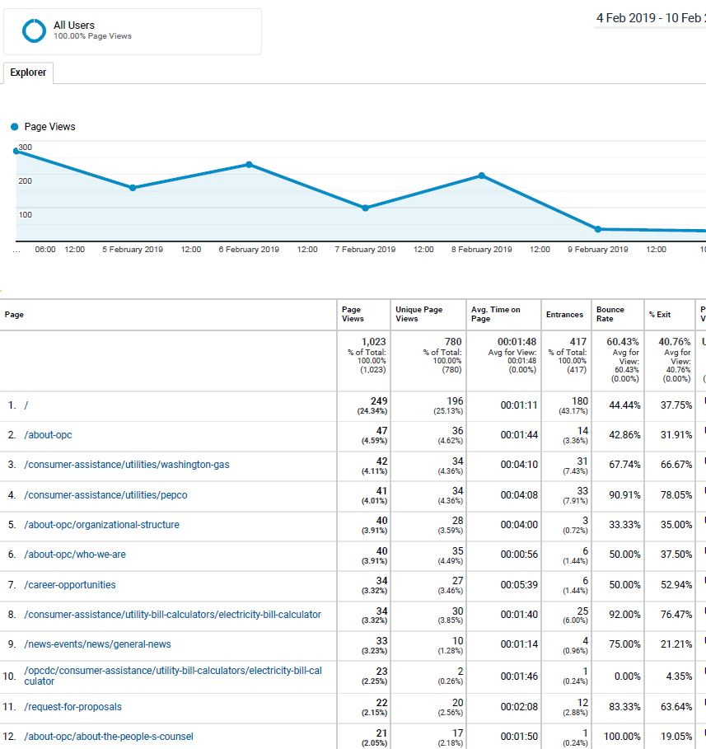
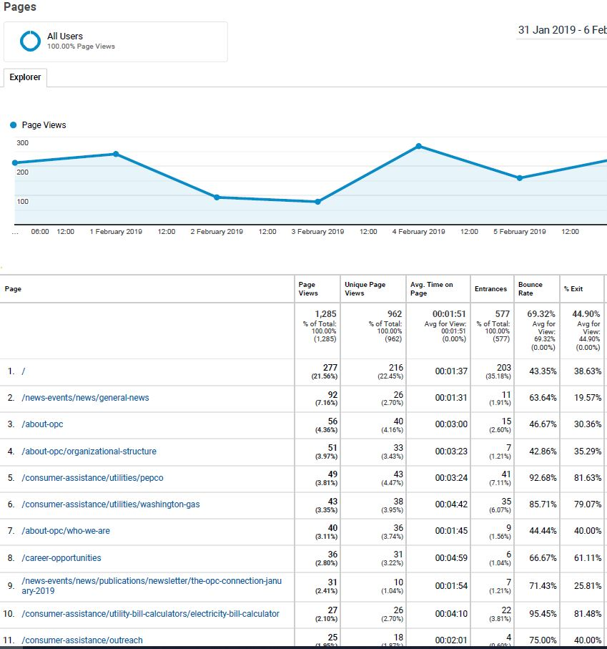

Slide 31
How can OPC use this information to improve our outreach initiatives?
Visitors are spending time on the “consumer assistance” pages and the “bill calculator” pages
“Bounce” rate, “entrance %” and “exit %” are instructive on those pages
Tells us that individuals may be coming to our website looking for this type of information and are most likely directed from search engines
Publications section of the website is not getting much traffic at all, which means we need to do better in making that information readily discoverable
After a cursory Google search for “utilities assistance in DC,” I discovered OPC isn’t even on the first page of results

Slide 32
Search Engine Optimization
Huh?

Slide 33
SEO is “the practice of increasing both the quality and quantity of website traffic, as well as exposure to your brand, through non-paid (also known as "organic") search engine results.”
Use consumer’s perspective to generate content
Search engines use programs called “crawlers” to read and scan websites for content related to searches
Sitemaps make your website easier to scan and easier to find. Ask your IT team if your website has a sitemap to increase your search engine results

Slide 34
Social Media
Facebook is the second most visited site on the internet behind only Google with over 2 billion users worldwide
7 out of 10 Americans say they use the platform
41% of U.S senior population use Facebook
Low-income teens use Facebook more than high-income
Twitter has about 321 million monthly active users

Slide 35
Strengthening Your Social "Brand”

Slide 36
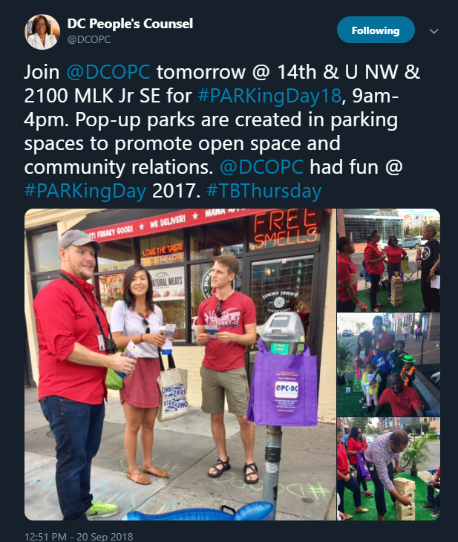
Use high-resolution imager
Include easy email subscription options
Include Video content
Make your content easy to share and encourage visitors to spread your content on their own social media accounts
Make sure that you are using hashtags (#). OPC noticed a significant increase in consumer engagement when we participated in large events and used the proper hashtags to reach the community
Improvements:
This single tweet obtained nearly 4000 impressions on Twitter alone
Include links and calls to action i.e. “Join us for our event by clicking here”
Don’t ignore negative engagement, rather respond in an appropriate manner, or invite the user to
private message you
Remember that conversations can be had with or without you, so its better to stay engaged

Slide 37
Using Social Media Analytics

Slide 38
Using Listservs and Blogs
Finally, OPC has had some success in increasing our outreach by following local blogs and by joining listservs using platforms such as Yahoo and Google Groups
Hyper local
Not only to Post Content, but also to engage in conversations

Slide 39
In Conclusion
New digital platforms and data analytics can be a powerful tool in making a positive improvement in how your organization engages with the public.
Try, Try, Try!

Slide 40
Q & A

Slide 41
References:
http://opc-dc.gov/images/pdf/Senior%20Report%20by%20OPC%203-13-17.pdf
http://neighborhoodinfo.dc.gov/wards ; and https://planning.dc.gov/
http://opc-dc.gov/images/pdf/Senior%20Report%20by%20OPC%203-13-17.pdf
https://issuu.com/opcdc7/docs/opc_2014_annual_report_final__2_?e=18355975/14219400
https://issuu.com/opcdc7/docs/tps_guide_3rd_party_suppliers_28aug?e=18355975/52721586
Granicus 2017 Public Sector Digital Communications Trends
https://optinmonster.com/is-email-marketing-dead-heres-what-the-statistics-show/
https://knowledgebase.constantcontact.com/articles/KnowledgeBase/5409-average-industry-rates?lang=en_US
https://web.archive.org/web/20140103132745/http://opc-dc.gov/
http://time.com/12933/what-you-think-you-know-about-the-web-is-wrong/
https://analytics.google.com/analytics/academy/course/6
https://support.google.com/analytics/answer/1009409?hl=en
https://moz.com/beginners-guide-to-seo/why-search-engine-marketing-is-necessary
https://www.pewresearch.org/fact-tank/2019/05/16/facts-about-americans-and-facebook/

