Slide 1
Holistic One Stop Shop
Partnerships and Collaborations

Slide 2
HELP!!! MY CLIENT NEEDS ASSISTANCE!
Who are the faces of the most vulnerable? They can be anyone! They are seniors, students, single moms, single dads, married couples, disabled individuals, children, millennials. They are all of us. What can we do?

Slide 3
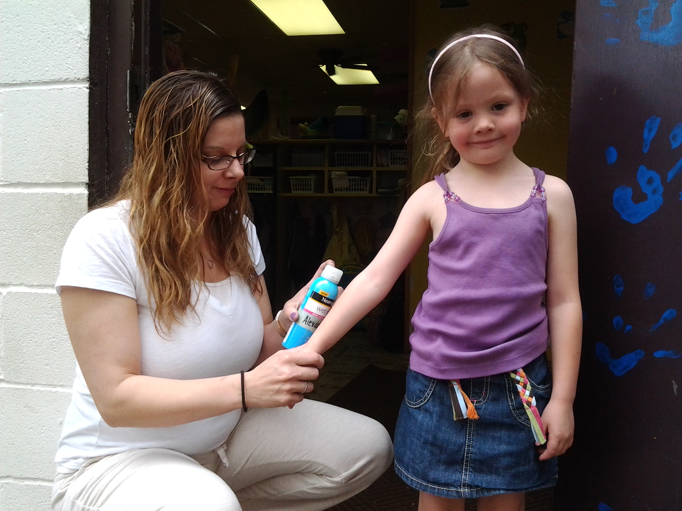

Slide 4
THE HEARTSHARE MODEL
HeartShare has a five assistance programs throughout NYS in partnership with our major utilities. HeartShare uses NYS legislative offices and community based organizations as intake centers. This is where the clients feel the most comfortable going to for help. These are the people they know first hand. HeartShare has used this model for over 23 years and it has been copied by multiple states. All of our client grantees are HEAP income eligible, however our outreach and service goes beyond HEAP clientele. Each year through it’s Energy Assistance Department alone, HeartShare helps between 18,000-20,000 individuals. Our partnership with NEUAC further extends our reach and allows other state agencies and social workers to contact us to assist clients in New York and vice versa.

Slide 5
Out In The Community
Due to the partnerships we have built the serving families in need and healing community issues, legislators, CBOs and utilities call me directly for emergency client assistance.
Because our partners get tired of emailing me and talking to me on the phone, they ask me to do special site visits, events and one on ones.

Slide 6
The Client Needs Help And So Do I ☹
Come to my office and help my clients!
I’m all alone!!
Sometimes offices need a little bit more than a twenty minute site visit and they are never afraid to ask (demand).
What I found was that dozens of clients during a site visit needed various amounts of assistance. I was emailing my contacts while on my cell with other contacts trying to get clients on the spot assistance.

Slide 7
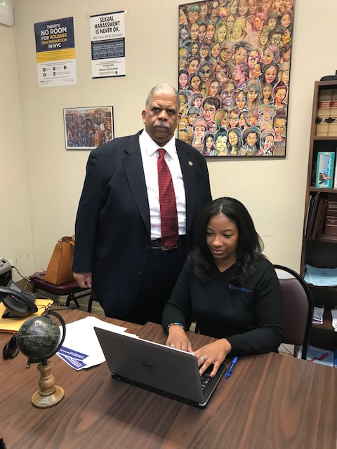

Slide 8
Your purpose in life is to use your gifts and talents to help other people. Your journey in life teaches you how to do that.
Tom Krause
Famous Finnish base baritone singer particularly associated with performing Mozart pieces who studied medicine or years before transitioning to the performing arts.

Slide 9
CUE VIDEO ☺

Slide 10
IDENTIFY AND USE YOUR NETWORK!
HeartShare’s Energy Assistance Clients primarily use the following:
HEAP for heating/electric/cooling
Gas to heat their homes
Electricity for heat and lights
DEP for water accounts
Public Service Commission so they can complain☺
Legislators so they can feel comfortable in their own neighborhoods and environment and also complain if they need to, while receiving the maximum amount of assistance.
What are the services your clients will need?
Who are the entities you work with on a daily basis?
What other service providers can these entities connect you with?
Who are your friends?
THIS IS YOUR NETWORK!!

Slide 11
Implement Client Assistance Days
Pictured here are Public Service Commission, Con Edison, HeartShare, HEAP Supervisor, DEP (Water), National Grid, Empower NY (weatherization) and Senator Comrie.

Slide 12
Implement Client One on One Days
Pictured here are Con Edison (electric), HEAP Supervisor, National Grid (gas) and HeartShare with the client in need.

Slide 13
THE ONE STOP SHOP
One on One Service Days- these are roundtable events that allow a client to sit with all the providers at once and get utility grants, HEAP grants and services, payment agreements and anything else they may need all at once.
Table Events- these events allow for each provider to have their own table with information where clients can just walk up and receive information, giveaways and speak to a provider quickly to get information they need.

Slide 14
EVERYBODY WINS!!!
Utilities are able to identify more low income customers.
Utilities are also able to make payment agreements with customers who have been categorized as “won’t pay”.
Numbers of customers assisted increases.
HeartShare wins because it is our sole mission to help others.
Customers are able to come to a location where they face no stigma and receive help from multiple entities at once.
Utilities are more lenient in a comfortable setting while they are hearing the customer’s entire story.
Customer is no longer hesitant to receive assistance.
Customer receives the maximum benefits available.

Slide 15
If you have some respect for people as they are, you can be more effective in helping them to become better than they are.
John W. Gardner
Secretary of Health, Education and Welfare under President Lyndon Johnson. Responsible for launching Medicare.

