Slide 2
Tess Richey
Senior Manager of Development

Slide 3
It’s important to have lots of friends who will raise money for you

Slide 4
To do that, you need to capture their hearts through impact

Slide 5
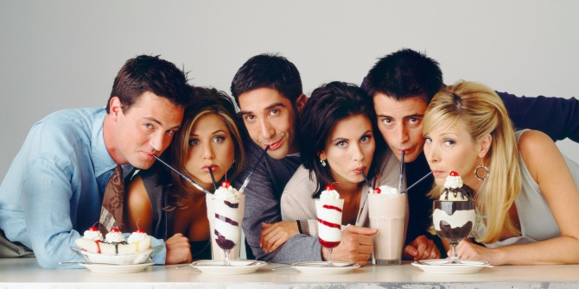
Friend-Raising 101
Prepare, Prospects, Plan, Pursue, Promote
Make your engagement tool(s) to tell your impact
Do your research – find your prospects
Plan your visits
Visits, visits, and more visits
Now, keep your champions
Once you have your champions,
start friend-raising

Slide 6
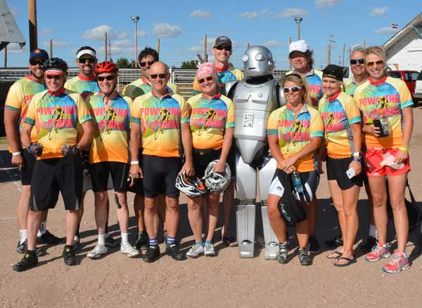
3rd Party Charity Events
Bike Race, Marathon
Pedal the Plains
Rural Electric Coop’s Bike Team races for EOC
EOC chosen as 1 of 3 charity partners in 2019
Colfax Marathon
EOC participated in 2017 and 2018

Slide 7
Small Friend-raising events
Charity Recipient, House Parties, Champion Meet-Up’s
Charity recipient of business
The Acreage Restaurant and Cidery in May
Champion Meet Up
@ local bar in May (bonus: use the discount as a kickback)
Board hosted house party

Slide 8
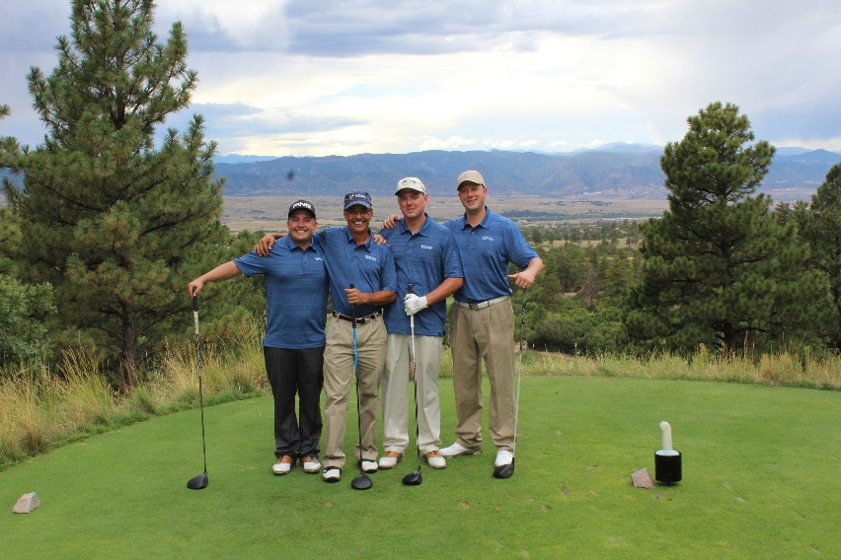
Charity tournaments
EOC’s annual golf classic – THE HEAT IS ON
Tournaments can be hosted by the nonprofit,
or by a 3rd party for-profit with proceeds
going to the charity (ideal!)
Great event for corporate
supporters
Traditionally about golf…
so we reframed it to
be about IMPACT

Slide 9
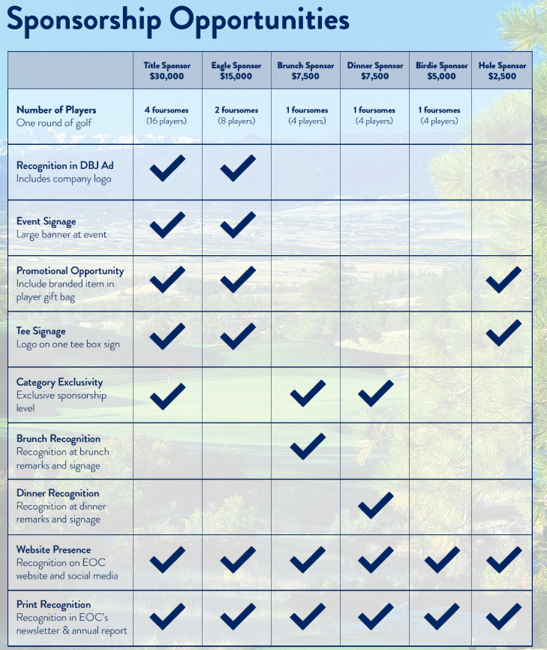

Slide 10
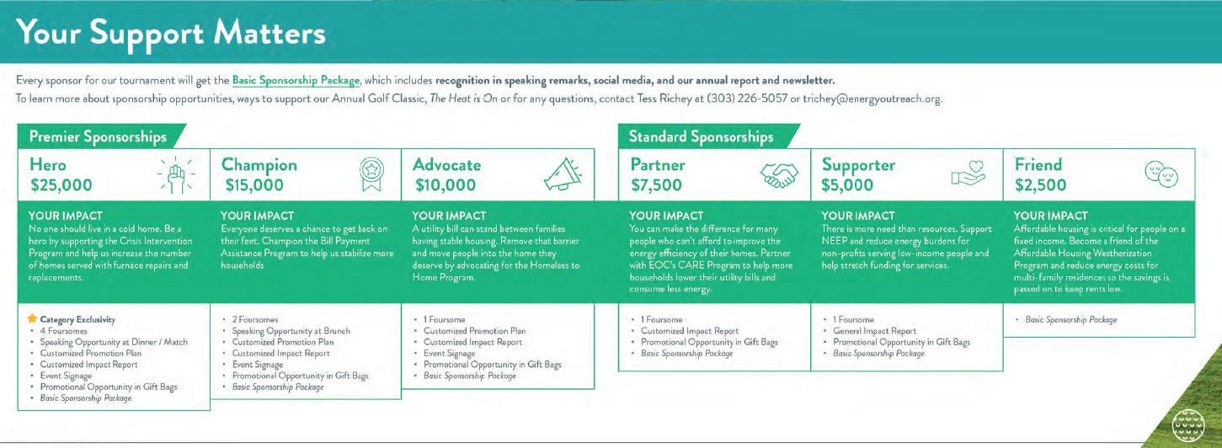

Slide 11
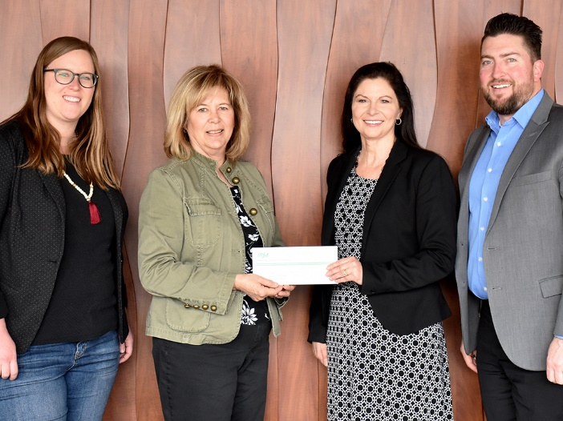
Recycling programs
Holiday Light Recycling
Partner with utility
IREA customers brought unwanted
holiday lights
3,700 pounds
Generated $680 – matched by IREA
= $1,360

Slide 12
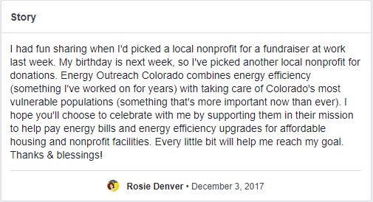
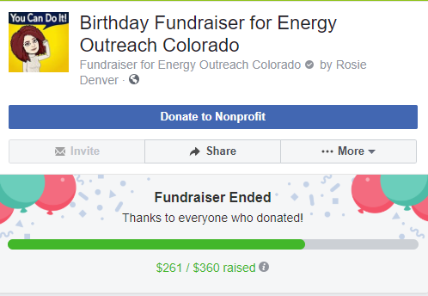
Birthdays, Memorials, tributes
Birthday Fundraisers on Facebook (or crowdfunding)
Tell your supporters about more ways to have an impact!
Rosie’s birthday fundraiser

Slide 13
After it’s all said and done, share the impact

Slide 14
Tess Richey
Senior Manager of Development
trichey@energyoutreach.org
303.226.5057

