Slide 1

Trends in persistent energy burden and threats to widening gap in energy poverty
Yohannes K.G. Mariam, Ph.D.
Senior Economist, Office of the People's Counsel for the District of Columbia
Ariel Drehobl, M.S.
Local Policy Manager, Energy Equity
American Council for an Energy Efficient Economy

Slide 2
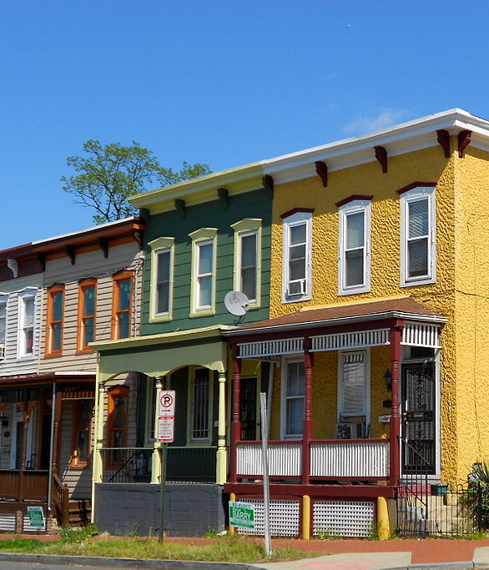
Trends in Persistent Energy Burden and Threats to a Widening Gap in Energy Poverty
National Energy Utility Affordability Coalition Conference
June 8, 2021, 3:30–4:15pm EDT
Yohannes K.G. Mariam, Ph.D.
Senior Economist, Office of the People's Counsel for the District of Columbia
Ariel Drehobl, M.S.
Local Policy Manager, Energy Equity
American Council for an Energy Efficient Economy

Slide 3
Presentation Overview:
Trends in persistence energy burden and threats to widening gap in energy poverty
Household Income, Poverty and Energy Trends in the District
Household income and poverty
Snapshot of energy and water affordability in the District
Overview of findings from energy and water burden analysis
Average energy consumption among low-income and non-low-income households
Relationship between energy consumption and income
Comparisons of burdens to other cities and national data
Experiences of energy insecurity in district (i.e., qualitative data findings)
Energy assistance
Impacts of emerging energy policies and technologies
Trends in energy assistance from federal and state agencies
How will these likely change in the short term in response to COVID-19?
Are there alternative approaches that may offer energy assistance?
Trends in arrearages, disconnections and income among low-income & non-low-income households
What are the current and future energy policies?
What are the emerging technologies?
How will these emerging policies and technologies affect low-income and non-low-income households?
Opportunities to address energy insecurity in the District
Reduce energy burden through structural investment, i.e., weatherization/ renewable energy
Ensure that programs are equitable in terms of who they serve (i.e., renters, affordable housing)
Minimize arrearages and disconnections, reduce income disparity, improve access to affordable new energy technologies

Slide 4
Energy Affordability and Energy Poverty
What is Energy Affordability?
Energy affordability refers to the extent to which energy bills account for the share of household’s income (also referred as energy burden). Households who spent 6% or more of their income on energy are considered to experience high energy burden or unaffordable energy bill. Most federal, state, and non-governmental or private sector assistance programs are geared toward improving energy affordability.
What is Energy insecurity or poverty?
Energy insecurity or poverty refers to households who are unable to meet their energy needs.
Attainment of energy affordability does not eliminate energy insecurity or poverty but contributes to reducing energy insecurity. The absence of thorough investigation of determinants of energy affordability at the federal and state levels limits an in-depth understanding of the prevalence, severity and causes of energy poverty.

Slide 5
Household Income, Poverty and Energy Trends in the District

Slide 6
Household Income, Poverty, and Energy Trends in the District
Household income and poverty
Data from US Census and Federal reserve indicates a general decline in poverty with increases in income for the US. However, data for DC shows that the number of people in poverty increases even with increases in income. Similar results hold true when measures of economic growth (i.e., GDP) is correlated with number of people in poverty.
Possible reasons may include:
  Income Inequality;
  Household characteristics (head of household, No. of people in the family, education, etc.)
Notes:
Source: https://www.census.gov/library/publications/2020/demo/p60-270.html

Slide 7
Household Income, Poverty, and Energy Trends in the District
Household income, home ownership and poverty
Data from US Census and Federal reserve indicates:
With increases in per capita income, rate of home ownership is expected to increase for the US.
For DC, despite sharp increases in income, % of home ownership and % of people in poverty declined for 2014-2019 but increased back to levels observed more than two decades ago (i.e., 1995)
Widespread economic impact of the pandemic may reduce % home ownership and increase % of people in the poverty.

Slide 8
Household Income, Poverty, and Energy Trends in the District
Average energy consumption among low-income and non-low-income households, Versus price of electricity
Price of electricity in DC skyrocketed reaching peak in 2009 and remain relatively high.
Non-low-income electricity consumers (UPC-R) consumption per month has shown a consistently declining trend.
However, low-income electricity consumers (UPC-RAD) consumption per month has remained high except a dip in 2015.
Why does low-income customers electricity consumption remain high despite increases in electricity prices? Why is their consumption greater than that of non-low-income customers?

Slide 9
Household Income, Poverty, and Energy Trends in the District
Comparison of electricity consumption by rate class pre- and post-Covid
Low-Income consumers (“RAD”) average electricity consumption per month in 2020 seem to be relatively higher than consumption in 2019.
Why was consumption in 2020 higher than in 2019?
(i) Characteristics of housing?
(ii) Household composition?
(iii) Moratorium, thus no incentive?
(iv) Stimulus fund?
(v) Others ????

Slide 10
  Household Income, Poverty, and Energy Trends in the District
  Relationship between energy consumption and income
The District’s economy (measured in Gross Domestic Product or GDP) has been growing at an accelerated rate. Similarly, District residents’ per capita income has shown the same trend as GDP.
Often, growth in income or economy is associated with increased energy consumption.
Data from DOE, however, showed that total energy consumption (measured in billions of Btu) has declined sharply since 2009.
Similarly, as it was shown earlier, residential electricity usage has been declining.
What does this trend tell us?

Slide 11
Snapshot of Energy and Water Affordability in the District
Findings from DOEE-funded study of energy, water, and combined burdens in the DC Metropolitan Statistical Area

Slide 12



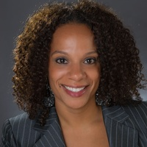



Project Team
American Council for an Energy-Efficient Economy
  Ariel Drehobl, Local Policy Manager, Energy Equity
  Lauren Ross, Director for Policy
  Roxana Ayala, Research Assistant
Columbia University
  Dr. Diana Hernández, Associate Professor
  Tasfia Rahman, Research Assistant
  Miranda Ysabel Simmes, Research Assistant
ONE DC
  Claire Cook, Administrative Organizer
Final report available at doee.dc.gov/energyassistance

Slide 13
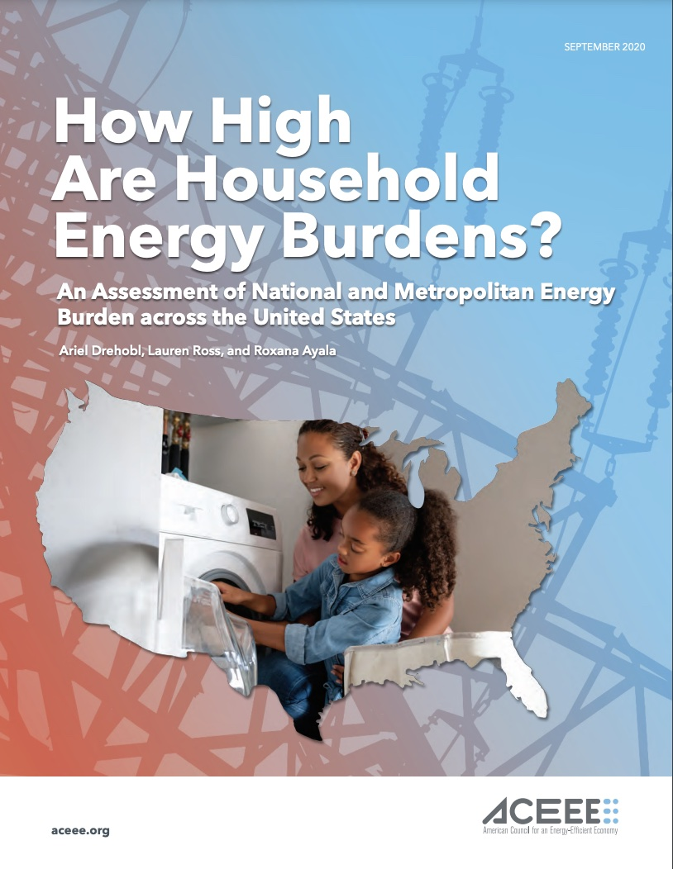


Utility Burden Methodology
Energy Burden = Annual energy bills/Annual income
  E.g., $1,500/$50,000 = 3% energy burden
  Annual energy bills include electricity, natural gas, and other heating fuels.
  Excludes households who do not pay for their energy bills directly.
  High energy burden is above 6%; severe energy burden above 10%
Water Burden = Annual water bills/annual income
  Excludes households who do not pay for their water bills directly.
  High water burden is above 4%
Utility Burden = Annual energy bills and water bills/annual income
  Excludes households who do not pay for their water bills and/or energy bills directly.
  High combined burden is above 10%
Notes:
- Note that population changes across each analysis; removing those who do not pay for their bills for each one (so different subset of population analyzed)

Slide 14
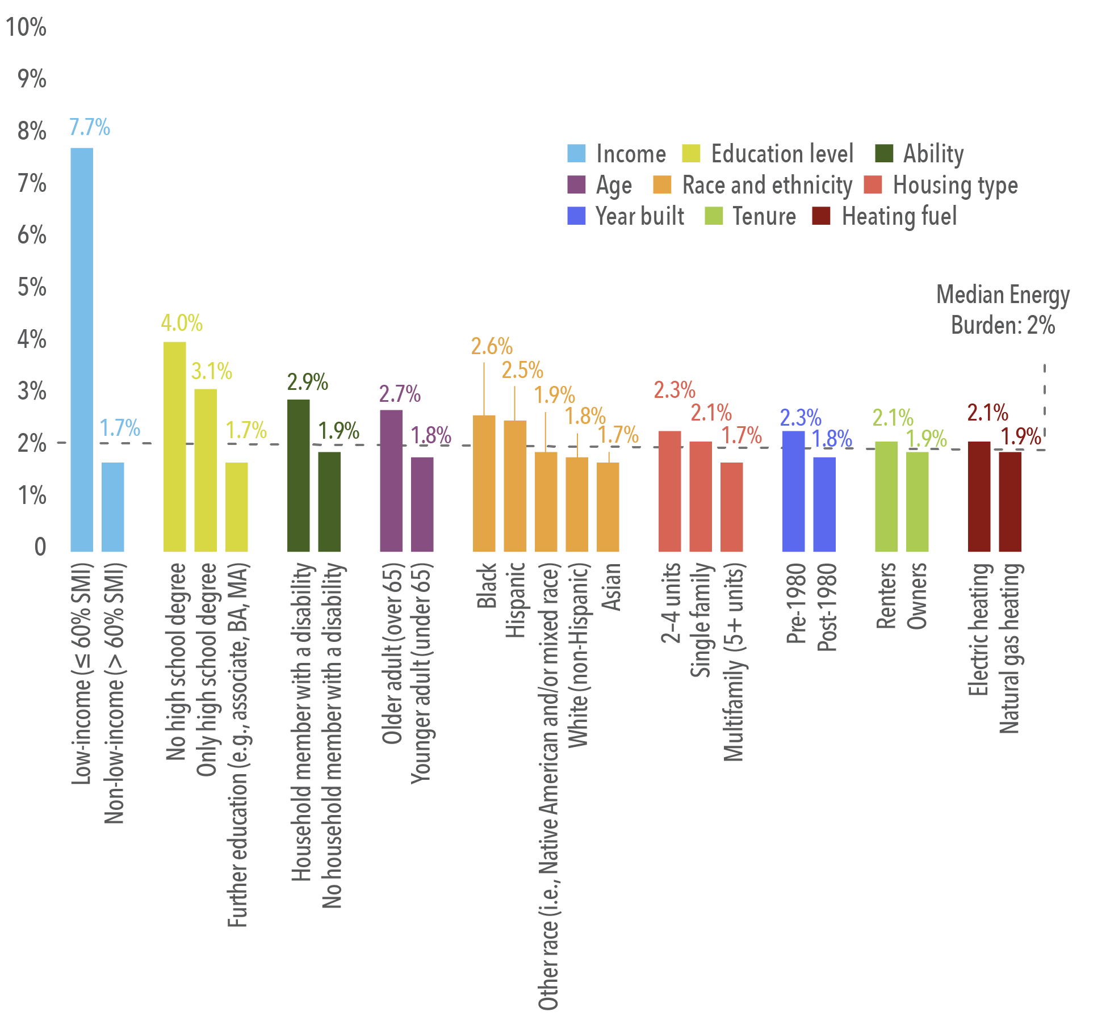
Energy Burden Findings
Median burden of 2%
64% of low-income households (60% SMI) face a high energy burden (i.e., above 6%)
40% of low-income households face a severe energy burden (i.e., above 10%).
25% of low-income households experience an energy burden of at least 15% (i.e., 7.5 times the median)

Slide 15
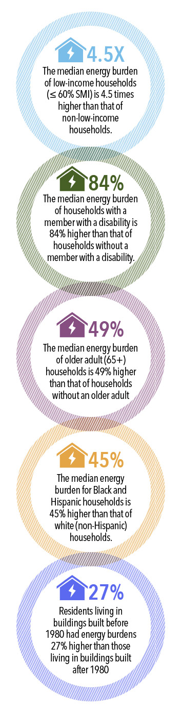
Energy Burden Findings (Cont.)
Compared certain groups to others (see images to the right)
Low-income vs. non-low-income energy burdens
  200% FPL had burdens 5.7 times higher,
  60% SMI had burdens 4.5 times higher,
  80% AMI had burdens 3 times higher,
  100% AMI had burdens almost 3 times higher.
Quarter of households with incomes less than
  200% FPL had an energy burden above 17%,
  60% SMI had an energy burden above 15%,
  80% AMI had an energy burden above 7.7%,
  100% AMI had an energy burden above 6.6%.
  These burdens are 8.5 to 3.3 times higher than the metro area median of 2%.

Slide 16
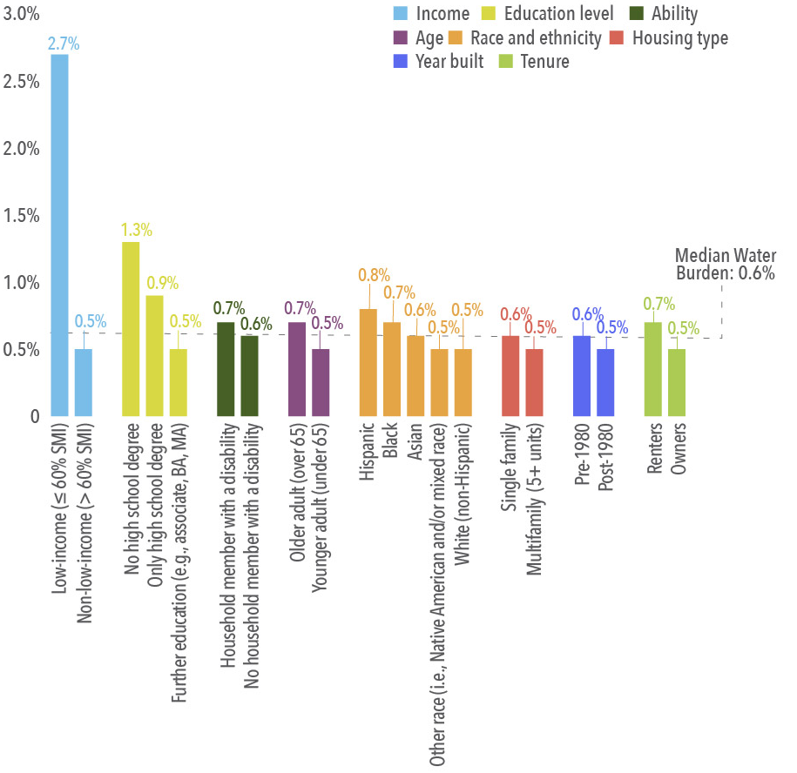
Water Burden Findings
Low-income households (60% SMI) have a median water burden that is 4.5 times higher than the metro area median
25% of low-income households experienced a water burden of at least 7.4% (12 times the median)
38% of low-income households and 10% of older adult households experience a high water burden (i.e., above 4%)

Slide 17
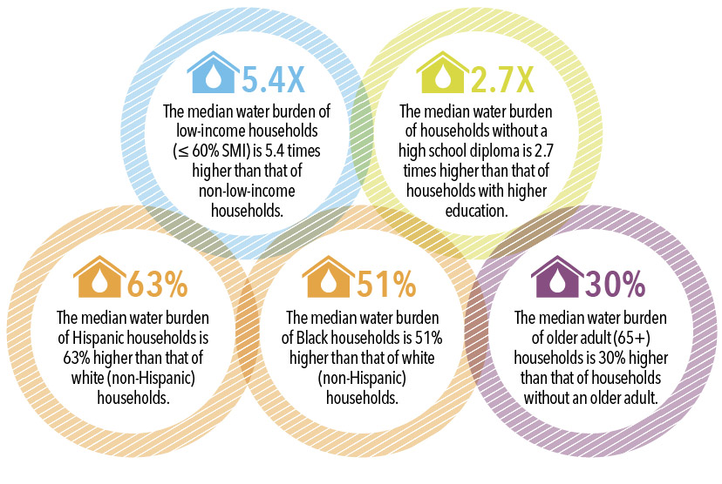

Water Burden Findings (Cont.)

Slide 18
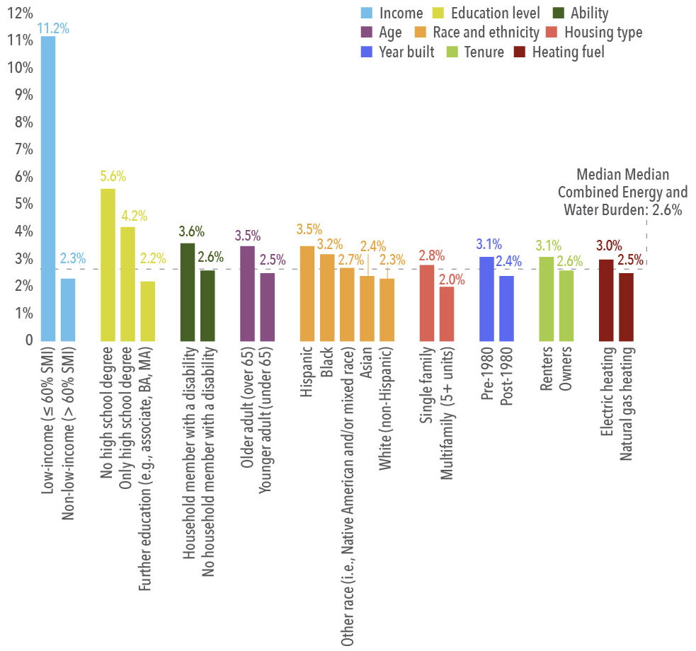
Combined Burden Findings
Low-income (60% SMI) combined burden is 11.2% (4.3 times the median)
25% of low-income households experience a combined burden of at least 23% (9 times median)
58% of low-income households experience a high combined utility burden (>10%)
Notes:
- 58% of low-income households experience a high combined utility burden (>10%), as did 26% of households without a high school degree, 16% of households with a member with a disability, 14% of older adult households, and 13% of Black households.

Slide 19
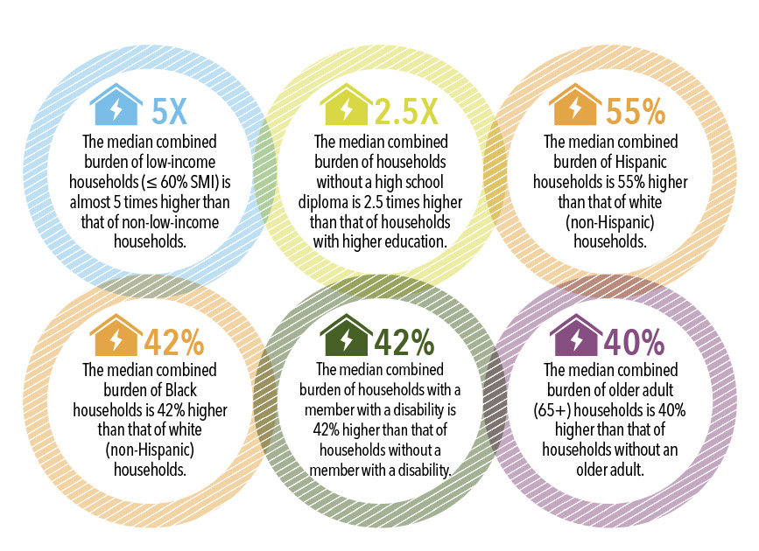
Combined Burden Findings (Cont.)

Slide 20
Experiences of Energy Insecurity in the District
Findings from DOEE-funded study from interviews with 30 utility assistance support program participants

Slide 21
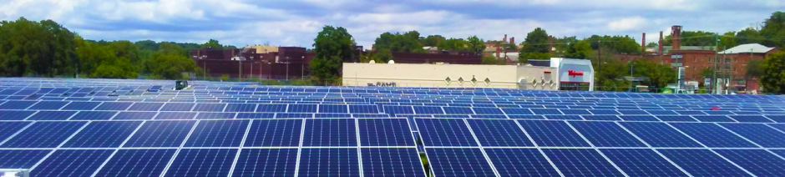
Department of Energy and Environment (DOEE) Programs in Study
Low-Income Home Energy Assistance Program (LIHEAP)
Utility Discount Program (UDP)
Solar for All (SFA)
Weatherization Assistance Program (WAP)
Clean Rivers Impervious Area Charge Residential Relief Program (CRIAC)

Slide 22
Interview Methodology
Category | Subcategory | Total (out of 30)
District Ward | Wards 1–6 | 16
 | Wards 7–8 | 14
Age | 29 and under | 4
 | 30–39 | 8
 | 40–49 | 6
 | 50–59 | 6
 | 60–69 | 2
 | 70–79 | 2
 | 80 and above | 1
Race/ethnicity | Black/African American* | 19
 | Hispanic | 2
 | White | 2
 | Asian | 1
 | Did not provide | 5
Tenure status | Owner | 14
 | Renter | 15
 | Other | 1
Interviews
  10 DOEE program staff
  30 recipients of DOEE utility affordability services
Interview Outreach
  Participants randomly selected across 5 programs
  Recruited through email and postcards outreach (contacted 601 recipients)
  Each participant received a $100 Visa gift card
Interview Process
  Utilized a semi-structure interview guide
  All interviews recorded, transcribed, and coded
* Note: Participant self-identified as either Black, African American, or both

Slide 23
Interview Questions and Goals
Participant Interview Questions:
What factors contribute to participants needing energy assistance?
What is the DOEE customer experience like?
What benefits/impacts are derived from receiving energy assistance?
Interview Goals:
  Better understand program challenges, client and participant base, and the impact of COVID-19 pandemic on program operations and outcomes
  Gain insights into participants’ household characteristics and experiences of energy insecurity
  Understand the experiences of energy and water assistance recipients

Slide 24
Participant Perspectives on Energy Insecurity, Coping, and the Impact of Affordability Programs
Utility bills were a clear priority for most participants
Many encountered recent and/or persistent challenges paying for these essential services.
Participants report that experiencing energy insecurity was rooted in:
  Economic Instability
  Changes in household composition
  Unexpected expenses
  Disability or health issues
  Poor housing quality
“I guess, me worrying about if I will be able to pay my electric bill even though my bill is lower now. I guess me thinking about because of what's going on and how my hours have been changing. And how I've been maybe working three days a week. I'm truly worried like can I pay the bill? I don't want a shut off. I have a young child. I don't want to be in our home and we come home one day and the power's out. I was just thinking about her.”

Slide 25
Coping with Energy Insecurity
“For me as far as layering, it really helps. It does wonders, and even using the special type of bedding, that makes it a lot warmer, with lining. Clothes that have lining inside. I find that that has been really useful. Even the face coverings... If you were going outside, for instance, can be applied inside. It's the same strategies.”
To cope, participants reported:
  Using fans instead of air conditioners
  Using extra layers of clothing during cold days
  Using space heaters to manage heating cost
  Seeking financial assistance from family and friends
  Prioritizing household expenses
  Establishing payment arrangements with utilities
  Seeking support through DOEE programs
“Usually around about November 1st, we start putting the plastic [in] the window seals and we take them off during the summertime… And you just take those types of plastic on the windows and it [that] cuts off some drafts. We just go to the Dollar store, we get the plastic and it is Dollar store plastic, but it's better than nothing.”

Slide 26
Participation in DOEE Programs
Programs are perceived as positive, with generous financial assistance and strong customer service
Some participants were unaware of when and how much assistance they received, especially related to lag in CRIAC benefit delivery
Some households were at risk of a water shutoff
Participants expressed uncertainties around program details including the amount of assistance for which they are eligible
Many only apply to programs during financial hardships rather than every year
"Well, no. The water bill ... The problem with the water bill is, what I was explaining earlier is that they will no longer front you the discount. They want the money from DOEE up front. So, today is November. So, your November bill, December bill, and January bill spike until DOEE physically sends them the money.''
Notes:
Bullet point two: this is because there is lapse in direct communication and many participants have to wait to see their utility bill to view the financial subsidy applied to their bill
Bullet point three: This was due to a backlog with the water company to process CRIAC discounts

Slide 27
Impact of DOEE Programs
Deep gratitude for programs
Programs help households meet other basic needs
Greater thermal comfort
Affordable utility bills and reduced stress
"Well, as I said before, for the water program, we can speak about, because it's a great help in regards to reducing our expenses. It has allowed us to funnel money from paying the water into other aspects, to help with the increased gas bill in the colder months, and in the warmer months, towards other expenses, for example, for school supplies, things that we need to get.”

Slide 28
DOEE Staff and Administrator Perspectives
"The most rewarding is just being able to see the change that we are able to effect every single day. Like being in people's homes. And I know because of COVID, we've had to adjust and do more or remote virtual type of interaction. But just ensuring that we have... We are dealing with families and households in the district that are literally, as I'm sure, making the choice between buying food and medicine and school supplies for their kids and just being able to maintain some level of reasonable quality of life. So just knowing that we can provide that relief to households that are most in need."
Strong sense of service towards clients and execution of organization's mission
Staff expressed a high degree of dedication to program offerings and improving the user experience, especially during these unprecedent times

Slide 29
Similarities and Differences between
Participant and Staff Interviews
Participants and staff agreed that DOEE program offerings and customer service were robust and superior to available alternatives
Most program participants were not aware of how their participation in the programs positively contributed to environmental stewardship, despite staff emphasizing the connection to larger environmental goals
Gaps in service to rental and multifamily housing residents were noted by both participants and staff, while prioritizing energy and conservation/ weatherization was emphasized by participants
"Aside from the solar for the community, I don't know for sure if I would say that I was attracted to the program because of the environmental, because it was more of an affordability issue. I don't know in their literature or in the program itself it specifically states applying to this program means you're going to be environmentally sound."

Slide 30
Energy Assistance
In the District of Columbia

Slide 31
Energy Assistance
Source and Trends in Energy Assistance
DC energy utility consumers receive assistance from:
Low-Income Home Energy Assistance Program (LIHEAP)- for electric and gas heat;
Residential Aid Discount (RAD)- for electric consumers;
Residential Essential Service (RES)- for gas consumers;
Solar for All – Through the Renewable Portfolio Standard Expansion Amendment Act of 2016 that established the Solar for All Program (Solar for All);
Washington area fuel fund;
Greater Washington Urban League; and
Other sources.

Slide 32
Energy Assistance
Source and Trends in Energy Assistance
DC utility consumers receive assistance through:
LIHEAP- that accounts for about 46% and 80% of home energy bill for gas main and electric main heat of low-income customers.
A snapshot of 2019 data shows that 61% of total funding originates from the Federal government LIHEAP grant.
Therefore, changes to the LIHEAP benefits will significantly affect energy affordability among low-income customers.
Energy Assistance Funding and Participation – Washington, DC (2019)
Program Name | Funding Source | Funding for Assistance Benefits | Households Served | % of Income-Eligible Served | Average Benefit
LIHEAP and Supplement (FY 2019) | Federal + Ratepayers | $16.8 million | 20,231 | 26% | $828.36
RAD (2019) | Electric Ratepayers | $5.8 million | 20,565 | 25% | $272
RES (2019) | Natural Gas Ratepayers | $0.5 million | 6,877 | 8% | $72
Solar for All (2019) | Electric Ratepayers | $4.3 million | 8,600 | 8% | $500
TOTAL | Federal + City + Ratepayer | $27.4 million | N/A | N/A | N/A
Total for Low-Income Households Only | Federal + City + Ratepayer | $23.1 million | 20,231 | 25% | $1,184
Please note DC consumers also receive assistance from Washington area fuel fund and undetermined amount for the Greater Washington Urban League. Source: DC OPC, Energy affordability 2021

Slide 33
Energy Assistance
Source and Trends in Energy Assistance
Total LIHEAP funding for DC declined from a high of about $11 million in 2001, rose to a peak in 20009 (after the great recession of 2007-2008), and sharply declined to funding level of 2001.
The LIHEAP funding per poverty-person showed similar trend as the trend in total LIHEAP funding.
Given that:
  the number of people in poverty has not declined but increased;
  LIHEAP funding accounts for a large share of energy assistance;
  Energy prices continue to increase;
  Growth in US and District economy will take few years to return to pre-Covid-19 level; and
  Other compounding factors;
Low-income customers may face increased energy burden, thus exacerbating severity of poverty unless alternative approaches to energy assistance are identified and implemented.

Slide 34
Energy Assistance
How will these likely change in the short term in response to COVID-19?
Election of a Democratic US government that favors assistance to low-income households may reduce the threat to significant reduction in LIHEAP funding;
Similarly, if the Congressional Budget Office’s (CBO) forecast about the return of US economic growth to pre-covid level by mid-2021 hold true, there may appear less threat to low-income energy assistance funding from the federal government.
However, if past trends hold true, and if the economy did not recover soon, it is plausible to argue that LIHEAP funding may decline in the future.
State or local funding that also depend on economic growth may face financial constraints to meet the needs of all low-income customers.
Therefore, alternative low-income energy assistance strategies need to be explored to ensure that low-income customers will not face severe energy burden and reduce threats to energy poverty.

Slide 35
Energy Assistance
Are there alternative approaches that may offer energy assistance?
District consumers already use multiple sources of energy assistance including LIHEAP. These include weatherization assistance, ratepayer-funded programs, state funds, and private fuel funds.
In addition to those listed above, alternative energy assistance strategies may include:
  Free Home Energy Audit;
  Education and Outreach;
  Investment in Community Solar;
  Coordination of all types of low-income assistance (housing, food, water and energy, etc., assistance) programs that are run by separate agencies;
  Create incentive programs to enhance energy conservation and efficiency; and
  Others.

Slide 36
Energy Assistance
Trends in arrearages, disconnections and income among low-income & non-low-income households
% of non-low-income electricity customers in arrears has increased slightly or remain unchanged since 2006;
% non-low-income customers with disconnection notices has risen slightly and remain same until 2014 and took a sharp dip in 2015 with minor increases since then.
% low-income electric customers in arrears and with disconnection notices move in parallel until 2014 when there appears to be a widening gap since 2015.
% of low-income customers in arears has increased continuously and remain high.
The implication is that unless low-income customers arear are managed in a timely manner, large percentage of them may be unable to pay and disconnected.

Slide 37
Energy Assistance
Trends in arrearages, disconnections and income among low-income & non-low-income households
The % low-income gas customers in arrears and with disconnection notices remained relatively high but took a sharp drop in 2011 and remained relatively high;
The % of non-low-income gas customers in arrears and with disconnection notices remain relatively low.
Unless the % of low-income gas consumers in arrears is managed in a timely manner, it is more than likely to see decline in energy affordability and increased disconnection notices.

Slide 38
Energy Assistance
Trends in arrearages, disconnections and income among low-income & non-low-income households
Increases in personal income is expected to reduce the number of low-income customers and enhance energy affordability.
Yet, with increases in income or economic growth, there has been increases in the number of non-low-income and low-income customers in arrears.
While disconnection among non-low-income customers remain high or declined slightly, disconnection among low- income customers have remained relatively low.
Arrears that are not timely managed will erode energy affordability, lead to increased disconnection, and increased energy poverty.

Slide 39
Comparison of DC’s energy consumption pre-& post-Covid (Low-income (RAD) Vs non-low-Income (R)) shows that low-income customers electricity consumption post-covid (2020) was relatively greater than pre-covid (2019). The reverse holds true for non-low-income electricity customers.
Why?

Slide 40
Impacts of emerging energy policies and technologies:
What are the future energy policies and technologies?
Why do we need to study the impacts of emerging policies and technologies?
  Emerging policies and new technologies are associated with relatively high costs compared with current policies & technologies;
  Emerging policies and new technologies inherently come with higher degree of risk;
  Current regulatory framework not only needs to be modified but also must ensure synchronization of the retail and wholesale markets; &
  Others.
  What is District’s over-arching energy policy that drives new technologies?
  Clean Energy DC (CEDC) is the District’s strategic plan to reduce greenhouse gas (GHG) emissions by least 50% below 2006 levels by 2032, while increasing renewable energy, reducing energy consumption, and progress toward carbon neutrality by 2050.
  CEDC’s vision took a big step closer to reality due to the Omnibus Bill Amendment Act of 2018. This act mandates 100% renewable electricity by the year 2032 and doubles the amount of solar energy from the District by 2041 (10% of retail load).

Slide 41
Impacts of Emerging Energy Policies and Technologies
In the District of Columbia

Slide 42
Impacts of emerging energy policies and technologies
What are the future energy policies?
  Pillars of Clean Energy DC
Source: DOEE, 2020. Clean Energy DC, Progress Report, April 2020. www.doee.dc.gov/cleanenergydc

Slide 43
Impacts of emerging energy policies and technologies:
What are the emerging technologies?
Based on strategies outlined in CEDC’s plan, new and emerging technologies include:
Constructing net-zero buildings;
Retrofitting existing buildings;
Shifting to clean energy;
Growing local solar;
Electrifying transportation;
Shifting transportation;
Invest in reliable, sustainable and resilient distribution energy delivery system in the District; &
Others.
End goal: Carbon neutrality by 2050 conditioned on clean energy (100% RPS) by 2032.
Will the primary driver for this target, RPS, attainable by 2032?

Slide 44
Impacts of emerging energy policies and technologies
How will emerging policies and technologies affect LMI and non-LMI households?
The primary energy policy is RPS. RPS compliance cost is composed of two components:
  Cost of solar and non-solar RECs to meet the RPS requirement, and
  Cost of compliance fees.
A study by LBNL shows that, in most states, RPS compliance costs accounts for ≤3% of average retail electricity rates but increasing. How fast it is increasing depends on how ambitious the RPS goal is.

Slide 45
Impacts of emerging energy policies and technologies:
How will emerging policies and technologies affect DC’s low-income and non-low-income households?
A review of several studies on costs of RPS compliance showed that it accounts for 2%-13% of retail electricity rates.
What is the lesson from this compliance cost that could potentially keep increasing?

Slide 46
Impacts of emerging energy policies and technologies
How will emerging policies and technologies affect low-income and non-low-income households?
A review of the cost of RPS on District of Columbia ratepayers showed that:
  The RPS compliance cost and its share in retail electricity price has risen sharply until 2016;
  Following the adoption of DC Omnibus bill act in 2018, the RPS compliance cost showed another significant increase that resulted in increases in its share in retail electricity prices;
  The share of RPS compliance cost in retail prices ranged from 2.1% in 2014 to more than 4.5% in 2019 and still increasing.
Funding for sustainable energy and efficiency, electrification, distribution system upgrades, and so on will add to energy burden of non-low-income customers, especially those on the borderline of becoming low-income.
It is expected that retail electricity prices will continue to rise for non-low-income and low-income customers because of the incremental costs associated with the RPS, new technologies, and the goal of carbon neutrality by 2050.

Slide 47
Opportunities to Address Energy Insecurity in the District
1) Reduce energy burdens through structural investments;
2) Ensure programs are equitable in terms of who they serve;
3) Minimize arrearages/disconnections, reduce income disparity, improve access to affordable new energy technologies

Slide 48
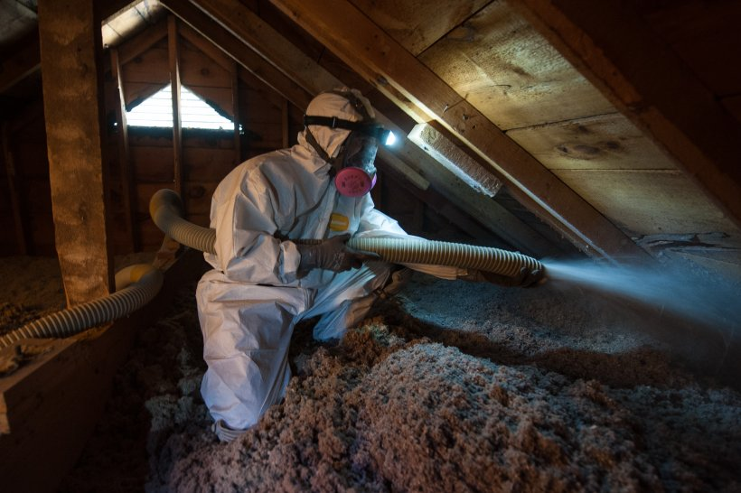
Opportunities to Reduce Burdens through Structural Investments
Increase structural solutions, such as weatherization and solar energy
  Weatherization as a long-term solution to reducing high burdens by 25% on average
Bolster bill payment assistance efforts to lead to long-term saving for income qualified households
For low-income energy efficiency program best practices, see Appendix D of ACEEE’s energy burden report:
  www.aceee.org/research-report/u2006

Slide 49

Ensure Programs Serve Residents Equitably
Target resources towards households with disproportionately high utility burdens
Target resources to households experiencing disproportionate health burdens
Provide resources for affordable housing building owners to help keep rents affordable
Pursue authentic community engagement to drive investments with accountability

Slide 50
Opportunities to Reduce Energy Insecurity in the District
Minimize arrearages & disconnections, reduce income disparity, improve access to affordable new energy technologies
The number of low-income electricity customers who participated in DC’s discount program (RAD) declined reaching an all-time low in 2016 but sharply rose and remain high.
The number of low-income customers in arears, however, has continued to increase and remained higher than that observed a decade ago.
The $ amount of arrears, however, has fluctuated significantly returning to an all-time high of more than $4 million in 2020. That is a huge financial risk because if left unpaid on time, other consumers have to pay.
Increases in arrearages coupled with high cost of new technologies will further erode disposable income of consumers resulting in reduced energy affordability, increase in energy poverty and contributes to increases in income inequality.

Slide 51
Opportunities to address energy insecurity in the District
Minimize arrearages & disconnections, reduce income disparity, improve access to affordable new energy technologies
Despite a general increase in the number of low-income electricity customers in arrears, there appear to be a declining trend in the number of disconnection notices issued to low-income customers. Why? Will this trend persist? What does it imply for energy affordability and security?

Slide 52
Opportunities to Address Energy Insecurity in the District
Minimize arrearages & disconnections, reduce income disparity, improve access to affordable new energy technologies
The data showed a significant decline in the number of low-income gas customers who participated in DC’s discount program (RES);
Similar trend is observed for low-income customers that are in arrears;
The arrears amount, however, fluctuates significantly with an increasing trend since 2014.
Why? [issue with data; declining gas prices that may result in smaller bill assistance; etc.]

Slide 53
Opportunities to reduce address energy insecurity in the District
Minimize arrearages & disconnections, reduce income disparity, improve access to affordable new energy technologies
Unlike low-income electricity customers, both the number of low-income natural gas customers in arrears and those that receive disconnection notices arrears showed a declining trend.
Why this trend observed among natural gas consumers?
  Declining share of gas in energy cost;
  Declining cost of gas;
  Energy efficiency;
  Education:
  Housing standard:
  Less energy bill assistance;
  Etc.

Slide 54
Opportunities to reduce address energy insecurity in the District
Minimize arrearages & disconnections, reduce income disparity, improve access to affordable new energy technologies
DC’s minimum wage has been increasing since 2013;
The number of low-income electricity customers in arears has been increasing but the number of gas customers in arears has been decreasing;
Interestingly, the percentage of all people in poverty moves in similar direction with the movement of unemployment rate.

Slide 55
Opportunities to reduce address energy insecurity in the District
Minimize arrearages & disconnections, reduce income disparity, improve access to affordable new energy technologies
Income Inequality
The Gini Index (ranging 0 to1) is a summary measure of income inequality. Gini coefficient of “0” refers to perfect equality while Gini value of “1” shows perfect inequality.
Despite significant increases in economic growth and personal income, the District’s poverty rate or population under poverty has not declined;
One of the primary factors for this trend in poverty is income inequality. As you see from the chart and in the literature, the District has the highest income inequality in the Nation, although with a general declining trend.
Reducing energy insecurity and improving energy affordability requires reducing income inequality, among other things.

Slide 56
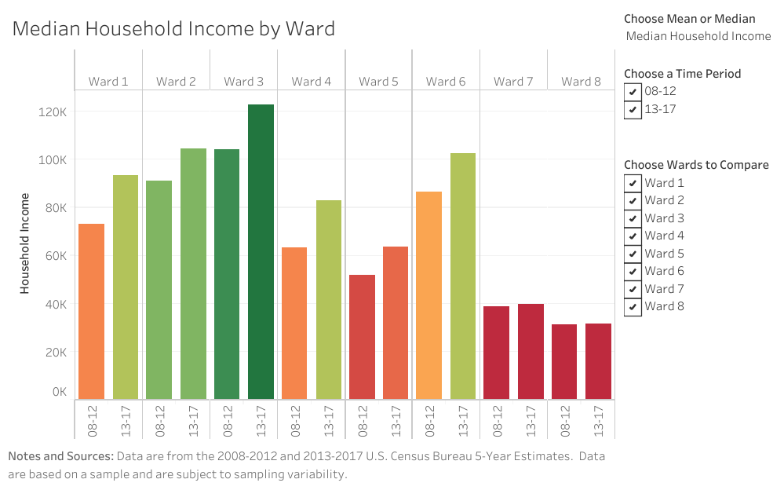
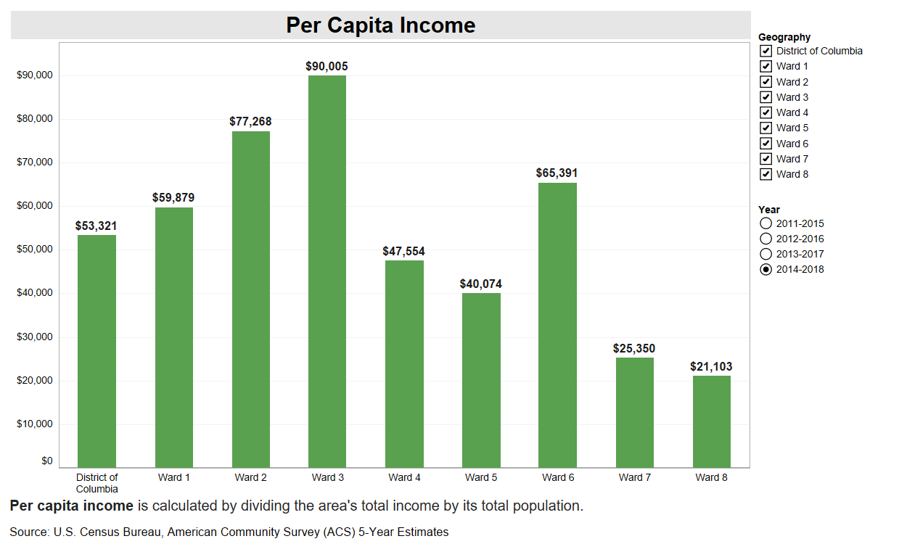
Opportunities to reduce address energy insecurity in the District
Reduce income disparity: Ward Level Income Inequality, 2012, 2017 & 2018
As you see in these charts, Wards 4,6, 7 and 8 exhibit relatively low income per capita. Interestingly, however, there appears to be no or minimal change in income per capita in wards 7 and 8 between 2012 and 2018. Why? What does this imply to strategies intended to reduce income inequality, energy affordability, and energy insecurity?

Slide 57
Opportunities to reduce address energy insecurity in the District
Minimize arrearages & disconnections, reduce income disparity, improve access to affordable new energy technologies
A study by the Office of the People’s Counsel for the District of Columbia found that the average energy burden for low- and moderate-income (LMI) households is about 7.8%. This finding indicates that DC’s LMI (41% of DC households) energy burden far exceeds baseline energy burden index of 6%.
LMI households have an average water burden of about 2.3% of income.
The combined energy and water burden, as well as housing and other burdens, will erode not only energy affordability but exacerbate energy insecurity.

Slide 58
Opportunities to reduce energy insecurity in the District:
Minimize arrearages & disconnections, reduce income disparity, improve access to affordable new energy technologies
Options to reduce income disparity, arrears and improve access to new energy technologies could include:
  Free energy audit and weatherization;
  Comprehensive educational and outreach programs to enhance better understanding of energy consumption and its implications;
  Comprehensive energy efficiency package;
  Increased allocation of solar for all and other ratepayer funded programs toward increasing access to low-income households (e.g., thigh more funding for community solar);
  Coordinate all financial and non-financial assistance administered by federal, state and private or non-governmental agencies to identify and offer solutions not only to reduce energy but to other forms of insecurity such as housing.

Slide 59
Conclusions
The issues discussed in this presentation demonstrated that:
  Despite increases in economic growth and personal income in the District of Columbia, there appears to be:
    Slight increases or “permanency” with respect to the number of people in poverty;
    Energy usage per non-low-income residential customer has continued to decline against the odds of increases in income; &
    Energy consumption per low-income customer appears to remain the same or increased slightly.
  Energy and water affordability have deteriorated especially among low-income customers where the burden has increased to about 2 or more times compared to a baseline that is considered to be affordable.
  Energy assistance to low-income customers has been declining. It is expected that assistance from all sources may continue to decline until the economy recovers to pre-Covid level. The fact that more than 50% of the energy assistance is from the federal government that may decline implies that it is necessary to explore alternative assistance programs to ensure that energy affordability among low-income customers will not deteriorate. This may include but not limited to consolidating all forms of assistance such as energy, water, housing, health, and so on such that not only resources could be used or targeted efficiently but may result in greater success from assistance offered.
  Emerging energy policies and technologies may limit access to clean energy sources and new technologies to low-income customers unless strategic changes are made to (a) increasing access to solar through community solar; (iii) offer energy audits followed by investments in weatherization and energy efficiency measures, and (iii) expand education and outreach programs. The cost of emerging policies and new technologies could disproportionately affect low-income consumers. In fact, attaining the District’s RPS standard at the moment accounts for more than 4% retail electricity prices, and may continue to rise a lot more.
  The most fundamental change that needed to take place to ensure energy security is to identify and target sources of increased energy burden and insecurity. These could include but not limited to (a) reducing the widening income inequality; (b) education to increase awareness about the benefits of reducing energy consumption; (c) improvements in housing characteristics of low-income customers; and (d) access to better wages, among others.

Slide 60
References
Barbose, G., (2015) . U.S. Renewables Portfolio Standards: Overview of Status and Key Trends. Lawrence Berkeley National Laboratory. 2015 National Summit on RPS, Washington, D.C. November 5, 2015
Bednar, D.J. and Reames, T.G. 2020. Recognition of and response to energy poverty in the United States. Nature Energy. VOL 5. June 2020: 432–439
Benson, C., 2020. Poverty: 2018 and 2019. American Community Survey Briefs Issued September 2020. ACSBR/20-04.
Census. 2019. Household Income: 2018. https://www.census.gov/content/dam/Census/library/publications/2019/acs/acsbr18-01.pdf’
DOEE. Clean energy DC, the District of Columbia climate and energy action plan. August 2018
DOEE 2018. District of Columbia LIHEAP Energy Burden Analysis. Prepared by APRISE for the Department of Energy & Environment, Washington, DC. September.
DOEE , Clean Energy DC. Progress report. April 2020
Drehobl, A., D. Hernandez, R. Ayala, and L. Ross. 2021. “An Examination of District Resident’s Experiences with Utility Burdens and Affordability Programs.” Washington, DC: ACEEE. doee.dc.gov/sites/default/files/dc/sites/ddoe/service content/attachments/Report_An%20Examination%20of%20District%20Residents%E2%80%99%20Experiences%20with%20Utility%20Burdens%20and%20Affordability%20Programs.pdf.
Drehobl, A., L. Ross, and R. Ayala. 2020. How High are Household Energy Burdens? An Assessment of National and Metropolitan Energy Burdens across the US. Washington, DC: ACEEE. www.aceee.org/research-report/u2006.
DOE. https://www.eia.gov/
Federal Reserve. https://fred.stlouisfed.org/
Galen Barbose. 2015. U.S. Renewables Portfolio Standards: Overview of Status and Key Trends. Lawrence Berkeley National Laboratory, National Summit on RPS, Washington, D.C. November 5, 2015
Hoynes, H., Page, M., and Stevens, A., 2005. Poverty in America: Trends and explanations, NBER working paper series. Working Paper 11681. Cambridge, MA 02138. October 2005. http://www.nber.org/papers/w11681
NBER. 2006. Why Poverty Persists. https://www.nber.org/digest/jun06/why-poverty-persists. ISSUE: No. 6, WORKING PAPER · NO. 2019-62. June 2006.
OPC. 2021. Energy affordability study: population characterization report. Summary Report. For Office of the People’s Counsel (OPC) of the District of Columbia. Prepared by APPRISE Incorporated, Princeton, NJ.
Pepco. Monthly Market Monitoring reports. 2009-2020; and monthly Arrearage & Disconnection Report (ARDIR). 2009-2020
WGL. Monthly Market Monitoring Report. 2020; and monthly Arrearage & Disconnection Report (ARDIR). 2020.
Phillips, J. 2017. Income Distribution and Poverty Trends in the District: 2005-2015. DC State Data Center. Briefing Report. June.
Public Service Commission of the District of Columbia. , Report on the Renewable Energy Portfolio Standard for Compliance Year 2018, 2019, 2020.
Semega, J., Kollar, M., Shrider, E.A., and Creamer, J.,2020. Income and Poverty in the United States: 2019. REPORT NUMBER P60-270
Smith, J. T., and Cornwall, V., 2019. What Is the Relationship between Renewable Portfolio Standards and Electricity Prices? Research in focus. February 2019. The center for growth and opportunity, at Utah University.
Young, D. and Bistline, J. 2018. The costs and value of renewable portfolio standards in meeting decarbonization goals Energy Economics 73 (2018) 337–351
Wiser, R., Mai, T., Millstein, D., Barbose, G., Bird, L., Heeter, J., Keyser, D., Krishnan., and Macknick, J., 2017. Assessing the costs and benefits of US renewable portfolio standards. Environ. Res. Lett. 12 (2017) 094023.

Slide 61
Continuing the Learning
ACEEE Report: An Examination of District Residents’ Experiences with Utility Burdens and Affordability Programs available at doee.dc.gov/energyassistance
ACEEE Energy Burden Research: www.aceee.org/energy-burden
OPC Research and Reports: www.opc-dc.gov/news-events/publications1/reports-papers; https://www.opc-dc.gov/initiatives ; and https://www.opc-dc.gov/consumer-assistance

