Slide 1

Virtual Weatherization Tools in a COVID World
Andrea Schroer
WAP Director
NASCSP
Frank Rapley
Senior Manager
TVA EnergyRight® for the Home

Slide 2



NASCSP provides research, analysis, training and technical assistance to State CSBG and WAP grantees, Community Action Agencies, and State Associations in order to increase their capacity to prevent and reduce poverty and build economic and energy security.
@NASCSP
https://nascsp.org

Slide 3
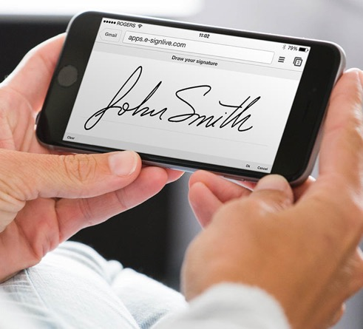

DOE Guidance on COVID-19: Memo 62
Considerations for WAP
Develop a plan for collecting applications remotely
Conduct intake and eligibility determination remotely
Utilize virtual training opportunities to improve skills and knowledge
Consider modifications to state monitoring process to allow virtual/remote inspections.
Notes:
In WAP Memo 062, DOE has recommended that states and local agencies develop a plan and protocol for collecting applications remotely.
We have heard from some states, that all of their local agencies now provide online applications as a result of COVID19. Some have developed YOUTUBE instructional videos.
If remote apps are not possible, implement strict social distancing protocols. Local agencies have gotten creative, using outside bank teller machines to collect applications.
Memo 62 says esignatures or photographs of signatures sent via text or email or reg mail will suffice.
Some states use the LIHEAP application, provide approval to share data among programs to minimize client exposure
Before sending workers to a clients home, Subgrantees are REQUIRED to screen applicants for known or suspected health concerns (WPN 17-7).
The H&S of WAP crew and contractors depends on screening this info during the COVID 19 pandemic.
Clients not feeling well or who have an occupant with COIVD 19 should be put on a deferred wait list. Remotely screen clients by phone prior to sending WAP crews.
Read above..
Underlying medical conditions? Those listed as “VULNERABLE clients” may be placed on the waitlist and give them priority once the local area is in Phase 3.
There are also online COVID 19 self-assessment tools, we shared an example of one created by Emory and the CDC on our website. (Crew / Clients)
Equip all field workers with PPE and provide training
Provide supplies to maintain clean surfaces in client homes
Ensure all vehicles and crew members are equipped with sanitizer
Prioritize completion of exterior work
Reduce the number of people simultaneously in the home
Require crews working inside of the home wear PPE
Offer face masks to clients
Install a physical barrier to isolate client during work
Limit contact in vehicles and disinfect daily

Slide 4
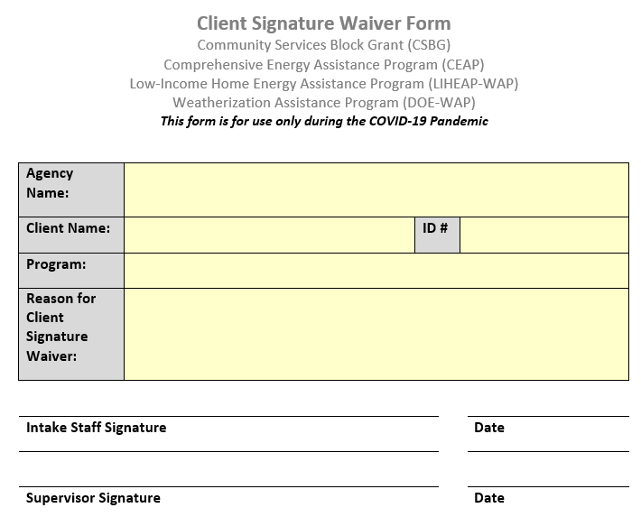
Adapting Processes and Operations:
Adapting processes to manage COVID
Client Signature Waivers
E-signatures
Email signatures with attestation
Photograph signature
Smart phone Apps
  https://thewirecutter.com/reviews/best-mobile-scanning-apps/
  https://thegrizzlylabs.com/genius-scan/
  https://fueled.com/blog/document-scanning-app/
https://www.tdhca.state.tx.us/community-affairs/covid19.htm
Notes:
These times will require many states and local agencies to adapt existing WAP processes to better protect the safety of both clients and workers.
Here is an example from the Texas, they are using Client Signature Waiver forms.
For use in taking phone applications for documents where the client signature/date must be obtained on a form.
I spoke with folks out in TX and they reported significant increases in WAP applications, that all agencies have moved to online applications, some with instruction videos.
Last week they were receiving almost 400 new WAP applications per day. Smart practice to utilize this down time to take and vet applications so that you have a solid approved wait list to work on when you return to the field.
We spoke with Kathy from AZ and they too are allowing email signature with attestation.
CAPLAW has resource on website about e-signatures
There is a distinction between verifiable software like DocuSign for e-signature and a simple email attestation – but maybe you could take a photo of the signature and email it.

Slide 5
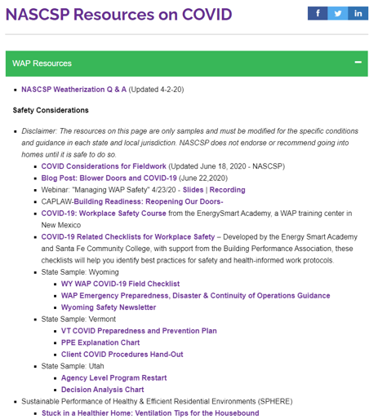
Continuing the Learning Virtually
Weatherization Online Training Opportunities
DOE /WAP Trainers Consortium
COVID19 Back to Work Safety Training
Energy Smart Academy
NASCSP COVID Resources
Federal Guidance and WAP Resources
Weatherization Grantee Manager Training –
Toolkit developed by NREL/IREC
Notes:
NASCSP continues to update our COVID resources page – including links to DOE and Trainers Consortium online trainings, access to the EnergySmart Back to Work Safety Training

Slide 6

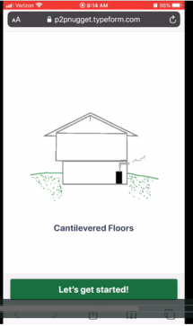
Innovations:
Innovative Mobile training by phone program developed in response to COVID-19 production pause
  Allows Subgrantee staff without home computers or internet to access TTA with a mobile phone
Developed for the Vermont WAP network with Global Learning Partners:
https://vimeo.com/414085008/a37980a6cc
Notes:
Every day the WAP workers and crew are texted several daily “Learning Nuggets” that include a short welcome video, training video and short quiz.
They identify which agency they are with when clicking on the links. They were also able to just do audio training on several short topics.

Slide 7
COVID Impacts to State Monitoring
NASCSP Conducted a poll in October 2021
Is your state currently under a travel restriction that is impacting your ability to perform on-site monitoring?
33 Grantees responded; 64% reported that they were under state travel restrictions.
Notes:
With COVID cases on a sharp upswing after several months of shelter in place ended, we saw states that tried to re-open have to shut back down again due to COVID.

Slide 8

VTM Is A Component
Virtual Technical Monitoring (VTM) is a component of virtual monitoring that is operated remotely from the field office or worksite.

Slide 9
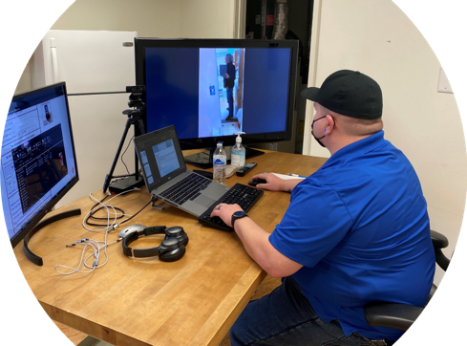

DOE Approval
Agency is the vehicle for the actual Quality Control Inspection.
The state monitor still assumes all responsibility as QCI.
Notes:
It is important to simulate in person monitoring as closely as possible. Re-do something if you must.
Assuming the QCI means asking the agency to check their CO monitors, look closely at the numbers on the meters/gauges, ask to zoom in whenever you feel it is necessary, ask them to perform a test again if you are unsure, including worse case set up, look closely at quality of caulking work, etc.
Gas leak at house. Made call.
It is important to simulate in person monitoring as closely as possible. Re-do something if you must.
Assuming the QCI means asking the agency to check their CO monitors, look closely at the numbers on the meters/gauges, ask to zoom in whenever you feel it is necessary, ask them to perform a test again if you are unsure, including worse case set up, look closely at quality of caulking work, etc.

Slide 10

Virtual Challenges
Pockets of lousy service, dropped connections
Battery life of device
May need to get used to asking people to do things
Only as good as the skill of QCI

Slide 11
Pros:
What Worked Well
Reduced Travel Expenses
Provided Training Opportunity
Reduced Travel Time & Improved Efficiency
PROS
Notes:
Half of week is driving. Also, sometimes after driving ½ day to do a monitoring visit the client cancels or gets sick. Less stress and loss of time and resources when this happens virtually. You can spend the time you would normally spend driving to do finish up reporting and deliver reports back to the agencies faster.
Training – the local QCI has to perform all the diagnostics virtually, there are training opportunities here and you can realty see who is comfortable and skilled with diagnostic testing and where you might need to focus more effort. If they use video recording, these also provide opps for training, you can go back and revisit these.

Slide 12
Pros:
The Cons to Consider- VTM
Less Time with Clients
Diagnostic Issues
Connectivity Issues
CONS
Notes:
Pockets of lousy service, dropped connections
Battery life of device
May need to get used to asking people to do things
Only as good as the skill of QCI
Lag time with virtual connection
Connection Issues – some areas not conducive for this
May need to confirm ahead of time that can use client's internet
Lack of personal communication with client while QCI is setting up
Find out the QCI/Auditor needs help with diagnostics
No one on one with client – CHP leaves phone number for follow up
Training – the local QCI has to perform all the diagnostics virtually, there are training opportunities here and you can see who is comfortable and skilled with diagnostic testing and where you might need to focus more effort. If they use video recording, these also provide opps for training, you can go back and revisit these.
Ensure adequate lighting for camera – need flashlight
Camera light –
Slow down – reduce shaking for clarity – May need to use tripod
*** Be aware of where you are panning camera!!
Training call with each agency – one on one (TN)

Slide 13
What do the agencies say??
I personally enjoyed the remote monitoring process. I was involved with four monitoring sessions. I enjoyed this way of monitoring because I was more involved. I had a hands-free mechanism that my phone was connected to for video so what I was looking at was what the Monitor was seeing.
This gave me a more organized approach to doing my QCI inspections in the future. When a question was asked, I got to respond, and I am a hands-on person, so I enjoyed being the eyes of the remote monitor.
I still prefer in person monitoring where you can directly see the work they are talking about. It wasn't as clear remotely and we had occasions where video froze up or disappeared.

Slide 14
Conclusions: Innovation is here to stay
Define virtual technical monitoring for your state.
Decide if it is right for your conditions
Other than going virtual, everything in your current practice the same
Keep it simple
Disclose and describe fully when seeking approval
Always works towards best practice
Notes:
We heard from many states that they plan to revise virtual monitoring into their annual state monitoring plans and leverage it when needed or use it in combination with on-site visits.
Sometimes it takes crisis to drive change, the online applications and other remote application improvements will be here to stay.

Slide 15

  Thank you!!
  Andrea Schroer,
  WAP Director
  aschroer@nascsp.org
  202-370-3666

Slide 16
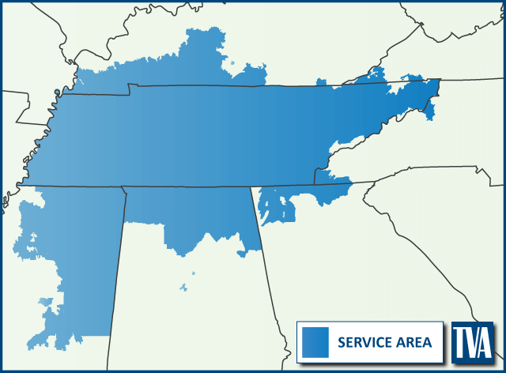
We power the Valley
ABOUT TVA
IMPROVING QUALITY OF LIFE
Energy
Environment
Economic
Development
Notes:
Nation’s largest public utility
80,000 square-mile service area covering parts of 7 states
Serving approximately 10 million residents through our 153 local power company partners
---
We were created out of the New Deal with a mission to improve the quality of life in the Valley through what we call “the three E’s”

Slide 17

Pandemic pivot
COVID-19 halted all in-person program operations for first part of 2020
We remained focused on providing value to customers with a renewed focus on safety
R&D of virtual auditing tool was already underway due to changing market and customer landscapes
Pandemic accelerated rollout of our Virtual Home Energy Evaluation tool, which has application in both our Residential Services and Home Uplift programs

Slide 18

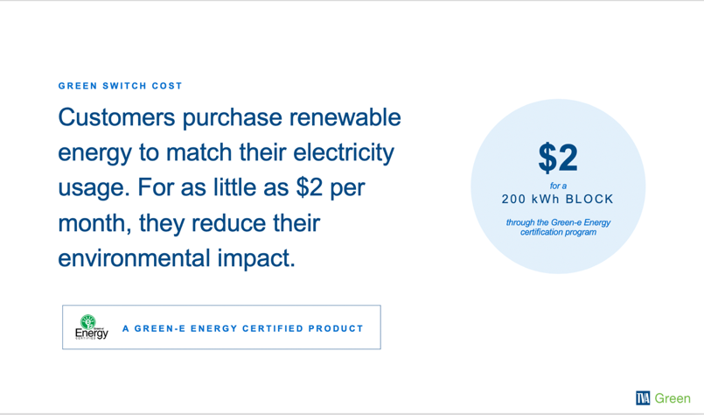
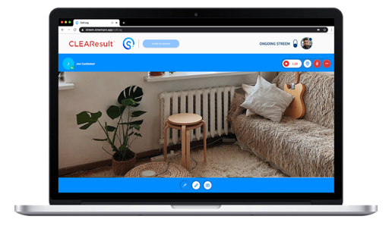
About our platform
TVA's virtual tool utilizes a live augmented reality (AR) remote support platform, called Streem enabling, that allows TVA’s third-party implementer to conduct home energy assessments and quality assurance inspections remotely - with customers guiding the process using a smart device.

Slide 19
Program features
Remote Home Energy Advisor-guided home assessments and follow-up inspections
Direct customer engagement
Faster EE initiative rollouts for utilities
Lower delivery costs

Slide 20
Evaluation and inspection areas

Slide 21
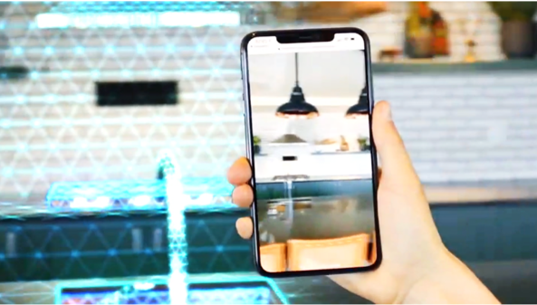
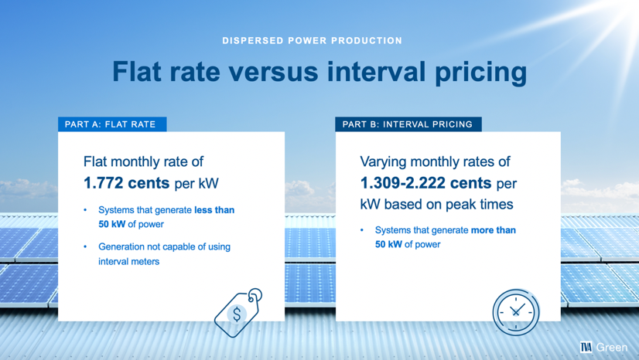
Value for everyone
Shrink or grow white boxes as you see fit
Size color tabs to fit the text, in otherwords don’t leave too much right margin
UTILITIES
CUSTOMERS
Keeps programs running and meeting customer needs
Safety
Reduces carbon emissions due to fewer field visits and truck rolls
Lower delivery costs and fewer liabilities
Flexible capacity utilization with Home Energy Advisors across the TN Valley
Flexible scheduling providing customers with options that are convenient for them
Teams no longer need to physically enter the home, allowing for increased social distancing and safety
Customers are in control of what the Home Energy Advisors sees in their home, providing greater privacy
Replace ‘icon here badge’—use icon library at the end of this deck to source an icon
Right click > ‘format background’ to change background image

Slide 22

Virtual is the future
Continued focus on safety
Alignment with changing customer preferences and expectations
Cost-effective delivery option

Slide 23
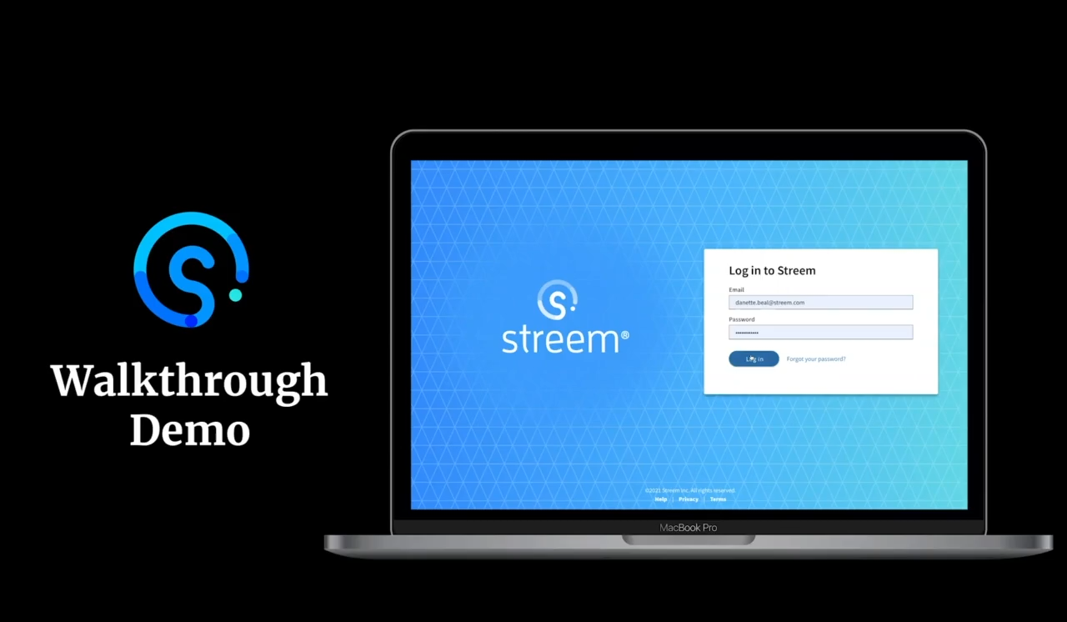

Slide 24
Continuing the Learning
Email: fmrapley@tva.gov
Web: www.energyright.com/residential
In-depth TVA walkthrough demonstration: https://vimeo.com/454169989/ed78acdcaf
Home Uplift video: https://youtu.be/O52AOoior3Q

