Slide 1
NTUA Renewable Energy Project
General Manager - Walter W. Haase P.E.
National Energy and Utility Affordable Coalition (NEUAC) Annual Conference
June 4, 2019 – Fort Worth, Texas

Slide 2
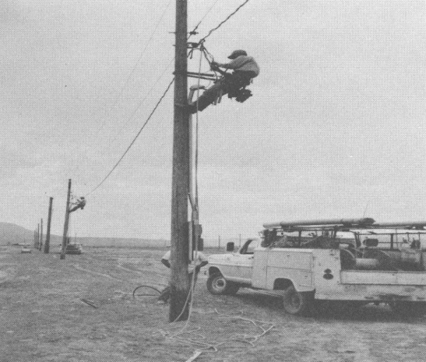
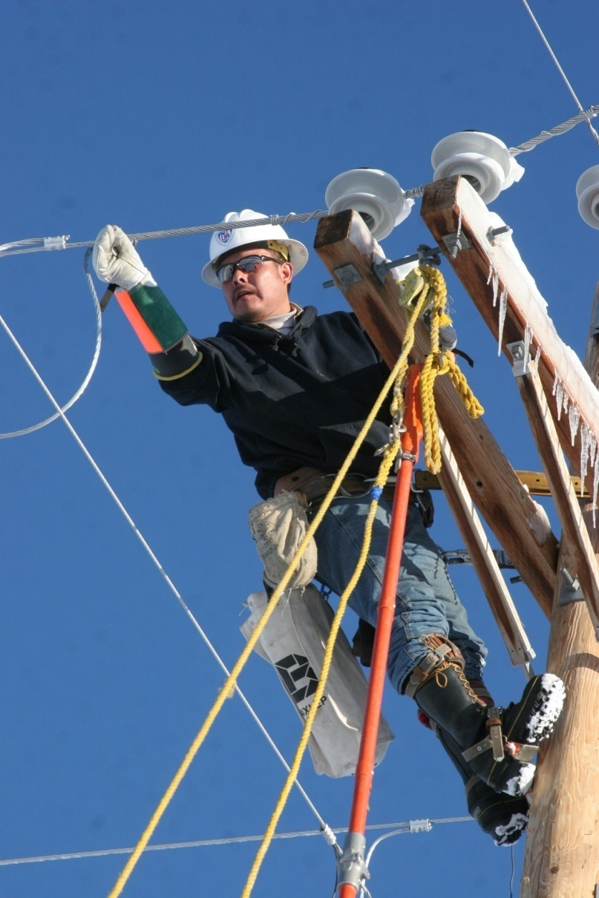
Navajo Tribal Utility Authority
Created in 1959
A not-for-profit enterprise of the Navajo Nation
Service Territory – 27,000 square miles across the Navajo Nation
Extends – Electricity, Water, Wastewater Treatment, Natural Gas, Residential Solar services
Recently added: Communications – Internet, Cell Phone, Data Storage Services, Renewable Energy Generation

Slide 3
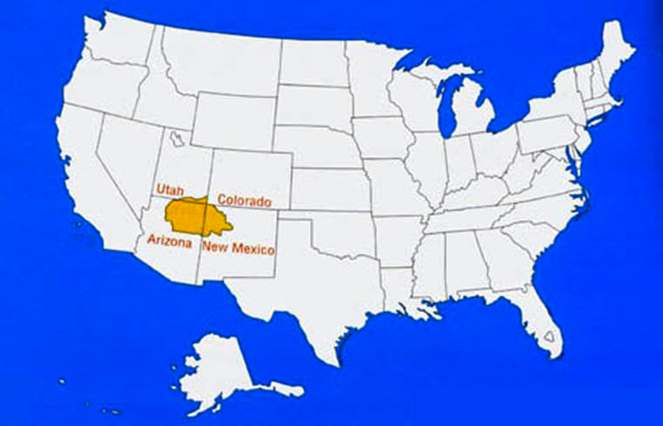

Slide 4
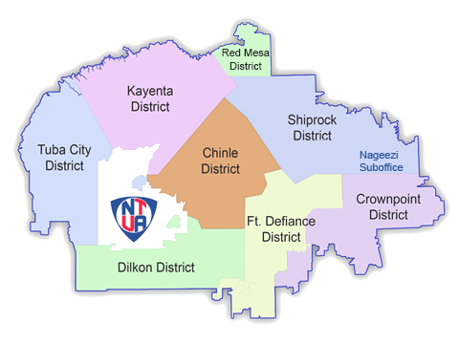

Slide 5
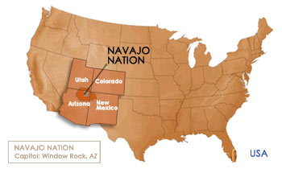
Navajo Nation – Southwest USA
186,500 Citizens
Territory larger than West Virginia
Unemployment rate of 48.5% -
(9 times current U.S. average)
38% of Navajo people live below poverty line
Avg per capita income of $10,695 vs U.S. Avg of $48,377
31% of all Navajo homes lack plumbing 38% lack water 32% lack electricity 86% lack natural gas 60% lack landline phone services – reducing immediate access to 911

Slide 6
NTUA Solar Development Platform:
Helping Navajo Communities Prosper
Infrastructure development
Increase electric distribution lines
Increase water distribution lines
Increase communication assets
Solar Generation for Navajo use
New Tax dollars to Navajo Nation for more infrastructure construction and utility use
Creating a new energy workforce to increase job opportunities for Navajo
Providing specialized solar training for the Navajo people
Increase additional scholarship/internship opportunities for students in Navajo Chapters
Create expenditure of dollars in the local community, e.g., hotels, food, arts and crafts vendors, and local services

Slide 7
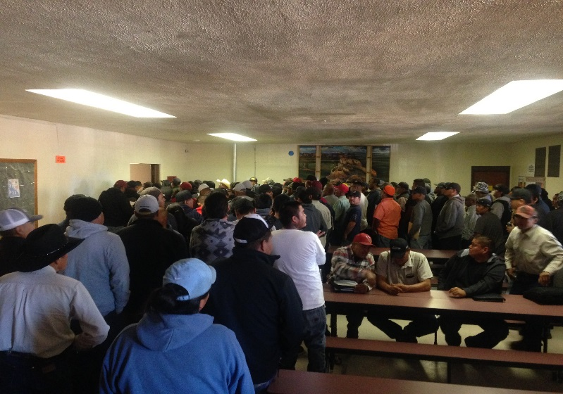
KAYENTA SOLAR PROJECT – PHASE I Direct Benefits to Kayenta Community
Phase I Job Fair
Kayenta Chapter House
550 people waited for hours just to
submit applications
Navajo people were paid $5.2 M as result of the construction of this project
The $5.2 M generated over $15.6 M in economic activity in Kayenta region
10 homes adjacent to site with electrified and now have water service
As a result of job creation - Navajo people received over 4,700 hours of specialized training
Specialized training opportunities for Navajo people, including creating long-term Solar operation & maintenance jobs
Two Scholarship and One Internship were prioritized for Kayenta Community members
During height of construction
284 people worked on the Project
85 percent were Navajo

Slide 8
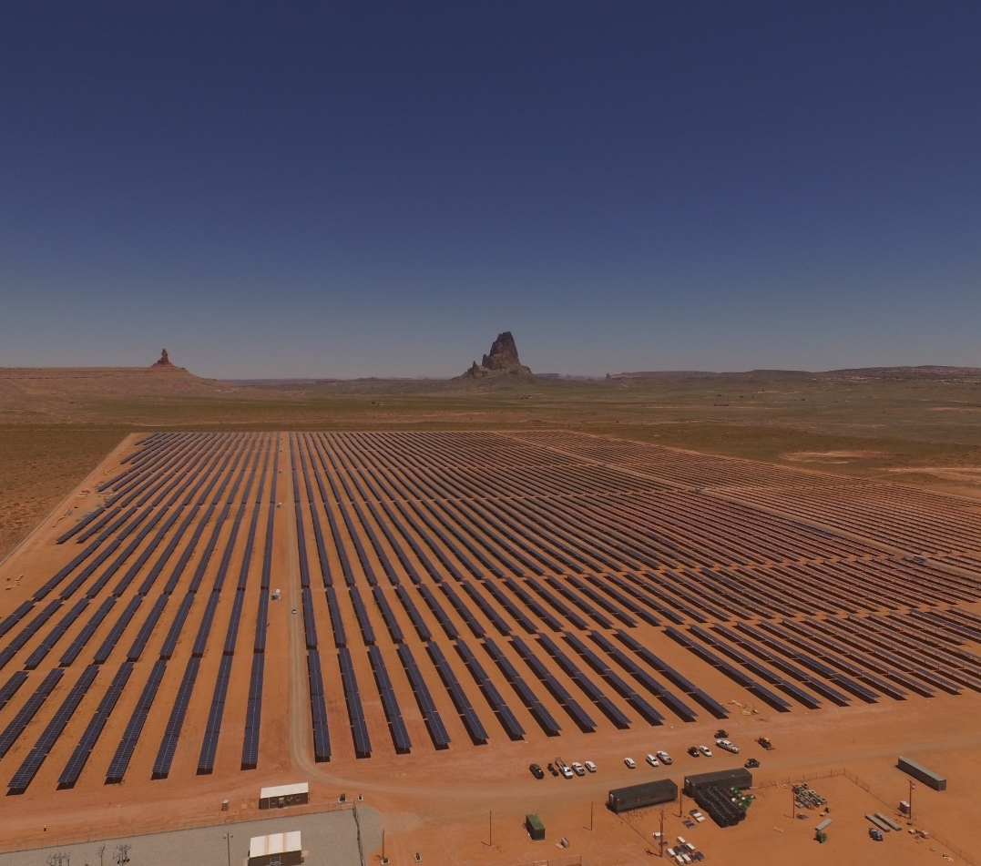
KAYENTA SOLAR PROJECT – PHASE I
Overall Financial Benefits to Navajo Nation
The construction generated $3,017,055 in taxes to the Navajo Nation
The first year tax revenue was $211,852 and the 30-year total will generate approximately $7,584,302 in tax revenue to the Navajo Nation
Over a two year period it is projected that the NN will collect an additional $850,000 in sales tax revenue as a result of the wages paid to these workers

Slide 9
KAYENTA SOLAR PROJECT – PHASE II
Projected Financial Benefits to Navajo Nation
KY II Job Fair – 11-28-18
589 Applications Submitted
101 – KY I employees
The construction is projected to generate $2,217,192 in taxes to the Navajo Nation
The first year tax revenue is expected to exceed $172,835 and the 30 year total will generate approximately $5,185,044 in tax revenue to the Navajo Nation
Over a two year period it is projected that the NN will collect an additional $694,800 in sales tax revenue as a result of the wages paid to these workers
Returns from Phase II are being used to pay for the electrification of Navajo Homes and keeping NTUA’s Electric Rates low

Slide 10
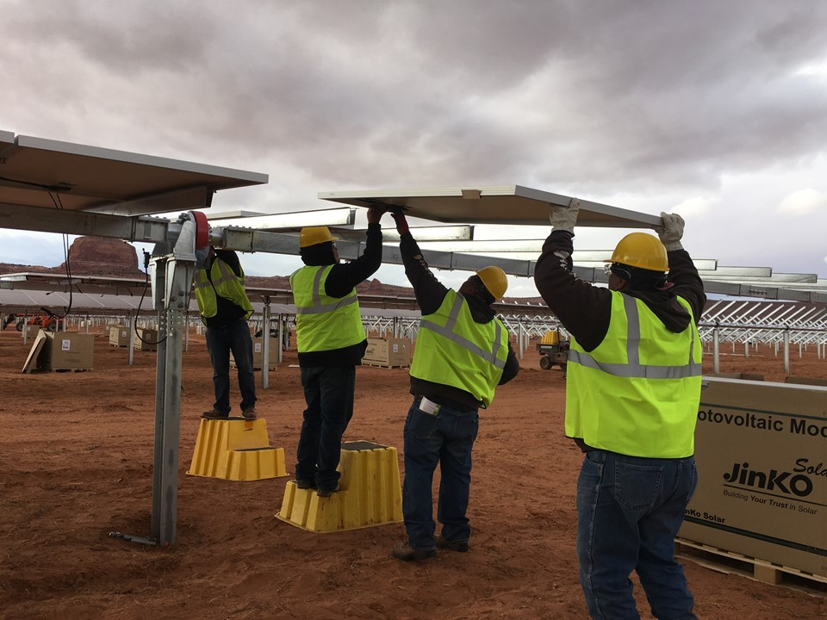
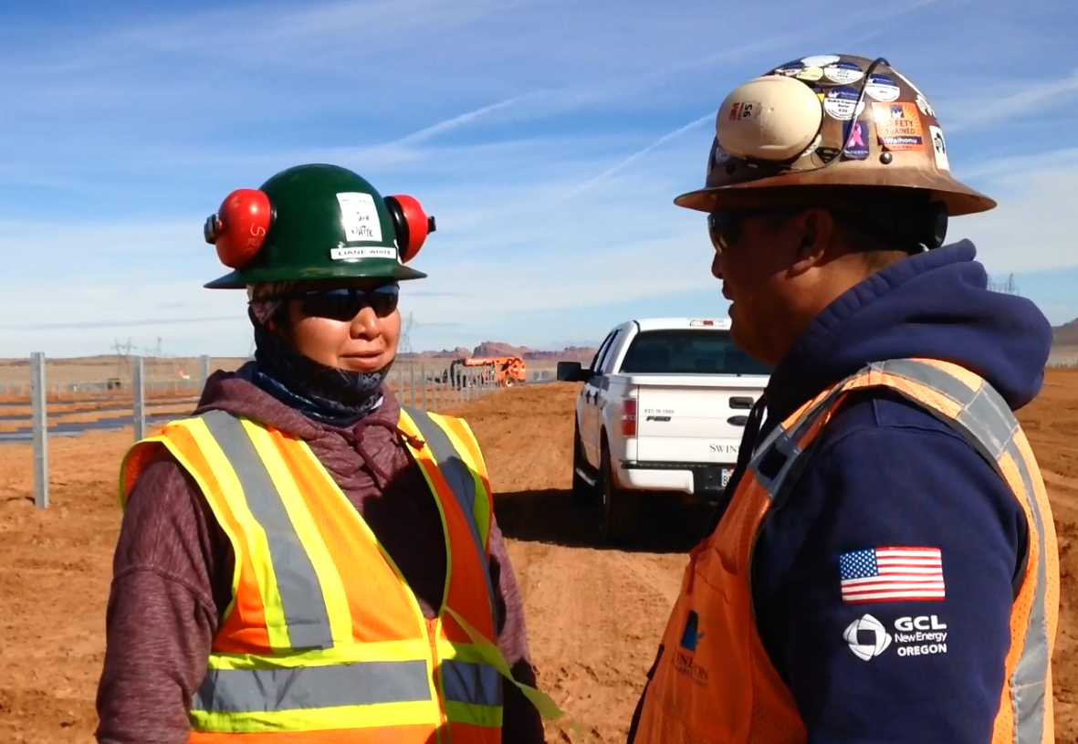
KAYENTA SOLAR PROJECT - PHASE II
Direct Kayenta Community Benefits
During height of construction 150 people worked on the project 80% were Navajo
Navajo people were projected to be paid $3.8 M as result of the construction of this project
Additional two Scholarships and one Internship are prioritized for Kayenta Community members
As a result of job creation - Navajo people also received 2,000 hours of specialized on-the-job training – that will enable them to qualify for any long-term Solar operation and maintenance jobs

Slide 11
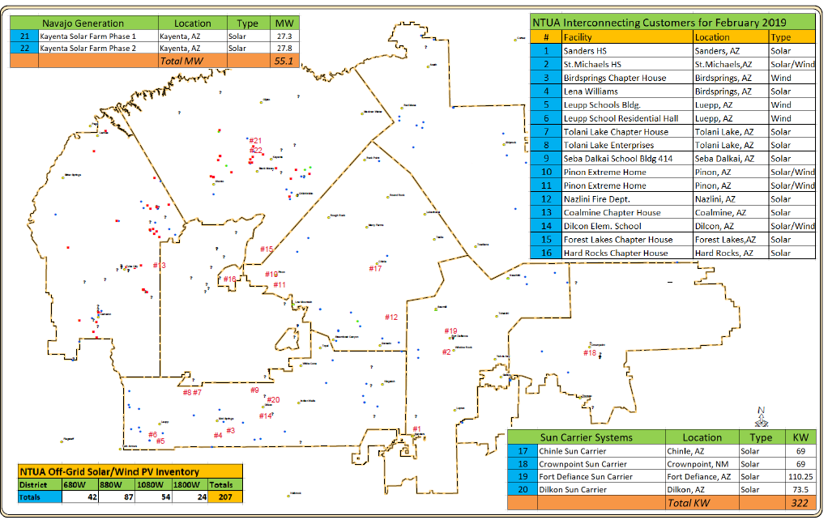

Slide 13
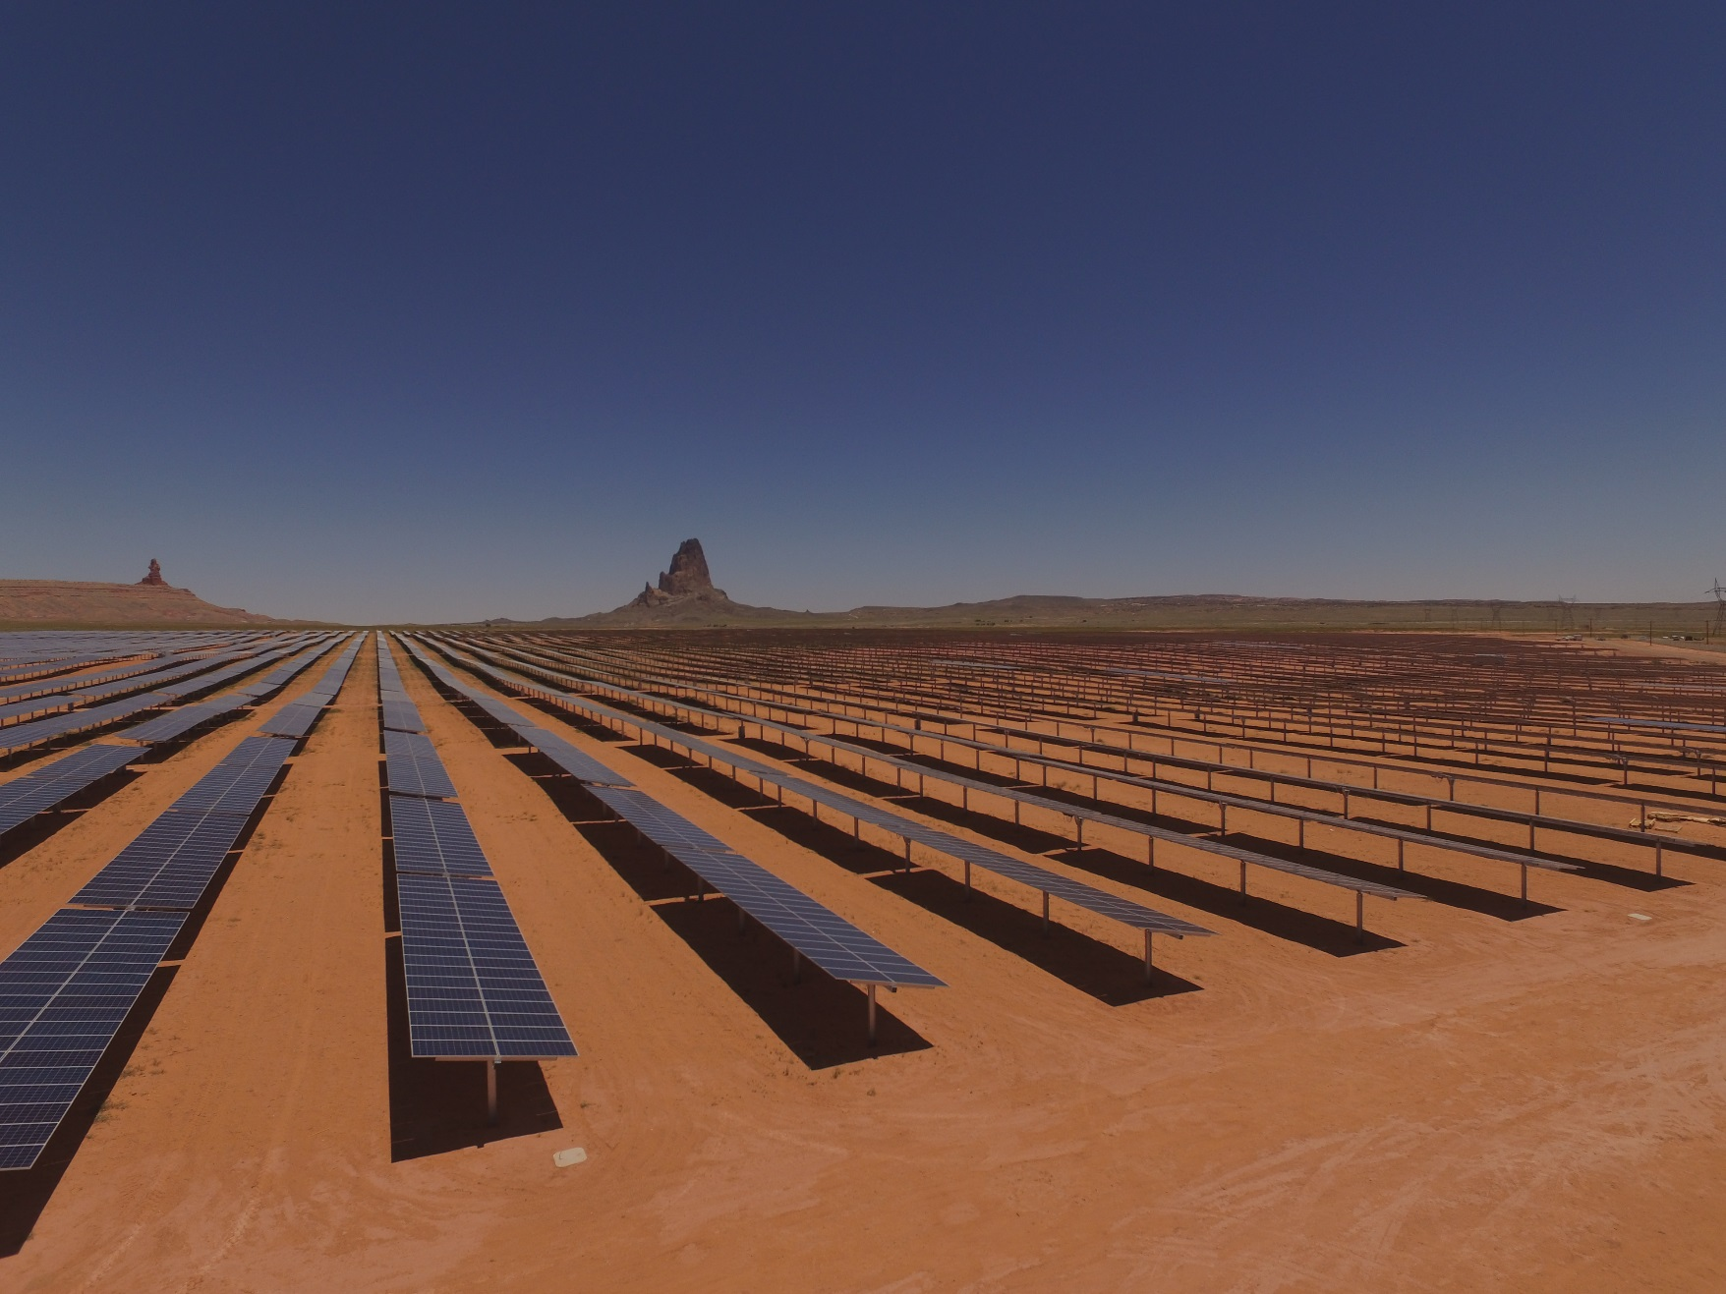
NTUA’s renewable generation facilities provided
seed funding for
#Light Up Navajo

Slide 14
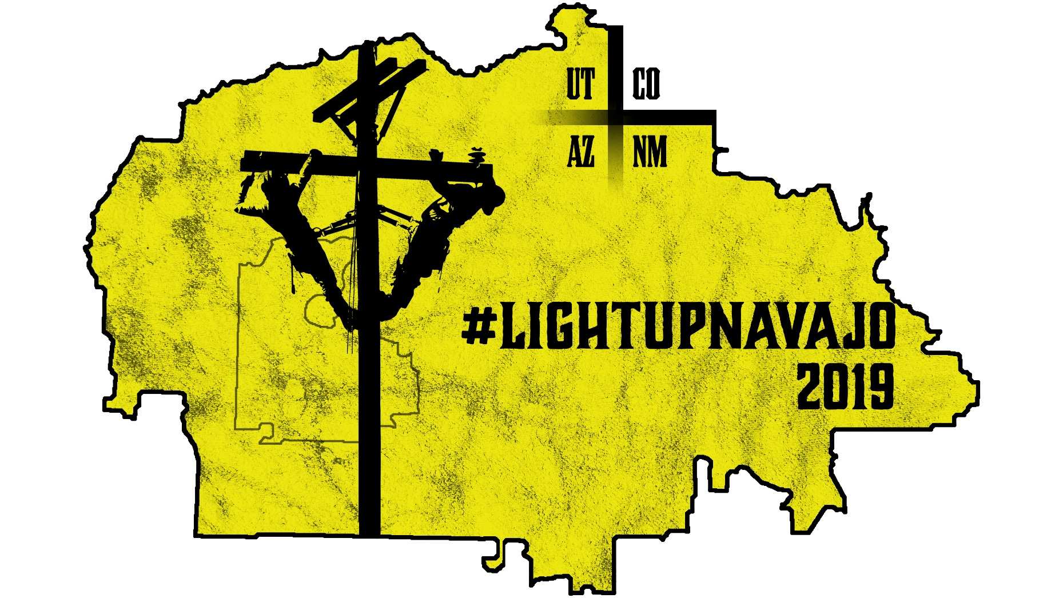

Slide 16
NTUA 11-year Residential Electric Connections
Year Families NN Tax from NN Tax from
Construction Consumption
2018 335 $859,275 $108,983
2017 409 $874,238 $84,123
2016 322 $688,275 $77,544
2015 256 $547,200 $72,342
2014 308 $658,350 $67,266
2013 407 $869,963 $60,831
2012 509 $1,087,988 $52,587
2011 782 $1,671,525 $40,968
2010 748 $1,598,850 $27,198
2009 677 $1,447,088 $14,373
2008 460 $983,250 $4,140
Total NN Taxes for
Construction Connections $11,896,357
Future NN Annual
Sales Consumption Tax
$112,601
On average, NTUA employs
91 staff members for
construction and construction support activities
Tot
Since 2008, NTUA has contributed $7,819,500
to electric connections
@ $1,500 per home
5,213 families connected
Average 474 homes per year

Slide 17
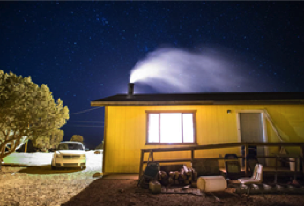
Real Cost of NTUA Electric Service
Per Residential Customers
Average Yearly Revenue - 2017 | $ 629.94
Average Monthly Revenue - 2017 | 52.49
Average Yearly kWh - 2017 | 5,576
Average Monthly kWh - 2017 | 465
Cost per Kwh | 0.113
NTUA net margin on this sale is 5% or $31.50
Each family receives a $1,500 credit on the cost of connecting their home to the electric grid
Cost to pay off the $1,500 is over 40 years which is longer than appreciated life of equipment

Slide 18
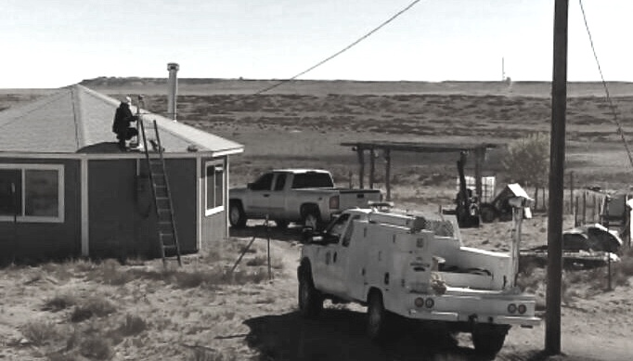
In the last three years - the average cost to connect one family - $40,000
15,000 families without electricity @ $40k = $600 million
$350 million for transmission lines and electric substations
$950 million to $1.0 Billion to connect all 15,000 families
To connect all families in 10 years with borrowed money from RUS over 40 years – @ zero interest rate
The average annual NTUA residential bill – will go from $630 per year to over $6,000 per year

Slide 19
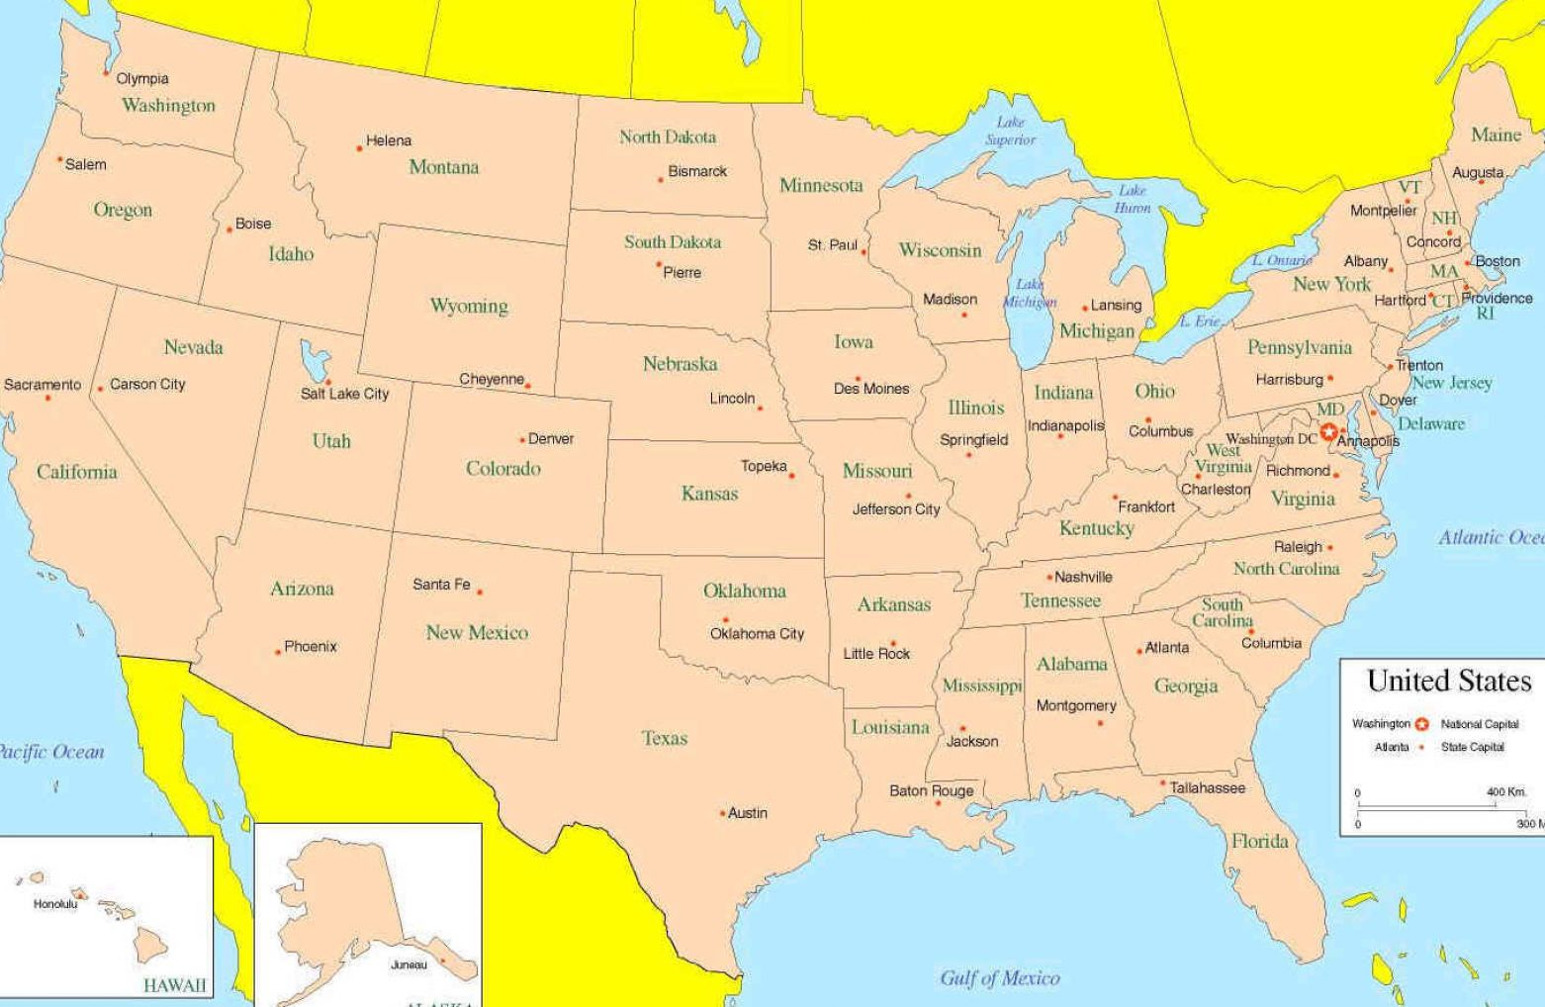
2019 LUN Volunteers represent 13 States
138 Volunteers from 28 communities
across the United States of America

Slide 20
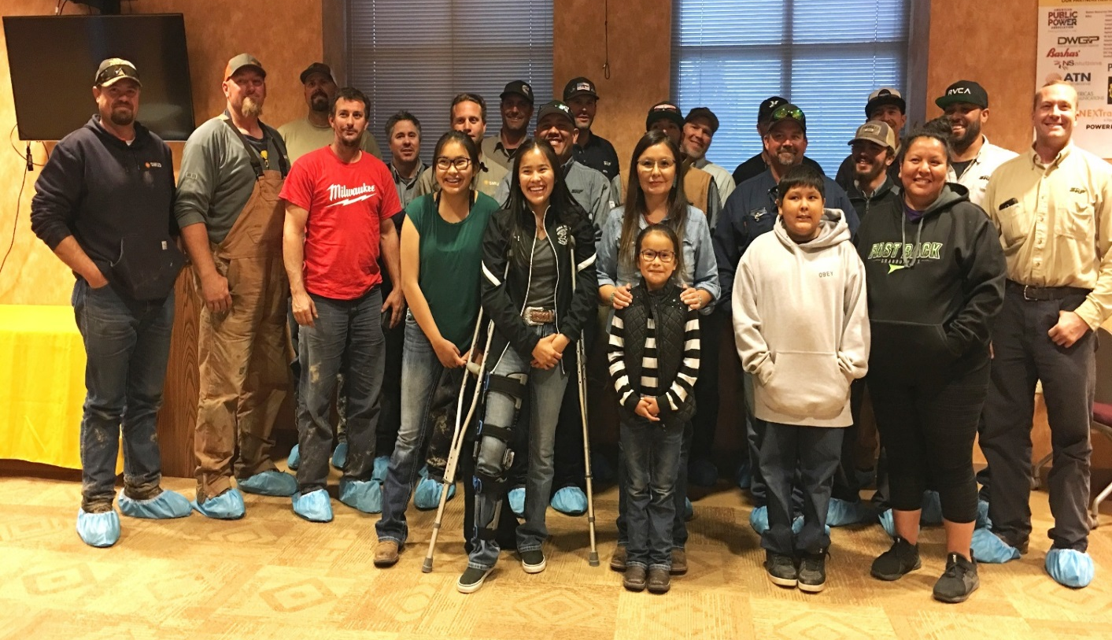
Light Up Navajo
Construction completed as of May 25, 2019
2 Week Trial Run - March 25th - April 6th
- 20 Families connected – 2.34 miles of line
233 Families connected
42.40 miles of line
First week - April 8th ⁻ April 13th
- 34 Families connected – 3.84 miles of line
Second week - April 15th – April 19th
- 36 Families connected – 6.76 miles of line
Third week - April 22nd – April 26th
- 30 Families connected – 3.82 miles of line
Fourth week - April 29th ⁻ May 4th
- 32 Families connected – 6.62 miles of line
Fifth week - May 6th – May 11th
- 30 Families connected – 5.43 miles of line
Sixth week - May 13th – May 18th
- 46 Families connected – 13.45 miles of line
Seventh Week – May 19 – May 25th
- 5 Families connected – 7.02 miles of line
Chinle District Appreciation Dinner

