Slide 1
POWERING HOMES, POWERING LIVES

Slide 2
Will Preston
Oregon Energy Fund
Communications Coordinator

Slide 3
More Than Lightbulbs:
Why Energy Assistance Matters

Slide 5
“An almost equal number of households encounter food insecurity as energy insecurity. But food is generally considered indispensable whereas energy is often perceived as an amenity. As most of people would cringe at the thought of hunger-prone families, few shudder at the notion of poor households living in the cold and in the dark, accruing debt to fulfill a basic need.”
- Diana Hernández, “Understanding Energy Insecurity and Why It Matters to Health” (2016)

Slide 6
Context, context, context!
Energy insecurity doesn’t exist in isolation – but many people don’t know that.
It’s part of a larger ecosystem that includes:
Housing & homelessness
Racial justice
The climate crisis
Childhood health & trauma
Economic stability

Slide 7
Younger donors are hyper-informed and highly conscious of how these various issues interact.
Engaging with these topics in your messaging emphasizes that energy assistance plays a vital role across the spectrum & donating has a much broader impact than many realize.

Slide 8
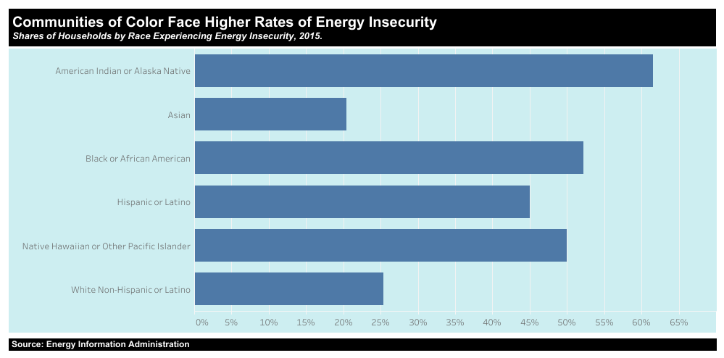
As a racial justice issue…

Slide 9
As homelessness prevention…

Slide 10
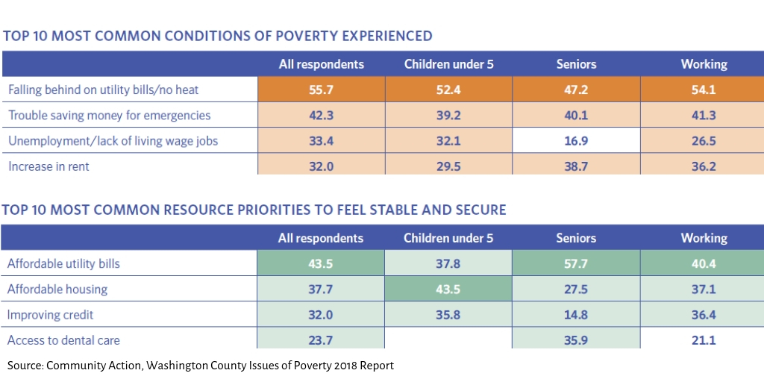
As an urgent resource for low-income families:

Slide 11
Collaborate!
Partnerships with other nonprofits:
Illustrate the different sides of energy insecurity
Educate the public
Emphasize the urgency of our work
Expand visibility to new donors
Allow other organizations to help spread the word

Slide 12
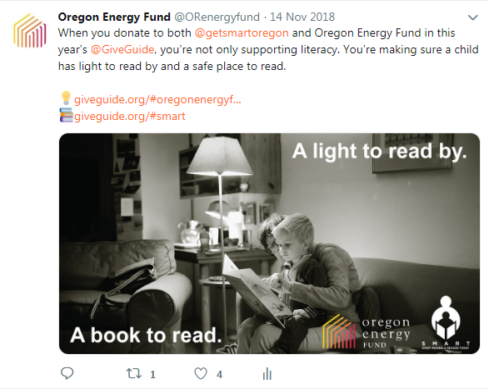
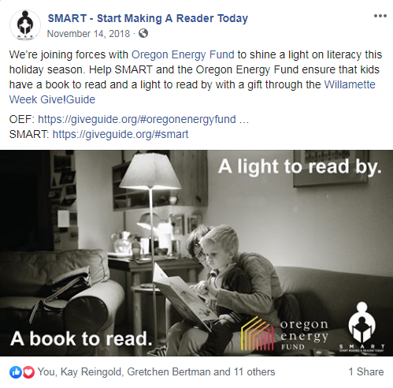
SMART: Start Making A Reader Today

Slide 13
IRCO, Latino Network, & NAYA

Slide 14
Meals on Wheels People

Slide 15
Energy insecurity is almost invisible to the naked eye. It’s up to us to show donors that it exists – and that their dollars can make a difference.

Slide 16
Will Preston
will@oregonenergyfund.org
971-386-2124

