Slide 1
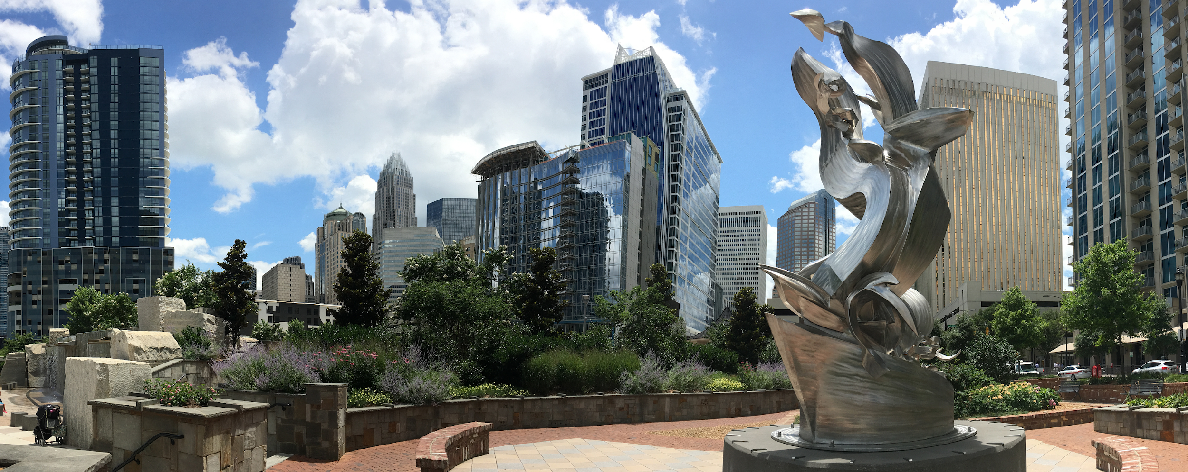
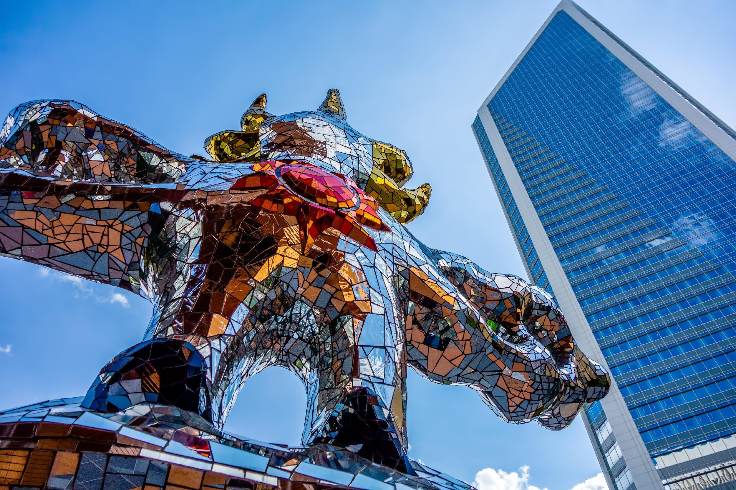
2025 Conference Planning Meeting
Westin Hotel - Charlotte, NC
Welcome to Charlotte!

Slide 2
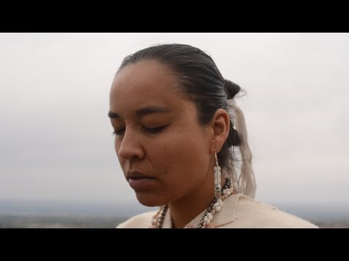

Slide 3
Meeting Expectations
1. We are all equal. In the room, at this time, each of us – regardless of position – are welcome and encouraged to participate.
2. “WAIT” (Why am I talking? Why aren’t I talking?) We will tap into the wisdom of the group, not focus on the opinions of individuals. No single person(s) shall dominate the conversation. Monitor your own air time.
3. Be open and respectful. We will seek ﬁrst to understand and give full consideration to new ideas, approaches and creative processes. We will question our own assumptions and those of our colleagues in order to think creatively. We will not fixate on past practices and will instead be flexible to change or new ideas.
4. Speak from your own experience. We will listen to each other and suspend judgments. We will respect all kinds of knowledge and value the full spectrum of knowledge in attendance; use “I” statements and resist expressing assumptions about the experience of others or asking others to speak on behalf of a group.
5. Be present and listen deeply. Our conversation is not about convincing each other, but rather about listening and providing your full attention to everything and everyone and then deciding what it all means.
Notes:
Not enough for app

Slide 4
Meeting Expectations
6. Final decisions are ﬁnal. Each of us will be heard, but that doesn’t mean each of us will get what we want. It’s okay to disagree. When issues are important and people care, they argue, but once we decide, each of us will accept and respect the organization’s decisions.
7. If we notice something of concern during a meeting, we have an obligation to speak up. If you choose not to provide input on decisions, it will be assumed that parties are amenable to decisions made. Discussion happens during meetings, not before or after.
8. Stay on track. We agree to focus on the meeting agenda and work diligently to stay on track.
9. Be conscious of intent vs. impact. The things we say or do may have a negative impact on others, despite our intent. Be accountable for the impact of your actions and words.
10. Be aware of power dynamics. Notice how you might be subconsciously using your power or privilege and hold awareness of histories of injustice.
11. Avoid jargon, acronyms, and industry language. Use inclusive language that is accessible to people with varying sector knowledge.
Notes:
Not enough for app

Slide 5
Officers
President - Kim Campbell Hailey, Vistra Corp
First Vice President - Keelie Andringa, Miami Valley CAP
Second Vice President - Mike Bradford, The Salvation Army
Treasurer - Marietta Doney, Oregon Energy Fund
Secretary - Michael Bell, Washington Gas
Non-voting positions:
Past President - Tanya Jones, HeartShare Human Services
Parliamentarian – John Rich, Mid-America Assistance Coalition

Slide 6
Jennifer Whiting, MSI
Charlotte Overview

Slide 7
Name that logo…
Notes:
Airbnb
National Geographic
Mastercard

Slide 8
Name that logo…
Notes:
Girls Scouts
United Way
CA

Slide 9
Name that logo…
Notes:
Instagram
Rolling Stones
U of NC Charlotte 49ers

Slide 10
Name that logo…
Notes:
AGA
Duke Energy
Lumbee Tribe

Slide 11
Trivia:
What was the most famous logo in the world as of 2022?
Activity:
Create a Logo
for Conference

Slide 13
Co-Chairpersons Tanya Jones, HeartShare Human Services of NY Frank Rapley, Tennessee Valley Authority Keelie Andringa, Miami Valley CAP Kim Campbell Hailey, Vistra
2025 Conference Overview

Slide 14
David Carroll, APPRISE Latoya Butler, CEDA Patricia Johnson, CSRA EOA Kevin Alexander, Duke Energy Steve Luxton, ECA Tony Hunt, Lumbee Tribe Gabe Terry, Consumers Energy Haly Laasme, Delaware Office of Community Services Aimee English, National Community Action Partnership Glenis Scott, Total Community Action
2025 Conference Overview
NEUAC Board of Directors Conference Committee
Cass Lovejoy, NEADA
Star Walker, SMUD
Sabrina Cowden, TVA Alternate
Kevin McGrath, VEIC
Shaylee Stokes, WA State CAP
Kelly Caplan, WSSC
Kaytee Watson, Dominion
Monica Toya, Lux Consulting
Theresa Kullen, Colorado LIHEAP Director, NEADA Scott Alan Davis, SEEL

Slide 15
NEUAC Board Meeting: Monday 6/2, 8-12 PM Preconference Sessions: Monday 6/2, 1-4 PM Conference: Tuesday 6/3 - Thursday 6/5 Cocktail Reception: Tuesday 6/3, 5:30-6:30 PM Deep Dive Sessions Thursday 6/5, 9-12 PM
2025 Conference Overview

Slide 16
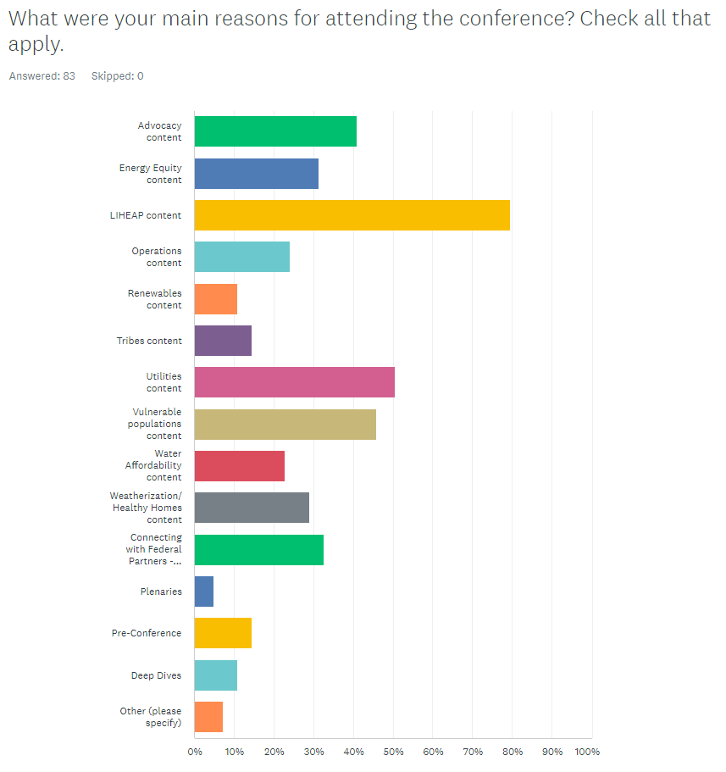
Summary of 2024 Evaluations
Networking with potential partner organizations
General networking and increased knowledge of what is going on in the space and how everything may fit together
LIHEAP, Utilities, Advocacy, Vulnerable Populations

Slide 17
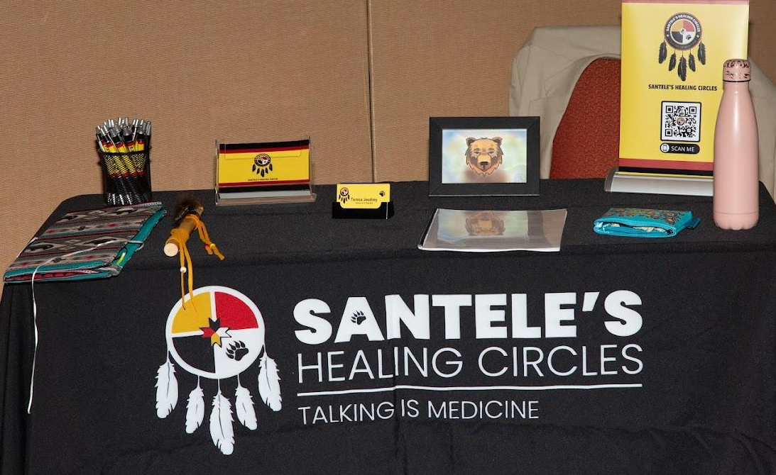
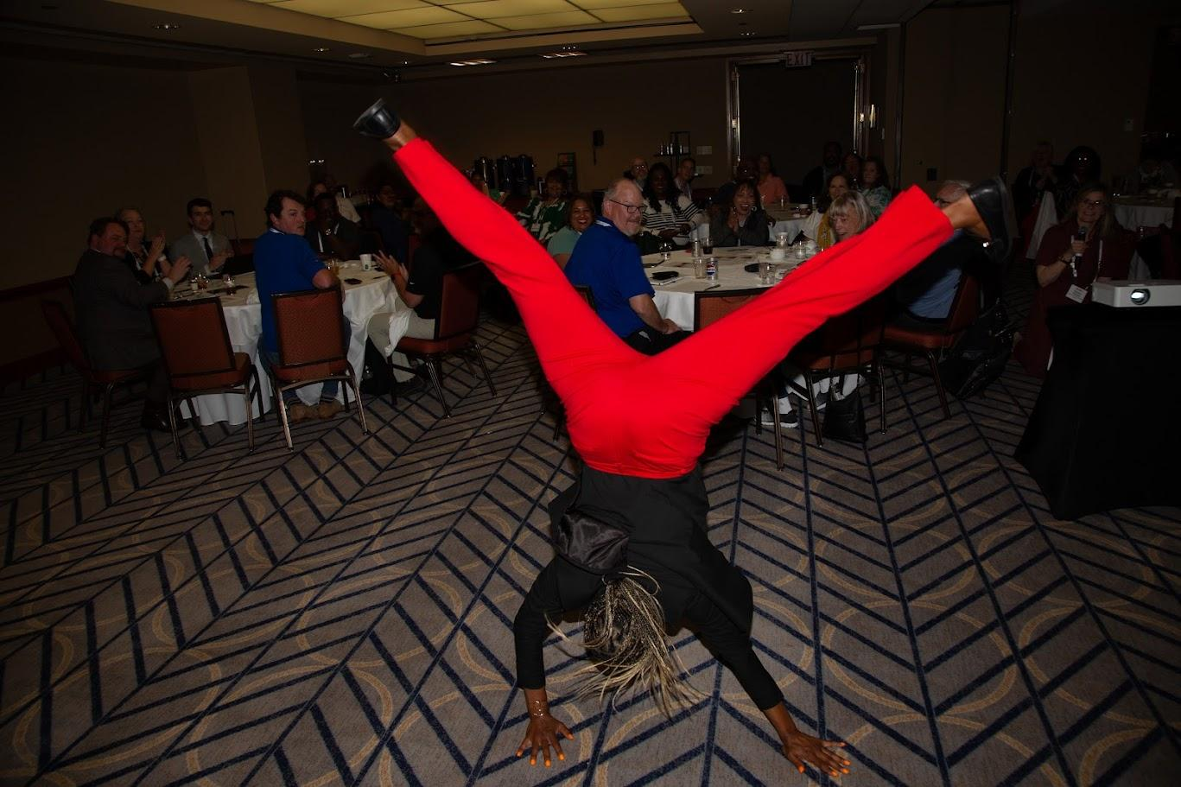
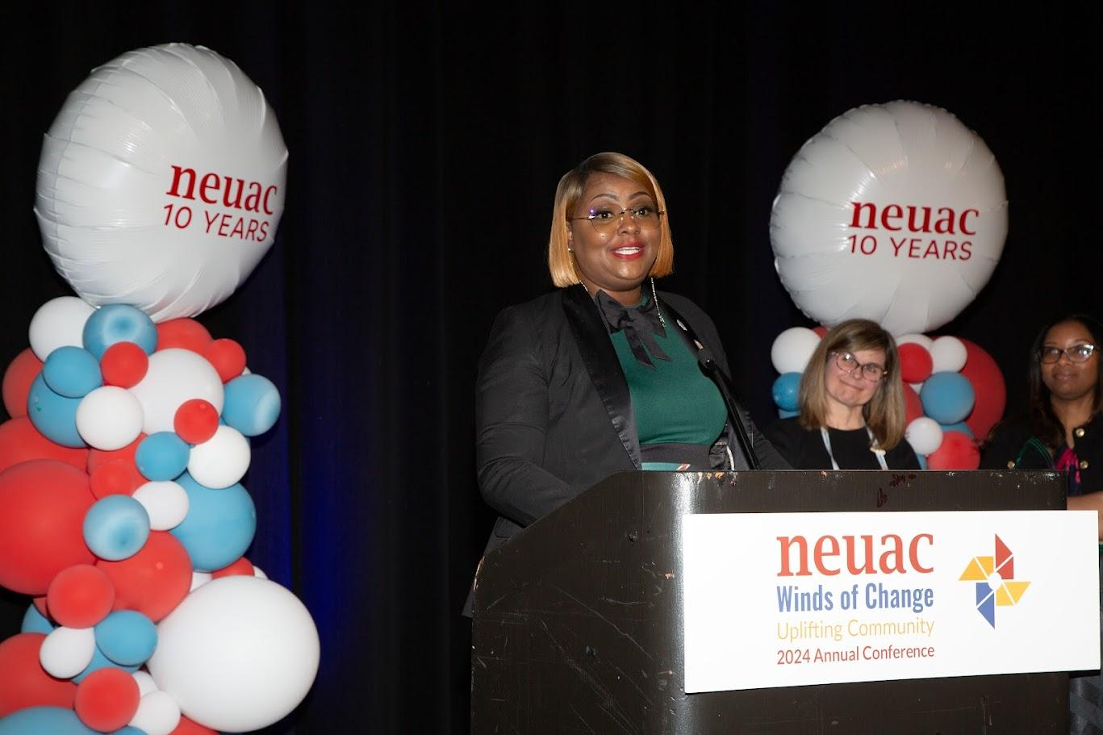

Slide 18
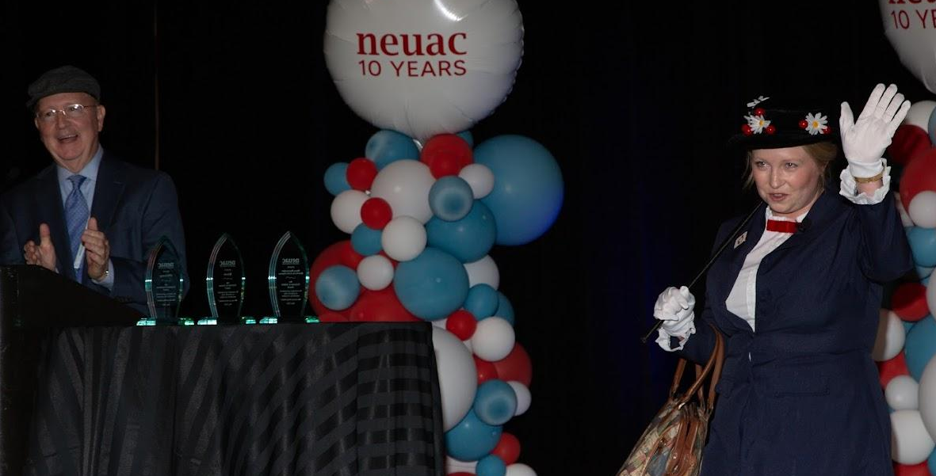
Summary of 2024 Evaluations
What was the most valuable aspect of this conference?
Connecting with peers
Energy equity content
Poverty simulation
Tribe content
LIHEAP intro session
LIHEAP 101
Future of LIHWAP
The documentary
Bonus: Seeing Keelie as Mary Poppins!

Slide 19
Summary of 2024 Evaluations
What was the least valuable aspect of this conference?
Plenary sessions
Some of the federal/utility talks were super high level and mostly talking
Not having long enough break in between sessions. Felt a little rushed.
Too many salesman disguised as presenters in sessions.
Pre-conference content (since it was earlier in the day it was inconvenient to arrive in time to attend)
Some of the session titles were misleading.
It would helpful if they had clear indicators if the session was good for utilities e.g.
Awards ceremonies
Audio in some sessions
Regional meeting
Not enough Tribal LIHEAP support
Networking opportunities were pretty scarce.
Gathered information relevant to some states rather than all states
Utilities portrayed as "bad guys“ in some sessions and/or by some presenters

Slide 20
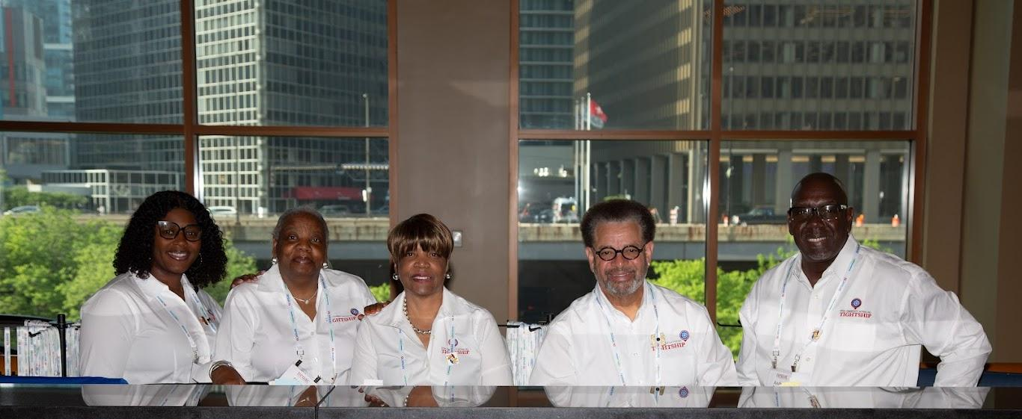
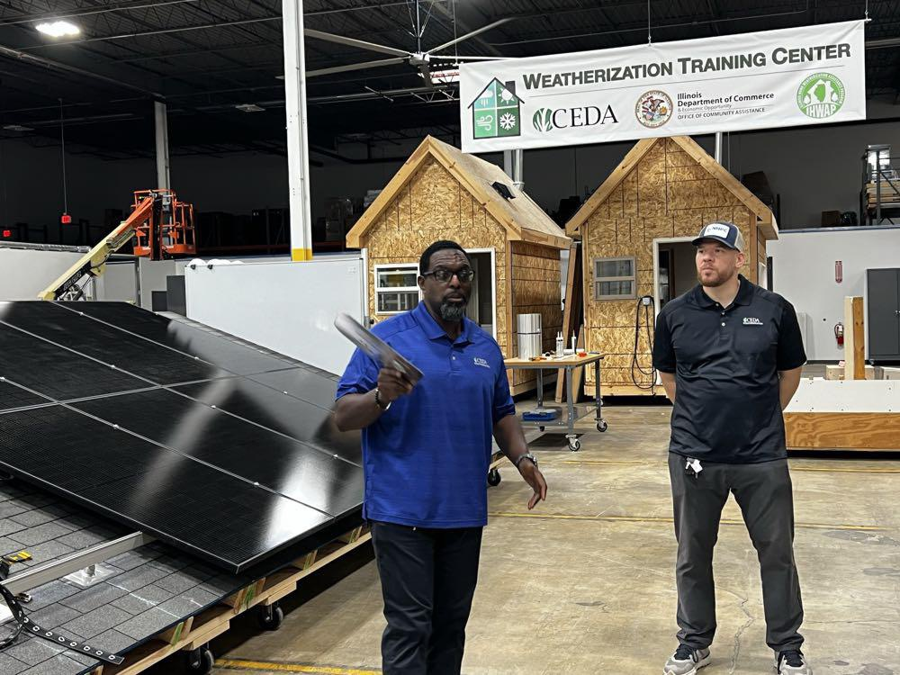
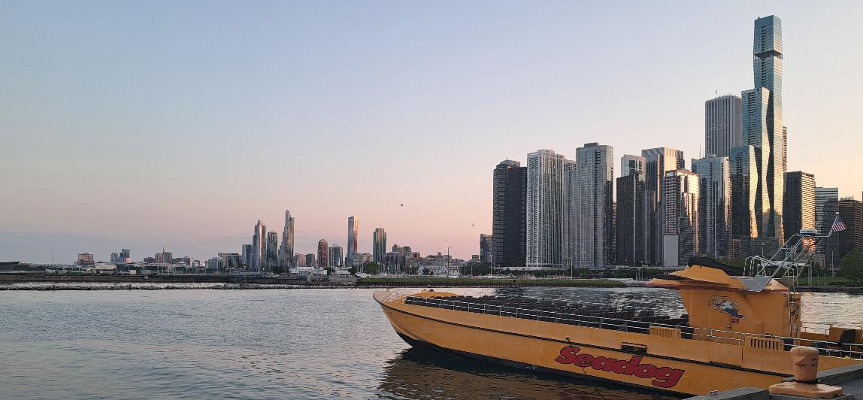

Slide 21
Summary of 2024 Evaluations
What sessions and/or topics would you like to have repeated at next year's conference?
Trauma Informed Care
JEDI
Documentary
LIHEAP intro (pre-conference)
LIHEAP 101/102
JEDI
Improv and advocacy
LIHWAP future
PIPP
5C's of Partnership with Kimberly Hightower & Shameikia Smith
AI
Self care and burnout
Free professional headshots! So great!
Establishing a fuel fund.
In-depth sessions on how others run their LIHEAP Programs.

Slide 22
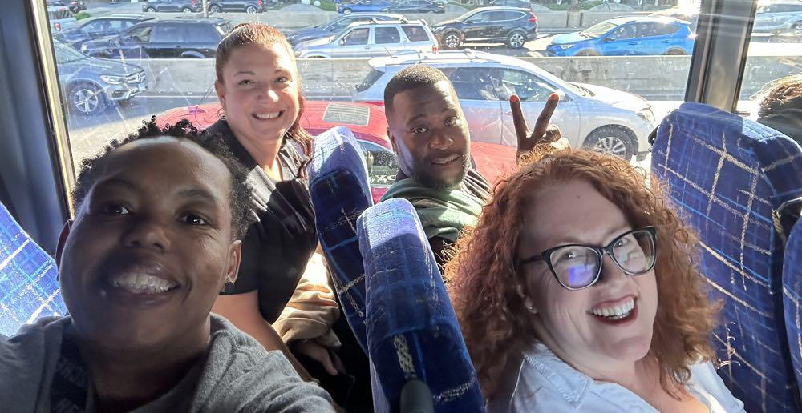
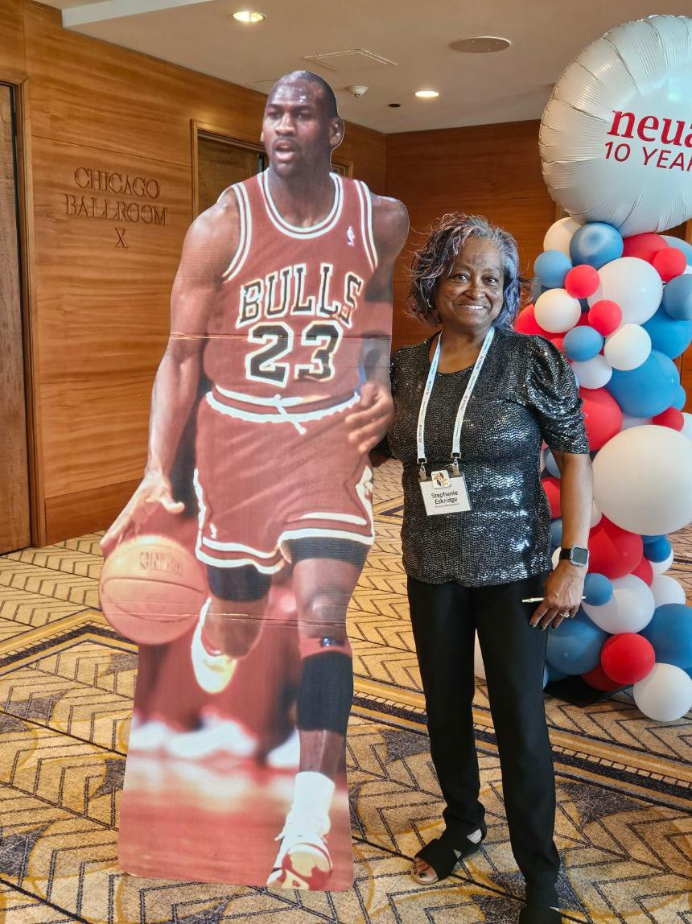
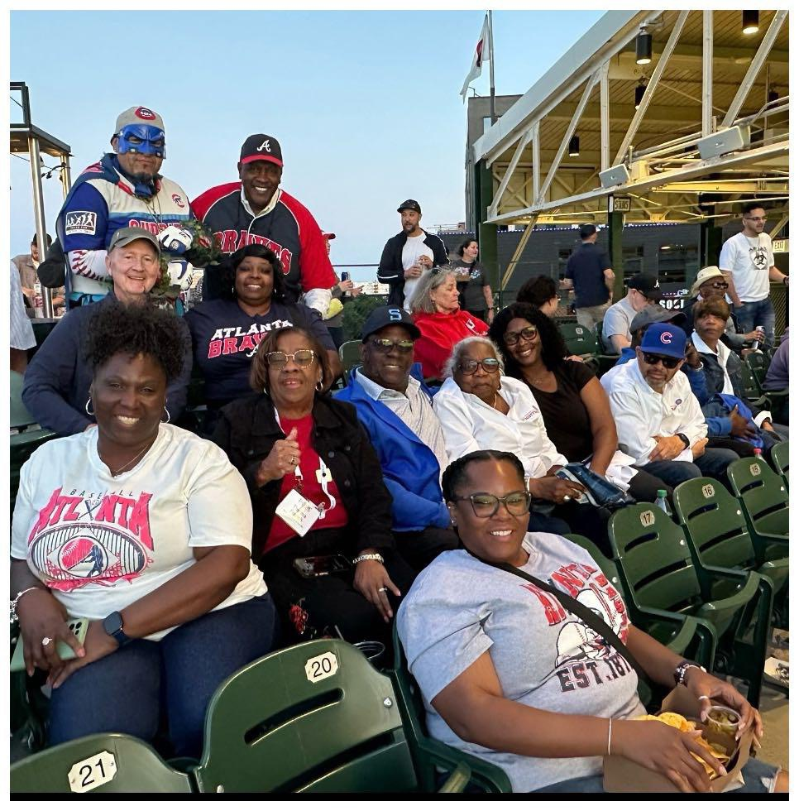
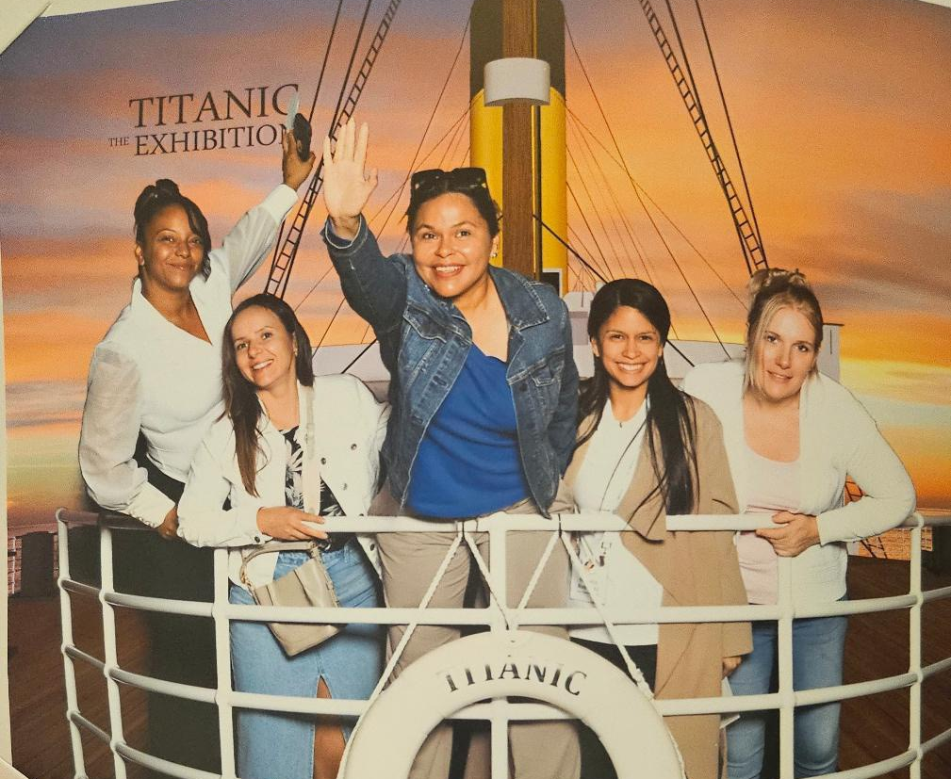

Slide 23
Summary of 2024 Evaluations
Any topics that weren’t addressed?
Trade show with more vendors would be nice
How is LIHEAP funding being spent state-by-state
Taking care of staff, compassion training
Developing and Processing LIHEAP applications
Fuel Funds - how they operate. Fundraise. Social Media
Panel with utilities and their partners to discuss hour they work together in increase LIHEAP enrollment, how they managed processing an increase in applications, and the percentage of new applicants and younger applicants
Workshop from Community Action Agencies on how utilities could better connect with them and support their missions
More water utilities
All Tribes meeting, Tribe-to-Tribe sessions
Energy kits
Avoiding increasing the energy burden on low income/income eligible customers that are electrified
How to network and get people within your organization on board for change
Advocacy assistance in amending laws for LIHEAP, how to get buy-in from legislators

Slide 24
Content Pre-Selected for 2025
Breakout Content:
Regional Meetings
HHS Dialogue with the Feds
DOE Dialogue with the Feds
LIHEAP 101
LIHEAP 102
Understanding the LIHEAP Formula
Introduction to LIHEAP Program Requirements and Noteworthy Practices
We still need…
20-30 Breakout Sessions
3-4 Deep Dive Sessions
1-2 Preconference Sessions
1-2 Plenary Sessions
Notes:
Plenary – Chicago author?

Slide 25
Content Ideas for 2025
Tribe-to-Tribe Training
Trauma-Informed Care
PREAP and LIHWAP
Electrification and Affordability
LIHEAP Solar Connector Program
Indiana University Disconnection Lab and EIA-112
“Powerless” by Dr. Diana Hernandez
“Revolutionary Power” by Dr. Shalanda Baker
Strategic Data Storytelling
Disaster Relief and LIHEAP
Lyla June – Indigenous professor, author, songwriter and performer
Notes:
Plenary – Chicago author?

Slide 26
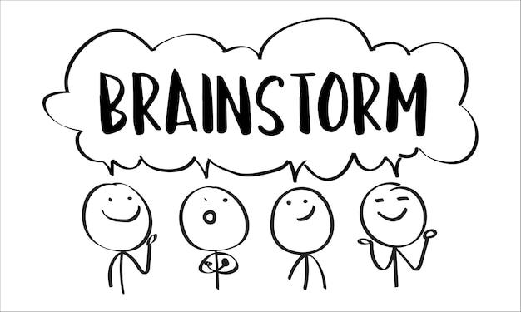
Group Brainstorming!
Topics and Speakers for General/Plenary Sessions
Topics by Content Area for Breakout Sessions – three must-haves
Pre-Conference Session(s)/Deep Dives
Reception, Music, Entertainment
“Fun Stuff” – field trips, volunteer experiences
Other ideas? How do we bring the character of Charlotte / the Southeast to the conference?
Notes:
Ai for nonprofits, utilities
Book Club
Utility Summit
Poverty Simulation
Movie – Cooked, Survival By Zip Code
Trauma informed care
Followup from Customer Panel
Kairos Blanket exercise

Slide 27
Afternoon Activity: Table Assignments
Plenary Speakers, Deep Dives, Preconference
Healthy Homes (weatherization, energy efficiency, energy education)
Water Affordability
Tribal and Indigenous Energy Assistance
Utility Programs and Fuel Funds, Partnerships
Vulnerable Populations – Unique Program Approaches
LIHEAP Implementation and Outreach, Local Programs
JEDI and Belonging, Energy Equity
Notes:
Plenary – Chicago author?

